Slide 1
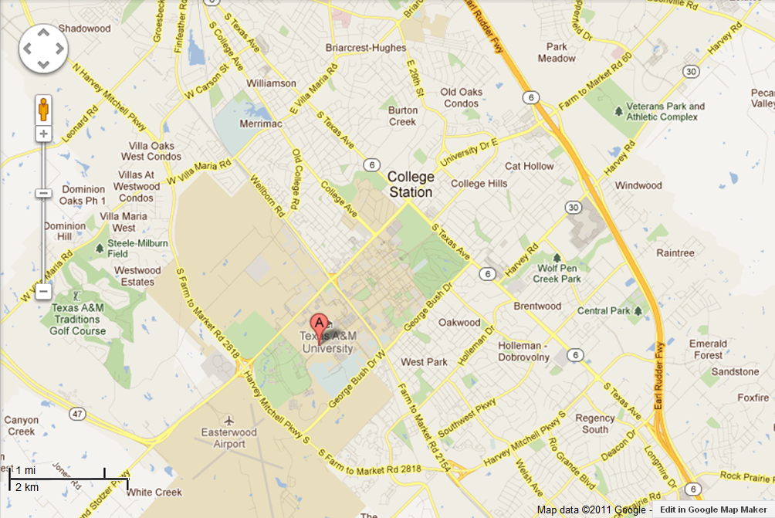
Come to intersection of Highway 6 and University.
Turn on university towards College Station (West)

Slide 2
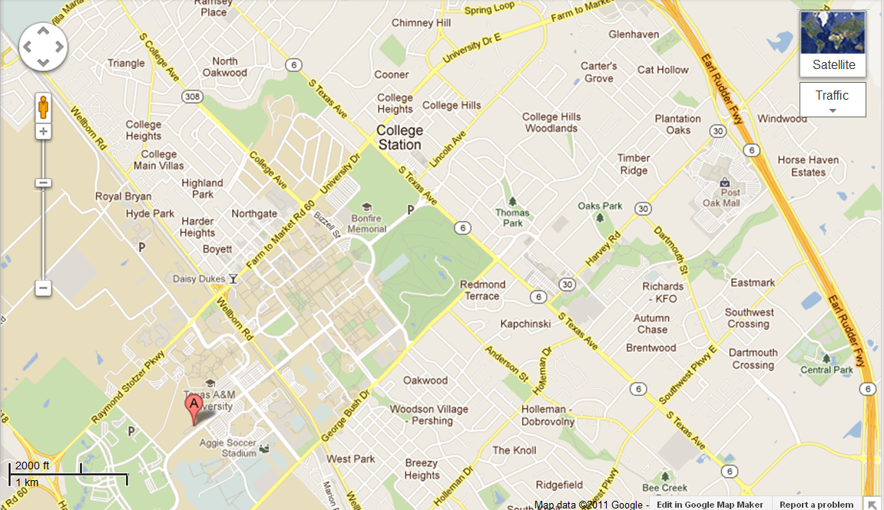
Come to intersection of Highway 6 and University.
Turn on university towards College Station (West)
Come down University to Wellborn road
Turn left toward Kyle field

Slide 3
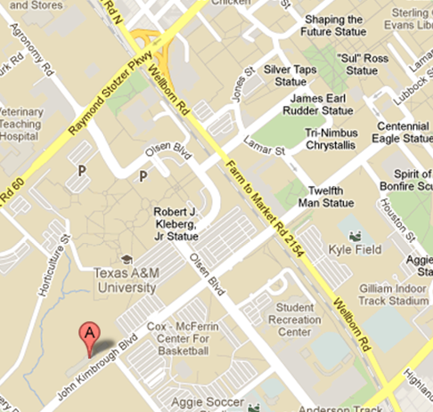
Come to intersection of Highway 6 and University.
Turn on university towards College Station (West)
Come down University to Wellborn road
Turn left toward Kyle field
Come to John Kimbrough BLVD (Just before parking garage and Kyle Field)
Turn Right
Kyle field
West Campus
Parking Garage
Agricultural and
Life Sciences
Reed Arena

Slide 4
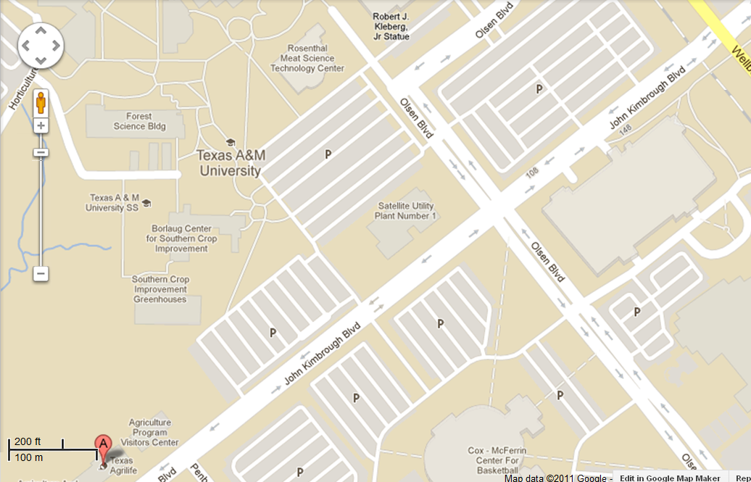
Come to intersection of Highway 6 and University.
Turn on university towards College Station (West)
Come down University to Wellborn road
Turn left toward Kyle field
Come to John Kimbrough BLVD (Just before parking garage and Kyle Field)
Turn Right, Go past garage and Reed Arena
We are in Agricultural and Life Sciences Building on right
West Campus
Parking Garage
Agricultural and
Life Sciences
Reed Arena

Slide 5
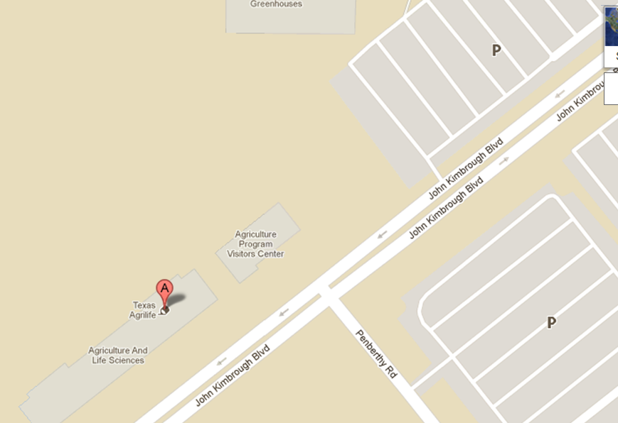
We are in Agricultural and Life Sciences Building on right
You can park in Lot 97 at pay parking
If a permit was prearranged you can park in Lot 96 at AGEC spaces
Lot 100 if you have a University permit
Back in West campus garage pay parking
Lot 97
Pay parking
Lot 96 (Prearranged Only) permit parking
West Campus
Parking Garage
Pay parking
back on
Kimbrough to
Corner
Wellborn RD.
Agricultural and
Life Sciences
Lot 100

Slide 6
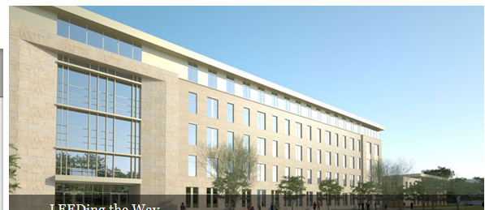
We are in Agricultural and Life Sciences Building on right
Ag ECON is on third floor
McCarl is in 373
McCarl
Office
373
AG ECON
Main Office
309

