Slide 1
Inter-temporal Investment in Climate Change Adaptation and Mitigation
Weiwei Wang and Bruce A. McCarl
Department of Agricultural Economics
Texas A&M University
AAEA/NAREA Joint Annual Meeting 2011
Notes:
Good morning everyone, the topic of my presentation “Temporal …”

Slide 2
Outline
Introduction
Climate change
Political strategies
Conceptual Framework
Optimal control model with both adaptation and mitigation investment
Technical Part
Adding explicit adaptation to DICE model
Sensitivity analysis
Conclusion
Future Work
Notes:
After a background introduction of … I will say sth about the conceptual framework. More details will in technical part, I will explain how did we try to extend the original DICE model with explicit adaptation.

Slide 3
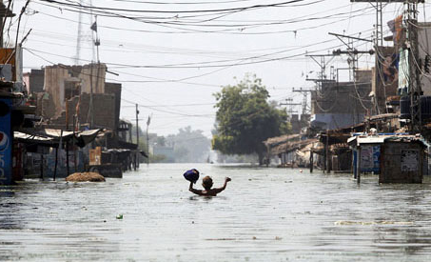
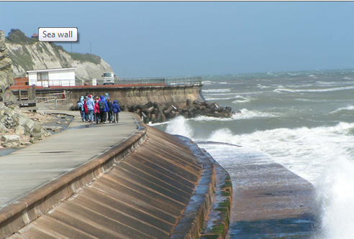
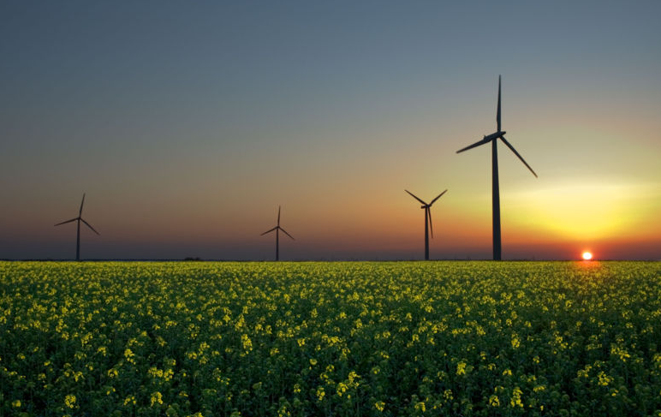
Climate Change
IPCC (2007) ”Most of the observed increase in global average temperatures since the mid-20th century is very likely (>90%) due to the observed increase in anthropogenic (human emission caused) greenhouse gas concentrations.”
Climate change is a unique externality.
The future will depend on the choices we make about
Do little and live with it
Plan to adapt
Mitigate Emissions
?
Notes:
Economically , human induced GHG emissions which cause climate changes represents an externality. Estimates show that world economy will suffer a lot of losses from future climate change damages if there is no action to reduce it. Currently there are two possible strategies being realized, adaptation and mitigation.

Slide 4
Policy Directions Economic Considerations
Effective climate policy involves a portfolio of adaptation and mitigation
Source IPCC Fouth Assessment Report WGII Ch 18

Slide 5
Research Objectives
What are the relative contributions of adaptation and mitigation to climate change damage reduction?
What are the social optimal allocations of investment in adaptation and mitigation over time?
How mainstreaming climate policy would be most effective and cost-efficient?

Slide 6
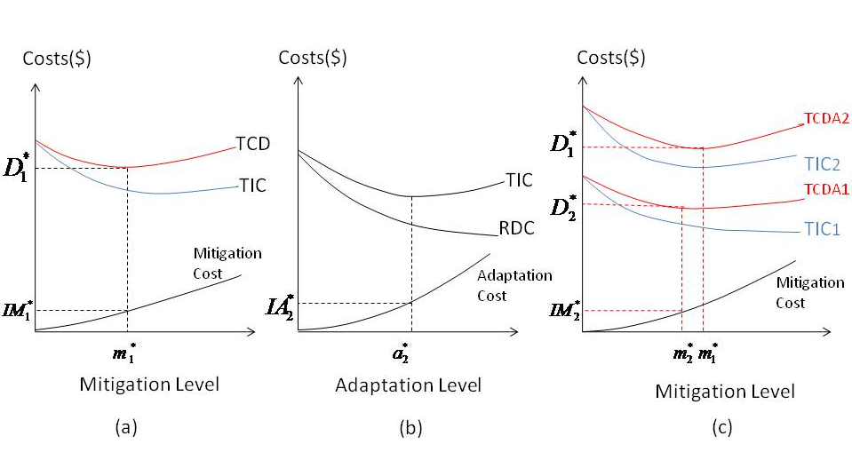
Static Optimal Control Model – Adaptation + Mitigation
where TCDA: total climate change damages with adaptation
c: realized climate change m: mitigation effort
a : the level of adaptation effort IM: mitigation investment
q(c,a): losses of realized climate change IA: adaptation investment
and the degree of adaptation effort
IA(a): the cost of investment in adaptation
Figure 1. Optimal adaptation and mitigation investment. Panel (a) shows optimal investment in mitigation in the absence of adaptation; Panel (b) the corresponding optimal adaptation investment at the optimal level of mitigation; Panel (c) optimal mitigation investment when alternative adaptation efforts are introduced

Slide 7
Literature Review on modeling adaptation and mitigation
DICE (Dynamic Integrated Model of Climate Change Economics)
(Nordhaus et al, 1992)
Mitigation investment competes with consumption and non-climate investment
Assumes optimal reactive adaptation wherever possible but largely ignores proactive adaptation activities and costs
AD-DICE (Adaptation in Dynamic Integrated model of Climate Change Economics) (de Bruin et al, 2009)
Adaptation is a powerful option in the first 100 years while mitigation does so afterwards
adaptation costs are “instantaneous” rather than persistent and based on coastal protection

Slide 8
Literature Review Cont’d..
FEEM-RICE (Bosello, 2008)
Planned adaptation and mitigation are strategic complements
Calibration of adaptation costs was based on 1990’s surveys
AD-WITCH (Adaptation- World Induced Technical Change Hybrid) (Bosello et al, 2010)
Mitigation started immediately while adaptation was delayed until somewhere later when gross damages were higher
Follow the same calibration as what did in the extension of FEEM-RICE
Literature base is rather small, yet very diverse and inconsistent in its conclusions

Slide 9
Adding explicit adaptation to DICE
Improving adaptation features
Adding adaptation effort

Slide 10
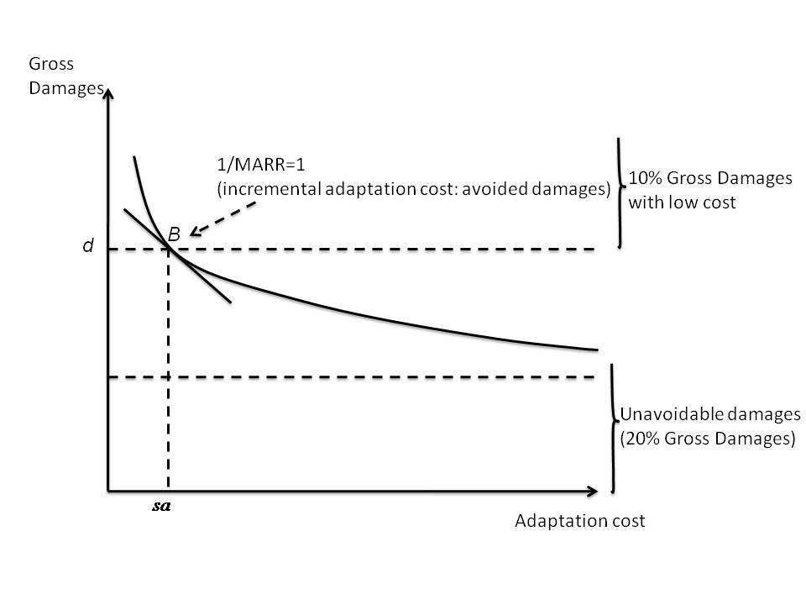
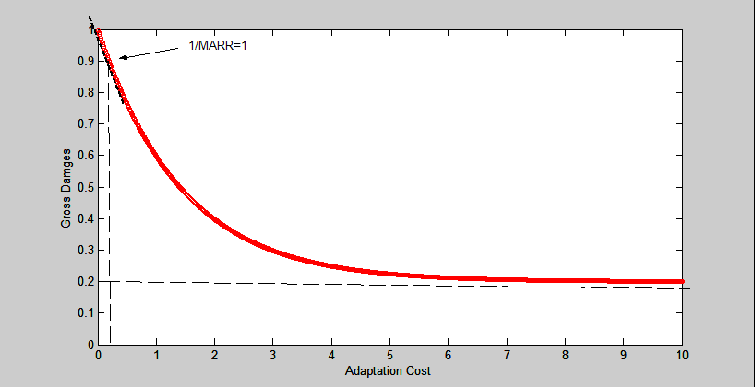
Calibration of Adaptation Cost Function
Calibrating adaptation cost function based on the economy wide assessment from Parry et al. (2009)
Figure 1. Portrayal of relationship between adaptation investment , residual damages and unavoidable damages
Figure 2. Fitted line

Slide 11
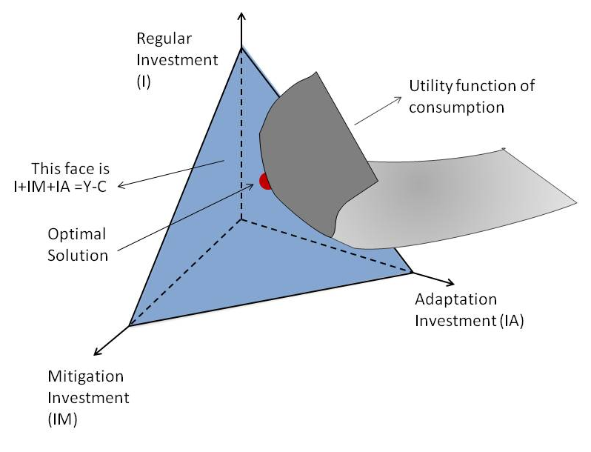
Add adaptation investment to DICE
Where Q: net output of goods and services net of climate change damages after abatement
C: consumption
I: “traditional” investment of production capital
IM: mitigation investment
IA: adaptation investment
Notes:
Assume that decisions on the levels of adaptation and mitigation are separable but compete for funds with consumption and traditional investment

Slide 12
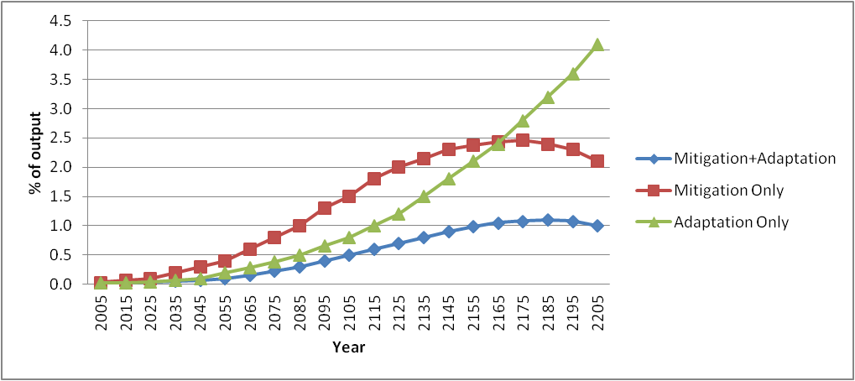
Results and Benefits
Figure 1. Total residual damages with and without adaptation

Slide 13
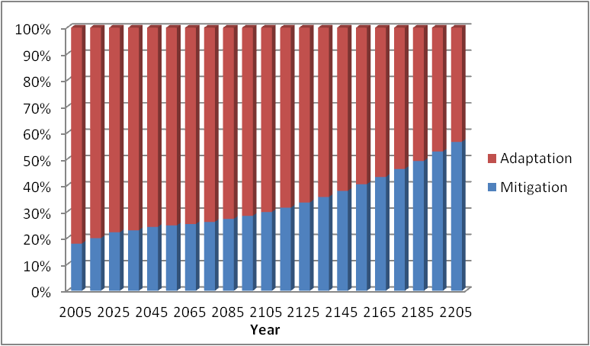
Figure 2. Temporal investment (percentage) of adaptation and mitigation in the model with both planned adaptation and mitigation investment allowed

Slide 14
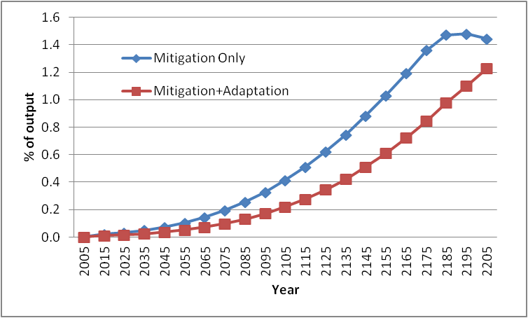
Figure 2-3. Results of optimal mitigation investment with and without adaptation investment allowed

Slide 15
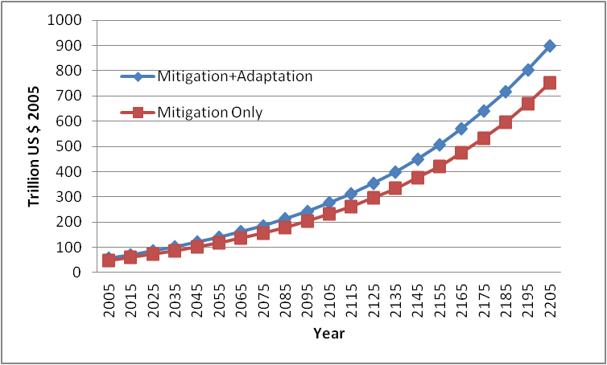
Figure 4. Gross world productivity with and without adaptation

Slide 16
Concluding Comments
Adaptation is an economically effective complement to mitigation and an important current policy option
Adaptation investment tackles the short run reduction of damages in the first 150 years while mitigation dominates from thereon
Effective political strategy is the immediate role for adaptation with a longer run transition to mitigation as the damages from GHG concentrations increases

Slide 17
Future Work
Modeling direct interaction between adaptation and mitigation in terms of their specific effectiveness and trade-offs
Identifying the optimal strategy mix considering regional differences and climate change uncertainties
Implementing extreme events and other risk analysis

Slide 18
Thank you very much for your attention
Questions?

Slide 19
Backup— Types of Adaptation Actions
Adaptation to climate change can be categorized as “autonomous” or “planned”(Carter et al,1994)
Autonomous adaptations are actions taken voluntarily by decision-makers (such as farmers or city leaders) whose risk management is motivated by information, market signals, co-benefits, and other factors.
Planned adaptations are interventions by governments to address needs judged unlikely to be met by autonomous actions – often adaptations larger in scale and/or resource requirements.

Slide 20
Importance of Adaptation
More societal robustness to climate change
Climate change cannot be totally avoided
Immediate benefit can be gained from better adaptation to climate variability and extreme events
Planned adaptation is likely to be more effective and less costly than last-minute, emergency adaptation
Droughts, heatwaves, increased hurricane intensity and new disease vectors required forward-looking investment
Adaptation has a productive life

Slide 21
Investment Allocation Economic Considerations
Activity | Consequences
Consumption | Current Utility
Conventional investment | Future production and consumption benefits
Adaptation investment | Avoided climate change damages to production now and possibly in future- more consumption
Mitigation investment | Avoided extent of climate change with lessened to production in future- more consumption

