Slide 1
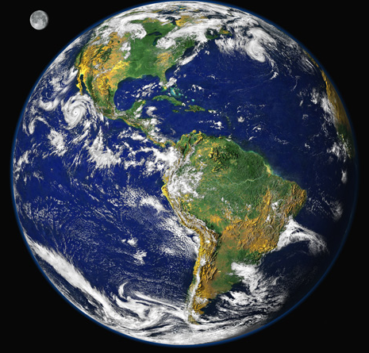
Climate Change Adaptation
Bruce A. McCarl
Distinguished Professor of Agricultural Economics, Texas A&M University
mccarl@tamu.edu, http//ageco.tamu.edu/faculty/mccarl
Energy
Climate Change Adaptation
Climate Change Mitigation
Climate Change Effects

Slide 2
What is Adaptation
IPCC Definition of Adaptation
Adjustment in natural or human systems to a new or changing environment. Adaptation to climate change refers to adjustment in natural or human systems in response to actual or expected climatic stimuli or their effects, which moderates harm or exploits beneficial opportunities. Various types of adaptation can be distinguished, including anticipatory and reactive adaptation, private and public adaptation, and autonomous and planned adaptation.
IPCC WGII 2001 Report Glossary

Slide 3
Adaptation and its inevitability

Slide 4
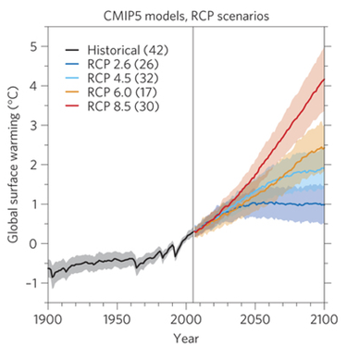
Given the emission growth –
Action Eras, Possible Climate Goals and Inevitability
4°
2°
Inevitable amount
Era 1
Era 2
Era 1 – In this time period (now until 2040-2050) there is not much contribution from limiting emissions with an inevitable amount of climate change. Needs adaptation plus mitigation
Era 2 – In this time period (2050-2100) mitigation has effects and the climate is warming the question is how much

Slide 5
Why Adapt - Inevitability
Characteristics of stabilization scenarios
Stabilization level (ppm CO₂-eq) | Global mean temp. increase at equilibrium (ºC) | Year CO2 needs to peak | Year CO2 emissions back at 2000 level | Reduction in 2050 CO2 emissions compared to 2000
445 – 490 | 2.0 – 2.4 | 2000 - 2015 | 2000- 2030 | -85 to -50
490 – 535 | 2.4 – 2.8 | 2000 - 2020 | 2000- 2040 | -60 to -30
535 – 590 | 2.8 – 3.2 | 2010 - 2030 | 2020- 2060 | -30 to +5
590 – 710 | 3.2 – 4.0 | 2020 - 2060 | 2050- 2100 | +10 to +60
710 – 855 | 4.0 – 4.9 | 2050 - 2080 |  | +25 to +85
855 – 1130 | 4.9 – 6.1 | 2060 - 2090 |  | +90 to +140
IPCC WGIII Table SPM.5: Characteristics of post-TAR stabilization scenarios WG3 [Table TS 2, 3.10], SPM p.23
[1] The best estimate of climate sensitivity is 3ºC [WG 1 SPM].
[2] Note that global mean temperature at equilibrium is different from expected global mean temperature at the time of stabilization of GHG concentrations due to the inertia of the climate system. For the majority of scenarios assessed, stabilisation of GHG concentrations occurs between 2100 and 2150.
[3] Ranges correspond to the 15th to 85th percentile of the post-TAR scenario distribution. CO₂ emissions are shown so multi-gas scenarios can be compared with CO₂-only scenarios.
Notes:
Table SPM.5: Characteristics of post-TAR stabilization scenarios WG3 [Table TS 2, 3.10], SPM p.23
In order to stabilize the concentration of GHGs in the atmosphere, emissions would
need to peak and decline thereafter. The lower the stabilization level, the more
quickly this peak and decline would would need to occur. Mitigation efforts over the next
two to three decades will have a large impact on opportunities to achieve lower
stabilization levels WG3 (3.3), SPM p.22.

Slide 6
Why Adapt
Greenhouse Gas Forcing and Climate Change
Lagged time between action and response
Inevitability of climate change
Slow mitigation action

Slide 7
Ag and Adaptation

Slide 8
Agricultural Manifestations of Risk
Greater plant water needs
Greater city water needs
More fresh surface water?
More water in infrequent events
More pests
altered grass
Less severe winter and cattle/hogs
Northward crop migrations
Altered water quality
Inundated facilities (not here)
GHG Emissions
Higher priced energy
Earlier lake thaw
Winter access to water transport

Slide 9
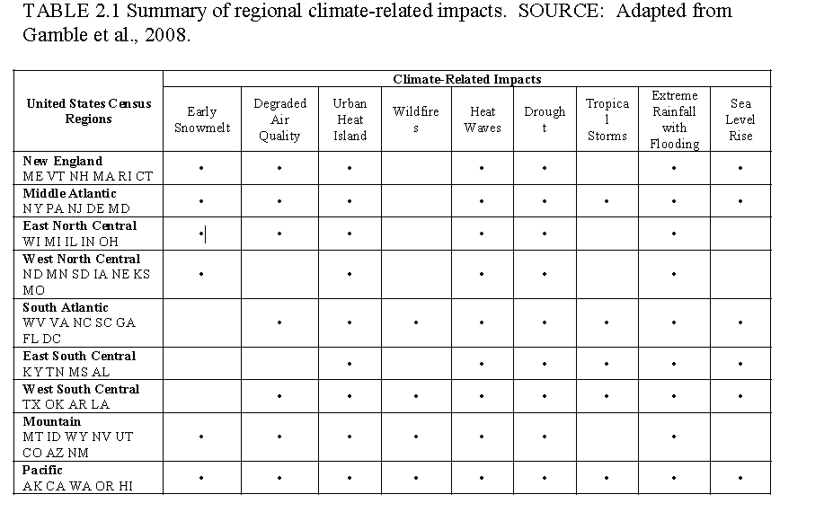
More General Manifestations of Risk
From NAS report Adapting to the Impacts of Climate Change http://americasclimatechoices.org/paneladaptation.shtml

Slide 10
Science Challenge
The level of scientific confidence in understanding and projecting climate change increases with spatial scale while the relevance and value of the projections for society declines.
A finer-scale understanding of climate change risks and vulnerabilities is needed
Multiple stresses will interact with the impacts of climate change, leading to different vulnerabilities to the same climate condition in different locations and a need for different adaptive responses
Adapting to changes in averages versus changes in extremes results in a fundamental scientific and policy challenge
Interactions and integration across regions and sectors cause considerable complexity and will lead to unanticipated consequences of both impacts and adaptations.
The types of impacts, vulnerabilities, and adaptation options are different for natural and human systems.
All from NAS Adapting report

Slide 11
Uncertainty
We need to understand the factors that drive both the impacts and our ability to respond. This has led to calls for information about the range of possible impacts and the level of certainty in our projections.
Society cannot avoid the risks of climate change entirely.
Challenge for decision-makers will be the limits to our ability to identify and reduce uncertainties related to climate change.
Major uncertainties include:
the natural internal variability of the climate system,
the trajectories of future emissions of greenhouse gases and aerosols,
the response of the global climate system to any given set of future emissions
Magnitude and sources can be explored using models - will not resolve to certainty
Lack of certainty about future conditions is commonly, but often inappropriately, used as a rationale for inaction. In fact, improving our understanding of the kinds of uncertainties that we face will be helpful in risk management decisions, even if the uncertainties cannot be readily quantified
All from NAS Adapting report

Slide 12
Types of Adaptation Actions

Slide 13
Means to Adapt
Investment to facilitate adaptation
  Research
  Extension
  Capital investment
Ag Adaptation
  Irrigation
  Drought resistant varieties
  Tolerant breeds and varieties
  Crop and livestock mix
  Tree rotation age
  Abandonment
McCarl, B.A., Adaptation Options for Agriculture, Forestry and Fisheries, A Report to the UNFCCC Secretariat Financial and Technical Support Division, 2007. http://unfccc.int/files/cooperation_and_support/financial_mechanism/application/pdf/mccarl.pdf

Slide 14
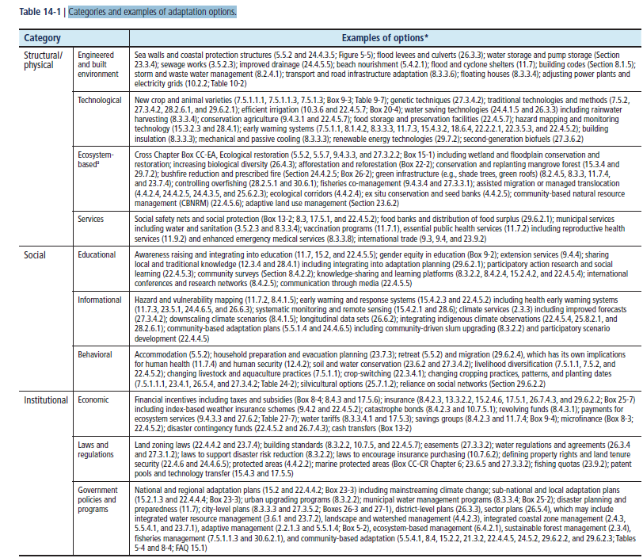
Adaptation types

Slide 15
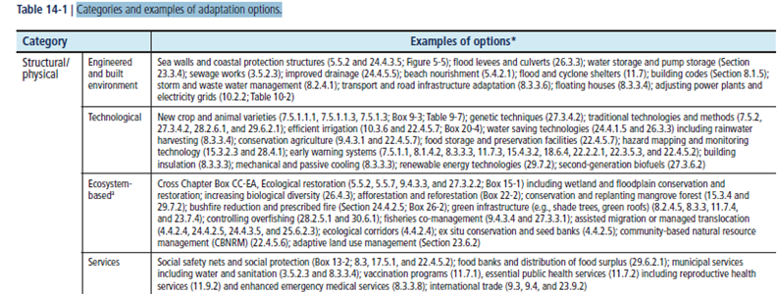
Adaptation types

Slide 16
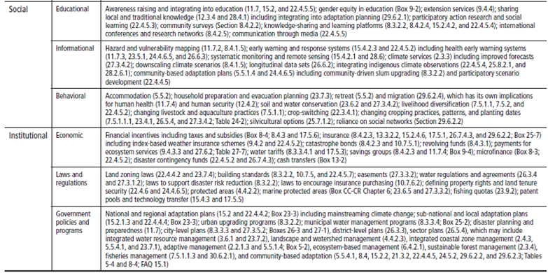
Adaptation types

Slide 17
Adaptation types

Slide 18
What do we know about Adaptation
Three fundamental forms
Crop/livestock/forest management
Timing likely works (earlier planting, maturity,
Rotation age etc)
Stocking rates
Pest treatment
Can be reaction to positive opportunity
Importing southern patterns
Heat resistant /exploiting systems
crop livestock/forest substitution
Investment
Research and extension
Moving infrastructure
Transport
Some will occur due to obsolescence

Slide 19
What don’t we know about Adaptation
Reaction to
Enhanced CO2
Increased variability
Earlier thaws
Investment needs reaction
wetter and water logging
Extreme events
Pests, invasive species, disease

Slide 20
Plan to Adapt
Investment to facilitate adaptation
  Research
  Extension
  Capital investment
Ag Adaptation
  Irrigation
  Drought resistant varieties
  Tolerant breeds and varieties
  Crop and livestock mix
  Abandonment
McCarl, B.A., Adaptation Options for Agriculture, Forestry and Fisheries, A Report to the UNFCCC Secretariat Financial and Technical Support Division, 2007. http://unfccc.int/files/cooperation_and_support/financial_mechanism/application/pdf/mccarl.pdf

Slide 21
What does WGII Say
Report Level Adaptation
Autonomous
Varieties/species,
Fertiliser, irrigation, water harvest, conserve soil moisture
Water management - waterlogging, erosion and nutrient leaching
Timing or location of cropping, livestock, aquaculture, forest
Diversifying integrating livestock raising, fish, crops, forest
Improving fire, pest, disease and weed management
Using seasonal climate forecasting to reduce production risk.
Harvesting patterns, rotation periods, salvaging dead timber,
Landscape planning to minimize fire and insect damage,
Adjusting to altered product size and quality
Fishery catch size and effort
.

Slide 22
Key Concepts

Slide 23
Key Concepts
Throughout history, people and societies have adapted to and coped with climate, climate variability, and extremes, with varying degrees of success
Adaptation is place- and context-specific, with no single approach for reducing risks appropriate across all settings

Slide 24
Key Concepts
Residual damages are those damages that remain after adaptation actions are taken.
There is a relationship between increasing adaptation effort and diminished residual damages with per unit cost increasing with more adaptation.
Adaptation deficit The gap between current state of a system and a state that minimizes adverse impacts from existing climate condition & variability.
Maladaptation Actions that improve local adaptation now but lead to increased risk of adverse climate-related outcomes, increased vulnerability to climate change, or diminished welfare, now or in the future.

Slide 25
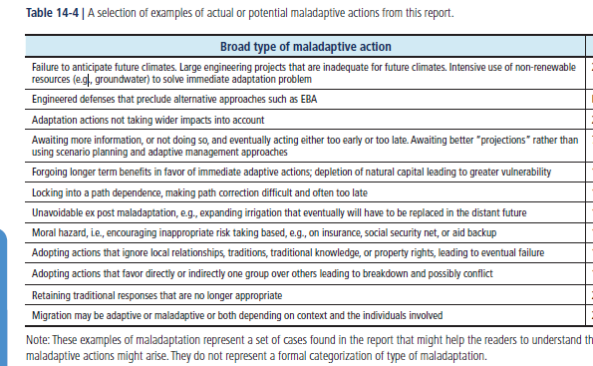
Maladaptation

Slide 26
Adaptation can be
“natural” or “autonomous” or “planned.”
Natural adaptations are actions in ecosystem stimulated by species reacting to climate
Autonomous adaptations are actions taken voluntarily by decision-makers (such as farmers or city leaders)
Planned adaptations are interventions by governments to address needs judged unlikely to be met by autonomous actions
Public sector may play important roles in all cases.
Support autonomous adaptation by providing information, shaping market conditions and developing technologies
Act directly by developing strategies, providing resources, and carrying out projects (infrastructure development).
Influence natural adaptation by managing the unmanaged
Agrilife scientists are in the public sector group

Slide 27
Key Concepts
Adaptation planning & implementation can be enhanced through complementary actions across levels, from individuals to governments
Integration of adaptation into planning and decision making can promote development and disaster risk reduction – often called mainstreaming
Strategies include actions with co-benefits for other objectives.

Slide 28
Key Concepts
Adaptation planning and implementation are contingent on societal values, objectives, and risk perceptions.
Recognition of diverse interests, circumstances, social-cultural contexts, and expectations is important
Underestimating the complexity of adaptation as a social process can create unrealistic expectations about achieving intended adaptation outcomes.

Slide 29
Key Concepts
Poor planning, overemphasizing short-term or failing to anticipate consequences can result in maladaptation.
Maladaptation can increase the vulnerability or exposure of the target group in the future, or the vulnerability of other people, places, or sectors.
Narrow focus on quantifiable costs and benefits can bias decisions against the poor, against ecosystems
Some near-term responses to increasing risks related to climate change may also limit future choices.

Slide 30
Is Adaptation Occurring?
A few words from the IPCC (WGII 2007)
Adaptive capacity is uneven across and within societies (very high confidence).
There are individuals and groups within all societies that have insufficient capacity to adapt to climate change. For example, women in subsistence farming communities are disproportionately burdened with coping with drought in southern Africa [17.3.2].
Capacity to adapt is dynamic and influenced by econ. and natural resources, social networks, entitlements, institutions and governance, human resources, and technology. Stresses related to HIV/AIDS, land degradation, econ. globalisation, and conflict affect adapt capacity.
Farming in India exposed to import competition and lower prices in addition to climate risks;
Marine ecosystems overexploited by globalised fisheries less resilient
There are substantial limits and barriers to adaptation.
High adaptive capacity does not always translate to action. Significant barriers including
inability of natural systems to adapt to the rate and magnitude of climate change,
technological, financial, cognitive and behavioural, and social and cultural constraints.
Also significant knowledge gaps for adaptation as well as impediments to flows of adaptation knowledge and information. New planning processes attempting to overcome. For example, least-developed countries are developing National Adaptation Programmes of Action and some developed countries have established national adaptation policy frameworks [17.4.1].

Slide 31
Key Concepts
Constraints can impede adaptation
limited financial and human resources
limited integration or coordination of governance
uncertainties about projected impacts
different perceptions of risks
competing values
absence of key adaptation leaders and advocates
limited tools to monitor adaptation effectiveness.
insufficient research, monitoring, and observation and the finance to maintain them.

Slide 32
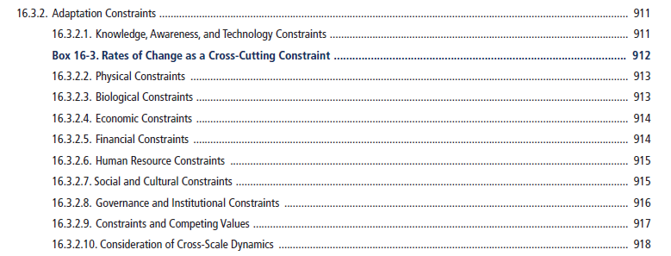
Constraints
Constraints can impede adaptation
limited financial and human resources
limited integration or coordination of governance
uncertainties about projected impacts
different perceptions of risks
competing values
absence of key adaptation leaders and advocates
limited tools to monitor adaptation effectiveness.
insufficient research, monitoring, and observation and the finance to maintain them.

Slide 33
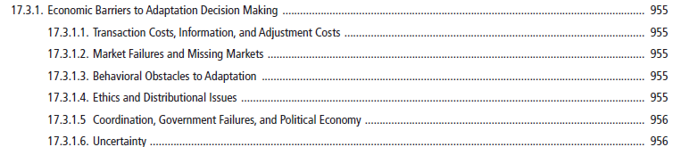
Barriers

Slide 34
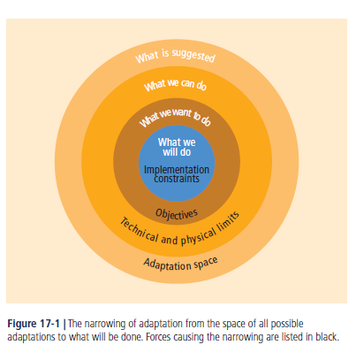
Key Concepts

Slide 35
Key Concepts
Economic instruments can foster adaptation by providing incentives
public–private finance partnerships
loans
payments for environmental services
improved resource pricing
charges and subsidies
norms and regulations
Risk sharing and transfer mechanisms

Slide 36
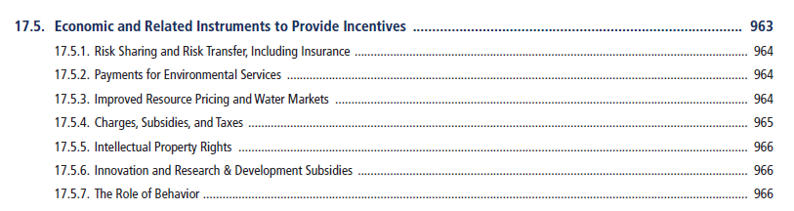
Key Concepts
Economic instruments can foster adaptation by providing incentives
public–private finance partnerships
loans
payments for environmental services
improved resource pricing
charges and subsidies
norms and regulations
Risk sharing and transfer mechanisms

Slide 37
Adaptation and the treadmill
Climate change and its continual progression raises a new demand on agriculture research and extension
Traditionally in agriculture we did research on yield improvenment and some maintainence for say pest resistance
We could count on weather being staationary but now this is likely not so.
So we must devote resources to technological adaptation in maintaining productivity at a spot

Slide 38
Empirical Adaptation

Slide 39
Agricultural Adaptation
Analytical approaches
Observe adaptation to get insights on possibilities
Observe “adapted agriculture”
Simulate adaptation
Structural modeling

Slide 40
Observe adaptation

Slide 41
Literature
Livestock adaptation in Africa and South America ( papers from Seo et al.)
Climate change and animal performance in the U.S. (Frank et al. 2001; Mader et al. 2009)
Few empirical studies focused on climatic conditions and livestock stocking rate.

Slide 42
Objectives of this study
Examine how climatic factors impact land allocation decisions between crop and livestock along with cattle stocking rates
Examine under climate change, what are the directions and magnitudes of likely adaptation
Mu, J.H., and B.A. McCarl, "Adaptation to Climate Change: Land Use and Livestock Management in the U. S", Presented at the 2011 annual meeting of the Southern Agricultural Economics Association, Corpus Christi, February, 2011.

Slide 43
Method
Assuming the net revenue from and agriculture operation is written as,
The probability of choosing land use
Fractional Multinomial Logit estimation with

Slide 44
Stocking rate,
individual animal performance,
gain per acre,
and net return per acre.
Source: Redfearn and Bidwell

Slide 45
Data
District-level data for Census years of 1987, 1992, 1997, 2002 and 2007
Land use for crop and pasture plus total aniaml population from the Agriculture Census
Climate data on historic temperature, precipitation, drought, extreme heat waves, precipitation intensity and the temperature-humidity index (THI) from NOAA
Regional dummies and cattle stocking rate

Slide 46
  Land use allocation and climate
Temperature and land use
Precipitation and land use

Slide 47
Projections under climate change
The third version of Hadley Center Coupled Model (HadCM3);
Changes of temperature and precipitation for the years 2010-2039, 2040-2069 and 2070-2099;
Three emission SRES scenarios: B1,A1B, A2
Holding other variables at mean.

Slide 48
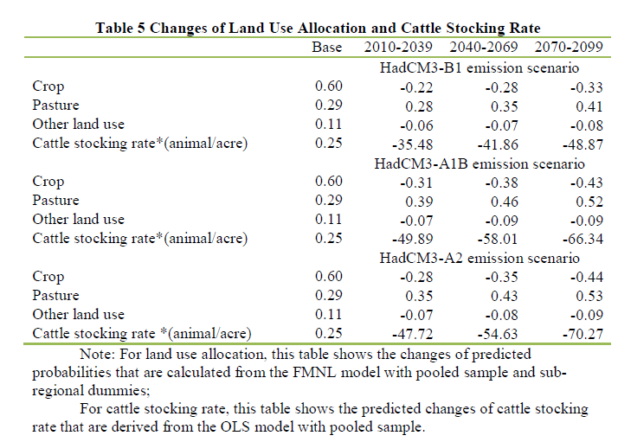
Projections under climate change

Slide 49
Changes of the probability of land allocation across regions under climate change
pasture
crop
Under B1 Scenario
pasture
crop
Under A1 Scenario

Slide 50
Conclusions
Observed data suggests stocking rate and land use adjustments are to be expected under climate change
Fractional Multinomial Logit (FMNL) Model lets us estimate this;
We expect less crop land and lower stocking rates under projected climate change

Slide 51
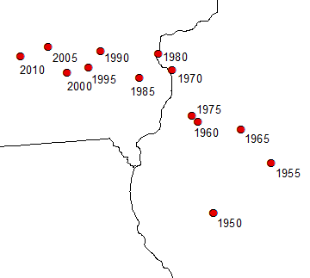
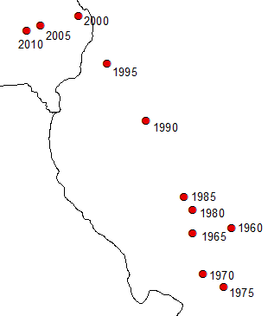
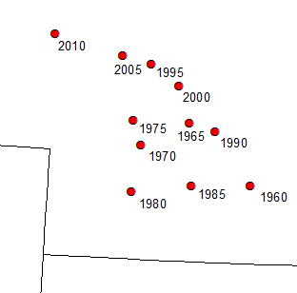
Autonomous actions
Production Weighted Centroid 1950-2010
IA
147 miles
IL
IL
Soybeans
150 miles
183 miles
MO
MO
Corn
Corn
NE
Shifts have already happened
Greater yield has transport implications
- wheat yields 44 bu/acre
- corn yields 165 bu/acre
More demands for transport and grain movement in the north
173 miles
KS
Wheat

Slide 52
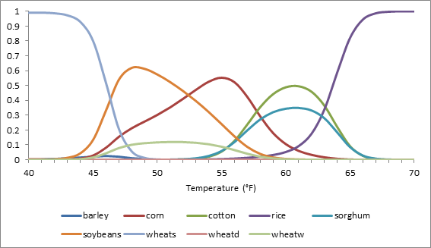
Crop choice
Park, J.Y., B.A. McCarl, and X.M. Wu, "The Effects of Climate on Crop Mix and Climate Change Adaptation", 2013.

Slide 53
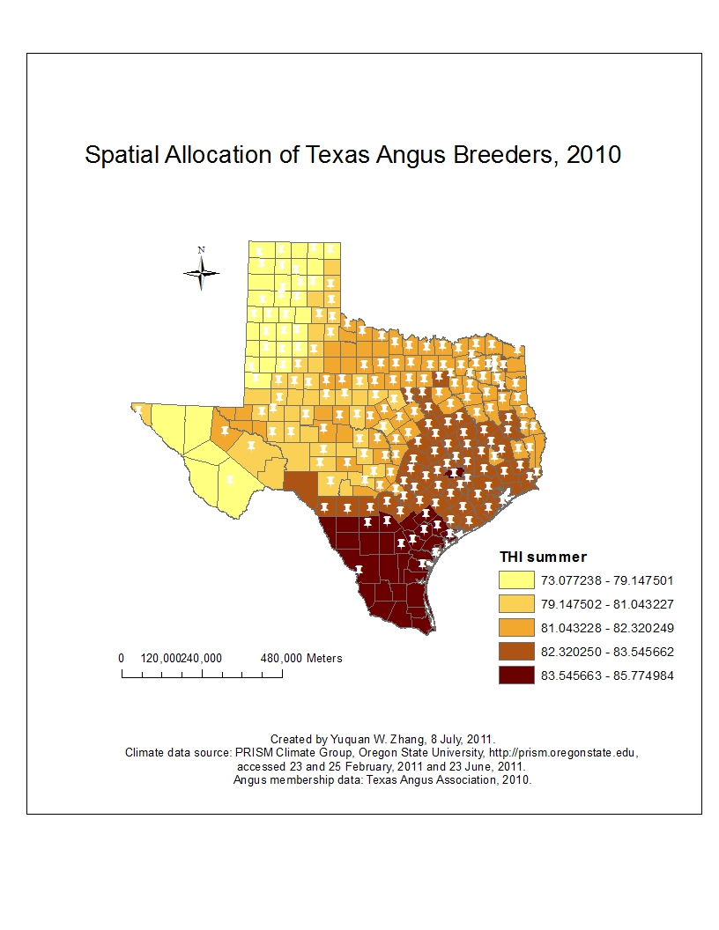
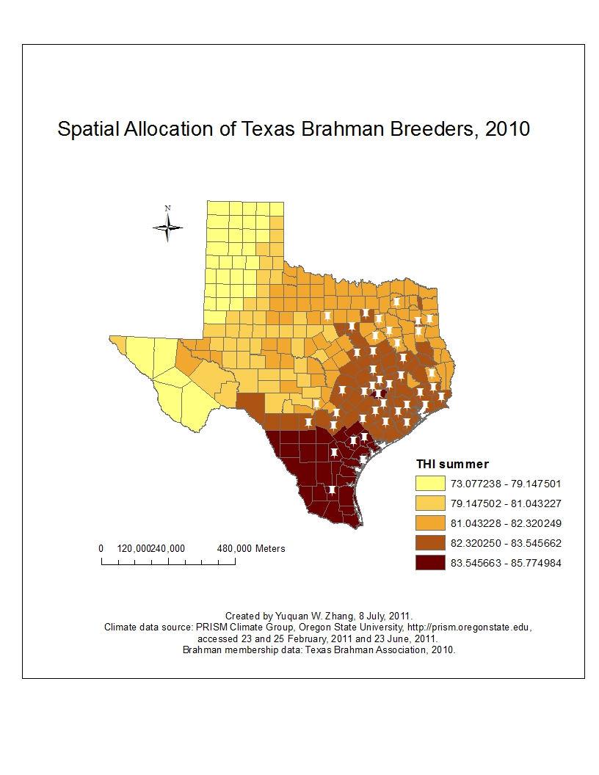
Autonomous actions-- Cattle breeds
Angus breeders spread across Texas.
Brahman breeders are located in Southeast Texas, where the temperature-humidity index (THI) values for summer are high.
Zhang, Y.W., A.D. Hagerman, and B.A. McCarl, "How climate factors influence the spatial distribution of Texas cattle breeds", Climatic Change, Volume 118, Issue 2, 183-195, 2013.

Slide 54
Is Adaptation Occurring?
A few words from the IPCC (WGII 2007)
Adaptation to climate change is already taking place, but on a limited basis
Societies have a long record of adapting to the impacts of weather and climate through a range of practices that include crop diversification, irrigation, water management, disaster risk management, and insurance.
Climate change poses novel risks often outside the range of experience, such as impacts related to drought, heat waves, accelerated glacier retreat and hurricane intensity [17.2.1].
Adaptation measures are undertaken by public and private actors through policies, investments in infrastructure and technologies, and behavioral change.
Examples include partial drainage of the Tsho Rolpa glacial lake (Nepal); changes in livelihood strategies in response to perma frost melt by the Inuit in Nunavut (Canada); and increased use of artificial snow-making by the Alpine ski industry.
Limited but growing set considers future climate change. Examples consideration of sea-level rise in design of infrastructure - the Confederation Bridge (Canada) and in coastal zone management (United States and the Netherlands) [17.2.2].

Slide 55
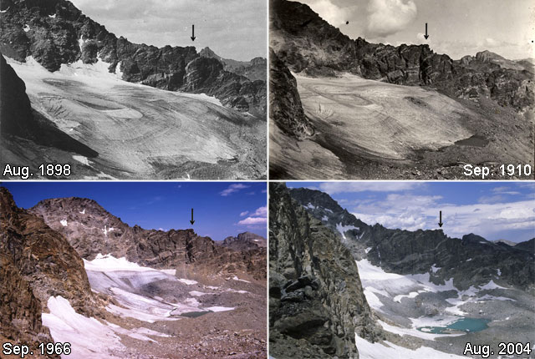
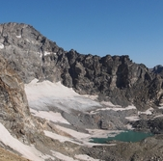


Observations - Natural Adaptation
We also have seen
Melting glaciers
More pests
Sea level rise
Coastal retreat
Pictures over time of glacial water
supply source, for Boulder CO
Aug 2013

Slide 56
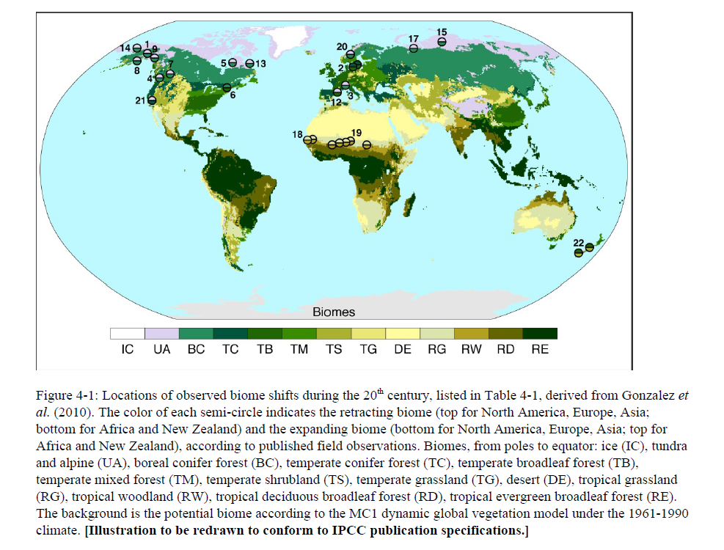
Natural Adaptation

Slide 57
Observe results of adaptation
No time
Mendelsohn
Schlenker
Land value studies

Slide 58
Simulation of adaptation

Slide 59
Simulate adaptation by planting cultivars that are better adapted to warmer temperatures, as well as by early planting.
These techniques help to reduce—but not to counterbalance completely—the yield reductions simulated under climate change and no adaptation.

Slide 60
Table 1 Data without Adaptation Data converted to percentage change from Base
cc cc hc hc
Crop Irrig neffect 2030 2090 2030 2090
cotton DRYLAND yld 18 96 32 82
cotton IRRIG yld 36 122 56 102
cotton IRRIG wuse -11 107 36 60
corn DRYLAND yld 19 23 17 34
corn IRRIG yld -1 -2 0 7
corn IRRIG wuse -34 -54 -30 -60
soybeans DRYLAND yld 20 30 34 76
soybeans IRRIG yld 16 28 17 34
soybeans IRRIG wuse 0 3 -12 -26
HRSW DRYLAND yld 15 -4 20 30
HRSW IRRIG yld -10 -18 4 6
HRSW IRRIG wuse -28 -22 -17 -21
Table 2 With Adaptation
cc cc hc hc
Crop Irrig neffect 2030 2090 2030 2090
cotton DRYLAND yld 18 96 32 82
cotton IRRIG yld 36 122 56 102
cotton IRRIG wuse -11 107 36 60
corn DRYLAND yld 20 24 17 34
corn IRRIG yld 1 0 1 9
corn IRRIG wuse -33 -55 -32 -60
soybeans DRYLAND yld 39 64 49 97
soybeans IRRIG yld 23 33 23 40
soybeans IRRIG wuse 18 12 0 -20
HRSW DRYLAND yld 20 14 23 36
HRSW IRRIG yld -1 -6 7 10
HRSW IRRIG wuse -12 -15 -12 -15
Source Data from McCarl, B.A., "Notes on the National and NCAR Agricultural Climate Change Effects Assessment", Background paper for National Climate Change Assessment Group Report, 1999.

Slide 61
Structural Modeling

Slide 62
Done in conjunction with vulnerability studies
Real issues in models
Expanding opportunity set
  Crop and livestock mix
  Not putting in attractive alternatives and getting double whammy
Cost benefit of adaptation
  Selectively stopping adaptation to estimate its value

Slide 63
History of McCarl Climate Change Effects Assessments
1987 – Corn Soy, Wheat no adaptation, no irrigation, no CO2
1992 – Corn, Soy, Wheat, no adaptation, irrigation, no CO2
1995 – Corn Soy, Wheat CO2, irrigation calendar adaptation
1999 – Corn, Soy, Wheat, cotton, sorghum, tomato, potato, CO2, irrigation, calendar adaptation, crop mix shift, livestock,
grass, input usage, water available
2001 -- Corn, Soy, Wheat, cotton, sorghum, tomato, potato, CO2,
irrigation, calendar adaptation, crop mix shift, livestock,
grass, input usage, pest, extreme event, forestry
2010 – above plus 2007 scenarios, risk, crop insurance
Cost continually went down now beneficial.

Slide 64
Structural adaptation
Adaptation in FASOM
Crop mix
Northward migration
AGCRPMIXUP(period,mapcountryreg(countrytouse,agreg),mixtype,crop)
$( (not notincropgroup(crop))
and agregsperiod(period,countrytouse,agreg)
and sum(matchirri(mixtype,irrigstatus),minmixdat(countrytouse,agreg,irrigstatus,crop))
and sum(proxycrop(crop,crop2)$(not sameas(crop,crop2)),1)=0
and minMixValue(countrytouse,agreg,mixtype,crop) gt 0
and ((sameas(mixtype,"total") and
minMixValue(countrytouse,agreg,"total",crop) ge minMixValue(countrytouse,agreg,"irrigated",crop))
or sameas(mixtype,"irrigated"))
and yesag gt 0 and cropmixy(period))..
sum((matchirri(mixtype,irrigstatus))
$minmixdat(countrytouse,agreg,irrigstatus,crop),
AGCRPMIX(period,countrytouse,agreg,irrigstatus,crop))
- 1.005 * sum(crpmixalt, cropmixdata(countrytouse,mixtype,crop,agreg,crpmixalt)
*AGMIXR(period,countrytouse,agreg,mixtype,crpmixalt))
$if not setglobal climate $goto arnd2
*new mixes under climate change
- 1.005 * sum(crpmixalt, cropmixdataclimate(mixtype,crop,agreg,crpmixalt)
*AGMIXR2(period,countrytouse,agreg,mixtype,crpmixalt) )$climadapt
$label arnd2
=l= 0.01 ;

Slide 65
Climate Sensitivity - Surplus Measures (Mil. Dollars)
Mali
Loss of 105-122
975
875
973
775
868
Gain of 133-177
850
675
689
575
647
Loss of 229-290
475
515
375
447
275
Loss of 6-9
175
219
75
157
11
2
5
-25
Total Surplus
Consumer Surplus
Producer Surplus
Foreign Surplus
Base
HADCM
CGCM
Butt, T.A., B.A. McCarl, and A.O. Kergna, "Policies For Reducing Agricultural Sector Vulnerability To Climate Change In Mali", Climate Policy, Volume 5, 583-598, 2006.

Slide 66
Value of Adaptation ($ Million) - Mali
Climate Change Effects and adaptation
120
Loss = 105
100
2
6
15
38
80
60
Loss in Mil Dollars
90
102
36% loss recovered
98
67
40
20
0
C Change
Crop Mix
Trade
Tech
Full
Adaptations Considered
Butt, T.A., B.A. McCarl, and A.O. Kergna, "Policies For Reducing Agricultural Sector Vulnerability To Climate Change In Mali", Climate Policy, Volume 5, 583-598, 2006.

Slide 67
Risk of Hunger –
With and Without Variety Adaptation
Mali
Without adaptation
80
75
69
With adaptation
70
60
49
50
42
Percent of Population
40
34
30
20
10
0
Base
HADCM
CGCM
HADCM
CGCM
HADCM: Hadley Coupled Model
CGCM: Canadian Global Coupled Model

Slide 68
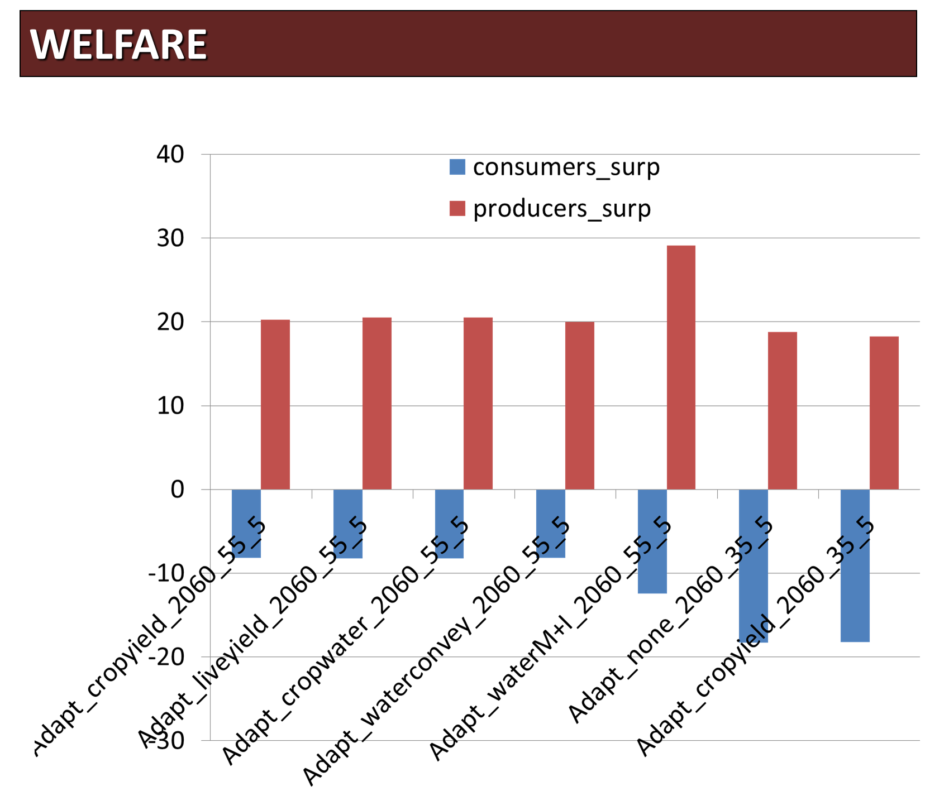
McCarl, B.A., M. Musumba, J.B. Smith, P. Kirshen, R.P. Jones, L. Deck, M. Abrado, A. El-Ganzori, M. Ahmed, M. Kotb, M. El-Shamy, M.A. Rabbo, I. El-Shinnawy, M. El-Agizy, M. Bayoumi, and R. Hynninen, "Implications of Climate Change for Egypt's Agricultural Sector", Mitigation and Adaptation Strategies for Global Change, Volume 20, Issue 7, pp 1097-1109, 2015.

Slide 69
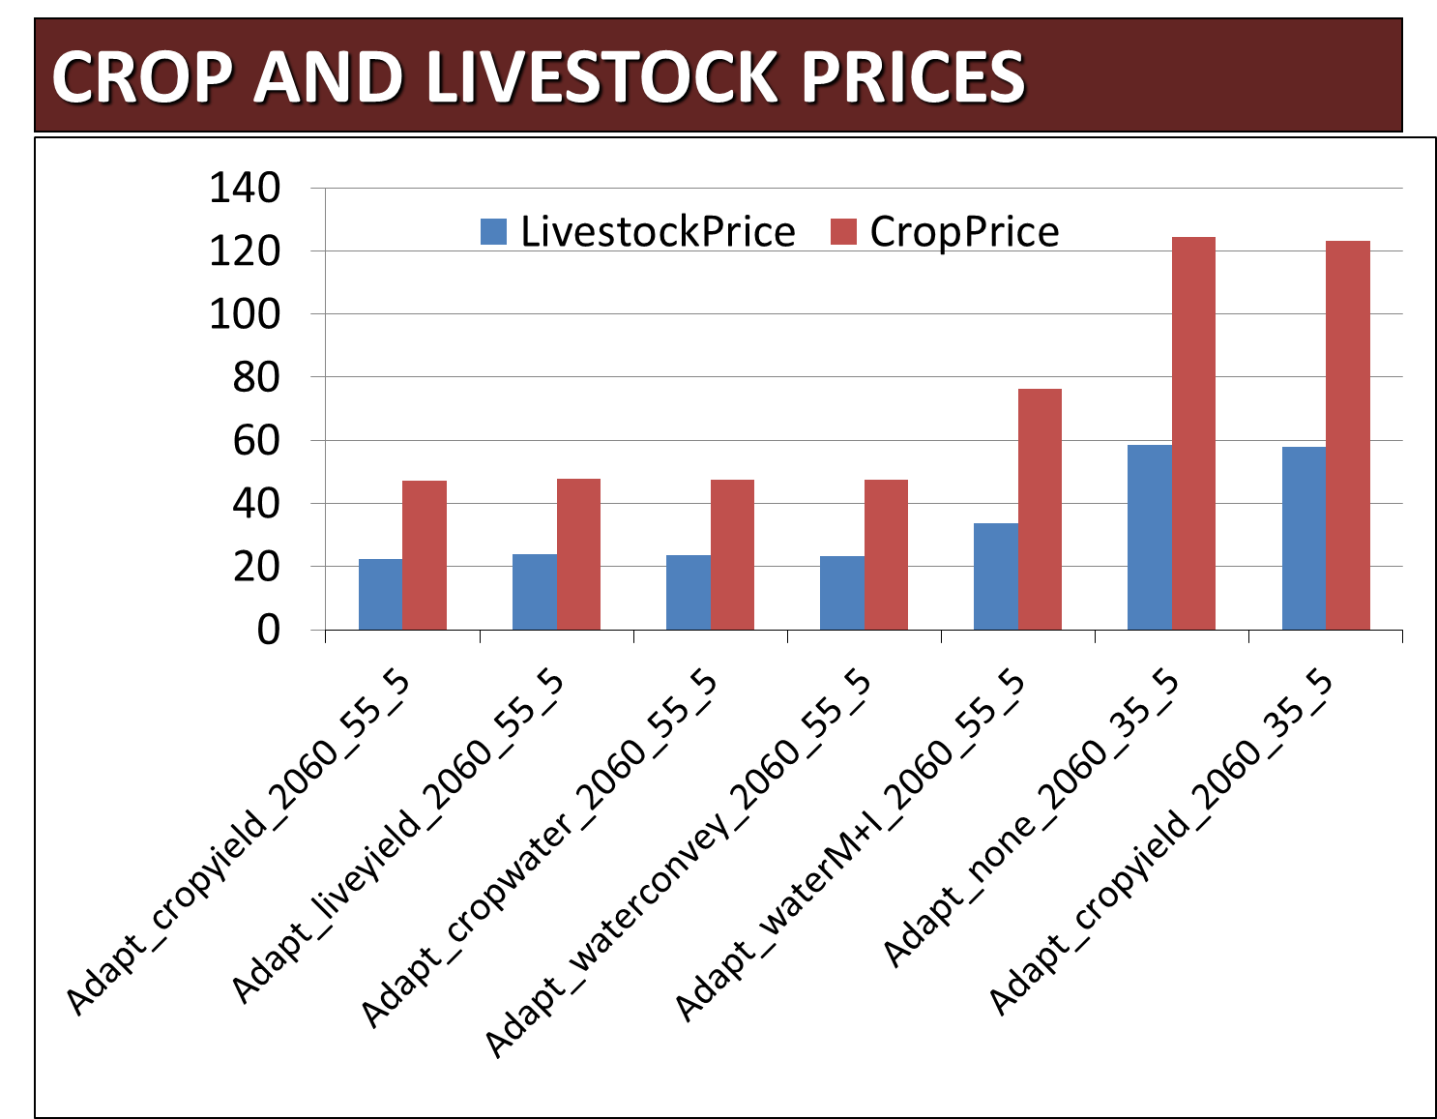
McCarl, B.A., M. Musumba, J.B. Smith, P. Kirshen, R.P. Jones, L. Deck, M. Abrado, A. El-Ganzori, M. Ahmed, M. Kotb, M. El-Shamy, M.A. Rabbo, I. El-Shinnawy, M. El-Agizy, M. Bayoumi, and R. Hynninen, "Implications of Climate Change for Egypt's Agricultural Sector", Mitigation and Adaptation Strategies for Global Change, Volume 20, Issue 7, pp 1097-1109, 2015.

Slide 70
Effect of Climate Change on Public Agricultural Research Returns
Scenario A1B | Percent increase / reduction under climate change
 | 2020 | 2050 | 2100
Northeast | 1.89 | 2.35 | -3.32
Southeast | 0.65 | -0.35 | -3.07
Central | -1.75 | 3.78 | -1.41
North Plains | 9.59 | 6.91 | -0.02
South Plains | -22.32 | -8.94 | -11.20
Mountains | 10.69 | 1.35 | 0.92
Pacific | 13.70 | -0.67 | 0.04
National | 1.37 | 0.93 | -2.58
Some gains some losses
To restore level of productivity requires invest percent increase of
 |  | 2020 | 2050 | 2100
South Plains |  | 10 | -21 | 8
National |  | -6 | -5 | 15

Slide 71
Costs of Ag Adaptation

Slide 72
So What Could be done
Adaptation - UNFCCC
Investment cost of adaptation
Always assumed people would just adjust but may need improves varieties and practices plus additional facilities like irrigation or land development
Assumes it occurs in 3 quarters
Research
Extension
Capital investment
McCarl, B.A., Adaptation Options for Agriculture, Forestry and Fisheries, A Report to the UNFCCC Secretariat Financial and Technical Support Division, 2007. http://unfccc.int/files/cooperation_and_support/financial_mechanism/application/pdf/mccarl.pdf

Slide 73
So What Could be done
Adaptation - UNFCCC
Investment cost of adaptation
Three scenarios
    Future population growth but no climate change
    Climate change
    Mitigated climate change

Slide 74
So What Could be done
Adaptation - UNFCCC
 |  |  | Primary Only |  | Plus processing
 | Today | BAU Gain | CC Add | Mitig CC ADD | CC Add | Mitig CC ADD
AFF Research | $35,959 | $30,075 | $3,007 | $2,632 | $3,007 | $2,632
AFF Extension | $6,426 | $547 | $55 | $48 | $55 | $48
AFF Capital Formation | $124,658 | $118,995 | $2,380 | $2,082 | $9,795 | $8,570
Total | $167,043 | $149,617 | $5,442 | $4,762 | $12,857 | $11,250
So with climate change investment level $5 to 13 billion
per year to adjust

Slide 75
What Could be done
Adaptation - UNFCCC
So with climate change investment level $5 to 13 billion
per year to adjust
So what
How can this be done better?
Does put a number on adaptation needs
Double counts some with ag assessments – irrigation
Investments are of magnitude of benefits in prior studies

Slide 76
Adaptation in IPCC

Slide 77
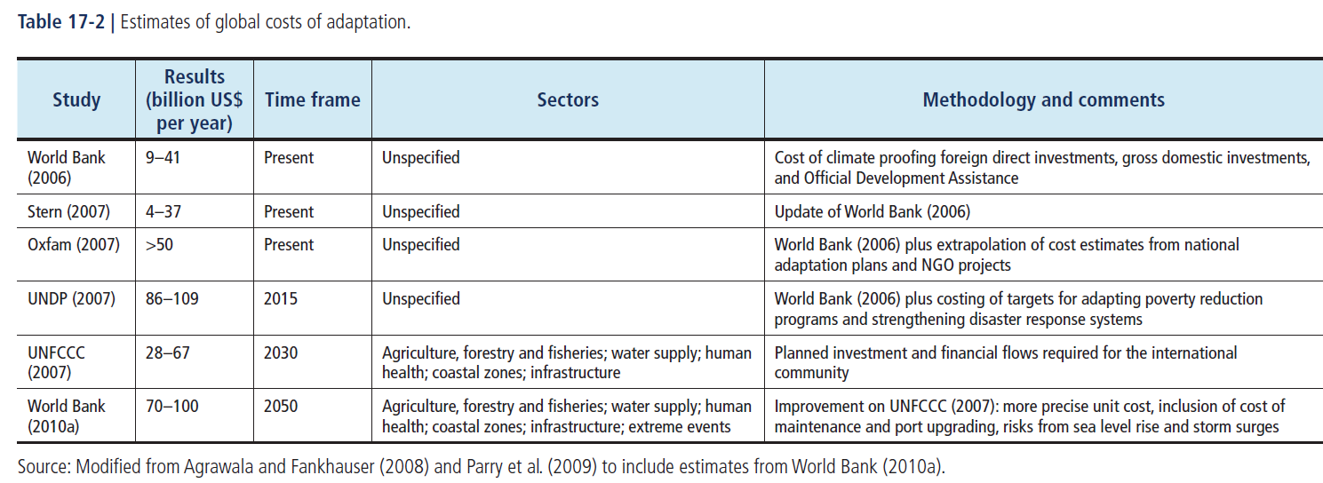
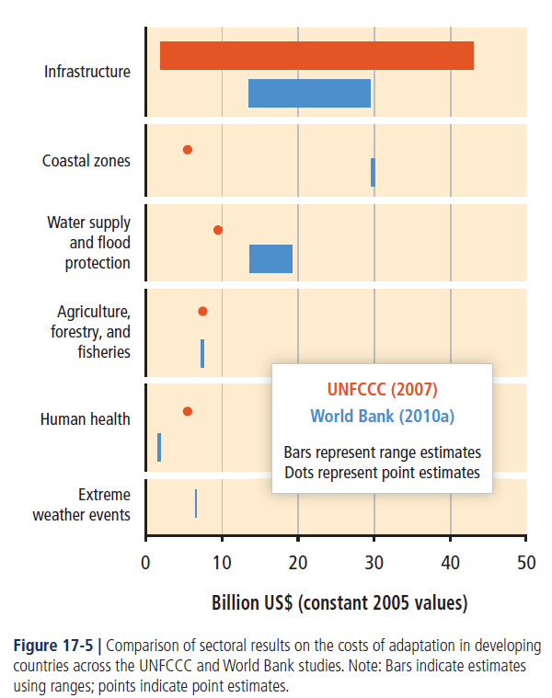
Global Costs

Slide 78
Global Costs
Limited evidence indicates a gap between global adaptation needs and funds available
Global estimates of the need for adaptation funds are variously estimated in the range of US$70 to US$100 billion annually (World Bank, 2010a), but with actual expenditures (agriculture) in 2011 estimated at US$244 million (Elbehri et al, 2011), and in 2012 estimated at US$395 million (Schalatek et al., 2012).

Slide 79
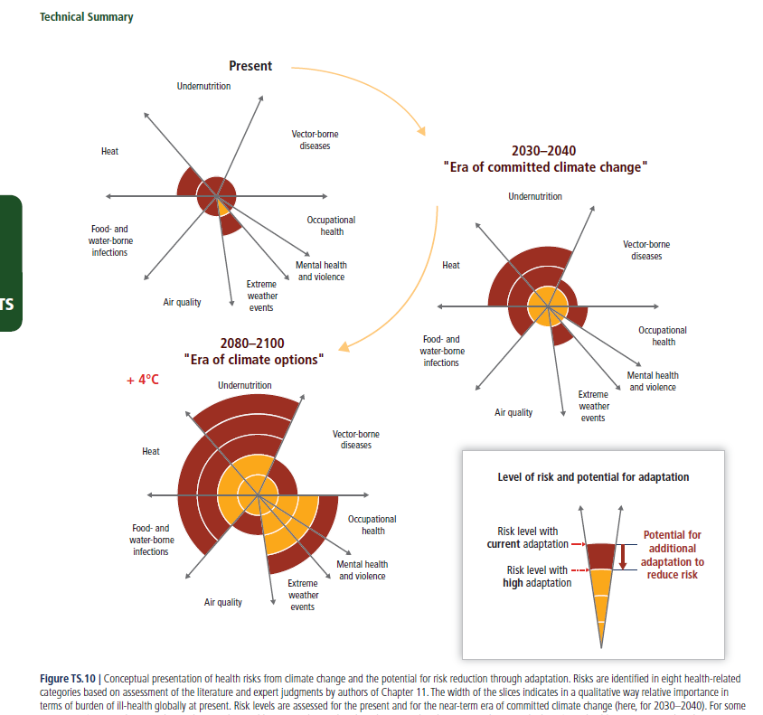
Effects and adaptation

Slide 80
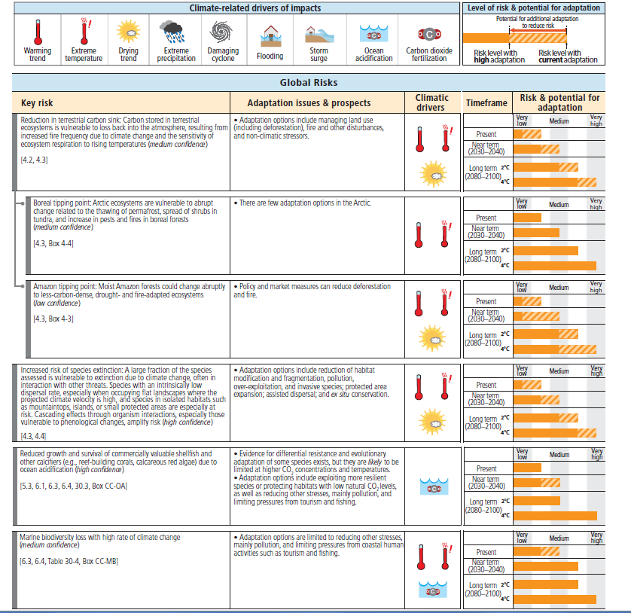
Effects
and
adaptation
Table TS.4 | Key sectoral risks from climate change and the potential for reducing risks through adaptation and mitigation. K

Slide 81
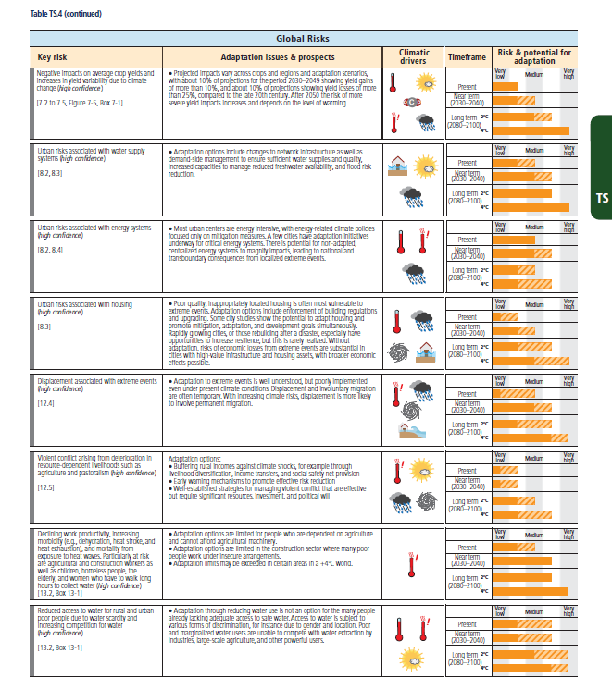
Effects
and
adaptation
Table TS.4 | Key sectoral risks from climate change and the potential for reducing risks through adaptation and mitigation. K

Slide 82
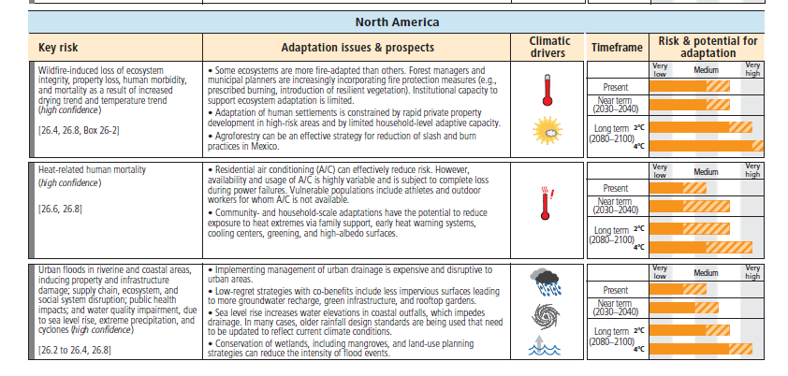
Effects and adaptation
Table TS.4 | Key sectoral risks from climate change and the potential for reducing risks through adaptation and mitigation. K

Slide 83
Adaptation over time
Just did a study on share of adaptation versus mitigation
Adaptation dominates for first 100 years
Wang, W.W. and B.A. McCarl Temporal Investment on Climate Change Adaptation and Mitigation

