Slide 1
Will Bioenergy be Profitable: Markets, Lifecycle Carbon Footprint, Commodity Prices and Leakage
Bruce A. McCarl
Distinguished Professor and Regents Professor
Department of Agricultural Economics
Texas A&M University
Invited paper presented at
GROW III - Oklahoma Conference on Biofuels
Oklahoma City, OK
November 12, 2008

Slide 2
Topic of the day
Reasons for bioenergy
Energy market
GHGS
Energy Bill
Lifecycle analysis
Issues with bioenergy
Leakage
Food prices, poor and the environment
Bioenergy as a preferred strategy as affected by GHG prices and Policy

Slide 3
Collaborators
Darius Adams, Oregon State Ralph Alig, USDA Forest Service
Gerald Cornforth, TAMU Greg Latta, Oregon State
Brian Murray, Duke Dhazn Gillig, TAMU/AMEX
Chi-Chung Chen, TAMU, NTU
Mahmood El-Halwagi, TAMU Uwe Schneider, University of Hamburg
Ben DeAngelo, EPA Ken Andrasko, World Bank
Steve Rose, EPA Francisco de la Chesnaye, EPA
Ron Sands, PNNL, Maryland Heng-Chi Lee, Taiwan
Thien Muang, TAMU Kenneth Szulczyk, TAMU
Michael Shelby, EPA Sharyn Lie, EPA
Sources of Support
USDA DOE
USEPA
CSiTE

Slide 4
An Aside
From a GHG perspective
Bioenergy ≠ Ethanol
Particularly corn or sugar ethanol
GHG offset = a1 * crop ethanol
+ a2 * cell ethanol
+ a3 * biodiesel
+ a4 * bio fueled electricity

Slide 5
Why Bioenergy
Four reasons for bioenergy
  Energy Prices and a possible cheap supply source
  Energy Security
  Greenhouse gas net emission removal
  Policy satisfaction
I will explore all but second

Slide 6
Will the interest persist ?
Supply and demand Forces

Slide 7
Energy Prices and Markets
High prices stimulated biofuel interest late 70’s and early 80’s
Bioenergy has been known to society throughout history and was reality pre 1900
Usage diminished in 1900s and has not greatly increased in the last few years particularly in unsubsidized forms
This is largely due to the availability of cheap fossil fuels.
Will this reverse or energy prices stay high?

Slide 8
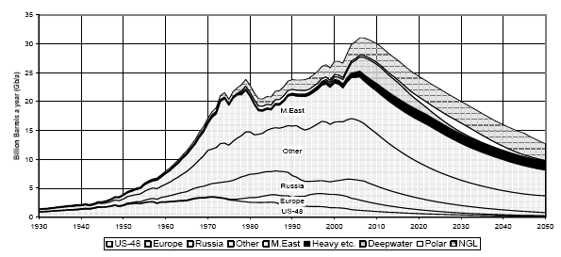
Scarcity and Fossil Fuel Cost
Offshore
Onshore
Graph of Oil Production
Source: Colin Campbell of the Association for the Study of Peak Oil and Gas (ASPO) Newsletter as in Wikapedia http://en.wikipedia.org/wiki/Peak_oil
Global Conventional Oil Production May Peak Soon
US has as has Texas

Slide 9
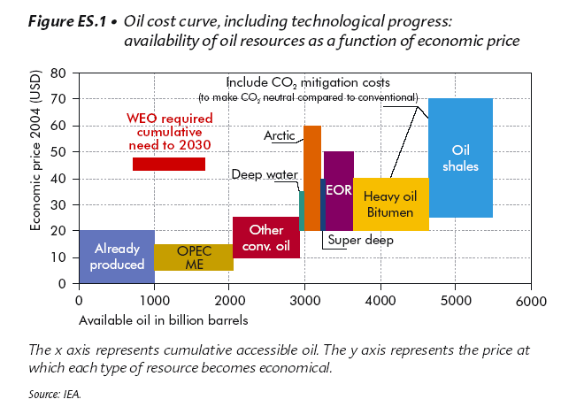
Supply, Scarcity and Fossil Fuel Cost
Lots of Oil But recovery cost will increase
Source: International Energy Agency Resources to Reserves Report http://www.iea.org/Textbase/npsum/oil_gasSUM.pdf

Slide 10
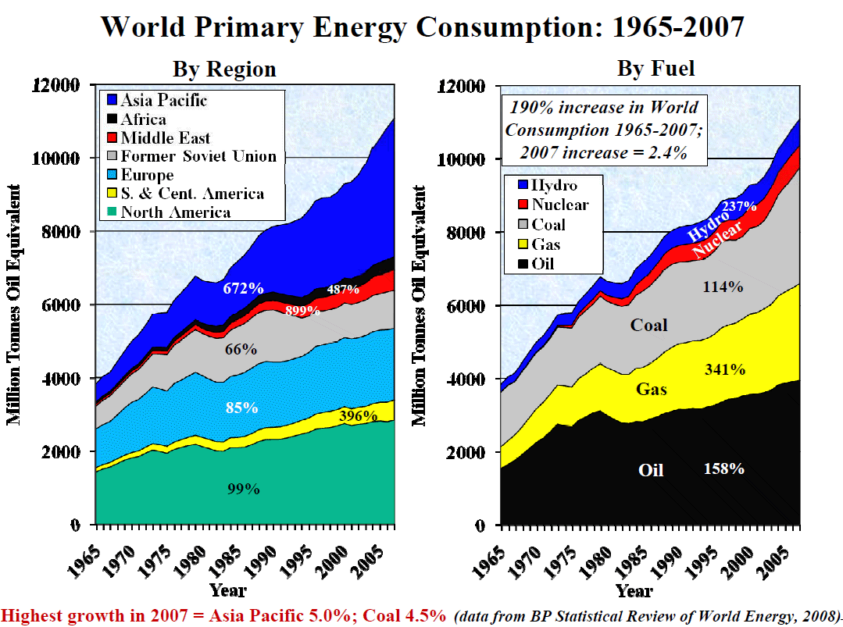
Consumption - Global
http://www.portlandpeakoil.org/content/selected-slides-2008-aspo-usa-conference

Slide 11
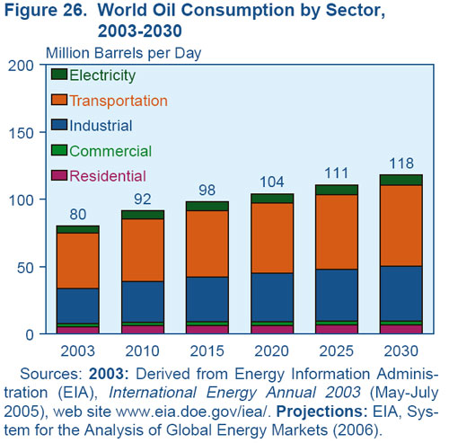
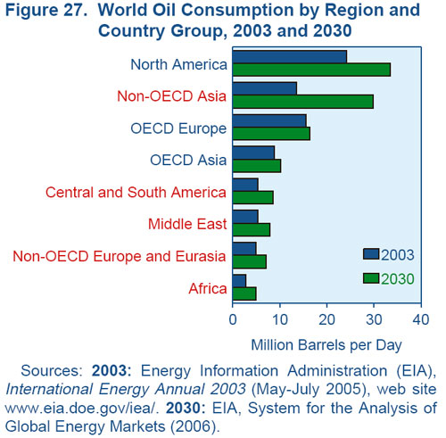
Consumption - Global
Source USDOE, Energy Information Agency, International Energy Outlook 2006 Report #:DOE/EIA-0484(2006)
Release Date: June 2006 , http://www.eia.doe.gov/oiaf/ieo/oil.html
Large oil demand growth especially in US and Asia – China and India

Slide 12
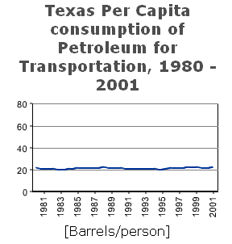
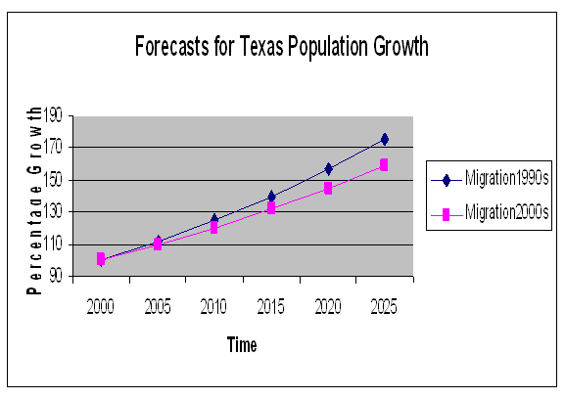
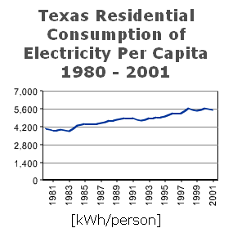
Consumption - Texas
Source: Texas State Demographer
http://txsdc.utsa.edu/tpepp/2006projections/
Source: USDOE Texas Energy Consumption
http://www.eere.energy.gov/states/
state_specific_statistics.cfm/state=TX#consumption
60-80% growth in 20 years
Liquid fuel rises at rate of population, electricity faster

Slide 13
Energy Economics Conclusion
Growing scarcity of conventional oil
Alternative sources possible at higher cost
= Higher cost future supply
Growing demand for Energy
(electricity and liquid fuels)
Global, US and Texas
= Higher future demand
Collectively implies
Higher demand for alternative energy
Likely brighter future for Renewables and
biofuels

Slide 14
Will the interest persist ?
GHG Forces

Slide 15
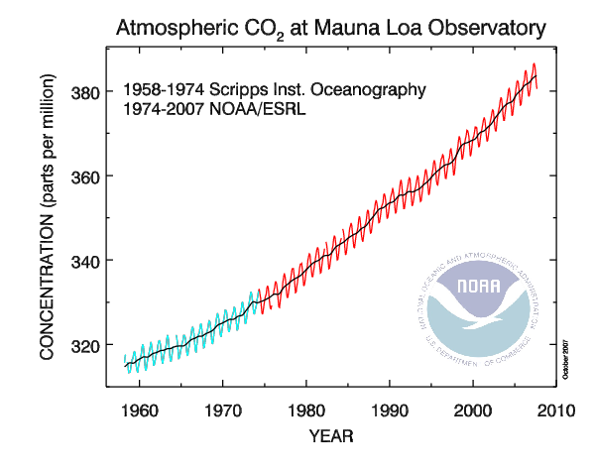
Degree of climate change
Why is this happening
Pre industrial - 275 Counting Non CO₂
- 345 this is increase almost doubles
2007 - 380+
http://www.esrl.noaa.gov/gmd/ccgg/trends/co2_data_mlo.html

Slide 16
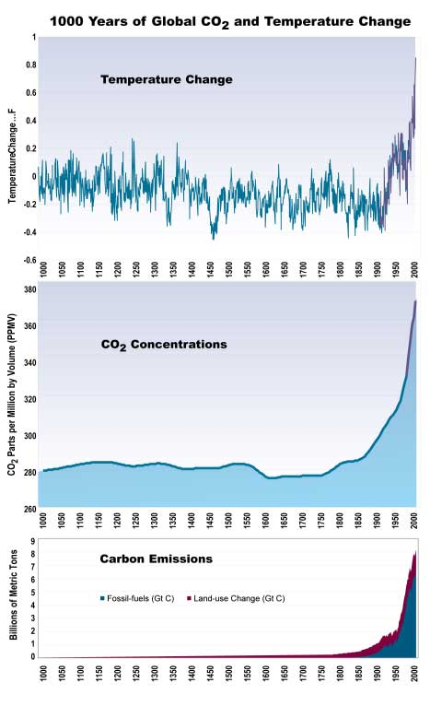
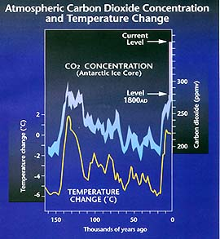
Greenhouse Gasses
Source http://ssca.usask.ca/2002conference/Bennett.htm
Source : U.S. National Assessment
Carbon Dioxide highly associated with climate change
Policy around world working to limit emissions

Slide 17
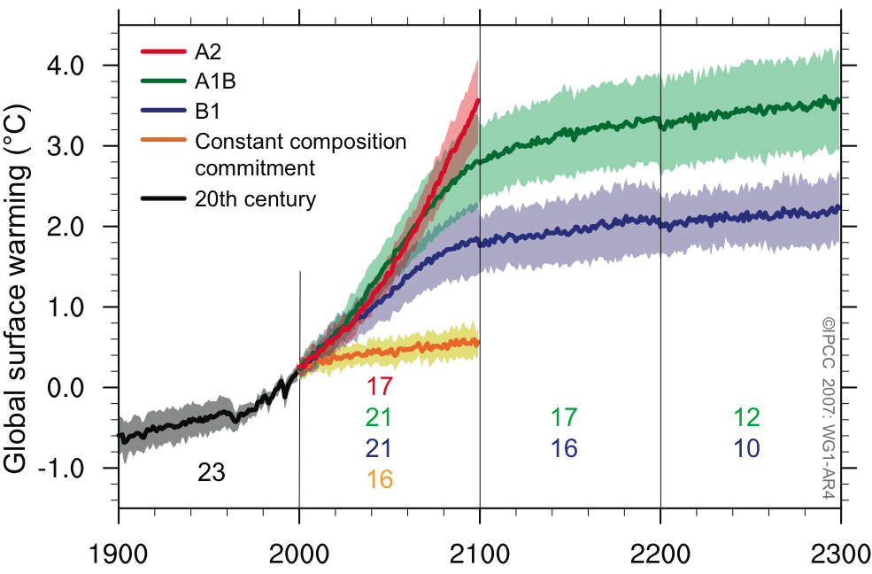
Degree of climate change - What is projected
Climate
models predict increasing
emissions will cause a temp increase
_{Where we are}
Source : IPCC AR4t

Slide 18
Why Adapt - Inevitability
Stabilization level (ppm CO₂-eq) | Global mean temp. increase at equilibrium (ºC) | Year CO2 needs to peak | Year CO2 emissions back at 2000 level | Reduction in 2050 CO2 emissions compared to 2000
445 – 490 | 2.0 – 2.4 | 2000 - 2015 | 2000- 2030 | -85 to -50
490 – 535 | 2.4 – 2.8 | 2000 - 2020 | 2000- 2040 | -60 to -30
535 – 590 | 2.8 – 3.2 | 2010 - 2030 | 2020- 2060 | -30 to +5
590 – 710 | 3.2 – 4.0 | 2020 - 2060 | 2050- 2100 | +10 to +60
710 – 855 | 4.0 – 4.9 | 2050 - 2080 |  | +25 to +85
855 – 1130 | 4.9 – 6.1 | 2060 - 2090 |  | +90 to +140
800
700
600
IPCC WGIII Table SPM.5: Characteristics of post-TAR stabilization scenarios WG3 [Table TS 2, 3.10], SPM p.23
500
http://www.whrc.org/resources/online_publications/warming_earth/scientific_evidence.htm
[1] The best estimate of climate sensitivity is 3ºC [WG 1 SPM].
[2] Note that global mean temperature at equilibrium is different from expected global mean temperature at the time of stabilization of GHG concentrations due to the inertia of the climate system. For the majority of scenarios assessed, stabilisation of GHG concentrations occurs between 2100 and 2150.
[3] Ranges correspond to the 15th to 85th percentile of the post-TAR scenario distribution. CO₂ emissions are shown so multi-gas scenarios can be compared with CO₂-only scenarios.
Notes:
Table SPM.5: Characteristics of post-TAR stabilization scenarios WG3 [Table TS 2, 3.10], SPM p.23
In order to stabilize the concentration of GHGs in the atmosphere, emissions would
need to peak and decline thereafter. The lower the stabilization level, the more
quickly this peak and decline would would need to occur. Mitigation efforts over the next
two to three decades will have a large impact on opportunities to achieve lower
stabilization levels WG3 (3.3), SPM p.22.

Slide 19
Where does biofuel come in?

Slide 20
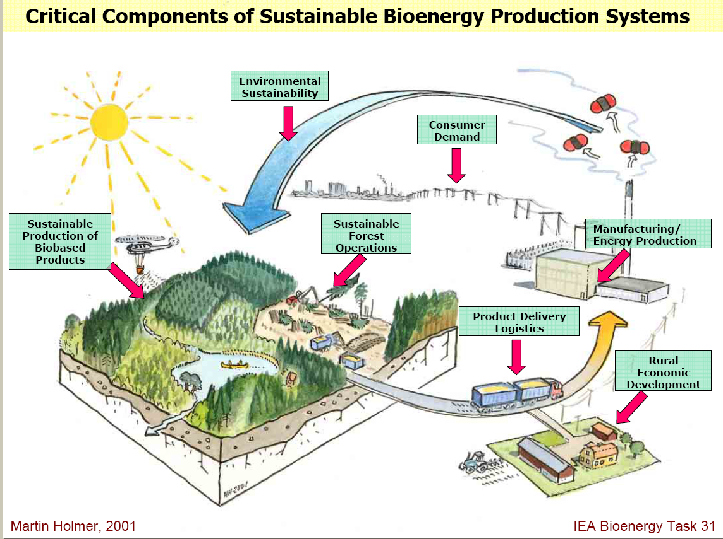
Greenhouse Gasses and Biofuels
Absorb CO2
Emit CO2
Please Pretend the growing stuff includes crops
Feedstocks take up CO2 when they grow then CO2 is emitted when feedstocks burned or when energy derivatives burned
But Starred areas also emit
In total they increase emissions but recycled on net
LCA accounts for total net offset
Source of underlying graphic: Smith, C.T. , L. Biles, D. Cassidy, C.D. Foster, J. Gan, W.G. Hubbard, B.D. Jackson, C. Mayfield and H.M. Rauscher, “Knowledge Products to Inform Rural Communities about Sustainable Forestry for Bioenergy and Biobased Products”, IUFRO Conference on Transfer of Forest Science Knowledge and Technology, Troutdale, Oregon, 10-13 May 2005

Slide 21
2011 Implementation of 2007 Energy Act
Last Nov. EPA finalized the 2011 RFS volume requirements reducing the requirements for cellulosic biofuels while maintaining the overall volume requirement.
Original goal 250 million is now reduced to 6.6-- a “high enough target to provide incentive for growth within the industry but low enough to balance the uncertainty”
In October, the EIA suggested that actual cellulosic biofuels production next year is likely to be 3.94 million gallons
EPA set a price of $1.13 for each 2011 cellulosic biofuel waiver credit, based upon an average gasoline price of $1.97 per gallon over 12 months.
EPA maintained overall volume requirement of 13.95 billion gallons.

Slide 22
Table 4. Percentage Reduction in Fossil Fuel Emissions by Alternative Biomass Energy Production.
Biofuels are big today address GHGs
Offset Rates Computed Through Lifecycle Analysis
Net Carbon Emission Reduction (%)
Crop ethanol<cellulosic<biodiesel<Electricity
Opportunities have different potentials
Ethanol offsets are in comparison to gasoline Power plants offsets are in comparison to coal.

Slide 23
2007 Energy Act
Imposes LCA requirements on eligible fuels.
Conventional Biofuels - ethanol from corn and facilities built since bill - 20% reduction no less than 10%.
Advanced Biofuels - other than ethanol from corn starch- at least 50% LCA minimum may be lowered to 40%
Cellulosic Biofuels -- LCA emissions at least 60% less - no lower than 50%
Biomass-Based Diesel -- at least 50% less LCA than diesel may be reduced to 40%.
Undifferentiated Advanced Biofuels - Other than corn ethanol derived from corn starch, has LCA at least 50% less than fuel replaced. Reducble to 40%
Bioelectricity has largely been left out of the story with some small research and development undertaken.

Slide 24
FASOMGHG Mitigation Options
Strategy Basic Nature CO2 CH4 N2O
Crop Mix Alteration Emis, Seq X X
Crop Fertilization Alteration Emis, Seq X X
Crop Input Alteration Emission X X
Crop Tillage Alteration Emission X X
Grassland Conversion Sequestration X
Irrigated /Dry land Mix Emission X X
Ferment Ethanol Production Offset X X X
Cellulosic Ethanol Production Offset X X X
Biodiesel Production Offset X X X
Bioelectric Production Offset X X X
Stocker/Feedlot mix Emission X
Enteric fermentation Emission X
Livestock Herd Size Emission X X
Livestock System Change Emission X X
Manure Management Emission X X
Rice Acreage Emission X X X
Afforestation Sequestration X
Existing timberland Manage Sequestration X
Deforestation Emission X
Forest Product Choice Sequestration X

Slide 25
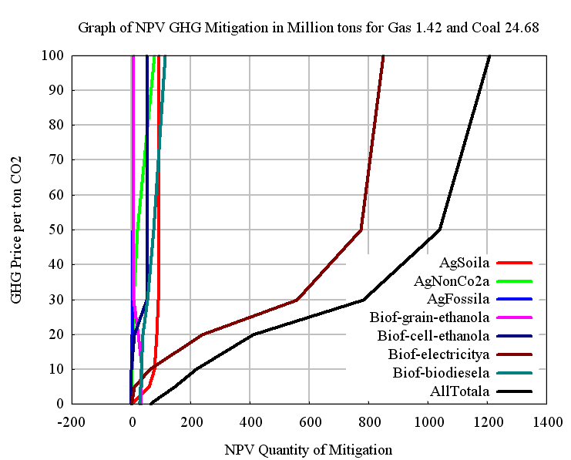
Portfolio Composition
Energy prices increases with CO2 price
Ag soil goes up fast then plateaus and even comes down
Why – Congruence and partial low cost
Lower per acre rates than higher cost alternatives
Biofuel takes higher price but takes off
Electricity gives big numbers due to plant expansion
Other small and slowly increasing

Slide 26
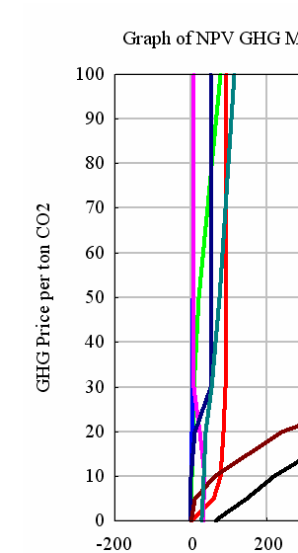
Liquid Portfolio Composition
Biodiesel
Cell Ethanol
Grain/Sug Ethanol

Slide 27
Some holes in LCA

Slide 28
Table 4. Percentage Reduction in Fossil Fuel Emissions by Alternative Biomass Energy Production.
Lifecycle Analysis
LCA is being expanded as we speak due to international leakage
Last 2 years have shown effect of higher crop prices on international activity

Slide 29
Food Prices, Incomes and Biofuels
Today food prices have increased quite a lot
  Corn is up by 2.5
  Rice has almost tripled but is not a biofuel crop
Why?
  Land competition – Biofuels
  Exchange rate
  Self sufficiency kick
  Strong export demand
  Bad yields and weather – climate change influence?
  Income and population growth
  Slowing technical progress
Will induce technical progress and land use change
We will produce our way partially out of this but it is likely demand here to stay

Slide 30
Table 4. Percentage Reduction in Fossil Fuel Emissions by Alternative Biomass Energy Production.
Lifecycle Analysis
LCA is being expanded as we speak due to international leakage
Last 2 years have shown effect of higher crop prices on international activity

Slide 31
Food Competition
Figure 1: Corn Production and use for ethanol 1980-2010
US Average Corn Price in $ per Bushel vs
Proportion of crop used for ethanol
Similarly soybean oil prices have changed

Slide 32
Food Prices, Incomes and Biofuels
Today food prices have increased quite a lot
  Corn is up by 2.5
  Rice has almost tripled but is not a biofuel crop
Why?
  Land competition – Biofuels
  Exchange rate
  Self sufficiency kick
  Strong export demand
  Bad yields and weather – climate change influence?
  Income and population growth
  Slowing technical progress
  Will induce technical progress and we will produce our way partially out of this but demand here to stay

Slide 33
Leakage
Price
P
SQ_{U}
TQ_{WM}
SQ_{ROW}
Quantity
US Market
World Market
Rest of World

Slide 34
Leakage
Price
P
SQ_{U}
SQ_{U}
TQ_{IT}
TQ_{IT}
SQ_{ROW}
SQ_{ROW}
Quantity
US Market
World Market
Rest of World
SQ_{ROW} - SQ_{ROW}
LEAK = 1-
SQ_{U} - SQ_{U}

Slide 35
Leakage
Cout/Cproj Leak GHG - Leak Discount
1 45% 55% (Only pay for ½)
2 91% 9% (Only pay for 10%)
0.5 23% 77% (Only pay for 3/4 )
Case 1 Emissions per acre of commodity prices = biofuel offset
Case 2 Emissions per acre of commodity prices = twice biofuel offset
Case 3 Emissions per acre of commodity prices = one half biofuel offset
Probably offsets gains for corn
Energy sorghum?

Slide 36
Leakage
Change in probability of forest
Change in Carbon
Source G.C. Nelson and R.D. Robertson, “Green Gold or Green Wash: Environmental Consequences of Biofuels in the Developing World” Paper prepared for ASSA 2008 Invited paper session “Biofuels-Long-Run Implications for Food Security and the Environment”. ASSA Meeting New Orleans, January, 2008 and forthcoming in Review of Agricultural Economics Run for Brazil with a 25 percent increase in the price of maize and a 10 percent increase in the price of sugar at exporting ports.

Slide 37
Leakage
Getting around this
Reducing land competition
Marginal lands
Higher yieds
Corn 150*2.8
Switch grass 6*100
energy sorghum 20*100
Complement
crop residue
Log residue
Complementary policy
Deforestation
Urban Poor
Trade

Slide 38
Food Prices, Incomes and Environment
Is rain forest deforestation bad?
What about providing better income potential in northeast Brazil or Rural Indonesia
Can policy address?
  May need a compensation policy to reflect our valuation – allow payment for avoided deforestation
  Allowing prices to transmit through to rural areas in countries with govenrment trading
  Will economics win?
  As population and food demand rises can we protect?
  Looks like US immigration policy

Slide 39
Sectoral Lifecycle Accounting
Corn ethanol from 15 to 18 billion gallons.
Soil carbon sequestration | -7.39
CH4 and N20 from animals | +7.18
CH4 and N20 – from crops | -5.98
Ag CO2 from Fossil fuel use | -3.80
Net offset when making Ethanol from grains | +80.6
Net offset when making Electricity from ag feedstocks | -7.65
Net offset when making Biodiesel from ag feedstocks | -2.55
Other miscellaneous | -0.08

Slide 40
Sheer Profitability
Lets look at soybean oil to biodiesel
Oil cost 1,208.43 per metric ton
Gallons per ton 287.14 gallons
Oil Cost $4.21 per gallon
Operating cost $0.50 per gallon
Cost of plant $1.00 per gallon
Total cost $5.71
Subsidy 1.00 so net is $.71
Sale price of diesel $3.40 – (-0.50 to retail)
Lesson may not be competitive

Slide 41
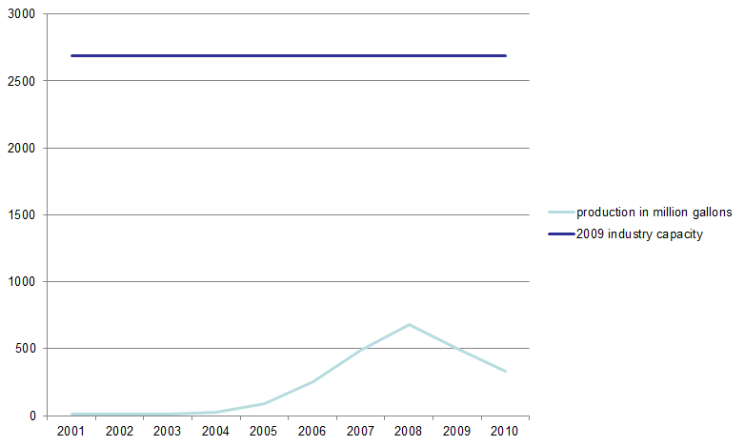
Sheer Profitability - Biodiesel
How viable is the industry – need new feedstock

Slide 42
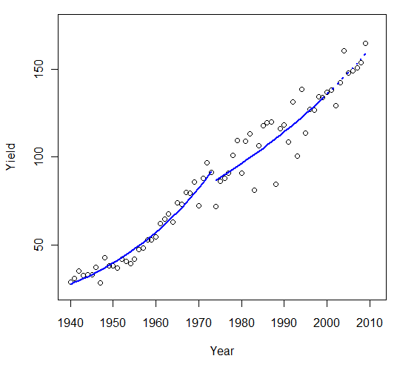
Crop Technology
People are observing that yield growth is falling off
Corn illustrates 3.7% before 1973, 1.7% since
Can we divert the land?

Slide 43
Technology
Most new biofuel forms lagging argued potential
Cellulosic
1973 statement
3% of goal
Money will help
Pyrolysis
Can we upgrade
Slow vs fast and energy/biochar
Cost is a factor
When will we develop full commercial production?

Slide 44
Big questions
Will society choose to reward biofuel carbon recycling?
Will energy prices remain high in short run?
Will ethanol and biodiesel subsidies persist?
When will cellulosic ethanol be producible at scale?
Can we increase energy recovery efficiency from biofeedstocks?
Will food technical progress remain high?
Will we think about this as we plot future of energy?
Will the science community expand the definition of biofuels away from corn ethanol?
Can we withstand current food price pressures?
Can we find a way to compensate for rainforest preservation?

Slide 45
For more information
http://agecon2.tamu.edu/people/faculty/mccarl-bruce/biomass.html

