Slide 1

Climate Change and Agriculture:
Mitigation Policy
Bruce A. McCarl
Distinguished Professor of Agricultural Economics,
Texas A&M University
Energy
Climate Change Adaptation
Climate Change Mitigation
Climate Change Effects
Class notes, March 2019

Slide 2
Role of Agriculture & Forestry
in GHG Mitigation
Four roles w.r.t. GHG emission reductions
  Emission reducers
  A carbon or GHG sequestering sink
  Offsetting net GHG emissions
  Operating in a mitigating world
In addition to emission reductions, also enhancement of sinks.
Society is searching for low cost emission reduction options.
First place they will look is energy sector - 80% of emissions.
Will only come to ag and forest if cheaper or otherwise attractive.
McCarl, B.A. , and U.A. Schneider, "US Agriculture's Role in a Greenhouse Gas Emission Mitigation World: An Economic Perspective", Review of Agricultural Economics, 22 (1), 134-159, 2000.

Slide 3
Greenhouse Gas Emissions
Sources

Slide 4
Agricultural Methane
Big Ag Emission accounts
  Manure emissions
  Enteric fermentation
  Rice cultivation
Mitigation Strategies
  Less rice acreage, dryout
  Fewer animals, diet
  Manure management
Other
Livestock Manure
Enteric Fermentation
Domestic Sewage
Coal
Rice Paddies
Landfills
Natural Gas
Biomass
Burning
Figure 1: World Anthropogenic Methane Emissions (IPCC 1996)

Slide 5
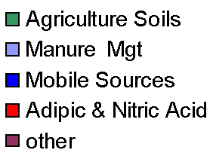
Agricultural Nitrous Oxide
Emission sources
De-nitrification
Air volatilization
Livestock manure
Mitigation Strategies
  Change of crop mix
  Less Nitrogen fertilization
  Choice between N-fertilizer types
  Animal reduction
  Manure management
Source: U.S. EPA
Figure 1: The U.S. Nitrous Oxide Emissions 1990-2005

Slide 6
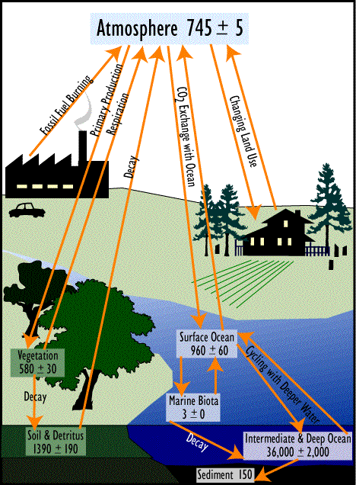
Sequestration and the Carbon cycle
http://www.cotf.edu/ete/modules/climate/GCcarbon1.html

Slide 7
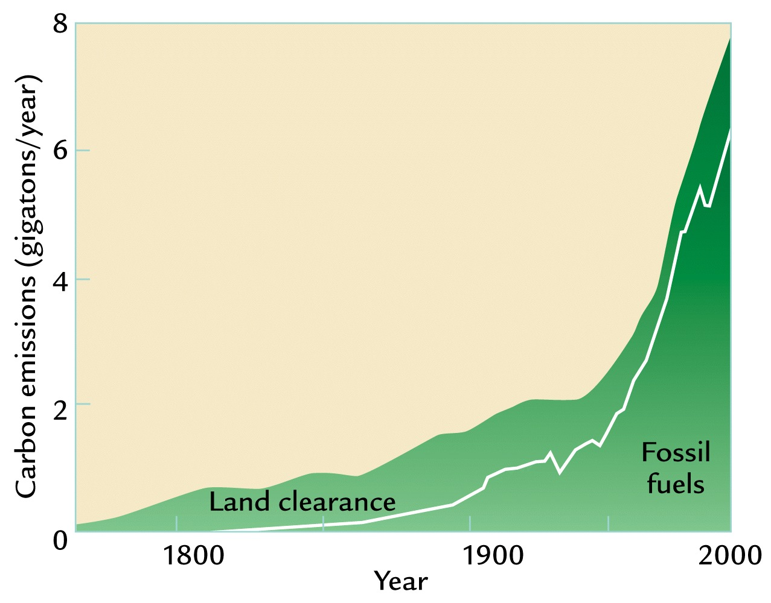
Land Use Change - Sequestration
Sequestration may have the potential to alleviate somewhere in the neighborhood of 25% of the historical atmospheric greenhouse gas accumulation.
Source: Apparently this was drawn from W. F. Ruddiman, 2001. Earth's Climate: Past and Future. W. H. Freeman and Sons, New York

Slide 8
Ag and Forest Mitigation Options
Strategy Basic Nature CO2 CH4 N2O
Crop Mix Alteration Emis, Seq X X
Crop Fertilization Emis, Seq X X
Crop Input Alteration Emission X X
Crop Tillage Alteration Emission X X
Grassland Conversion Sequestration X
Irrigated /Dry land Mix Emission X X
Biofuel Production Offset X X X
Stocker/Feedlot mix Emission X
Enteric fermentation Emission X
Livestock Herd Size Emission X X
Livestock System Change Emission X X
Manure Management Emission X X
Rice Acreage Emission X
Afforestation Sequestration X
Existing timberland Mgt Sequestration X
Deforestation Emission X

Slide 9
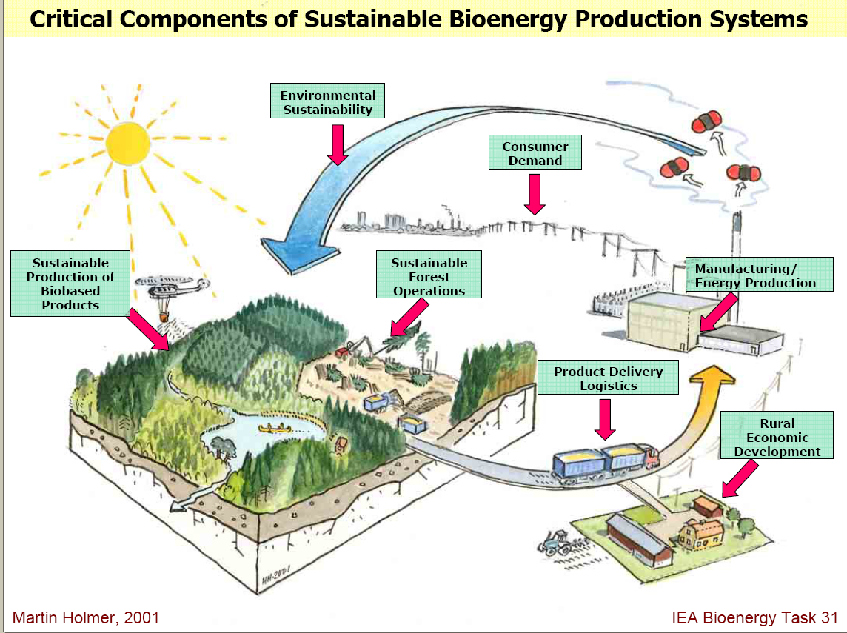
Greenhouse Gasses and Biofuels
Absorb CO2
Emit CO2
Please Pretend the growing stuff includes crops
Feedstocks take up CO2 when they grow then CO2 is emitted when feedstocks burned or when energy derivatives burned
But Starred areas also emit
In total they increase emissions but recycled on net
LCA accounts for total net offset
Source of underlying graphic: Smith, C.T. , L. Biles, D. Cassidy, C.D. Foster, J. Gan, W.G. Hubbard, B.D. Jackson, C. Mayfield and H.M. Rauscher, “Knowledge Products to Inform Rural Communities about Sustainable Forestry for Bioenergy and Biobased Products”, IUFRO Conference on Transfer of Forest Science Knowledge and Technology, Troutdale, Oregon, 10-13 May 2005

Slide 10
Table 4. Percentage Reduction in Fossil Fuel Emissions by Alternative Biomass Energy Production.
Biofuels are big today address GHGs
Offset Rates Computed Through Lifecycle Analysis
Net Carbon Emission Reduction (%)
Crop ethanol<cellulosic<biodiesel<Electricity
Opportunities have different potentials
Ethanol offsets are in comparison to gasoline Power plants offsets are in comparison to coal.

Slide 11
Mitigation Assessment
What do we want to know
  GHG reduction potential (Tons of carbon equivalent)
  Co benefits – income, cost reducing, water holding, soil conservation, water quality, biodiversity, etc.
  Economic and Social Considerations
        Cost-effectiveness
        GDP, jobs created or lost, implications for long-term development, etc.
        Differential impacts on countries, income groups or future generations

Slide 12
Issues in Mitigation Assessment
What do we want to know
  Institutional and Political Considerations
        Monitoring, enforcement issues and design
        Capacity to pass through political and bureaucratic processes and sustain political support
        Consistency with other public policies
Uncertainty
Mitigation portfolio establishment
Incentive needs and design

Slide 13
Multigas value
The EMF did a comparison between mitigating GHGs with CO2-only and multi-gasses. The results examined a scenario that attained a stabilization target that stabilized radiative forcing at 4.5 Wm-2 relative to pre-Industrial times by 2150.
They found show that under multi-gas mitigation versus CO2 only that the reductions are much cheaper if all are managed.
Carbon Permit Price (2000 $US/tCe)
Essentially, less costly reductions in NonCO2 gases are displacing more costly reductions in CO2 from the energy sector.
Source http://emf.stanford.edu/publications/emf_21_multigreenhouse_gas_mitigation_and_climate_policy/
 | 2025 | 2050 | 2075 | 2100
CO2 only | $101.3 | $314.2 | $406.2 | $877.0
CO2 plus non-CO2 | $57.8 | $158.7 | $241.8 | $480.3
% reduction | 48% | 41% | 23% | 39%

Slide 14
Dynamics and Saturation
Sequestration accumulates carbon until a new equilibrium is reached
West and Post find a 10-15 year period for tillage changes
Birdsey shows a longer period 30-70 years for forest carbon.
West and Post, Soil Science Birdsey et al, USFS, FORCARB
Note accumulation stops by year 20 Note equilibrium by year 80

Slide 15
Can We Identify Competitive Potential for U.S. Ag & Forest Options?
Example: U.S. ag soil potential:
500
Competitive
Potential
Economic
Potential
400
300
Technical
Potential
C price ($/tCeq)
200
100
0
0
20
40
60
80
100
120
140
160
Soil carbon sequestration (mmtce)
Source: B. McCarl and U. Schneider, presented at 2001 EPA-USDA Forestry and Agriculture
Greenhouse Gas Modeling Forum.

Slide 16
Dynamics
Cumulative Contribution at a $5 per tonne CO2 Price
Cumulative Contribution at a $50 Price
Note
Effects of saturation on sequestration
Growing nonco2 and biofuels
Cumulative Contribution at a $15 Price
Lee, H-C., B.A. McCarl, and D. Gillig, "The Dynamic Competitiveness of US Agricultural and Forest Carbon Sequestration", Canadian Journal of Agricultural Economics, 5, 343-357, 2005.

Slide 17
Leakage
Change in probability of forest
Change in Carbon
Source G.C. Nelson and R.D. Robertson, “Green Gold or Green Wash: Environmental Consequences of Biofuels in the Developing World” Paper prepared for ASSA 2008 Invited paper session “Biofuels-Long-Run Implications for Food Security and the Environment”. ASSA Meeting New Orleans, January, 2008 and forthcoming in Review of Agricultural Economics Run for Brazil with a 25 percent increase in the price of maize and a 10 percent increase in the price of sugar at exporting ports.

Slide 18
Science developments
To avoid saturation
Biotechnology plant breeding.
Biomass carbonization. Biochar and pyrolysis
Deep-Soil Sequestration.

Slide 19
Key Agricultural Economics Questions
What would it cost to achieve reductions in net GHG emissions by modifying agricultural practices, specifically those associated with more carbon sequestration, emissions reduction or offsets , relative to other mitigation options?
How does agricultural carbon sequestration carbon profile compare relative to other mitigation options?
What things do we need to consider in designing incentive and monitoring systems to cause agriculturally based carbon sequestration to occur at appropriate levels?
What are the economic welfare and environmental implications?

Slide 20
Mitigation Analysis Steps
Local
Regional
International
Global effects
Scope
of geographical
Effects
Only CO2
Only N2O
Only CH4
Other CFSs, etc.
All GHGs
Scope
of GHGs
Taxes
Subsidies
Trading
Etc.
Emission
Coefficients
Crop simulation
i.e. EPIC/CENTURY
Avoidance strategies
Policy
Instruments
Basic
Data
Alter relevant
Parameters
Select models
e.g. ASMGHG
FASOMGHG
Develop
Scenarios
Assess
Mitigation
Impacts
Physical
Economic
Environmental
Effects
Form
Decision
Making
Conduct
Comparative
Analysis
Criterion:
Ghg reduction,
eco/social
Considerations,
etc.

Slide 21
A Modeling Approach: FASOMGHG
Forest and Agricultural Sector Optimization Model with GHG effects (CO2, CH4, N2O)
Examines land-based GHG strategies
Considers saturation characteristics of both soils and forests (uses 30 years for ag soils, FORCARB model for forest soils and growth/yield characteristics of forests from USDA Forest Service)
100 year model, decadal time-step
Land exchanges in response to GHG prices, plus all the agricultural activities by decade

Slide 22
Scope
FASOM Basics
Forestland
Forest
Production
Biofuel/GHG
Demand
Cropland
Domestic
Demand
Water
Crop
Production
Markets
Labor
Export
Natl. Inputs
Processing
Import
Other Resources
Livestock
Production
Feed
Mixing
Pasture Land
AUM Grazing

Slide 23
Economic Scope
FASOM Basics

Slide 24
Ag Primary Commodities
Cotton , Corn , Soybeans , SoftWhiteWheat
HardRedWinterWheat , SoftRedWinterWheat , DurhamWheat , HardRedSpringWheat
Sorghum , Rice , Oats , Barley
Rye
,
AcreOatsGrazing , AcreWheatGrazing , AcreRyeGrazing
AcreOatsGrazeout , AcreWheatGrazeout , AcreRyeGrazeout , AcreImprovePasture
Silage , Hay
softwoodres , hardwoodres , softwoodpulp , hardwoodpulp
cornres , sorghumres , wheatres , oatsres
barleyres , riceres , softmillres , hardmillres
biomanure , beefbiomanure , dairybiomanure ,
Sugarcane , Sugarbeet
Potatoes , TomatoFrsh , TomatoProc , OrangeFrsh75box , OrangeFrsh90box , OrangeFrsh85box , OrangeProc75box , OrangeProc90box , OrangeProc85box , GrpfrtFrsh67box , GrpfrtFrsh85box , GrpfrtFrsh80box , GrpfrtProc67box , GrpfrtProc85box , GrpfrtProc80box ,
SwitchGrass , HybrdPoplar , Miscanthus
Willow , EnergySorghum , SweetSorghum , SweetSorghumR
NonFedSla , FeedlotBeefSlaughter, CalfSlaugh , CullBeefCo
Milk , CullDairyCows , HogsforSlaughter , FeederPig
CullSow , LambSlaugh , CullEwes , Wool
SteerCalve , HeifCalve , StockedCalf , StockedHCalf
StockedSCalf , DairyCalves , StockedYearling , StockedHYearl
StockedSYearl , HorsesandMules , Eggs , Broilers
Turkeys

Slide 25
Ag Secondary Commodities
OrangeJuic , GrpfrtJuic ,
SoybeanMeal , SoybeanMealeq , SoybeanOil ,
HFCS , Beverages , Confection
Baking , Canning , RefSugar ,
GlutenMeal , GlutenFeed , DDGExport , DDGcorn DDGnoncorn , DDGcornfrac , CornStarch , CornOil CornOilnonfood , CornSyrup , Dextrose ,
FrozenPot , DriedPot , ChipPot
FedBeef , NonFedBeef , Pork
Chicken , Turkey , WoolClean , FluidMilkwhol
FluidMilkLowFat , SkimMilk , Cream , EvapCondM
NonFatDryM , Butter , AmCheese , OtCheese
CottageChe , IceCream ,
CropEthanol , CellEthanol , Biodiesel , BiodieselWO Tot_Biodiesel , Tot_Ethanol , Tbtus ,
Bagasse , Lignin , LigninHardwood
LigninSoftwood , EdTallow , NonEdTallow , YellowGrease
SSPulp , TonsBiomassCTL , Lard , PoultryFat
CornforBeefCattle , CornforDairyCattle, CornforHogs , CornforPoultry
StockPro0 , CatGrain0 , HighProtCa , CowGrain0
CowHiPro0 , FinGrain0 , FinProSwn0 , FarGrain0
FarProSwn0 , FPGGrain0 , FPGProSwn0 , DairyCon0
BroilGrn0 , BroilPro0 , TurkeyGrn0 , TurkeyPro0
EggGrain0 , EggPro0 , SheepGrn0 , SheepPro0

Slide 26
Forest Commodities
SWSLOG_WOODS HWSLOG_WOODS SWPLOG_WOODS
HWPLOG_WOODS SWFLOG_WOODS HWFLOG_WOODS
SWLOGRES HWLOGRES
SLUM SPLY OSB
HLUM HPLY SWPANEL
HWPANEL SWMISC HWMISC
SRESIDUES HRESIDUES
HWPULP SWPULP AGRIFIBERLONG
AGRIFIBERSHORT OLDNEWSPAPERS OLDCORRUGATED
WASTEPAPER PULPSUBSTITUTE HIGDEINKING
NEWSPRINT UNCFREESHEET CFREESHEET
UNCGROUNDWOOD CGROUNDWOOD TISSUE
SPECIALTYPKG KRAFTPKG LINERBOARD
CORRUGMED SBLBOARD RECBOARD
CONSTPAPER DISPULP SWKMPULP
HWKMPULP RECMPULP CTMPMPULP

Slide 27
Commodity | CropEthanol | CellEthanol | Biodiesel |  | Tbtus
Corn | X
SoftWhiteWheat | X
HardRedWinterWht | X
SoftRedWinterWhat | X
DurumWheat | X
HardRedSpringWht | X
Sorghum | X
Rice | X
Oats | X
Barley | X
softwoodres |  | X |  |  | X
hardwoodres |  | X |  |  | X
softwoodpulp |  | X |  |  | X
hardwoodpulp |  | X |  |  | X
cornres |  | X |  |  | X
sorghumres |  | X |  |  | X
wheatres |  | X |  |  | X
oatsres |  |  |  |  | X
barleyres |  | X |  |  | X
riceres |  | X |  |  | X
softmillres |  | X |  |  | X
hardmillres |  | X |  |  | X
biomanure |  |  |  |  | X
beefbiomanure |  |  |  |  | X
dairybiomanure |  |  |  |  | X
SwitchGrass |  | X |  |  | X
Miscanthus |  | X |  |  | X
HybrdPoplar |  | X |  |  | X
Willow |  | X |  |  | X
EnergySorghum |  | X |  |  | X
SweetSorghum | X
SoybeanOil |  |  | X
RefSugar | X
CornOil |  |  | X
CornOilnonfood |  |  | X
CanolaOil |  |  | X
Bagasse |  | X
EdTallow |  |  | X
NonEdTallow |  |  | X
SSPulp |  | X
Lard |  |  | X
Bio Energy Pathways

Slide 28
Regions
Pacific Northwest
West
East
Lake States
Great Plains
Northeast
Pacific Southwest
Rocky Mountains
Corn Belt
South West
Southeast
South Central

Slide 29
Land Dimensions
FASOM land values
Ag Land Types
Cropland , CropLandPasture
Rangeland ForestPastureinforest
ForestPastureinpublic, ForestPastureinag
Forest Land Classes -- FORONLY, FORCROP, FORPAST, CROPFOR, PASTFOR
Forest Site Quality -- HI, ME, LO
Forest Age Cohorts of trees
0TO4 , 5TO9 , 10TO14 , 15TO19 , 20TO24 , 25TO29 , 30TO34 , 35TO39
40TO44 , 45TO49 , 50TO54 , 55TO59 , 60TO64 , 65TO69 , 70TO74 , 75TO79
80TO84 , 85TO89 , 90TO94 , 95TO99 , 100PLUS, 85PLUS , 90PLUS
Forest Owners -- FI , OP
Forest Types -- DOUG_FIR , NAT_PINE , OAK_PINE , OTH_SWDS , PLNT_PINE,
PLT_PINE , SOFT BOT_HARD , HARD , UP_HARD
Forest Management Intensity Classes MICs
TRAD_PLNT_PINE PLNT_LO_THIN PLNT_MED PLNT_MED_THIN
PLNT_HI PLNT_HI_THIN SHORT_ROTSWDS RESERVED
PASSIVE PART_CUT_LO LO , PART_CUT_HI
PART_CUT_HI+ AFFOR NAT_REGEN , NAT_REGEN_THIN PLANT_THIN PLANT+ NAT_REGEN_PART_CUT_LO , affor_CB
NAT_REGEN_PART_CUT_MED NAT_REGEN_PART_CUT_HI , LO_PART_CUT

Slide 30
World trade
FASOM Trade ag
26
23
22
27
21
26
20
19
8
10
13
12
25
2
7
6
14
16
5
11
15
1
29
3
28
15
17
30
FASOM has international explicit supply and demand curves for corn, 5 types of wheat, soybeans, rice and sorghum across the above regions. Production and trade are modeled with 11 major US regions where the region trades the commodity. FASOM also maintains transportation costs between all regions. The model determines exports to the point where prices are in equilibrium considering transport across all markets. Other commodities through excess demand.
Forest by 11 trading regions plus canada

Slide 31
Greenhouse gas emissions
Forest_SoilSequest , Forest_LitterUnder , Forest_ContinueTree
Forest_AfforestSoilSequest , Forest_AfforestLitterUnder , Forest_AfforestTree
Forest_USpvtProduct , Forest_USpubProduct , Forest_CANProduct
Forest_USExport , Forest_USImport , Forest_USFuelWood
Forest_USFuelResidue , Forest_USresidProduct , Forest_CANresidProduct
Carbon_For_Fuel ,
Dev_Land_from_Ag , Dev_Land_from_Forest
AgSoil_CropSequest_Initial , AgSoil_CropSequest_TillChange , AgSoil_CropSequest_CropChange
AgSoil_PastureSequest ,
Carbon_AgFuel , Carbon_Dryg
Carbon_Fert , Carbon_Pest , Carbon_Irrg
Carbon_Ethl_Offset , Carbon_Ethl_Haul , Carbon_Ethl_Process
Carbon_CEth_Offset , Carbon_CEth_Haul , Carbon_CEth_Process
Carbon_CEth_Residue_Offset , Carbon_CEth_Residue_Haul , Carbon_CEth_Residue_Process
Carbon_BioElec_Offset , Carbon_BioElec_Haul , Carbon_BioElec_Process
Carbon_BioElec_Residue_Offset , Carbon_BioElec_Residue_Haul , Carbon_BioElec_Residue_Process
Carbon_Biodiesel_Offset , Carbon_Biodiesel_Haul , Carbon_Biodiesel_Process
Methane_Liquidmanagement , Methane_EntericFerment , Methane_Manure
Methane_RiceCult , Methane_AgResid_Burn , Methane_BioElec
Methane_Biodiesel , Methane_Ethl , Methane_CEth
NitrousOxide_Manure , NitrousOxide_BioElec , NitrousOxide_Biodiesel
NitrousOxide_Ethl , NitrousOxide_CEth , NitrousOxide_Fert
NitrousOxide_Pasture , NitrousOxide_Sludge , NitrousOxide_Nfixing
NitrousOxide_CropResid , NitrousOxide_Histosoil , NitrousOxide_Volat
NitrousOxide_Leach , NitrousOxide_AgResid_Burn

Slide 32
Assumptions
Brief overview of the assumptions (Do you have a month?)
FASOMGHG is multiperiod, intertemporal, price-endogenous, mathematical programming model
Depicts land transfers and other resource allocations between and within the agricultural and forest sectors in the US.
Model solution portrays simultaneous market equilibrium over an extended time - 70 to 100 years on a five-year time step
Results from FASOMGHG yield a dynamic simulation of
prices, production, processing,
consumption, exports, imports
GHG effects, other environmental indic.
economic indicators
Under scenario depicted in the model data.

Slide 33
Assumptions
FASOMGHG programming model encompasses four submodels and an integrating objective function:
Forestry sector – Forest production, manufacturing, input supply, consumption, interregional transport, international trade, and terminal inventory valuation.
Agricultural sector – Crop and livestock production, processing, feed blending, factor supply, consumption, interregional transport and international trade.
Intersectoral transfers – Transfers of land and commodities between the forestry and agricultural sectors.
GHG submodel – Covers GHG accounting and payments
Integrating objective function – Net present value of consumers' and producers' surplus across all four submodels

Slide 34
Assumptions
Math Programming – Basic Structure
A number of different firms/farms/forests (β) are modeled.
Each has a finite set of production processes (k) which depict particular ways of combining fixed factors (j) with purchased factors (i) to produce commodities (h).

Slide 35
Assumptions

Slide 36
Assumptions
Given multiyear timber production, FASOMGHG needs to handle economic returns over time.
Solves multiple interlinked market equilibria in adjacent five-year periods for model duration, rather than single period .
Objective function depicts maximization of the net present value of producers' and consumers' surpluses, across both agricultural and wood products.
First-order conditions set cost equal to expected price taker revenue
Optimizing nature of the model holds that producers and consumers' have perfect foresight.

Slide 37
Assumptions
Forest tree growth model is harvest in a 5 year period. Ag is harvest in a typical year during the period as is Forest processing and consumption.
Thus terms in obj get multiplied by value of a constant return over a 5 year period. (model_structure.gms)
sum(period,
(disc(period)
*annuitywt(period,"agriculture"))*(
Ag obj...)
.

Slide 38
Assumptions
Given finite time period (e.g., 70-100 years), there will be immature trees of some age at the end of the time period modeled.
Model must place a value on these forests or it would deplete timber at end of modeled period.
Similarly, agricultural land values at end of the period must reflect future use to ensure that land is not inappropriately converted.
To counter terminal conditions are imposed that value ending immature trees and land remaining in agriculture.

Slide 39
Model Outputs
Social Welfare
Consumer Surplus
Producer Surplus - Net Income
Foreign Surplus
Government Payments
Deficiency Payments
Marketing Loan Payments
Primary Production
Quantities, Prices
Exports, Imports
Processing Use
Program Participation
Secondary Production
Quantities, Prices
Exports, Imports
Factor Inputs
Labor: Family and Hired
Use and Wage
Water: Surface and Pumped
Use and Values
Land: Cropland, Pasture, AUMS
Use and Rental Rate
Harvested Acreage
Dryland, Irrigated, Diverted
National Input Use
Quantity and Cost
Soil Erosion
Water (USLE), Wind
Water Sediment Delivery

Slide 40
What are the strengths and weakness of the FASOM model in addressing major increases in biofuels over the next decade or two?
Strengths
Comprehensiveness
Trees and crops
Domestic land use competition
Hauling, storage and biofuels
GHG Accounting
Weaknesses
Cellulosic
Transaction cost
Uncertain Cap and Trade
Climate change
Foreign GHGs
Data
Tech change

Slide 41
Portfolio
MMt arising at an offset price giving $/tonne carbon equiv
Small importance of CH4 and N2O
Different strategies dominate at different price levels

Slide 42
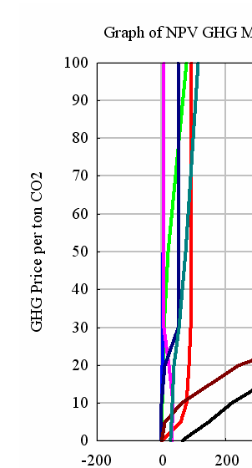
Liquid Portfolio Composition Ag Only
Biodiesel
Cell Ethanol
Grain/Sug Ethanol

Slide 43
· ASMGHG: GHG Features
·
Major findings – Dynamic role of strategies
Source: Lee, Heng-Chi, An Economic Investigation of the Dynamic Role for Greenhouse Gas Emission Mitigation by the U.S. Agricultural and Forest Sectors , PhD Dissertation, Texas A&M University,December 2002

Slide 44
· ASMGHG: GHG Features
·
Major findings – Dynamic role of strategies
Time from now
O to30 years >30 years
Limited forest and afforest
Non co2
Bio fuels
Non co2
Ag soils
Limited forest and afforest
Non co2
Limited Ag soils
Forest and afforest
Biofuels
Non co2
<$50/metric ton >$50/metric ton
Level of Price

Slide 45
Research Insights – Economic and Environmental Impacts
Tradeoff between carbon and traditional production – prices rise
Consumers lose
Producers gain (co-benefits)
Environmental gains (co-benefits)
High carbon prices erode co-benefits due to intensification

Slide 46
What issues might IAM modelers consider?
Regional heterogeneity
Regional Shares of Agricultural Soil Carbon Sequestration

Slide 47
What issues might IAM modelers consider?
Regional heterogeneity

Slide 48
What issues might IAM modelers consider?
Undesirableness of sequestration only modeling
Example: U.S. ag soil potential:
500
Competitive
Potential
Economic
Potential
Technical
Potential
400
C price ($/tCeq)
300
200
100
0
0
20
40
60
80
100
120
140
160
Soil carbon sequestration (mmtce)

Slide 49
Research Insights – Ag Soil Results
Ag-Soil sequestration gets bigger then becomes smaller
    Land use & management
    Other things yield more carbon (Ag soils ~0.30 tonnes/acre ala West and Post. Biofuels 2+, Trees 3+, but to get these we give up some traditional ag commodities.)
    Agricultural Intensification

Slide 50
What issues might IAM modelers consider?
Substitution with traditional production
– short and long run
Production Quantity Index over Time
Crops Livestock
120
100
Index (Baseline = 100)
80
$1
$5
$15
$30
$50
60
2010
2020
2030
Year
2040
2050
2060
Substitutes

Slide 51
U.S. Cropland over Time

Slide 52
What issues might IAM modelers consider?
Substitution with traditional production
– short and long run
Near term Substitutes, Long Run Complement

Slide 53
Findings
GHG mitigation competitive with Current Production
Price implications are substantial
Ag and forest income will increase
Consumers will pay
Big opportunities Afforestation, Bio electricity, Ag soil management, Forest management, Fossil fuel use
Leakage/indirect land use is a factor need global accounting and more than what lifecycle does
GHG prices move us away from current ethanols

Slide 54
Making it happen

Slide 55
Forms of Legislation
Energy Bill
Cap and trade Bills/Policies
State and Local
Federal
International
Clean Air Act

Slide 56





State And Regional Initiatives
From Lydia Olander RECENT EFFORTS IN US CLIMATE POLICY: IMPLICATIONS FOR FORESTRY AND AGRICULTURE, presented at 5th Forest and Agriculture Greenhouse Gas Modeling Forum April 2009
Notes:
56
CA – AB32
RGGI – State laws
CCAR - forest, soil carbon, and livestock methane reporting and verification protocols.
WCI- GHG calculation protocols for pulp and paper industry, nothing on agriculture.
MGGRA- No specific mention of forestry or ag projects/protocols.
RGGI- developed verification standards for sequestration of carbon due to afforestation and avoided methane emissions from agricultural manure management operations
Alberta - lots
CCX- Agricultural Methane- Eligible systems include covered anaerobic digesters, complete-mix, plug flow digesters, as well as covered lagoons.
Agricultural Soil- Eligible agricultural soil carbon sequestration projects include continuous conservation tillage and grass planting.
Forestry- Eligible projects on CCX may exist under all four of the mitigation measures outlined by the Intergovernmental Panel on Climate Change (IPCC)

Slide 57
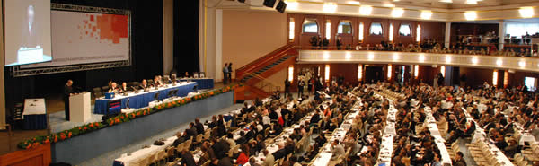



International Policy
Annex 1 targets
Developing country participation
REDD
CDM
US Critical
CONFERENCE OF THE PARTIES- December
From Lydia Olander RECENT EFFORTS IN US CLIMATE POLICY: IMPLICATIONS FOR FORESTRY AND AGRICULTURE, presented at 5th Forest and Agriculture Greenhouse Gas Modeling Forum April 2009
Notes:
Post 2012 targets for Annex 1 countries – How stringent?
Participation of developing countries, particular fast growing economies – China and India – How bring in these countries in a meaningful way – Sectoral caps?
REDD _ How to bring in tropical deforestation in a meaningful way
Changes to CDM (A/R)
57

Slide 58
Clean Air Act and Policy
Two years after a Supreme Court decision ordering the EPA to decide how to approach greenhouse gas emissions under the Clean Air Act, the Agency issued proposed findings that the gasses endanger public health, and that emissions from automobiles contribute to this form of pollution on April 17
EPA identifies six key greenhouse gasses: carbon dioxide, methane, nitrous oxide, hydrofluorocarbons, perfluorocarbons, and sulfur hexafluoride.
It lists a host of environmental and health impacts, such as rising sea levels, changes in precipitation patterns and associated water shortages, extensive tree die-offs and forest fires, extended heatwaves, and intense precipitation events. For anyone who doesn't buy the scientific community's general agreement that greenhouse gasses can force the climate, the document mentions the ocean acidification caused by increases in atmospheric carbon dioxide.
The EPA is soliciting public feedback for the next 60 days, and will hold two public hearings before finalizing the decision.
http://epa.gov/climatechange/endangerment.html

Slide 59
Markets versus taxes
Program characteristics

Slide 60
Markets versus taxes - Generalities
In general pollution costs are typically not fully considered by the emitting decision maker.
Thus often too much pollution is being emitted and it is judged desirable to reduce emissions.
Three approaches have evolved to fix this
  Limit maximum allowable pollution by individual
  Tax emissions by individuals
  Cap total emissions and allocate emission permits to individuals allowing them to trade.

Slide 61
Markets versus taxes - Generalities
The latter two (tax and cap/trade) are generally preferred in the us as they provide incentives for and rewards to reduce pollution.
Basically both aim to reduce pollution,
  the tax by placing the pollution cost as a burden on the producer
  the cap and trade by limiting total emissions and then passing the burden through the market.
so let us explore these two forms

Slide 62
Tax characteristics
First the tax
  Levied against emissions
  Money to the government can redistribute but transactions costs
  Reduce pollution if reduction cost < than tax
  Keep emitting if reduction cost > tax but incentive to reduce
  Will not stimulate sequestration in absence of credit
  If cost of emissions reduction < tax may do nothing but could get a tax credit if defined
  May need emissions grandfathering and tax above that
  Magnitude of emissions reduction is uncertain

Slide 63
Cap and Trade Market characteristics
Now cap and trade
  Total cap on emissions
  Would need development of a credit for sequestration
  Firms with expensive emission reduction costs could buy from firms with cheap cost and have incentive to reduce
  Would create least cost reductions for emission cap level
  Money stays in private hands
  Incentive to reduce if cost < market price and firm gains a valuable salable commodity
  Emission reduction is certain cost/unit is uncertain
  Place of emission reductions uncertain
  SO2 example – power plants
  Chosen Kyoto mechanism

Slide 64
What might be covered and how
Some generalities and cases

Slide 65
Markets versus taxes – Some Cases
Manure lagoon that could be covered with methane recovery system
  Carbon/GHGs arises
    Methane emissions that are destroyed (revenue source)
    Carbon emissions when methane burned, capital cost (cost source)
    A possible offset of fossil fuel (revenue source)
  Under tax
    Without grandfathering methane emissions would be taxed.
    Reduce if covering is cheaper than tax.
    Money to government
    If covering cost < tax might reduce too much but only gain tax
    Could increase operation size but would have to pay for emissions
  Under cap and trade
    Would have rights to emit
    Could do nothing and have business as usual
    Could cover lagoon reducing emissions and sell permits if cost of covering was cheaper than cap and trade market price
    If covering a lot less might reduce too much but only gain tax savings
    Could increase operation size but would have to buy permits

Slide 66
Markets versus taxes – Some Cases
Farmer producing switchgrass as a biofuel feedstock
  Carbon/GHGs arises
    As sequestration in soil (revenue source)
    As emissions from N application (N2O), equipment (cost source)
    As offset of fossil fuel (revenue source)
  Under tax
    Without grandfathering pay for fuel and N emissions when buying
    Might experience reductions from prior land use and this is a savings
    Sequestration revenue would require a credit provision
    Money to government
    Biofuels not a credit but added revenue through higher switchgrass price if switchgrass combustion/fuel emissions are exempted from tax
  Under cap and trade
    Would probably pay for permits when buying diesel and fertilizer
    Might experience reductions from prior land use and this may be a savings
    Sequestration would be salable if rules allow
    Money to permit seller or from buyer
    Not saleable as credits, higher switchgrass price if use exempted from cap

Slide 67
Markets versus taxes – Some Cases
Farmer changing tillage to less intensive
  Carbon/GHGs arises
    As sequestration In soil (revenue source)
    As emissions from equipment and N use (cost source)
    As reduced emissions from equipment (revenue source)
  Under tax
    Without grandfathering would pay for equipment and N application emissions probably when buying diesel and fertilizer
    Might experience reductions from prior land use - a savings
    Sequestration revenue would require a credit provision
    Money to government but savings to farmer
  Under cap and trade
    Would probably pay for permits when buying diesel and fertilizer
    Might experience reductions from prior tillage - a savings
    Sequestration credits would be salable if rules allow
    Money to farmer as permit seller

Slide 68
Arguments from Advocates

Slide 69
For an incentive
Whether it be a tax or Cap/trade
  Need price to provide a strong incentive for emission reduction
  Voluntary does not get us there
  Stabilization takes 20 times Kyoto volume – time to get on with it
  Irreversibilities

Slide 70
For a tax
(from Mankiew, New York Times – Harvard and former CEA chair)
  Government needs tax revenue can do good with it by redistributing to reduce tax burden
  Car standards too expensive, efficient cars stimulates driving
  Cap and trade depends on how permits allocated, would mainly go to energy/power companies
  Energy cost would rise, no revenue to compensate
  Tax could be better internationally as China et al could be included, not exempted (Kyoto failure), easier to negotiate
  May be politically acceptable and implementable

Slide 71
For cap and trade plus market
(from House committee on Energy and Commerce)
  Point of regulation can be set where appropriate (refiners, power plants), may allow coverage of small sectors
  Certainty in level of emission reductions
  Produces emissions at lowest cost
  Rewards innovation
  Comprehensive, avoids leakage
  Can be complemented with R&D and other programs
  Ag too small with too many emitters to include
  Money stays in private hands, more efficient (added)

Slide 72
What might hit or miss
Sequestration
Measurement and monitoring takes effort
Unlikely under tax
?? Under cap and trade
Manure lagoons and enteric (“too small?”)
Per head tax?
Need rules for cap and trade
Biofuels
Need exemption under both
Value passed through
Fertilizer (“too small?”)
N2o is uncertain
Emission rating per unit N acquired
Fossil fuel
Tax at pump
emissions cap at refiner/distributor – cost passed through

Slide 73
Effects of such a
tax or market on agriculture

Slide 74
Will a tax or market mean money for producers
Cost sources
fossil fuel use, fertilizer use, enteric fermentation, rice, manure, deforest, break out land
Revenue sources
Sequestration, biofuel offsets
Results show for moderate tax offset revenue exceeds cost given grandfathering

Slide 75
Concerns the Farm Sector
Might Have
Or
Items to Possibly
Work on

Slide 76
Concerns as Market/Tax Evolves
Will tax policy or market have provisions for sequestration or manure lagoon covering?
Will biofuels use have emissions or use exempted?
If a tax is defined will there be a given level of deduction or a compensation scheme for historic energy use?
Should N2O from fertilizer be included? Enteric fermentation? Rice?
Is ag too small to be a player?
If ag is too small will it still face elevated energy prices?
If permits are upstream will ag get credits or grandfathering?
If we sell sequestration what happens to property rights, long run land use options and ability to cut down trees or breakout land?

Slide 77
Problems

Slide 78
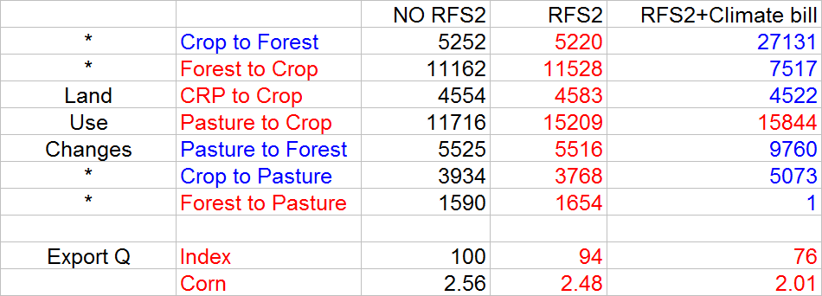
Policy tensions
Ordinarily
Red items regarded as carbon sequestration reducing
Blue items regarded as carbon sequestration increasing
Colors for numbers are relative to NO RFS2

Slide 79
Why do we care about ILUC
Market reaction to diversion of commodities
Actions in one country offset by actions elsewhere
Leakage
Less exports/more imports lead to shifts in ROW
Also food prices, poor and the environment

Slide 80
Why do we care about ILUC
Policy desires
energy security
GHG/climate change
Cheap energy
Policy at biofuels not reflective of all of above
How to patch to consider GHGs
Feeling that all biofuel possibilities are not same in
leakage and LUC
Policy issue is how to favor items with less leakage

Slide 81
Leakage
Economists reinventing the wheel in biofuels
Trade diagram – excess supply and demand
Actions in one country affect activity elsewhere
Leakage in international GHG negotiations context
Two recent papers in Science that say replacement production use offsets GHG gains

Slide 82
Leakage basics
Price
P
SQ_{U}
TQ_{WM}
SQ_{ROW}
Quantity
US Market
World Market
Rest of World

Slide 83
Leakage for an exporter (US)
Price
P
SQ_{U}
SQ_{U}
TQ_{IT}
TQ_{IT}
SQ_{ROW}
SQ_{ROW}
Quantity
US Market
World Market
Rest of World
SQ_{ROW} - SQ_{ROW}
LEAK = 1-
SQ_{U} - SQ_{U}

Slide 84
Leakage for an importer (EU)
Price
P
SQ_{ROW}
SQ_{ROW}
TQ
TQ
SQUK
SQ_{UK}
Quantity
ROW Market
World Market
UK
SQ_{ROW} - SQ_{ROW}
LEAK = 1-
SQ_{UK} - SQ_{UK}

Slide 85
Does Leakage happen
yes
CRP case - Wu found that under US conservation reserve program, that about 20% of the reserved acres were replaced by additional acreage moving into the cropland category
Tree Planting Lee, Kaiser and Alig (1992) examine U.S. tree planting programs and find that government subsidized tree planting programs lessen private tree planting.
Farm Program setside Hoag, Babcock, and Foster (1993) , Brooks, Aradhyula, and Johnson (1992) and Rygnestad and Fraser (1996) all found that acreage reductions were larger than production reductions because of retirement of less productive lands.
Reduced deforestation Pacific Northwest public lands harvest reductions in the 1990s were matched by accelerated rates of harvest in Pacific Northwest private lands, Canada and Southern U.S. (See Wear and Murray (2001) and Murray, McCarl and Lee (2002) who treat this case deriving leakage estimates in the neighborhood of 85%)

Slide 86
Economic and other principles about ILUC
Ignoring it may seal doom of biofuels
it is a factor and politically we cannot ignore it
how can it be specified to do best job of making a GHG difference in biofuels policy
we need a carbon market and then we could ignore
partial coverage of carbon market causes leakage
biofuel opportunities are heterogeneous in leakage
the lesser the market effect the lesser the leakage

Slide 87
Economic and other principles about ILUC
Leakage is multi commodity, multi country force
us corn diversion raises corn production in ROW and raises implicit GHGs in world traded corn
Cant border correct only on biofuels other commodities involved
EU leakage likely manifest in greater imports (biofuel and traditional commodities) from elsewhere with land clearing etc
UK leakage likely manifest in less exports with other countries filling the gap

Slide 88
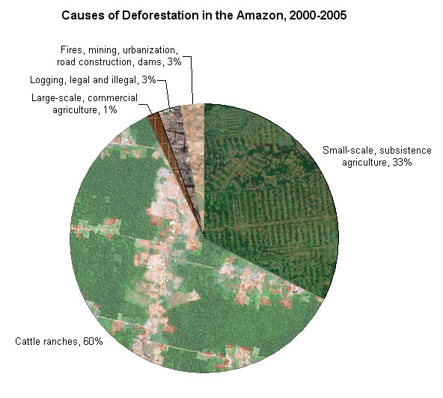
Why talk about Brazil and rainforest
Note crops displace pasture which
moves livestock which is big source
of rainforest displacement
TROPICAL RAINFORESTS: Deforestation in Brazil,
http://www.mongabay.com/brazil.html

Slide 89
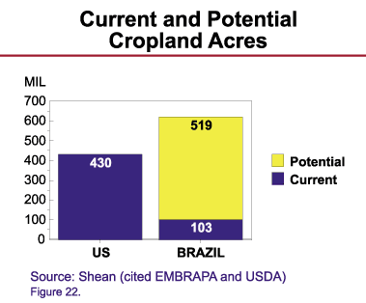
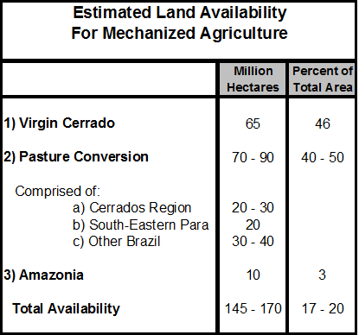
Brazil What Could Happen
Michael J. Shean, “Brazil: Future Agricultural Expansion Potential Underrated,” USDA Foreign Agricultural Service, January 21, 2003. www.ag.ndsu.edu/pubs/agecon/market/eb79w.htm

Slide 90
Food Prices, Incomes and Environment
Is food price induced rain forest deforestation bad?
In wealthy western eyes yes
What about in northeast Brazil or Rural Indonesia
  Two of the most impoverished areas on the globe
  Rain forest does not now provide a large source of income.
  When agricultural prices / market access rise leads to cutting to exploit income possibilities and improve rural life
Classic Conflict of western (rich) values vs local (poor) interests

Slide 91
References
Gillig, D., B. A. McCarl, and R. Sands, “Integrating Agricultural and Forestry GHG Mitigation Response into General Economy Frameworks: Developing a Family of Response Functions”. Working Paper #1016, Department of Agricultural Economic, Texas A&M University, College Station, TX
Jerko, C. “The Economic Potential of Production Energy From Agricultural Biomass.” Master Thesis, Department of Agricultural Economic, Texas A&M University, College Station, TX
McCarl, B. A., and Uwe A. Schneider, U.S. Agriculture’s Role Greenhouse Gas Emission Mitigation World: An Economic Perspective, Review of Agricultural Economics 22(1), 134-159, 2000.
McCarl, B. A., D. M. Adam, and R. J. Alig, “Analysis of Biomass Fueled Electrical Power Plants: Implications in the Agricultural & Forestry Sectors. Annuals Of Operations Research 94 37-55, 2000.
http://ageco.tamu.edu/faculty/mccarl/papers/htm

