Slide 1
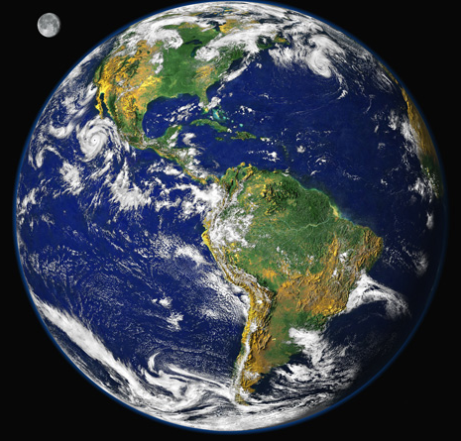
Climate Change Mitigation
Bruce A. McCarl
Distinguished Professor of Agricultural Economics
Texas A&M University mccarl@tamu.edu
http://agecon2.tamu.edu/people/faculty/mccarl-bruce/
Climate Change Adaptation
Energy
Climate Change Mitigation
Climate Change Effects

Slide 2
Mitigation
from IPCC WGIII Glossary Mitigation is human intervention to reduce the sources or enhance the sinks of greenhouse gases.
I think the definition is too narrow as geoengineering and other forms of reducing drivers are also relevant
Mitigation (McCarl)
A human intervention to reduce the extent of climate change by limiting drivers (anthropogenic GHGs, reducing incoming radiation, increasing reflectivity ….).
Anthropogenic - of, relating to, or resulting from the influence of human beings on nature

Slide 3
Why Might We Mitigate?
Greenhouse gas forcing is causing climate change
Lagged time between action and response
Compliance with International agreements under UNFCCC – Paris Agreement
Domestic policy moves
International pressures for emission reduction
Industry planning under uncertainty
Need for cheap emission offsets
Congruence of programs with other agriculturally related societal desires such as farm income support and water quality protection. Plus development of another market for farm products

Slide 4
Why is mitigation challenging
High interrelationship between income growth and fossil fuel use -- in turn emissions
Large areas of the world are rapidly expanding economically and with that comes emissions
Power plants, cars, industrial equipment etc. are expensive long lived and will only be replaced slowly over time
We must drop to zero net emissions to stabilize
While geoengineering could reduce trapped radiation it does not help other effects like ocean acidification
Large inventory of cheap fossil fuels
Mitigation requires changes in ways we do things that can be expensive

Slide 5
GHG concentrations
and the climate

Slide 6
Key Concepts
Climate Change is a global commons problem that implies the need for international cooperation in tandem with regional policies.
Because the emissions of any agent affect every other, an effective outcome will not be achieved if individual agents advance their interests independently of others.
International cooperation can contribute
Research and development in support of many forms of mitigation is a public good, which means that international cooperation can play a constructive role in the coordinated development and diffusion of technologies.
Idividual investments are likely too low
This gives rise to separate needs for cooperation on R&D, opening up of markets, and the creation of incentives to encourage private firms to develop and deploy new technologies and households to adopt them.

Slide 7
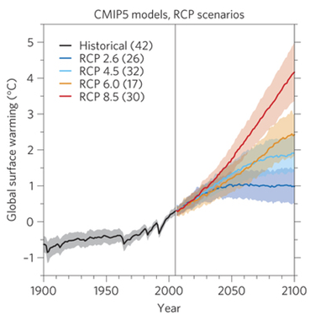
Effects of Mitigation
Lag until effectiveness
4°
2°
Inevitable amount
What we have seen so far
Era 1
Era 2
Source : IPCC AR5

Slide 8
The world is beginning to take action
on mitigation and adaptation
Energy will be affected

Slide 9
History -International Agreements on Mitigation
UNFCCC : United Nations Framework Convention on Climate Change
  Adopted on May 9, 1992 and ratified by 176 governments worldwide as of October 1998
  Developed plans for responding to climate change “... to achieve ... stabilization of greenhouse gas concentrations in the atmosphere at a level that would prevent dangerous anthropogenic interference with the climate system” (p.9).
  Established to negotiate net GHGE reduction
  Under it’s auspices, the KYOTO Protocol was adopted in 1997.

Slide 10
The KYOTO Protocol
  The first major international agreement towards GHGE reduction
  Industrialized countries agreed to reduce emissions of CO₂, CH₄, N₂O, HFCs, CFs, SF₆]to 5-8% below 1990 levels between 2008 - 2012.
  Annex I and Annex II – developing generally excluded (ended up covering 14% of emissions)
  GHGs are compared to each other using global warming potential (GWP) coefficients
  Treatment of emissions of GHGs from land-use change
  Approval of offsets through enhancement of sinks
  Authorization of mechanisms to reduce cost of meeting target

Slide 11
The KYOTO Protocol – Mechanisms
Mechanisms to reduce the cost of meeting the above target
  International Emissions Trading (Article 17)
  Allows the trading of assigned amounts within or among industrialized countries to meet quantified emission limitation or reduction commitments.
  Clean Development Mechanism (CDM) (Article 12)
  Allows industrialized countries to finance emission reductions in developing countries to help in sustainable development and receive emission credits for doing so.
  Joint Implementation (JI) (Article 6)
  Allows Annex I transferring/acquiring emission reductions resulting from activities aiming to reduce anthropogenic emissions by sources or enhance anthropogenic removals by sinks.

Slide 12
Recent Policy toward Climate Change
Paris Climate Agreement ( Dec 2015)
195 countries were participants 186 turned in INDCs
  1.5 to 2 degree C goal for climate change control
  Submitted targets “Intended Nationally Determined Contributions (INDCs)” covering 96% of globe emissions as opposed to 14% under Kyoto
  Use of transparent standardized accounting, monitoring, verify
  Adaptation/mitigation fund of $100 billion per year from 2020 until 2025, after which this will increase
  Agreed to have increasingly ambitious targets every five years
  Set up so can be agreed to without vote of US Congress
Has Shortcomings:
  No coordinated mechanism but allows international transfers
  No enforcement
  As is reduces temperature increase to 3.5 degrees from preindustial “ If all INDCs included in the pact are fully implemented, with no further action, global temperatures are expected to rise 3.5°C (6.3°F) above preindustrial levels. “(climate initiative - https://www.climateinteractive.org/tools/scoreboard/ )
http://blogs.ei.columbia.edu/2015/12/15/a-guide-to-understanding-the-paris-climate-accord-and-its-implications/
http://www.robertstavinsblog.org/2015/12/12/paris-agreement-a-good-foundation-for-meaningful-progress/
Fawcett et al Science, Dec 2015

Slide 13
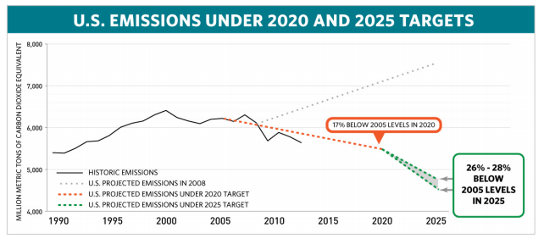
Recent Policy toward Climate Change
US INDC to Paris Climate Agreement
  Reduce GHG emissions 26-28% below 2005 level by 2025.
  Current trajectory is 17% below 2005 levels by 2020.
  Does not intend to use international market mechanisms.
  Includes: Clean Power Plan, appliance efficiency, CAFÉ, California state laws, Northeast Regional GHG Initiative
https://www.whitehouse.gov/the-press-office/2015/03/31/fact-sheet-us-reports-its-2025-emissions-target-unfccc
http://www4.unfccc.int/submissions/indc/Submission%20Pages/submissions.aspx
Notes:
Language is use “best effort” to reduce by 28%
Acknowledges that US currently has sectors and laws in place to make this goal achievable although ambitious. Existing legislation include: Clean Power Plan, CAFÉ, appliance energy efficiency, California state laws, and northeast regional GHG emissions plan.
Other targets (note not just emissions reductions) include:
India: Reduce emissions intensity of its GDP by 33-35% by 2030 from 2005 level. 40% cumulative electric power installed capacity from non-fossil fuel based sources. Also includes increasing forest and tree cover.
China: achieve peak carbon dioxide emissions around 2030 and make best efforts to peak early. Increase share of non-fossil fuels in primary energy consumption to around 20%. Increase forest stock volume.
Brazil: intends to commit to reduce GHG emissions by 37% below 2005 levels in 2025.

Slide 14
Domestic mitigation action

Slide 15
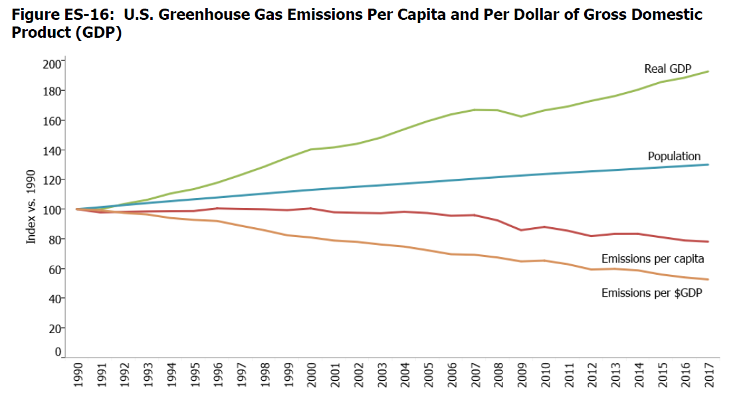
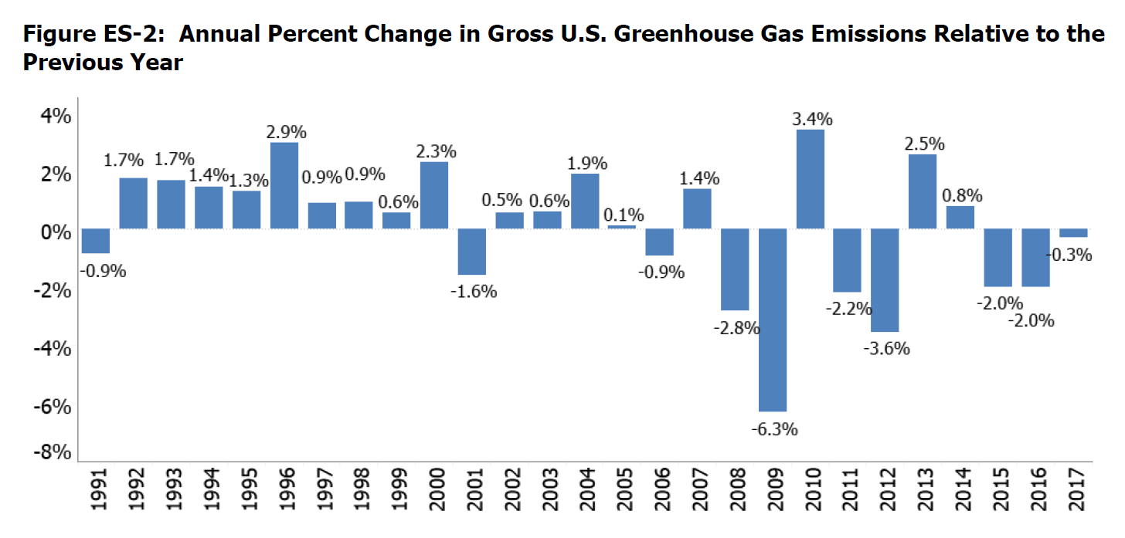
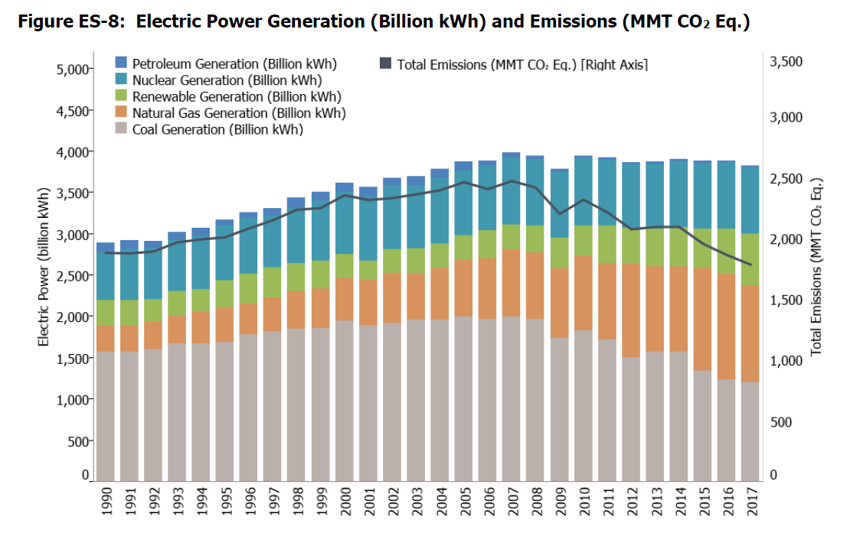
US Domestic Mitigation
Bush Rose Garden target in early 2000s an 18 percent reduction in emissions intensity between now and 2012 - will allow actual emissions to increase 12 percent.
Source EPA Draft Inventory of U.S. Greenhouse Gas Emissions and Sinks: 1990-2017

Slide 16
Domestic Policy Efforts toward Climate Change
Clean Power Plan
In 2007 Supreme Court ruled that GHGs are air pollutants covered by Clean Air Act and that EPA should regulate GHGs if they endanger human health.
  In Aug 2015 EPA made final version Clean Power Plan
  Final goal -- national electric power CO2 emission reductions by 2030 of 32 percent from CO2 emission levels in 2005.
  State level targets - Texas is at 36%.
  States were to submit plan in 2016. 2 year extension possible.
  Starting date of emission reductions is 2022.
  Market-based mechanisms encouraged including interstate cap-and-trade program, carbon tax and tradable renewable certificates
  Only existing plants covered. States must address leakage.
  Main thrust is fuel and technology switching
  EPA made biogenic carbon rules
  Power plants are considering cofiring with biomass
Now under Supreme Court stay
http://www3.epa.gov/climatechange/ghgemissions/biogenic-emissions.html
http://www.epa.gov/cleanpowerplan

Slide 17
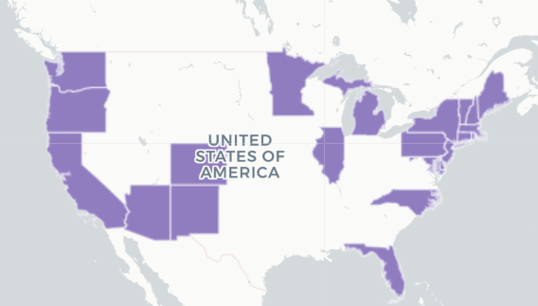
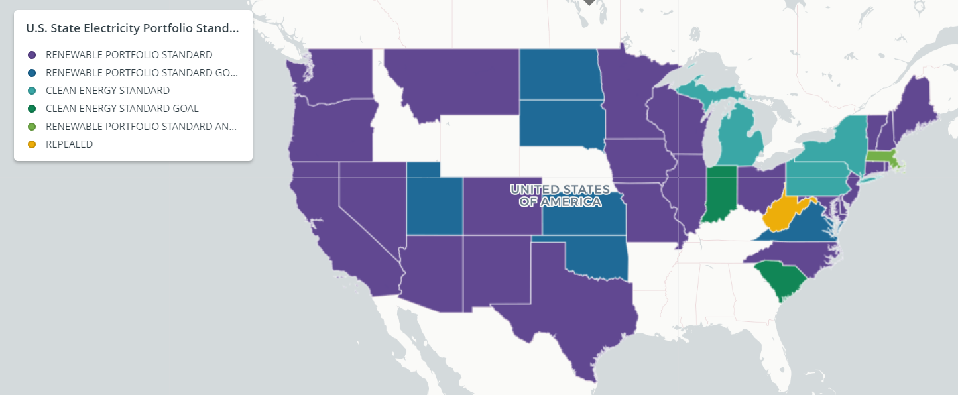
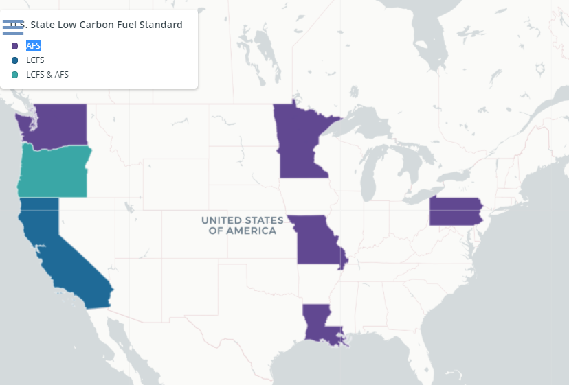
State Policy
Twenty-nine states plus the
District of Columbia have
adopted specific greenhouse
gas reduction targets
Policies include carbon pricing, emission limits, energy efficiency mandates and incentives, and steps to promote cleaner transportation.
https://www.c2es.org/content/state-climate-policy/
Notes:
- Language is nuanced here: “in continuation of their existing obligations under the Convention,” a stipulation sought by the United States so the agreement would not create new binding financial commitments requiring congressional approval”
Funding mentioned in the “decision” part of the document not the “action” section which further brings into question how much will actually be committed.
“strongly urges developed country Parties to scale up their level of financial support, with a concrete roadmap to achieve the goal of jointly providing USD 100 billion annually by 2020 for mitigation and adaptation while significantly increasing adaptation finance from current levels and to further provide appropriate technology and capacity-building support”
Sec Kerry’s commitment came in early December at a speech in Paris.

Slide 18
State Policy
California Air Resources Board
A trading program
Ag opportunities provide offsets
Participation is voluntary
Protocols are in place for
  Forest
    Reforestation
    Improved Forest Management
    Avoided Conversion
  Manure management
  Rice Cultivation (Dry seed, early drain, wet/dry)
http://www.arb.ca.gov/cc/capandtrade/offsets/offsets.htm
Notes:
- Language is nuanced here: “in continuation of their existing obligations under the Convention,” a stipulation sought by the United States so the agreement would not create new binding financial commitments requiring congressional approval”
Funding mentioned in the “decision” part of the document not the “action” section which further brings into question how much will actually be committed.
“strongly urges developed country Parties to scale up their level of financial support, with a concrete roadmap to achieve the goal of jointly providing USD 100 billion annually by 2020 for mitigation and adaptation while significantly increasing adaptation finance from current levels and to further provide appropriate technology and capacity-building support”
Sec Kerry’s commitment came in early December at a speech in Paris.

Slide 19
Other reasons Why Might We Mitigate?
Industry planning under uncertainty
  Demonstration projects
  Interests at risk
  Multinationals
Need for cheap emission offsets
  Firms investing
  CCX
Congruence of programs with other agriculturally related societal desires such as farm income support and water quality protection
Development of another market for farm products

Slide 20
Ag perspective inelastic vs elastic demand who gains
Economic Needs
D
S’
S’
Price
S
S
D
P’
P
Q’
Q
Quantity
Q’
Q
Quantity

Slide 21
Means of mitigation action

Slide 22
Mitigative Actions
Reduce emissions
Capture and destroy
Lower emitting energy Nat. Gas, Biogenic feedstocks, Nuclear, Hydrogen, Wind, Solar
Alter consumption (meat)
Increase energy efficiency
Change production to reduce emissions from fossil fuels, rice, coal mines, livestock, fertilization etc
Increase sequestration
Capture/store- Oceans, Mines, Aquifers (CCS)
Link CCS and Bioenergy/biopower - BECCS
Biological - Forest, Soils
Geoengineer
Solar rad. mgt –deflect sunlight, increase reflectivity
CO2 removal, biochar, Air capture, Ocean nourish

Slide 23
Potential Sectoral GHG Emission Mitigation Strategies
  Agricultural and Forestry Sector
    Contributed 4% of global energy-related CO₂ emissions in 1995 but about 50% of methane and 70% of nitrous oxide
    Conservation Improvement of agriculture (e.g. conservation tillage, reduction of land use intensity, etc.)
    Sequestration management
    Substitute product production (biofuels)
    Altered ag management of cattle, rice, fertilization
    Fuel switching
  Waste Management Sector
    Use of landfill gas for heat and electricity
    Increase of waste recycling rates
    Utilize waste paper as a biofuel
  Energy Sector
    Contributed 38 % of global energy-related CO2 emissions in 1995
    Improvement in the energy efficiency of power plants
    Fuel switching
    Deregulation of the electric power sector to drive technological progress

Slide 24
Potential Sectoral GHG Emission Mitigation Strategies
  Buildings Sector
    Contributed 31% of global energy-related CO2 emissions in 1995
    Improvement in the energy efficiency of windows, lighting, refrigeration, air conditioning, etc.
    Passive solar design & integrated building
    Fuel switching
  Transportation Sector
    Contributed 22 % of global energy-related CO2 emissions in 1995
    Improvement in the energy efficiency of vehicles
    Vehicle Fuel switching to natural gas, electricity, biofuels
    Subsidize mass transit
  Industry Sector
    Contributed 43 % of global energy-related CO2 emissions in 1995
    Improvement in the energy efficiency
    Material efficiency improvement e.g. recycling, material substitution
    Fuel switching
Adapted from CC 2001 mitigation p. 29-40

Slide 25
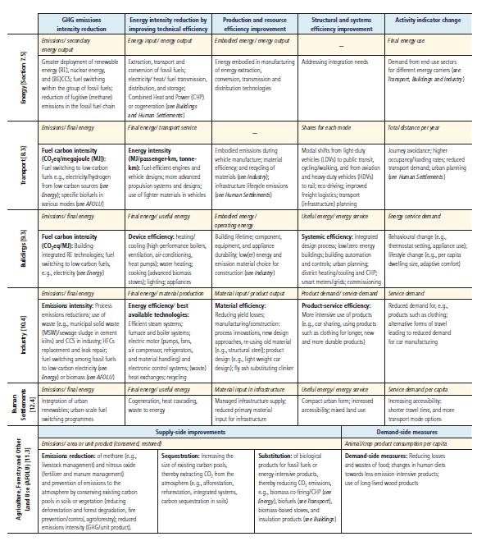
Sectoral
Mitigation
IPCC WGIII AR5 Table TS.3 | Main sectoral mitigation measures categorized by key mitigation strategies (in bold) and associated sectoral indicators (highlighted in yellow) as discussed in
Chapters 7 – 12.

Slide 26
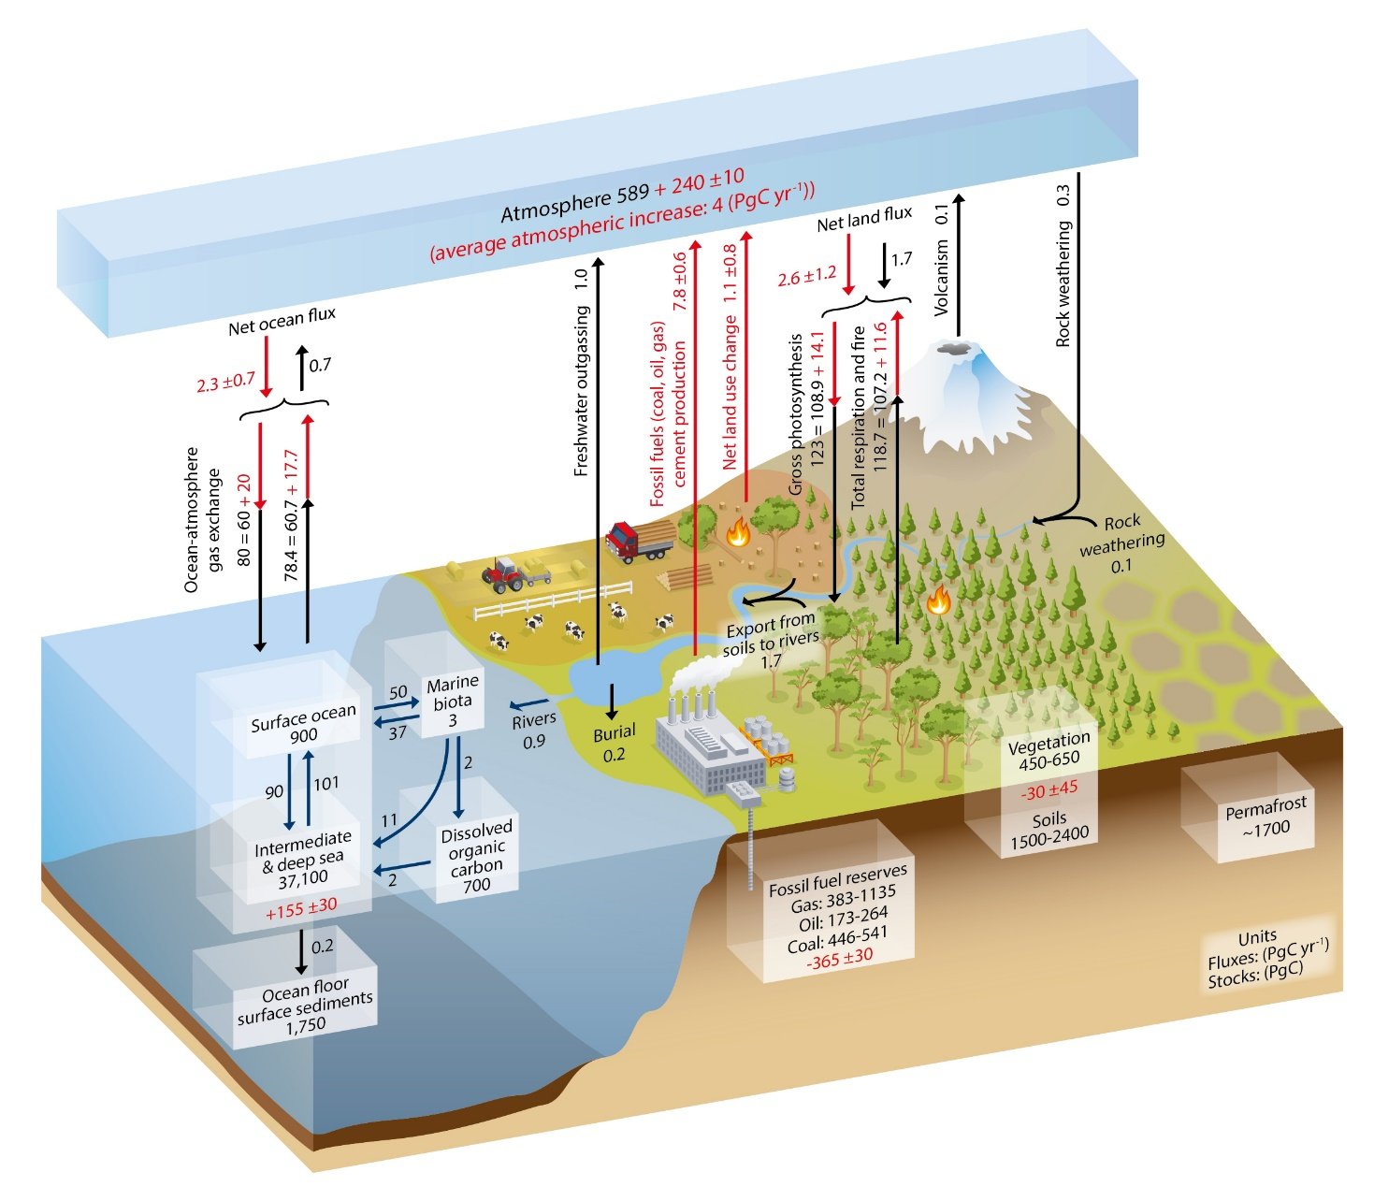
Global Carbon Cycle
Figure 6.1 | Simplified schematic of the global carbon cycle. Numbers represent reservoir mass, also called ‘carbon stocks’ in PgC (1 PgC = 1015 gC) and annual carbon exchange fluxes (in PgC yr–1). Black numbers and arrows indicate reservoir mass and exchange fluxes estimated for the time prior to the Industrial Era, about 1750
IPCC, AR5 WG1

Slide 27
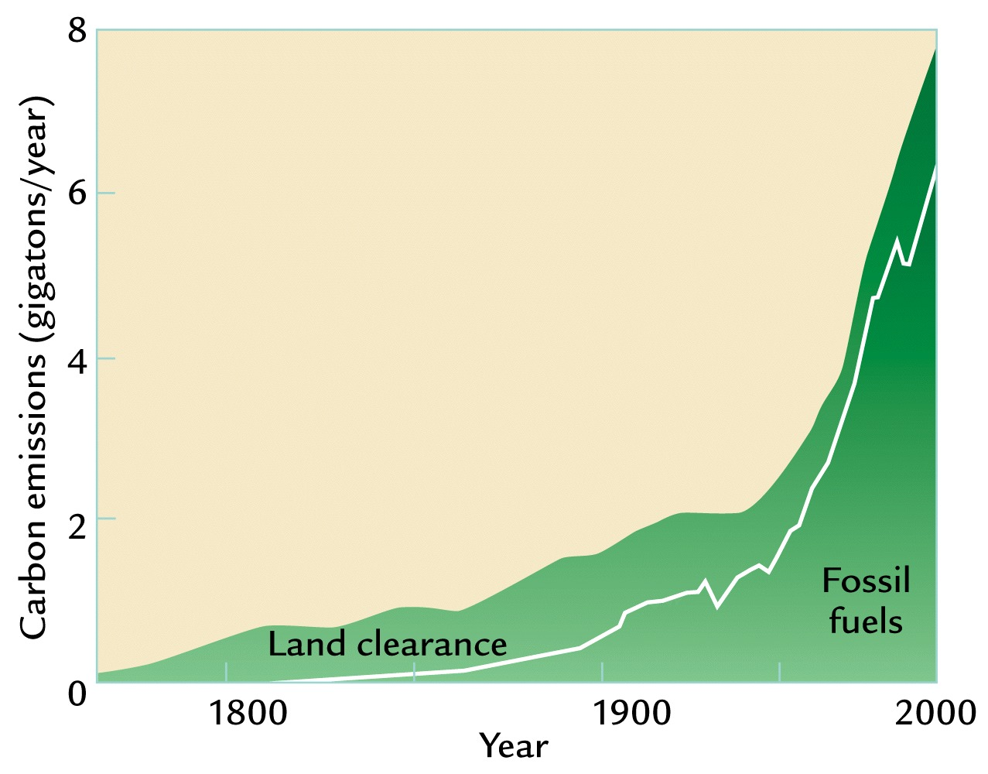
Historical Emissions Estimates
Sequestration may have the potential to alleviate somewhere in the neighborhood of 25% of the historical atmospheric greenhouse gas accumulation.
Source: Apparently this was drawn from W. F. Ruddiman, 2001. Earth's Climate: Past and Future. W. H. Freeman and Sons, New York

Slide 28
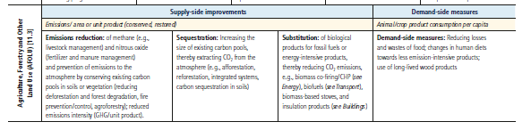
Ag Sector Mitigation
IPCC WGIII AR5 Table TS.3 | Main sectoral mitigation measures categorized by key mitigation strategies (in bold) and associated sectoral indicators (highlighted in yellow) as discussed in
Chapters 7 – 12.

Slide 29
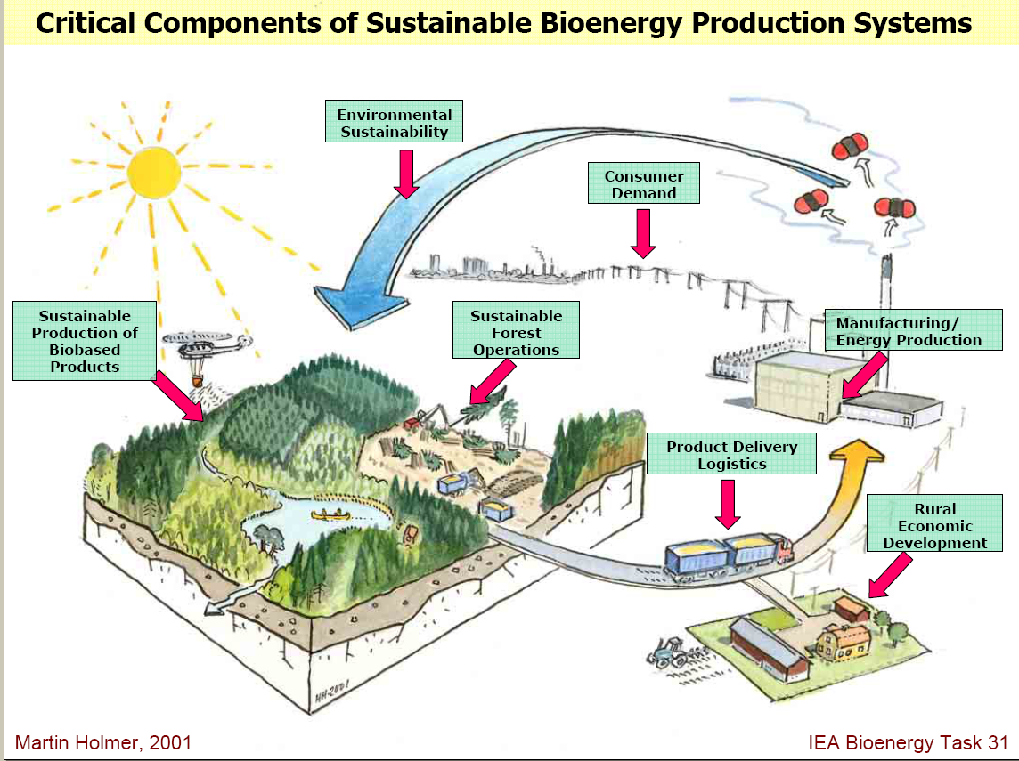
Avoid it – Biofuel
Absorb CO2
Emit CO2
Please Pretend the growing stuff includes crops
Feedstocks take up CO2 when they grow
CO2 emitted when feedstocks burned or when energy product derivatives burned
But Starred areas also emit
Source of underlying graphic: Smith, C.T. , L. Biles, D. Cassidy, C.D. Foster, J. Gan, W.G. Hubbard, B.D. Jackson, C. Mayfield and H.M. Rauscher, “Knowledge Products to Inform Rural Communities about Sustainable Forestry for Bioenergy and Biobased Products”, IUFRO Conference on Transfer of Forest Science Knowledge and Technology, Troutdale, Oregon, 10-13 May 2005

Slide 30
Comments on strategies
Sequestration
saturation, permanence, storage cost
General
uncertainty, permanence, leakage,
additionality, transactions costs
Bioenergy
life cycle accounting
cost algae $20
land competition
indirect land use

Slide 31
Implementing mitigation action

Slide 32
Bringing in Mitigation
  Identify emission threats
    Permafrost
    Peat
    Fires
  Identify feasible, cheap mitigation possibilities
    For threats
    For existing systems
  Identify ways to grow without growing emissions
  Identify ways to maintain and grow food production
    Without more emissions
    Protecting environment
  Incentive design

Slide 33
Policies, Measures, and Instruments
    Here are a set of policies, measures, and instruments to limit GHG emissions or enhance sequestration by sinks.
      Command and control
      Taxes on emissions, carbon, and/or energy
      Subsidies
      Tradable emissions permits (cap-and-trade)
      Non-tradable permits
      Emission reduction credits
      Voluntary agreements
      Technology and performance standards
      Product bans
      Direct government spending and investment (R&D)
Adapted from CC 2001 mitigation p. 399-450 http://www.grida.no/climate/ipcc_tar/wg3/224.htm

Slide 34
Policies, Measures, and Instruments
  Command and Control
    Imposing a specific and inflexible emission standards on sources
  Taxes on Emissions, Carbon, and/or Energy
    A levy imposed by a government on each unit of emissions or on carbon content of fossil fuels (carbon tax), or on the energy content of fuels
    Advantage: 1. Yields cost minimizing allocation
        2. Promotes technological progress
        3. Increases revenues to subsidize R&D
    Disadvantage: 1. How to determined an appropriate level of Tax?
Cost ($)
Marginal control cost
Tax
A
B
D
C
O
15
Emission Reductions (tons)

Slide 35
Policies, Measures, and Instruments
  Subsidies
    A direct payment from the government
    Lowers existing subsidies to fossil fuel use, or increasing subsidies for practices reducing emissions or enhance sinks
  Tradable Emissions Permits (Cap-and-Trade)
    Puts a cap or limit on aggregate GHG emissions on sources
    Requires each source to hold permits equal to its actual emissions
    Allows permits to be traded among sources
    Advantage: Flexibility
    Disadvantage: Need to consider transaction costs

Slide 36
Policies, Measures, and Instruments
  Subsidies
    A direct payment from the government
    Lowers existing subsidies to fossil fuel use, or increasing subsidies for practices reducing emissions or enhance sinks
C_{other}
Cost
of meeting cap
C_{emitter}
100% of cap
Percent of Cap by technology

Slide 37
Policies, Measures, and Instruments
  Non-Tradable Permits
    Puts a cap or limit on GHG emissions on each regulated source
    Requires each source to keep its actual emissions below its own cap
    Does not allow trading among sources
C_{other}
Prespecified share
Cost
of meeting cap
C_{emitter}
Emitter share
Other share
100% of cap
Percent of Cap by emitter

Slide 38
Policies, Measures, and Instruments
  Non-Tradable Permits
    Puts a cap or limit on GHG emissions on each regulated source
    Requires each source to keep its actual emissions below its own cap
    Does not allow trading among sources
C_{other}
Prespecified share
Cost
of meeting cap
C_{emitter}
Emitter share
Other share
100% of cap
Percent of Cap by emitter

Slide 39
Policies, Measures, and Instruments
  Tradable Emissions Permits (Cap-and-Trade)
    Puts a cap or limit on aggregate GHG emissions on sources
    Requires each source to hold permits equal to its actual emissions
    Allows permits to be traded among sources
    Advantage: Flexibility
    Disadvantage: Need to consider transaction costs
C_{other}
Adding a trade partner
Trade partner cost goes up with percent of cap assumed
Cost
of meeting cap
C_{emitter}
Emitter share
Other share
0% of cap
All bought
100% of cap
Percent of Cap by emitter

Slide 40
Policies, Measures, and Instruments
  Voluntary Agreements
    An agreement between a government authority and one or more private parties
    A unilateral commitment to achieve environmental objectives or to improve environmental performance beyond compliance
  Technology and Performance Standards
    Establishment of minimum requirements for products or processes to reduce GHG emissions associated with the manufacture or use of the products or processes
  Product Bans
    Prohibition on the use of a specified product in a particular application, such as hydrofluorocarbons (HFCs) in refrigeration systems

Slide 41
Policies, Measures, and Instruments
  Direct Government Spending and Investment (R&D)
    Government expenditures on research and development (R&D) measures to lower GHG emissions or enhance GHG sinks
Remarks:
(1). A group of countries can implement one or a combination of these instruments.
(2). If we control too much at the present time, the current generation pays high price but the future generation gains benefit, or a vice versa.
Adapted from CC 2001 mitigation p. 399-450 http://www.grida.no/climate/ipcc_tar/wg3/224.htm

Slide 42
Policies, Measures, and Instruments
  Emission Reduction Credits
    Combination of a deposit or fee (tax) on a emissions with a refund or rebate (subsidy) for emission reductions
    Credits are implemented through
      Offset policy
      Bubble policy
      Netting within the firms
      Banking
    Advantage: allow growth
    Disadvantage: quantifiability, and monitoring and enforcement

Slide 43
Policies, Measures, and Instruments
  Direct Government Spending and Investment (R&D)
    Government expenditures on research and development (R&D) measures to lower GHG emissions or enhance GHG sinks
Remarks:
(1). A group of countries can implement one or a combination of these instruments.
(2). If we control too much at the present time, the current generation pays high price but the future generation gains benefit, or a vice versa.
Adapted from CC 2001 mitigation p. 399-450 http://www.grida.no/climate/ipcc_tar/wg3/224.htm

Slide 44
Incentivizing

Slide 45
How Incent Mitigation
Voluntary
Carbon pricing system
  cap and trade
  tax
Tax high emitting activities or fossil fuels
Subsidize low emitting activities or fuels
Increase energy efficiency.
Increase use of low GHG-emitting electricity generation options
  renewable energy sources.
  improved transmission infrastructure,
  offering long-term stability in financial incentives
  encouraging private research, development, and deployment
  testing and demonstration of new-generation nuclear power
Develop and demonstrate carbon capture and storage
Advance low GHG-emitting transportation options.
  vehicle efficiency,
  energy efficient modes of passenger and freight transport, and
  advancing low-GHG fuels (such as cellulosic ethanol).
Accelerate retirement, retrofit or replacement of high emissions infrastructure.
Create new technology choices
Fri, R., M. Brown, D. Arent, A. Carlson, M. Carter, L. Clarke, F. de la Chesnaye, G. Eads, G. Giuliano, A. Hoffman, R.O. Keohane, L. Lutzenhiser, B.A. McCarl, M.C. McFarland, M.D. Nichols, E.S. Rubin, T. Tietenberg, J. Trainham, L. Geller, A. Crane, T. Menzies, and S. Freeland, America's Climate Choices Limiting the Magnitude of Future Climate Change, National Academy Report, The National Academies Press, Washington, D. C, 2010.

Slide 46
NAS Mitigation recommendations
Adopt economy-wide carbon pricing system .
Complement the carbon price with policies to:
  realize potential for near term emissions reductions through energy efficiency and low emission energy;
  establish feasibility of CCS and nuclear;
  accelerate retirement, retrofitting or replacement of GHG emission-intensive infrastructure.
Create technology - research/stimulated innovation.
Design/ implement policies to promote equity
Establish US as a leader to stimulate other countries.
Enable flexibility and experimentation with policies.
Design policies that balance durability and consistency with flexibility and capacity for modification as we learn
http://dels.nas.edu/Report/Limiting-Magnitude-Climate-Change/12785

Slide 47
Why Pricing?
Internalizes externality
Improves efficiency
Stimulates innovation and conservation
But for Ag the question is coverage –
  Are all ag possibilities covered?
  Do we want to extend cap to agriculture
Answer to both is generally no
Cap and trade has a bad political reputation
Attention has turned to voluntary programs like that in California
Producers can optin if they so choose, and are not capped

Slide 48
Multi gas priceing

Slide 49
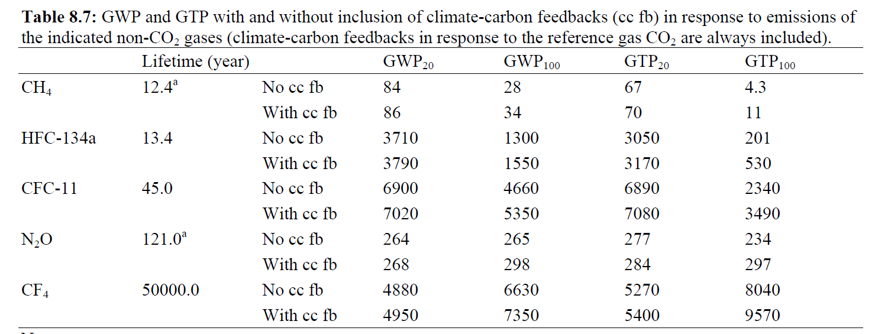
GWP, GTP and Climate Change
GWP is used to make comparisons of relative contributions among GHGs to global warming by comparing the ability of each gas to trap radiation in the atmosphere over a chosen time horizon. Global Temperature change Potential (GTP), which is change in GMST at a chosen point in time relative to CO2
IPCC uses CO₂ as a reference gas with a GWP or GTP of 1
CO2 lifetime is complicated by multiple physical and biogeochemical processes in the ocean and the land. For a pulse of about 1000 PgC, about half is removed within a few decades, but the remaining fraction stays in the atmosphere for much longer. About 15 to 40% of the CO2 pulse is still in the atmosphere after 1000 years.
Source: Climate Change 2014: The Scientific Basis, Table 8.7

Slide 50
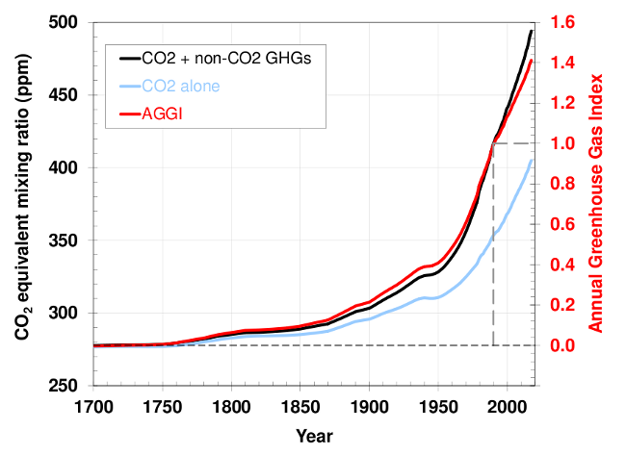
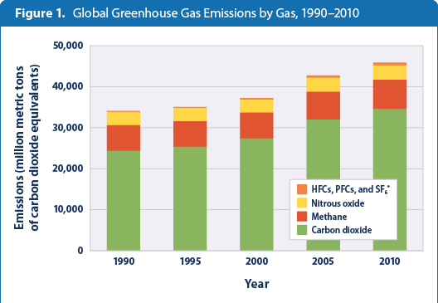
Multi-Gas GHG Total Forcing
Greenhouse gas radiation reflection
Increase in CO2 concentration
Plus CH4 N2O
Energy related emissions
Energy – development relationship
Growth of BRIC economies
Pre industrial 275 Counting Non CO₂
345 this exceeds 493 (2017)
2019 411
Data 1700-2017
http://www.epa.gov/climatechange/science/indicators/ghg/global-ghg-emissions.html
http://www.esrl.noaa.gov/gmd/aggi/aggi.html

Slide 51
Social Cost of Carbon

Slide 52
Social Cost of Carbon
The US government has estimated social cost of carbon
  Technical Update of the Social Cost of Carbon, 2015 and Social Cost of Carbon for Regulatory Impact Analysis under Executive Order 12866. February 2010.
  Used Global Computable General Equilibrium (CGE) Models
Gives an Estimate of NPV of all future monetized damages from a one ton increase in CO2 equivalent emissions in a given year.
  Includes changes in agricultural productivity, human health, property damages from floods, ecosystem services, home heating/cooling and properties under sea level rise.
Social Cost of CO2 eq (in 2007 dollars per metric ton)
 | Discount rate
Year | 5% | 3% | 2.5%
2015 | 12 | 38 | 58
2030 | 16 | 52 | 76
2050 | 27 | 71 | 98

Slide 53
So What does this mean for energy cost

Slide 54
Social Cost of Carbon
So what does imposing prices ($40, $70, $100) on CO2 emissions from
fossil fuels do to fossil fuel prices
Use US average price as of mid September 2016 and EIA emission factors
 |  |  |  | CO2 Price per mT
 |  |  |  | $40 | $70 |  | $100
 |  | Approximate $ Cost/unit | Emissions in MT CO2 | % Cost increase
Coal in short tons |  | 40.2 | 2.595 | 258% | 452% | 646%
Gasoline in 1000 gallons |  | 2224 | 8.927 | 16% | 28% | 40%
Diesel in 1000 gallons |  | 2382 | 10.173 | 17% | 30% | 43%
Natural Gas 1000 cu ft |  | 2.90 | 0.053 | 73% | 128% | 184%
This would make lower emitting forms energy more competitive – particularly replacing coal and natural gas for electricity
Bigger hit on electricity

Slide 55
How about market share

Slide 56
Fossil fuel share
Basic setup of an economic exploration
Cost of Fossil energy rises the larger its share of the energy market –
A supply curve
For now 100% fossil market share
Cost
of energy
P_{E}
C_{Fossil}
0%
No Fossil
100%
All Fossil
Percent of energy market

Slide 57
Fossil fuel share
Adding another energy source
For now call it a renewable
C_{Renew}
Cost of renewable energy rises the larger its share of the energy market –
A mirror image of supply curve
Cost
of energy
C_{Fossil}
0%
No Fossil
All Renewable
100%
All Fossil
No Renewable
Percent of energy market

Slide 58
Fossil fuel share
Market Share
C_{Renew}
Cost
of energy
Equate Marginal Costs to get market share
C_{Fossil}
P_{E}
Fossil share
Renew share
0%
No Fossil
All Renewable
100%
All Fossil
No Renewable
Percent of energy market

Slide 59
Fossil fuel share
Factor in cost of the externality
C_{fossil +externality}
Cost
of energy
External cost raises the cost at all market shares.
Amount depends on market share
_{External}
_{Cost}
C_{Fossil}
0%
No Fossil
100%
All Fossil
Percent of energy market

Slide 60
Fossil fuel share
Market Share with internalized externality
External cost differentially raises the cost of renew versus fossil.
Assumption here that renewable has less external effect
Here renewable gains market share
C_{fossil +externality}
Cost
of energy
_{External}
_{Cost}
P_{E w/externality}
C_{Fossil}
P_{E w/o externality}
C_{renew +externality}
C_{Renew}
0%
No Fossil
Q_{E w/o xternality}
Q_{E w/externality}
100%
All Fossil
Percent of energy market

Slide 61
Issues with buying offsets

Slide 62
Fungibility
A number of concepts have arisen that are likely to differentially characterize the contribution of alternative possible offsets within the total regulatory structure. These involve:
Permanence
Additionality
Leakage
Uncertainty
GWP
General concern price may differentiate based on characteristics like a grading standard

Slide 63
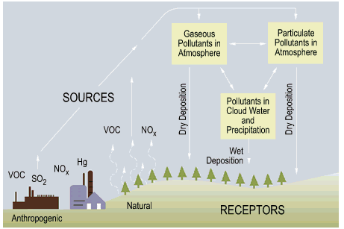
Example of Acid Rain Program
  SO2 and NOx are the primary causes.
  Acid rain occurs when these gases react in the atmosphere with water, oxygen, and other chemicals to form various acidic compounds.
  This acid rain program is designed to reduce emission of SO2 AND NOx by 10 million tons below 1980 levels at the lowest cost to society.
  How does this program work?
    Technology improvement
    Fuel switching
    Conserves energy
    Allows Trading System
    Auctions and Direct Sales
    Opt-in Program
    Etc.
http://www.epa.gov/airmarkets/acidrain/#what

Slide 64
Example of Acid Rain Program – allowance trading system
  EPA sets allowances based on historical fuel consumption and emission rates.
  Allowance trading provides incentives for energy conservation and technology innovation that can both lower the cost of compliance and yield pollution prevention benefits.
  Regulated firms decide the most cost-effective way to use available resources to comply with the acid rain requirements by
    employing energy conservation measures
    switching to a lower sulfur fuel
    employing pollution control technologies, etc.
  Firms that reduce their emissions below their regulated allowances may trade their allowances, sell them on the open market or through EPA auctions, or bank them to cover emissions in future years.
  Shortfalls were penalized at 35 times price in 2009 - $3400 per ton penalty versus $88 price
Source: EPA’s Acid Rain Program: Overview at http://www.epa.gov/airmarkets/arp/overview.html

Slide 65
Example of Ozone Depletion Program
  The ozone layer acts as a blanket in the stratosphere that protects us from harmful UV radiation. CFC-12 destroys this layer of gas which leads to an increase in cataracts and skin cancer.
  The largest uses of CFC-12 is as a refrigerant in motor vehicle air conditioners
  Firms are given funds to switch from ozone pollutable to other sources.
  Taxes on ozone
  Certification Requirements
    Regulation on service shops must certify to EPA that they have acquired and are properly using approved refrigerant recovery equipment, and that each person using the equipment has been properly trained and certified.
  Global Action to Protect the Ozone Layer
    Montreal protocol => agreement to phase out production of most ozone-depleting substances
Source: EPA Regulatory Requirements at http://www.epa.gov/ozone/title6/609/justfax.html

Slide 66
Mitigation Assessment
Assessment criterion
  GHG reduction potential (Tons of carbon equivalent)
  Other environmental considerations
        soil conservation, watershed management, etc.
  Economic and Social Considerations
        Cost-effectiveness
        GDP, jobs created or lost, implications for long-term development, etc.
        Differential impacts on countries, income groups or future generations

Slide 67
Issues on Mitigation Assessment
Assessment criterion (continued)
  Institutional and Political Considerations
        Monitoring, enforcement issues
        Capacity to pass through political and bureaucratic processes and sustain political support
        Consistency with other public policies
Uncertainty
Ranking mitigation strategies accordingly to criterion

Slide 68
Mitigation and pricing

Slide 69
Economics of Partial Coverage
Annex I and Annex II Countries

Slide 70
GHG Market Equilibrium
D
Price of GHG net emission reduction
S
P*
Q*
Quantity of net emission reduction

Slide 71
GHG Market Equilibrium
with cap
D
Price of GHG net emission reduction
S
P
P*
Q*
Cap
Quantity of net emission reduction

Slide 72
Multi region GHG Market Equilibrium
with cap – Autarkic, no trade
Price of GHG net emission reduction
D
D
S
S
P
P*
Q*
Capped
region
Quantity
Quantity
Q*
Uncapped
Region
Quantity

Slide 73
Multi region GHG Market Equilibrium
with cap – with trade
Price of GHG net emission reduction
D
D
S
S
ES
ED
P
P
P*
Q*
Capped
region
Quantity
Quantity
Q*
Uncapped
Region
Quantity

Slide 74
Multi region GHG Market Equilibrium
with cap – with trade and transactions costs
D
D
Price
S
S
ES
ED
P
P
Transactions
Costs
P*
Q*
Capped
region
Quantity
Quantity
Q*
Uncapped
Region
Quantity

Slide 75
Climate Change Mitigation Challenge
Complex set of sources
Energy is key
Tie to Development
Multinational need
BRIC countries
Futility of unilateral action
Legislation
Offset controversy

