Slide 1

Economic Vulnerability under Climate Change
: With an Agricultural Emphasis
Bruce A. McCarl
Distinguished Professor of Agricultural Economics
Texas A&M University mccarl@tamu.edu
http://agecon2.tamu.edu/people/faculty/mccarl-bruce/
Climate Change Adaptation
Energy
Climate Change Mitigation
Climate Change Impacts
Ramblings from an Ongoing and Never Ending Effort
Presented at the Climate Change Class, March 2003

Slide 2
Appraisal Approaches
Physical assessments that only consider changes in physical character (e.g. changes in yield)
Changes in cost as estimated in Chen and McCarl (Land rent, and Profit)
Welfare estimates (market and non-market)

Slide 3
Climate Impacts Analytical Framework
GCM /ESM SSP Scenario
Feedback
External
Environmental
impacts
Physical
impacts on
Yield, cost, variability, resource available
Given Climate Scenario
Aggregate
Economic
Impacts
Regional
impacts
Output
Many on and off ramps

Slide 4
Assessment Methodology - Summary Steps
Identify sectors and physical Impacts to examine
Determine spatial and time scales
Adopt or develop scenario regarding non-climatic factors
Obtain GCM projections
Chose analytical framework (econ theory foundation and physical/econometric models to be used)
Use or estimate models on physical impacts
Project physical impact of climate change and a no change case
Make assumptions about unmodeled phenomena
Incorporate physical impact into economic models
Construct with and without climate change projections
Incorporate data on possible adaptations to climate change
Do analysis with adaptation
Link to finer scale and environmental models
Do finer scale climate impacts projection
If needed feedback to physical
Notes:
xx

Slide 5
Scenario Development
Climate change Scenarios CMIP4-5-6
Non-climatic Scenarios – SRES-SSP
Time frame and uncertainty
Notes:
Time frame and uncertainty: As climate change analysis involves a longer term horizon, factors that affect estimates of impact assessment, e.g. population, technology, resource availability etc., are also likely to change. Predicting some of the factors might be beyond the scope of assessment. Therefore, we might need to make assumptions about these factors, which is what scenario building is referred to. For example, in U.S. assessment assumptions were made about how rest of the world will be impact by climate change, which lead to gains from trade in the assessment. In West African study on climate change, I used prices from the U.S. model as an estimate of what the import prices would be for West Arica in the event of climate change.

Slide 6
Non Climatic - Socio-Economic Scenarios
Before AR5 we had what was called the SRES scenarios which were based on populations, income, technology
As of AR5 we switched to RCPS which are purely GHG concentration based. But a group has developed shared socioeconomic pathways (SSPS) to accompany them
O’Neill, Brian C., et al. "A new scenario framework for climate change research: the concept of shared socioeconomic pathways." Climatic Change 122.3 (2014): 387-400.
Riahi, Keywan, et al. "The shared socioeconomic pathways and their energy, land use, and greenhouse gas emissions implications: an overview." Global Environmental Change (2016).
Van Vuuren, Detlef P., et al. "A new scenario framework for climate change research: scenario matrix architecture." Climatic Change 122.3 (2014): 373-386.
Notes:
Often the question that the policy makers pose is weather are not the society will be vulnerable to climate change. The vulnerability to climate change, however, will be determined by the degree of climate change and also by socio-economic factors (non-climatic stress, as the U.S. National Assessment Report calls them) such as population, demand, economic growth, and economic structure. Researchers have handeled soico-economic factors in at least two different ways. There are studies, for example, Yates and Strzepek; Rosenzweig and Hillel, that have incorporated population projections and various scenarios of demand and economic growth into their assessment studies. Other researchers, for example, Adams et al., have examined climate change impact against existing conditions.
There is an uncertainty in projecting socio-economic factors. A motivation for including socio-economic scenarios is that one can perform sensitivity analysis to impact assessment under different assumption about socio-economic scenarios, while motivation for excluding these factors is to not confound analysis with further uncertainties.
Club of Rome predicted a catastrophic increase in mortality rates through out the world beginning in the first decades of the 21st century, largely as a result of resources shortages (Gottinger). However, technology and discovery of new resource falsified their pessimism.

Slide 7
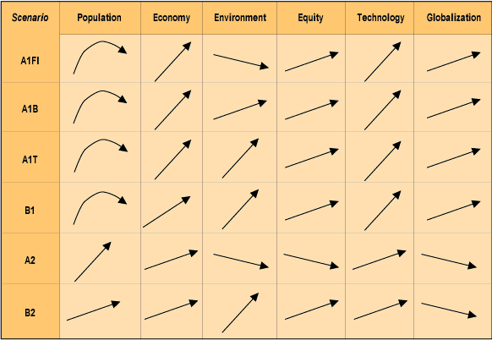
Scenarios
The Socio-Economic Driven SRES Scenarios
The SRES (Special Report on Emissions Scenarios) scenarios resulted from specific socio-economic scenarios regarding future demographic and economic development, regionalization, energy production and use, technology, agriculture, forestry and land use
The climate change projections discussed in AR4 were based primarily on the SRES A2, A1B and B1 scenarios.

Slide 8
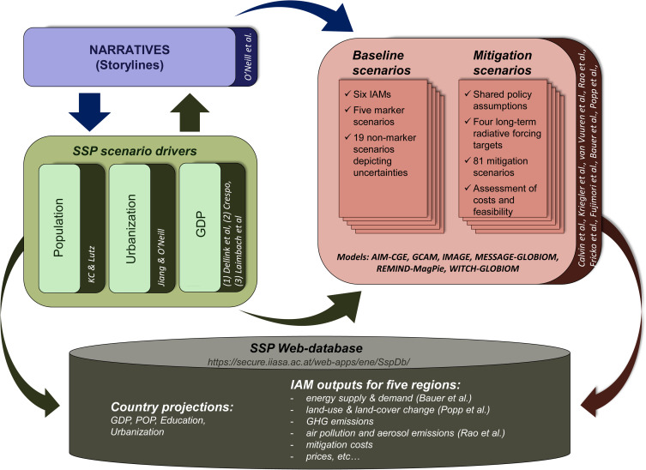
Non Climatic - Socio-Economic Scenarios
Socio-economic pathways describe the drivers of how the future might unfold in terms of population growth, governance efficiency, inequality across and within countries, socio-economic developments, institutional factors, technology change, and environmental conditions
Fig. 1. Schematic illustration of main steps in developing the SSPs, including the narratives, socioeconomic scenario drivers (basic SSP elements), and SSP baseline and mitigation scenarios.
Riahi, Keywan, et al. "The shared socioeconomic pathways and their energy, land use, and greenhouse gas emissions implications: an overview." Global Environmental Change (2016).

Slide 9
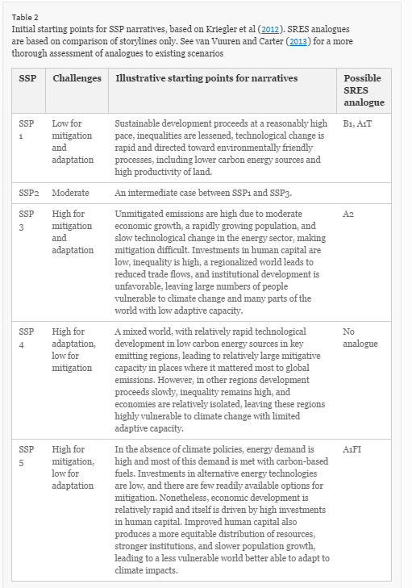
Non Climatic - Socio-Economic Scenarios
From O’Neill, Brian C., et al. "A new scenario framework for climate change research: the concept of shared socioeconomic pathways." Climatic Change 122.3 (2014): 387-400.

Slide 10
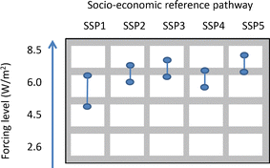
Non Climatic - Socio-Economic Scenarios
Matrix from
Van Vuuren, Detlef P., et al. "A new scenario framework for climate change research: scenario matrix architecture." Climatic Change 122.3 (2014): 373-386.
Not a One to one mapping
For a discussion see the special issue on this
Nakicenovic, Nebojsa, Robert J. Lempert, and Anthony C. Janetos. "A framework for the development of new socio-economic scenarios for climate change research: introductory essay." Climatic Change 122.3 (2014): 351-361

Slide 11
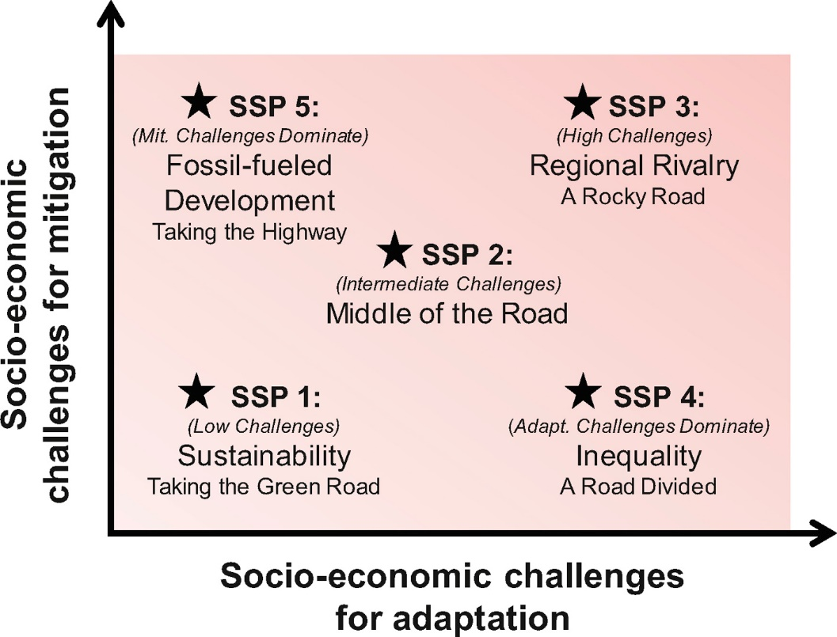
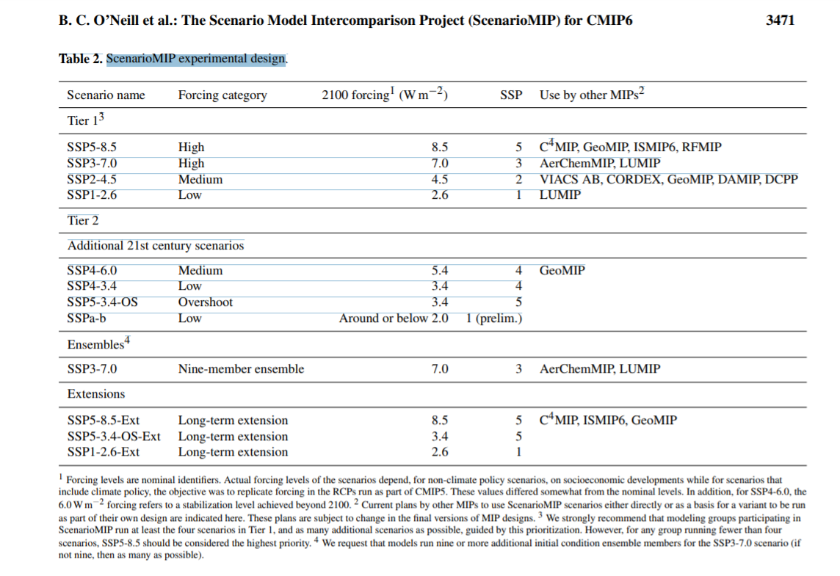
Some new economic Scenarios –
Shared Socioeconomic Pathways (SSPs)
Scenario framework combining radiative forcing with socioeconomic development. These describe alternative trends in society and ecosystems over a century. They involve story lines on how social, economic, and environmental development could produce the RCPs.
Being used in CMIP6
O’Neill, Brian C., Elmar Kriegler, Keywan Riahi, Kristie L. Ebi, Stephane Hallegatte, Timothy R. Carter, Ritu Mathur, and Detlef P. van Vuuren. "A new scenario framework for climate change research: the concept of shared socioeconomic pathways." Climatic change 122, no. 3 (2014): 387-400.
O’Neill, B.C., Kriegler, E., Ebi, K.L., Kemp-Benedict, E., Riahi, K., Rothman, D.S., van Ruijven, B.J., van Vuuren, D.P., Birkmann, J., Kok, K. and Levy, M., 2017. The roads ahead: Narratives for shared socioeconomic pathways describing world futures in the 21st century. Global Environmental Change, 42, pp.169-180.
O'Neill, B.C., Tebaldi, C., Vuuren, D.P.V., Eyring, V., Friedlingstein, P., Hurtt, G., Knutti, R., Kriegler, E., Lamarque, J.F., Lowe, J. and Meehl, G.A., 2016. The scenario model intercomparison project (ScenarioMIP) for CMIP6. Geoscientific Model Development, 9(9), pp.3461-3482.

Slide 12
Obtain GCMs Projections
  Data Distribution Center https://gdo-dcp.ucllnl.org/downscaled_cmip_projections/dcpInterface.html#Welcome
  Decide GCM scenarios whose projections you would use Visualization pages /Downloadable files
  Chose GCMs that have better calibrated base climate for the assessment country/region
  Compute percentage changes in temp. and precip for a grid and apply to weather stations
  Choose more than one GCMs for sensitivity analysis

Slide 13
GCM - Geographic Scale
Circa 2001
  HADCM: 3.75 x 2. 5 deg. (96X72 grids)
  CGCM: 3.75 x 3.75 deg. (96*48 grids)
  GDFL: 7.5 x 4.5 deg. (48*40 grids)
    Texas was covered by 4 grids
Today
GCMs depict the climate using a three dimensional grid over the globe, 10 to 20 vertical layers in the atmosphere and sometimes as many as 30 layers in the oceans.
https://portal.enes.org/data/enes-model-data/cmip5/resolution
Notes:
Recently, GCMs experiments have been made for finer geo-graphic and time scales. These are called Stretched Grid GCMs and provide projections for as low as 40 Km resolution and for seasonal, annual, and multi-year time scale. See, Robinovitz, University of Maryland.
http://www.pnl.gov/ccpp/oct01mtg/Fox-Rabinovitz_Oct2001.pdf

Slide 14
Simulator Bundle
FASOMGHG “System”
(and friends/ancestors)
Crop and
Env
Simulators
Livestock
Simulators
Ag Census
NRI
State Annual
Crop Acres
Pest
Regressions
GREET
FASOMGHG
Runoff
Simulators
GIS
Regional
Crop Mix
input use
Env.
loads
FASOM
Regionalizing
Model
County
Crop Mix
& percent
loads
Transport
simulation
Non ag
Resource
demand
GHG
Implications
Model
Water
Quality
Model
GCMs
IPCC
Scenarios

Slide 15
Economic Component Functions
FASOM
Why – Land use change, market Impacts, Welfare
What – Acres, exports, prices, mitigation choice,
Components – Forest and Ag simulator
Example – Adams et al, Murray et al
Regionalizing Model
Why – Link to localized env models
What – Land use by county
Components Humus model, multiple objectives
Example – Pattanayak et al, Atwood et al
Ag Census
NRI
State Annual
Crop Acreage
FASOM
Regional
Crop Mix
input use
Env loads
Regionalizing
Model
County
Crop Mix
and
percent loads
GHG
Implications
Model
Water
Quality
Model

Slide 16
Output Simulator Component Functions
Water quality simulator
Why – Water implications of land use
What – Chemistry, erosion load
Components – SWAT, NWPCAM, Regressions
Example – Pattanayak st al, Atwood et al
GHG implications simulator
Why – GHG implications, Mitigation response
What – Net GHG Impacts
Components – GHG component of FASOM
Example – Murray et al
Ag Census
NRI
State Annual
Crop Acreage
FASOMGHG
FASOM
Regional
Crop Mix
input use
Env loads
Regionalizing
Model
County
Crop Mix
& percent
loads
GHG
Implications
Model
Water
Quality
Model

Slide 17
Simulator Component Functions
Others
Forest simulators
Fire simulators
Processing plant models
Regional Logistics
International economics
Economy wide models

Slide 18
History of McCarl Climate Change Assessments
1987 – Corn Soy, Wheat no adaptation, no irrigation, no CO2
1992 – Corn, Soy, Wheat, no adaptation, irrigation, no CO2
1995 – Corn Soy, Wheat CO2, irrigation calendar adaptation
1999 – Corn, Soy, Wheat, cotton, sorghum, tomato, potato, CO2, irrigation, calendar adaptation, crop mix shift, livestock,
grass, input usage, water available
2001 -- Corn, Soy, Wheat, cotton, sorghum, tomato, potato, CO2,
irrigation, calendar adaptation, crop mix shift, livestock, grass, input usage, pest, extreme event, forestry
Cost continually went down now beneficial.

Slide 19
U.S. National Assessment
Scope: National
Sectors: Agri., Forest, Water, Coastal Area, & Health
Timeframe: 2060
Socio-Econ Scenario: Only climate changed (Ag.)
GCMs: HADCM and CGCM
Assess. Meth.: Structural approach
Adaptations: Planting schedule, tech., market
$0.5 bil. loss, with $12.5 bil. gain
Gains from trade
Notes:
xx

Slide 20
Some technical findings - Climate Change Assessment
How do you do it?

Slide 21
Methodology – Climate Change Assessment
Climate Scenarios – GCMs
Crop Simulation – regional crop yields (dry and irrigated)
regional irrigated crop water use
Hydrologic simulation – irrigation water supply,
Expert opinion – livestock performance,
Range and hay simulation and calculation --
livestock pasture usage,
animal unit month grazing supply
Other studies – international supply and demand
Regression – pesticide usage
Economics – ASM sector model

Slide 22
Percentage Changes in Crop Yield
Canadian Hadley
2030 2090 2030 2090
Cotton Dry +10% +104% +34% +79%
Cotton Irr +45% +113% +34% +79%
Corn Dry +19% + 23% +17% +34%
Corn Irr - 1% - 2% + 0% + 7%
Soybean Dry +16% + 21% +26% +60%
Soybean Irr +16% + 27% +17% +34%
Wheat Dry -16% +104% +21% +55%
Wheat Irr - 4% - 6% + 5% +13%
Tomato Irr -10% - 22% - 4% - 9%
Oranges Irr +32% + 99% +40% +69%
Hay Dry -10% - 1% + 2% +15%
Hay Irr + 3% + 2% +23% +24%

Slide 23
2030 U.S. Effects of Climate Change
Canadian Hadley
Water Use - 4% -16%
Irrig Land + 7% - 7%
Dry Land -11% - 5%
Crop land - 9% - 6%
Crop Price -11% -15%
Crop Prod + 9% +11%
Exports +25% +26%
Lvst Price 0% - 4%
Producer income -10% - 8%
Cons Surplus +0.3% +0.6%
Foreign Surp +0.8% +0.5%
Total Welfare +0.5 bill$ +5.2 bill$
TX Mun Water Use +2% +3%

Slide 24
2030 Regional Effects
Canadian Hadley
Northeast + 3 + 4
Lakestates +63 +43
Cornbelt +16 +14
Northplains - 2 +18
Applachia -24 -25
Southeast -60 -15
Delta - 6 +25
South Plains -24 - 7
Mountain +30 +39
Pacific +26 +47

Slide 25
Climate Change Effects In Texas Regions
Gainers
East Texas
Central Blacklands
Rolling Plains
South Texas
Losers
High Plains
Edwards Plateau
Coastal Bend
TransPecos

Slide 26
U.S. Agricultural Sector Irrigation Relevant Findings
Hadley
Canadian
Economic Impacts of Climate Change under the Canadian and Hadley Climates. The economic index is change in welfare express as the sum of producer and consumer surplus in billions of dollars.

Slide 27
Some Economic Findings - Climate Change Assessment
Welfare and productivity estimates were negative in earlier studies but have tended to become less so or beneficial. GCMs now include aerosols, and other improvements yielding milder temperature and precipitation estimates and crop models have enhanced CO2 fertilization Impacts.
Likely shift in comparative advantage of agricultural production regions.
Yield changes will be modified by adaptations made by farmers, consumers, government agencies, and other institutions.
Welfare Impacts are sensitive to assumed CO2 fertilization Impact.
Pests problems may be exacerbated.
Climate change is likely to increase yield variability.

Slide 28
Some Technical Findings - Climate Change Assessment
Using crop simulations climate change has been found to alter dryland and irrigated crop yields as well as irrigation water use.
Crop sensitivity varies by crop, and location as well as the magnitude of warming, the direction and magnitude of precipitation change.
Crops are differentially sensitive. Full range of cropping possibilities needs to be considered when assessing climate change. Early US studies limited to corn, soybeans and wheat, in contrast to later studies which included many more heat tolerant crops. Including cotton, sorghum etc changed sign of total effect.
CO₂ fertilization effect is important factor. Inclusion significantly raises the estimates of climate effected yields of many crops. It is however controversial.
Yield effects vary latitudinally across the world. Yields generally improve in the higher latitudes,. On the other hand there are estimates that there will be net reductions in crop yields in warmer, low latitude areas and semi-arid areas.

Slide 29
Some Technical Findings - Climate Change Assessment
Yield changes can be reduced or enhanced by adaptations made by producers. Farmers may adapt by changing planting dates, substituting cultivars or crops, changing irrigation practices, and changing land allocations to crop production, pasture, and other uses.
Livestock effects can be significant. Adjustments also expected in pasture requirements and range productivity.
Irrigation water availability is an issue. There is also a need to develop estimates on how nonagricultural water use might change in the face of climate change.

Slide 30
Some Economic Findings - Climate Change Assessment
Climate change is not expected to greatly alter global food production or cause a global economic disaster in food production. This occurs because the climatic alteration is less that the range of temperatures now experienced across agriculture.
Impacts on regional food supplies in low latitude regions could amount to large changes in productive capacity and significant economic hardship.
Climate induced productivity changes act in opposite directions for consumers and producers. Either less is produced and consumers' pay higher prices with producers making more money or more is produced with opposite effect.
Climate change influences prices, acreage and market signals. Market-level supply increases or decreases induce behavioral responses that mitigate impacts projected by biophysical changes alone.

Slide 31
Simultaneous Consideration of Forestry
Forest and agricultural sector model including ag effects over time and forest yield effects. Used GCM based analyses as well as ecology simulators and all ag results.
Findings
  Climate change is beneficial in both sectors
  The independent vs linked appraisal does not contribute a great deal qualitatively to the appraisal. The resultant gain in both sectors is bigger but with the same sign.
  Distributionally we see that climate change increases consumer welfare but decreases producer welfare in both sectors.
Irland, L. C., D.M. Adams, R.J. Alig, C. J. Betz, C.C. Chen, M. Hutchins, B.A. McCarl, K. Skog and B. L. Sohngen, "Assessing Socioeconomic Impacts of Climate Change on U. S. Forests, Wood-Product Markets and Forest Recreation", BioScience, 51(9) September, 753-764, 2001.

Slide 32
Mail- Adaptations to Climate Change
Economic Adaptations
  Crop mix
  Market and Trade
Agronomic Adaptations
  Changing planting and harvesting dates
  Heat resistant varieties
Policy Adaptations (later)
Butt, T.A. , B.A. McCarl, and A.O. Kergna, "Policies For Reducing Agricultural Sector Vulnerability To Climate Change In Mali", Climate Policy, Volume 5, 583-598, 2006.
Butt, T.A. , B.A. McCarl, J.P. Angerer, P.R. Dyke, and J.W. Stuth, "Food Security Implications of Climate Change in Developing Countries: Findings from a Case Study in Mali", Climatic Change, volume 68 (3), February, 355-378, 2005.

Slide 33
Mali - Value of Adaptation ($ Million)
120
Loss = 105
100
2
6
15
38
80
60
Loss in Mil Dollars
90
102
36% loss recovered
98
67
40
20
0
C Change
Crop Mix
Trade
Tech
Full
Adaptations Considered
HADCM Model Projections

Slide 34
Risk of Hunger –
With and Without Variety Adaptation
Mali
Without adaptation
80
75
69
With adaptation
70
60
49
50
42
Percent of Population
40
34
30
20
10
0
Base
HADCM
CGCM
HADCM
CGCM
HADCM: Hadley Coupled Model
CGCM: Canadian Global Coupled Model

Slide 35
Extreme Events
Timmermann et al suggested climatic change would alter ENSO frequency. Their results imply El Nino and La Nina increase in probability, Neutral decreases. Strength of these events increases
probability of event occurrence.
From To under
Today IPPC - IS92a
El Nino 0.238 0.351
La Nina 0.250 0.310
Neutral 0.512 0.351
with stronger events
Chen, C. C., B. A. McCarl, and R.M. Adams, "Economic Implications of Potential Climate Change Induced ENSO Frequency and Strength Shifts", Climatic Change, 49, 147-159, 2001.

Slide 36
Extreme Events
No ENSO Reaction No Reaction
Current Prob 1458947 1459400
(453)
New Probabilities 1458533 1459077
(544)
[-414] [-323]
New Prob and Strength 1457939 1458495
(556)
[-1008] [-905]
Agriculture loses - $323 - $414 mill under freq shift under freq and strength $905 - $1,008 million
Variability goes down
Value of producer ENSO reaction becomes larger but does not offset
Losses as big as effects of climate change on the mean
Chen, C. C., B. A. McCarl, and R.M. Adams, "Economic Implications of Potential Climate Change Induced ENSO Frequency and Strength Shifts", Climatic Change, 49, 147-159, 2001.

Slide 37
Edwards Aquifer Climate Change Assessment
Climate change can have regional effects and water effects. Here we look at a regional water scarce economy -- Edwards Aquifer
Climate Scenarios – GCMs
Crop Simulation /Blaney Criddle –
regional crop yields (dry and irrigated)
regional irrigated crop water use
Regression – recharge water supply
M&I demand shift when hotter (Griffin and Chang)
Other studies – national prices (USGCRP National Assessment)
Economics – EDSIM sector model
Edwards
Kerr
Hays
Kendall
Real
Comal
Bandera
Bexar
San
Antonio
Springs
Recharge zone of the EA region
Kinney
Uvalde
Medina

Slide 38
Climate Change Edwards Aquifer
Slightly neg welfare result in San Antonio region but strong neg on the agricultural sector. Welfare in the non-agricultural sector is only marginally reduced by the climatic change and value of permits rises dramatically.
Agricultural water usage declines while nonagricultural water use increases.
Environmentally, springflow decreases.
Maintaining ecology becomes substantially more expensive.
Chen,C. C., D. Gillig and B. A. McCarl, "Effects of Climatic Change on a Water Dependent Regional Economy: A Study of the Texas Edwards Aquifer", Climatic Change, 49, 397-409, 2001.

Slide 39
EA Regional Results
under Alternative Climate Change Scenarios
Climate Scenario
HAD2030
HAD2090
CCC2030
CCC2090
Variable
Units
Base
-----------
% change from Base Scenario
----------
Ag Water Use
1000 af
150.05
-
0.89
-
2.4
-
1.35
-
4.15
M&I Water Use
1000 af
249.72
0.63
1.54
0.9
2.59
Total Water Use
1000 af
399.77
0.06
0.06
0.06
0.06
Net AG Income
1000 $
11391
-
15.85
-
30.34
-
29.41
-
44.97
Net M&I Surplus
1000 $
337657
-
0.2
-
0.58
-
0.36
-
0.92
Authority Surplus
1000 $
6644
3.76
12.73
7.07
21.6
Net Total Welfare
1000 $
355692
-
0.64
-
1.3
-
1.16
-
1.93
Comal Flow
1000 af
379.5
-
9.95
-
20.15
-
16.62
-
24.15
San Marcos Flow
1000 af
92.8
-
5.07
-
10.09
-
8.3
-
12.06

Slide 40
Springflow maintenance under climate change
    Pumping level to keep springflows at the BASE
        ⇨ decreases 35,000 to 50,000 af under the 2030 scenarios
        ⇨ decreases 55,000 to 80,000 af under the 2090 scenarios
        Agricultural and M&I water use reduction
        Substantial economic costs: an additional cost of $0.5 to $2 million per year
        Increase in EA authority surplus or rents to water right holders

Slide 41
Analytical Framework - Spatial Analogue
Ricardian Land Rent Approach
Profit Function Approach
In both cases
  EconValue = f(controls,climate)

Slide 42
Economic Approach: Ricardian Model
Regress land values or annual land rent or net revenues on climate, Major characteristics of region
The basic hypothesis is that climate shifts the production function for crops. Farmers at particular sites adjust their inputs and outputs accordingly. …assume that the economy has completely adapted to the given climate so that land prices have attained the long-run equilibrium.

Slide 43
Climate change and land rent value
  The Ricardian method shows the long-term impacts of climate change on agriculture while accounting for adaptation (Mendelsohn, Nordhaus and Shaw, 1994).
  This hedonic method starts from the assumption that land rents reflect the expected productivity of agriculture
  Mendelsohn et al. (1994) pooled all counties in U.S. to estimate the effect of climatic variables as well as non-climatic variables on both land values and farm revenues.

Slide 44
Theoretical framework
Ricardian approach examines how climate in different places affects the net rent or value of farmland instead of studying yields of specific crops.
Ricardian model corrects the bias and overestimation of damages arise in the traditional production function by taking account of infinite variety of substitutions , adaptations as climate changes.
A simple model
Net revenue = ʄ (climate variables,controls).

Slide 45
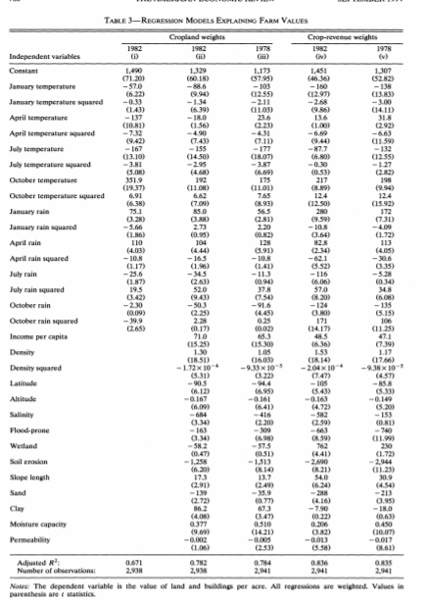
Climate change and land rent value
Mendelsohn, Robert & Nordhaus, William D & Shaw, Daigee, 1994. "The Impact of Global Warming on Agriculture: A Ricardian Analysis," American Economic Review, American Economic Association, vol. 84(4), pages 753-771, September.
Controls

Slide 46
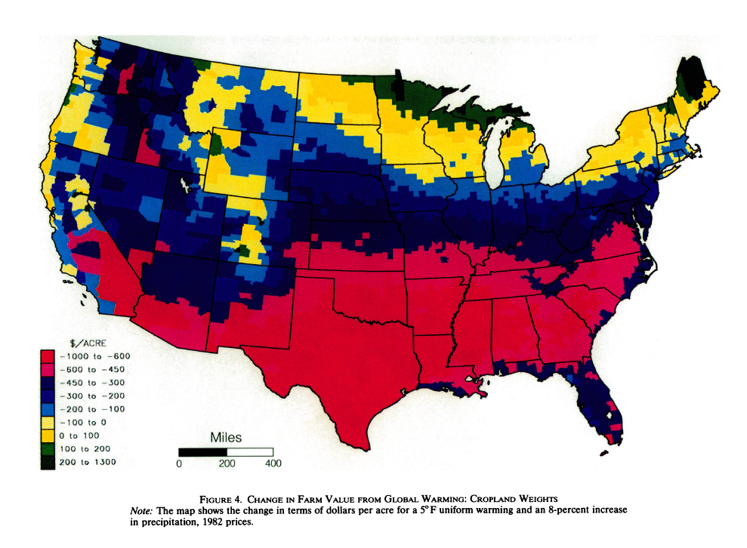
Climate change and land rent value
Regression
  Dependent variables: Cropland values
  Control variables: Temperature, Precipitation, Soil conditions, etc.

Slide 47
Comparison and irrigation
Comparison
  Schlenker et al. (2005) focused on irrigation by separating U.S. into irrigated and dryland counties.
Conclusion
  A hedonic farmland value regression for irrigated areas requires different variables than for dryland areas (Schlenker et al. 2005).
  Economic effect of climate change for dryland non-urban areas is negative, and adding in irrigated areas the losses would be greater. (Mendelsohn et al. 1994 got some beneficial result)
Schlenker, W., Hanemann, W.M. and Fisher, A.C., 2005. Will US agriculture really benefit from global warming? Accounting for irrigation in the hedonic approach. American Economic Review, 95(1), pp.395-406.

Slide 48
Criticisms
Partial equilibrium, exogenous price
Linkage of climate and economic data
Time horizon and spatial scale covered by available data (limiting the use of panel-data model)
No CO2

Slide 49
Emerging or Untreated Issues in Assessment
Probability and severity of extreme events
Valuation of non-market impacts (loss of life and bio-diversity)
Distributional issues (weights)
Aggregation and extrapolation from limited geographic studies hides heterogeneity of responses to climate change
How can we alter policy/research innovation investment to achieve a more desirable mix of CC Impacts
Notes:
xx

Slide 50
More References
Chen, C.C. and B.A. McCarl, "Pesticide Usage as Influenced by Climate: A Statistical Investigation", Climatic Change, 50, 475-487, 2001.
Chen,C. C., D. Gillig and B. A. McCarl, "Effects of Climatic Change on a Water Dependent Regional Economy: A Study of the Texas Edwards Aquifer", Climatic Change, 49, 397-409, 2001.
Chen, C. C., B. A. McCarl, and R.M. Adams, "Economic Implications of Potential Climate Change Induced ENSO Frequency and Strength Shifts", Climatic Change, 49, 147-159, 2001.
Irland, L. C., D.M. Adams, R.J. Alig, C. J. Betz, C.C. Chen, M. Hutchins, B.A. McCarl, K. Skog and B. L. Sohngen, "Assessing Socioeconomic Impacts of Climate Change on U. S. Forests, Wood-Product Markets and Forest Recreation", BioScience, 51(9) September, 753-764, 2001.

