Slide 1

Economic Vulnerability under Climate Change
: With an Agricultural Emphasis
Bruce A. McCarl
Distinguished Professor of Agricultural Economics
Texas A&M University mccarl@tamu.edu
http://agecon2.tamu.edu/people/faculty/mccarl-bruce/
Climate Change Adaptation
Energy
Climate Change Mitigation
Climate Change Impacts
Ramblings from an Ongoing and Never Ending Effort

Slide 2
Would Climate Change Hurt/Benefit?

Slide 3
Climate Impacts Analytical Framework
GCM /ESM SSP Scenario
Feedback
External
Environmental
impacts
Physical
impacts on
Yield, cost, variability, resource available
Given Climate Scenario
Aggregate
Economic
Impacts
Regional
impacts
Output
Many on and off ramps

Slide 4
Assessment Methodology - Summary Steps
Identify sectors and physical Impacts to examine
Determine spatial and time scales
Adopt or develop scenario regarding non-climatic factors
Obtain GCM projections
Chose analytical framework (econ theory foundation and physical/econometric models to be used)
Use or estimate models on physical impacts
Project physical impact of climate change and a no change case
Make assumptions about unmodeled phenomena
Incorporate physical impact into economic models
Construct with and without climate change projections
Incorporate data on possible adaptations to climate change
Do analysis with adaptation
Link to finer scale and environmental models
Do finer scale climate impacts projection
If needed feedback to physical
Notes:
xx

Slide 5
Scope of Assessment
Identify sectors and physical Impacts
  The question relates to the choice of sector of the economy for impact assessment – agriculture, water, etc. Can this really be treated independently? Also one identifies what types of things like crop yields, livestock weight gain, costs etc
Economic and geographic scale
  Firm level or sector level assessment, regional or national or international
Time frame
  Climate change is a long-term phenomenon that requires analysts to decide the time frame of analysis, which would determine impact assessment results
  Dynamic Vs Static Analysis
Notes:
Scope of Assessment: The scope will determine the type of analytical framework you would need to conduct the impact assessment. The analytical framework will, in turn, will influence the assessment results. For example, in firm level impact assessment, prices are fixed that might give a different assessment compared to when prices are endogenous.
Economic scale of assessment: Firm level analysis or sector level analysis
Geographic scale of assessment: Regional or national or international assessment
Time frame: Projections are made for 2030, 2060, and 2100. Dynamic assessment considers climate change in time steps, while under static analysis time between base and climate change is ignored. Dynamic analysis can account for time path of climate change (gradual warming).

Slide 6
Scenario Development
Climate change Scenarios CMIP4-5-6
Non-climatic Scenarios – SRES-SSP
Time frame and uncertainty
Notes:
Time frame and uncertainty: As climate change analysis involves a longer term horizon, factors that affect estimates of impact assessment, e.g. population, technology, resource availability etc., are also likely to change. Predicting some of the factors might be beyond the scope of assessment. Therefore, we might need to make assumptions about these factors, which is what scenario building is referred to. For example, in U.S. assessment assumptions were made about how rest of the world will be impact by climate change, which lead to gains from trade in the assessment. In West African study on climate change, I used prices from the U.S. model as an estimate of what the import prices would be for West Arica in the event of climate change.

Slide 7
Degree of climate change - RCPs
Representative Concentration Pathway Scenarios
Representative Concentration Pathway (RCP) scenarios specify watts of climate forcing per square meter and reflect concentrations and corresponding emissions, but are not directly based on socio-economic storylines.
Representative Concentration Pathways (RCPs) Scenarios that include time series of emissions and concentrations of the full suite of greenhouse gases and aerosols and chemically active gases, as well as land use/land cover.
The word representative signifies that each RCP provides only one of many possible scenarios that would lead to the specific radiative forcing characteristics.

Slide 8
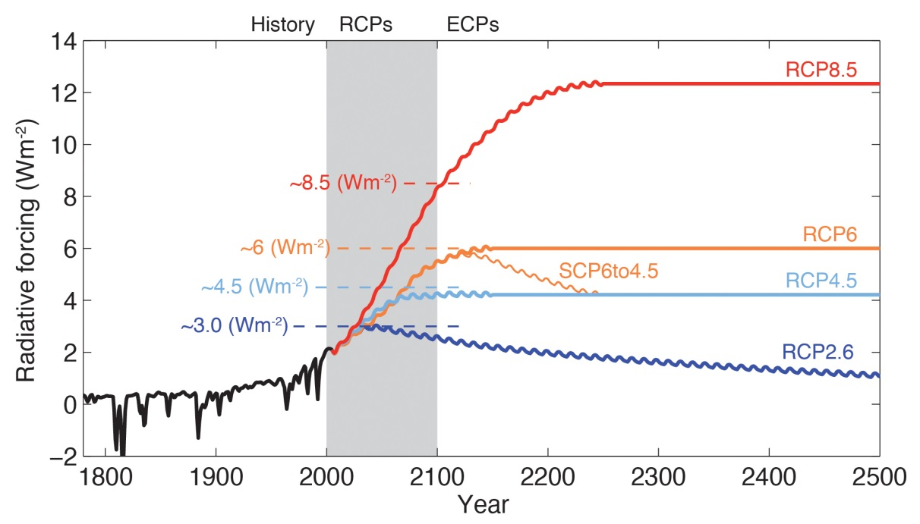
RCPs
Four RCPs produced from Integrated Assessment Models were used in AR5
RCP2.6 One pathway where radiative forcing peaks at approximately 3 Watts per square meter Wm^{–2} before 2100 and then declines
RCP4.5 An intermediate stabilization pathway in which radiative forcing is stabilized at approximately 4.5 Wm^{–2} after 2100
RCP6.0 An intermediate stabilization pathway in which radiative forcing is stabilized at approximately 6.0 Wm^{–2} after 2100
RCP8.5 A high pathway for which radiative forcing reaches greater than 8.5 Wm^{–2} by 2100
From WGI AR5 Box 1.1

Slide 9
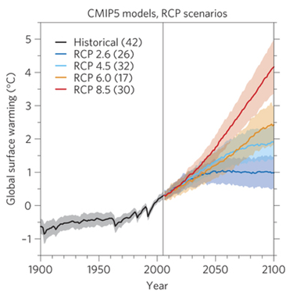
Yet more could happen
What could happen
What we have seen so far
Figure 1: Global temperature change and uncertainty. From Robustness and uncertainties in the new CMIP5 climate model projections
Reto Knutti & Jan Sedláček, Nature Climate Change 3, 369–373 (2013) doi:10.1038/nclimate1716,

Slide 10
Non Climatic - Socio-Economic Scenarios
Before AR5 we had what was called the SRES scenarios which were based on populations, income, technology
As of AR5 we switched to RCPS which are purely GHG concentration based. But a group has developed shared socioeconomic pathways (SSPS) to accompany them
O’Neill, Brian C., et al. "A new scenario framework for climate change research: the concept of shared socioeconomic pathways." Climatic Change 122.3 (2014): 387-400.
Riahi, Keywan, et al. "The shared socioeconomic pathways and their energy, land use, and greenhouse gas emissions implications: an overview." Global Environmental Change (2016).
Van Vuuren, Detlef P., et al. "A new scenario framework for climate change research: scenario matrix architecture." Climatic Change 122.3 (2014): 373-386.
Notes:
Often the question that the policy makers pose is weather are not the society will be vulnerable to climate change. The vulnerability to climate change, however, will be determined by the degree of climate change and also by socio-economic factors (non-climatic stress, as the U.S. National Assessment Report calls them) such as population, demand, economic growth, and economic structure. Researchers have handeled soico-economic factors in at least two different ways. There are studies, for example, Yates and Strzepek; Rosenzweig and Hillel, that have incorporated population projections and various scenarios of demand and economic growth into their assessment studies. Other researchers, for example, Adams et al., have examined climate change impact against existing conditions.
There is an uncertainty in projecting socio-economic factors. A motivation for including socio-economic scenarios is that one can perform sensitivity analysis to impact assessment under different assumption about socio-economic scenarios, while motivation for excluding these factors is to not confound analysis with further uncertainties.
Club of Rome predicted a catastrophic increase in mortality rates through out the world beginning in the first decades of the 21st century, largely as a result of resources shortages (Gottinger). However, technology and discovery of new resource falsified their pessimism.

Slide 11
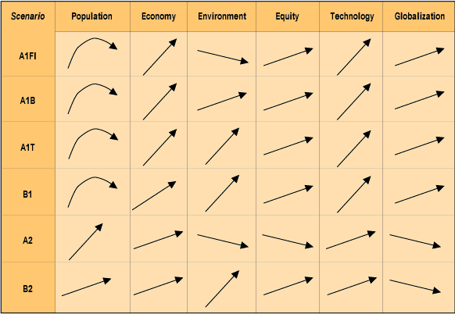
Scenarios
The Socio-Economic Driven SRES Scenarios
The SRES (Special Report on Emissions Scenarios) scenarios resulted from specific socio-economic scenarios regarding future demographic and economic development, regionalization, energy production and use, technology, agriculture, forestry and land use
The climate change projections discussed in AR4 were based primarily on the SRES A2, A1B and B1 scenarios.

Slide 12
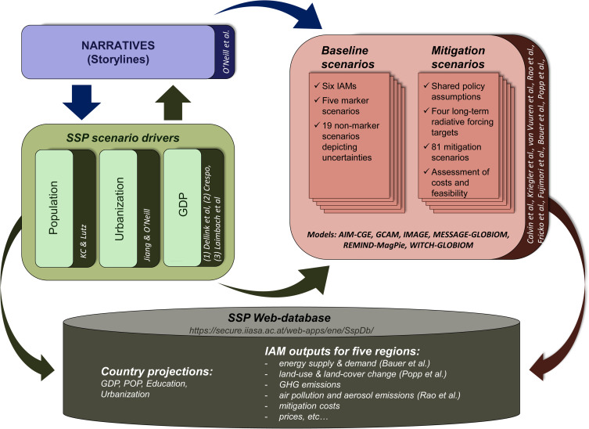
Non Climatic - Socio-Economic Scenarios
Socio-economic pathways describe the drivers of how the future might unfold in terms of population growth, governance efficiency, inequality across and within countries, socio-economic developments, institutional factors, technology change, and environmental conditions
Fig. 1. Schematic illustration of main steps in developing the SSPs, including the narratives, socioeconomic scenario drivers (basic SSP elements), and SSP baseline and mitigation scenarios.
Riahi, Keywan, et al. "The shared socioeconomic pathways and their energy, land use, and greenhouse gas emissions implications: an overview." Global Environmental Change (2016).

Slide 13
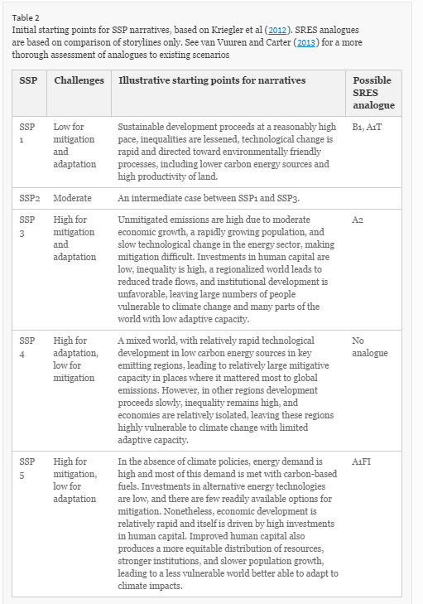
Non Climatic - Socio-Economic Scenarios
From O’Neill, Brian C., et al. "A new scenario framework for climate change research: the concept of shared socioeconomic pathways." Climatic Change 122.3 (2014): 387-400.

Slide 14
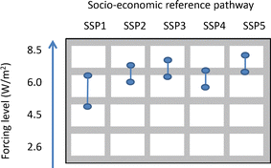
Non Climatic - Socio-Economic Scenarios
Matrix from
Van Vuuren, Detlef P., et al. "A new scenario framework for climate change research: scenario matrix architecture." Climatic Change 122.3 (2014): 373-386.
Not a One to one mapping
For a discussion see the special issue on this
Nakicenovic, Nebojsa, Robert J. Lempert, and Anthony C. Janetos. "A framework for the development of new socio-economic scenarios for climate change research: introductory essay." Climatic Change 122.3 (2014): 351-361

Slide 15
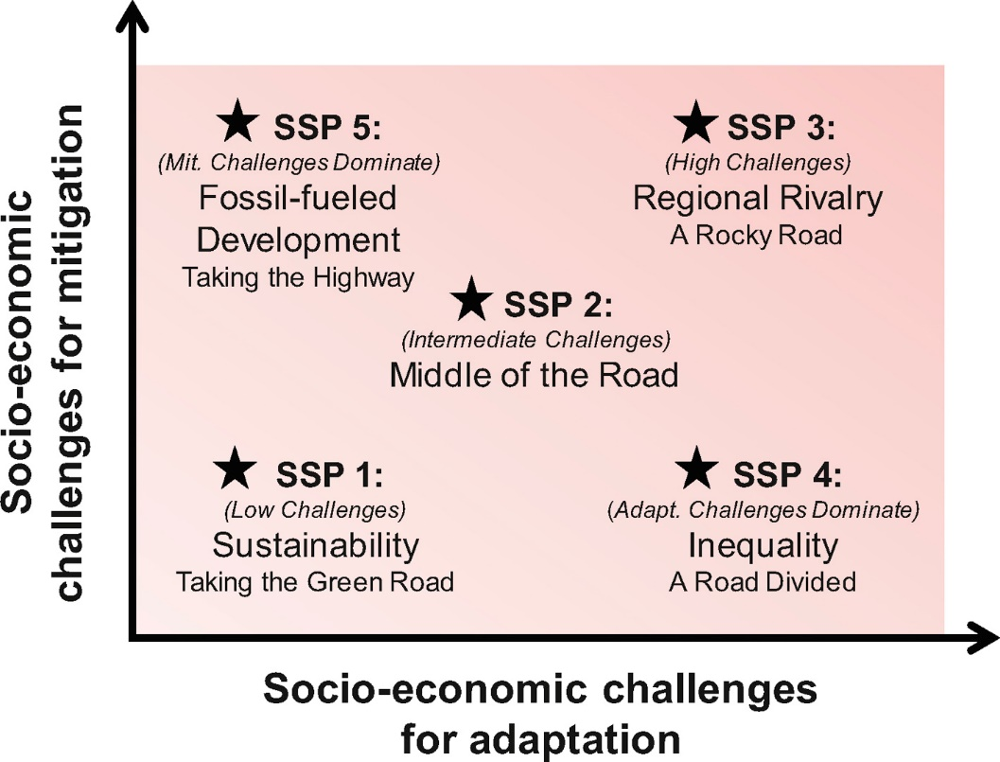
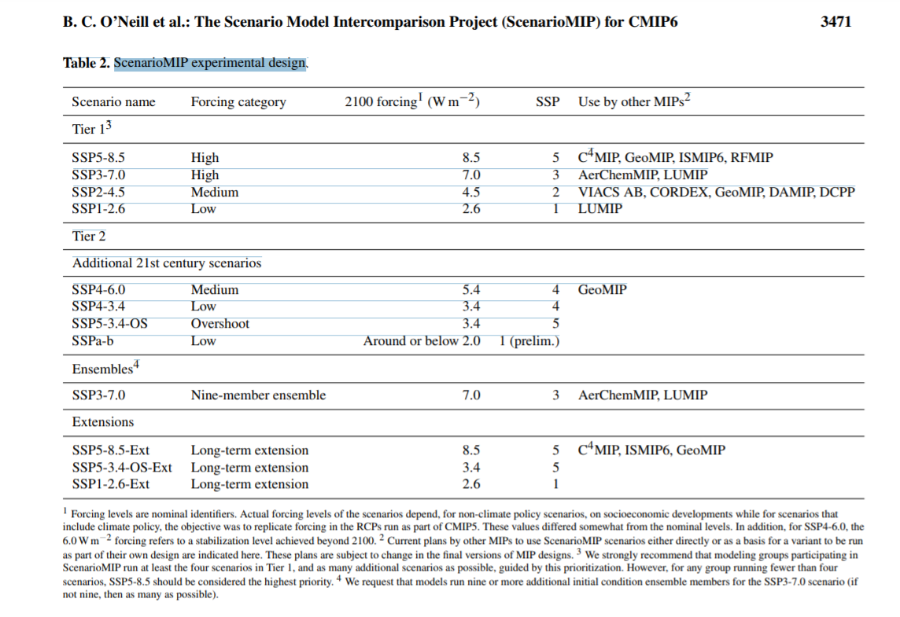
Some new economic Scenarios –
Shared Socioeconomic Pathways (SSPs)
Scenario framework combining radiative forcing with socioeconomic development. These describe alternative trends in society and ecosystems over a century. They involve story lines on how social, economic, and environmental development could produce the RCPs.
Being used in CMIP6
O’Neill, Brian C., Elmar Kriegler, Keywan Riahi, Kristie L. Ebi, Stephane Hallegatte, Timothy R. Carter, Ritu Mathur, and Detlef P. van Vuuren. "A new scenario framework for climate change research: the concept of shared socioeconomic pathways." Climatic change 122, no. 3 (2014): 387-400.
O’Neill, B.C., Kriegler, E., Ebi, K.L., Kemp-Benedict, E., Riahi, K., Rothman, D.S., van Ruijven, B.J., van Vuuren, D.P., Birkmann, J., Kok, K. and Levy, M., 2017. The roads ahead: Narratives for shared socioeconomic pathways describing world futures in the 21st century. Global Environmental Change, 42, pp.169-180.
O'Neill, B.C., Tebaldi, C., Vuuren, D.P.V., Eyring, V., Friedlingstein, P., Hurtt, G., Knutti, R., Kriegler, E., Lamarque, J.F., Lowe, J. and Meehl, G.A., 2016. The scenario model intercomparison project (ScenarioMIP) for CMIP6. Geoscientific Model Development, 9(9), pp.3461-3482.

Slide 16
Obtain GCMs Projections
  Data Distribution Center of IPCC maintains GCM projections (http://ipcc-ddc.cru.uea.ac.uk/)
  Decide GCM scenarios whose projections you would use (Ref. Guide to GCM Scenarios - DDC)
  Visualization pages /Downloadable files
  Chose GCMs that have better calibrated base climate for the assessment country/region
  Compuate percentage changes in temp. and precipt for a grid and apply to weather stations
  Choose more than one GCMs for sensitivity analysis

Slide 17
GCM - Geographic Scale
Circa 2001
  HADCM: 3.75 x 2. 5 deg. (96X72 grids)
  CGCM: 3.75 x 3.75 deg. (96*48 grids)
  GDFL: 7.5 x 4.5 deg. (48*40 grids)
    Texas was covered by 4 grids
Today
GCMs depict the climate using a three dimensional grid over the globe (see below), typically having a horizontal resolution of between 250 and 600 km (2.25-5.4 degrees), 10 to 20 vertical layers in the atmosphere and sometimes as many as 30 layers in the oceans.
Notes:
Recently, GCMs experiments have been made for finer geo-graphic and time scales. These are called Stretched Grid GCMs and provide projections for as low as 40 Km resolution and for seasonal, annual, and multi-year time scale. See, Robinovitz, University of Maryland.
http://www.pnl.gov/ccpp/oct01mtg/Fox-Rabinovitz_Oct2001.pdf

Slide 18
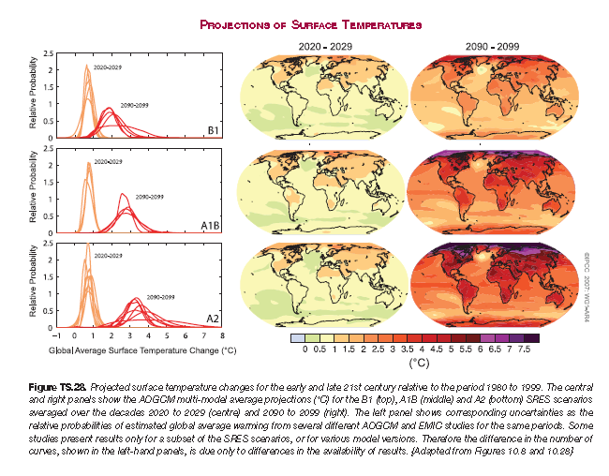
Time scale What is projected
  Hotter

Slide 19
Physical Analytical Framework
Statistical
Spatial Analogue/current data
Simulation Approach

Slide 20
Broad classes of Impacts
Temp Rainfall CO2 Sea Level Extreme Events
Plants
Crop and forage growth X X X X
Crop /forage water need X X X X
Soils
Soil moisture supply X X
Irrigation demand X X X
Soil fertility X X
Animals
Performance X X X
Pasture/Range Carry cap X X X X
Markets
Demand curve& prices X X X X X
Import supply & prices X X X X X
Land values X X X X
Irrigation Water Supply
Evaporation loss X X
Run-off/general supply X X X
Non-AG competition X X X
Other
Water borne transport X X
Port facilities X X
Pest and diseases X X
Insurance X X X
Crop land X X X

Slide 21
Statistical Framework
Crop
Yield
Ice
Temperature
Fire
Zeros at extremes
Inflection Point
At least quadratic functional form maybe higher order or piecewise
Attavanich, W. and McCarl, B.A., 2014. How is CO 2 affecting yields and technological progress? A statistical analysis. Climatic change, 124(4), pp.747-762.
Schlenker, W. and Roberts, M.J., 2009. Nonlinear temperature effects indicate severe damages to US crop yields under climate change. Proceedings of the National Academy of sciences, 106(37), pp.15594-15598.

Slide 22
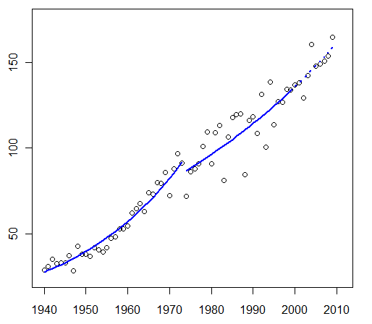
Statistical Framework
US corn yields
Heteroskedastic?

Slide 23
Heteroskedastic Model Estimation
Climate potentially impacts both mean and variance
To estimate Just and Pope (1978) stochastic production function is employed:
Y=f(x,β)+h(x,α)ε
where
f(x,β) models the mean process,
h(x,α) models (heteroskedastic) variance,
ε is an i.i.d. error. E(ε)=0
E(Y)=E(f(x,β)+h(x,α) ε) = f(x,β)+h(x,α) E(ε) = f(x,β)
σ²(Y) = E(f(x,β)+h(x,α) ε)-E(Y))² ⁼ h²(x,α) σ²(ε)
McCarl, B.A. and Rettig, R.B., 1983. Influence of hatchery smolt releases on adult salmon production and its variability. Canadian Journal of Fisheries and Aquatic Sciences, 40(11), pp.1880-1886.
McCarl, B.A., Villavicencio, X. and Wu, X., 2008. Climate change and future analysis: is stationarity dying?. American Journal of Agricultural Economics, 90(5), pp.1241-1247.

Slide 24
Statistical Framework
Climate descriptors
  Temp
  Precip
  THI – temperature humidity
  Degree days
  Cooling days
  Extremes
    Precipitation intensity
    Hot days
    Dry days
    Hurricanes
    Dry-hot days
    PDSI
  May need thresholds
Other descriptors
  Tech progress- time
  CO2
  ENSO – El Nino
  DCV
  Input use
  Prices
  Irrigation extent
  Upstream Water shed conditions
Attavanich, W. and McCarl, B.A., 2014. How is CO 2 affecting yields and technological progress? A statistical analysis. Climatic change, 124(4), pp.747-762.
Schlenker, W. and Roberts, M.J., 2009. Nonlinear temperature effects indicate severe damages to US crop yields under climate change. Proceedings of the National Academy of sciences, 106(37), pp.15594-15598.
XinXin Fan, Three Essays on Climate Change, Renewable Energy and Agriculture in the US, Ph.D. Dissertation, Texas A&M University, May, 2018
File Number 2533 Zhang, H. , J.E. Mu, and B.A. McCarl, "Will future climate change increase global energy use?", 2019.

Slide 25
What is Spatial Analogue?
Spatial analogues are regions which today have a climate analogous to that anticipated in the study region in the future
Predict future changes
Used to infer how changes in an environmental condition or input will change yields or another measure of interest
Need information from a range of conditions
Adams, Richard A. "On the search for the correct economic assessment method." Climatic change 41.3 (1999): 363-370.

Slide 26
What is Spatial Analogue? (Example)
What would happen if the climate warmed?
  Look at warmer regions to infer how cooler regions would adapt if warmed
Assumption: Farmers in the cooler region will be able to adapt the warmer region practices
Uses statistical/econometric methods
  Investigate change in spatial patterns of crop production
Adams, Richard A. "On the search for the correct economic assessment method." Climatic change 41.3 (1999): 363-370.

Slide 27
Spatial Analogue Limitations
Farmers in one region may not be willing or able to adapt in the same way that a farmer in a different region can.
  Cool to warm climate
Magnitude of CO₂ level changes create a new growing environment
  If changes larger than what is seen previously, we cannot accurately predict Impact
  Multiple changes simultaneously can lead to different outcomes for adaptation practices

Slide 28
Spatial Analogue Limitations
Ignores changes in input and output prices that may result from non-climate change
  May impact adaptation decisions
Range restriction
Requires a data set containing multiple regions over time
  May not be available in developing countries

Slide 29
Climate and Milk Production
Milk production is especially sensitive to climate conditions and climate is projected to change in the future
Econometric panel data approach is commonly used to analyze climate change effects on crop yields but few studies did econometric analysis to examine climate effects on milk production
And spatial models dealing with omitted variables and spatial correlation are not applied in previous studies
XinXin Fan, An Integrated Analysis of Federal Milk Marketing Order Price Differential Policy and Climate Change Effects in the U.S Dairy Industry, TAMU AGEco PhD Thesis, 2018

Slide 30
Climate and Milk Production
Objective:
Explore climate effects on milk production considering spatial correlation;
Project future changes of milk production based on climatic projection
Data
Historical data: annual dataset for 48 contiguous US states from 1924 to 2016
Projected climate data: temperature and precipitation are drawn from RCP 2.6 emission scenario using Beijing Climate Center Climate System Model (BCC_CSM 1.1) in 2030 (wrong one – Why?)
Temperature Humidity Index (THI) takes air temperature and humidity into account and represents heat stress. A U shaped curve is expected with the threshold level identifying the value above which heat stress starts to diminish productivity. This threshold has been identified to fall in the range from 64 to 86, with a THI value of 72 being the most common.

Slide 31
Climate and Milk Production
Panel – non spatial estimation results
 | Fixed effects
Spring Palmer Modified Drought Index (PMDI) | 0.00 | *** | U
Square | 0.00 | ***
Summer Palmer Modified Drought Index (PMDI) | 0.00
Square | 0.00
Winter Palmer Modified Drought Index (PMDI) | 0.01 | *** | Inv U
Square | 0.00 | ***
Summer Precipitation | -0.01 | *** | U
Square | 0.00 | ***
Spring Precipitation | -0.01 | *** | U/L
Square | 0.00
Winter Precipitation | 0.00 | *** | U
Square | 0.00 | ***
Max Spring Temperature Humidity Index | -0.05 | *** | U
Square | 0.00 | ***
Min Spring Temperature Humidity Index | 0.07 | *** | Inv U
Square | 0.00 | ***
Max Summer Temperature Humidity Index | 0.06 | *** | Inv U
Square | 0.00 | ***
Min Summer Temperature Humidity Index | -0.05 | ** | U
Square | 0.00 | *
Max Winter Temperature Humidity Index | 0.03 | ** | Inv U
Square | 0.00 | **
Min Winter Temperature Humidity Index | -0.02 | ** | Inv U
Square | 0.00 | *
Time | 0.01 | ***
Time Squared | 0.00 | ***
Constant | 2.98 | ***
R Squared | 0.95
* notes significance at 10% level, ** at 5%, and *** at 1%

Slide 32
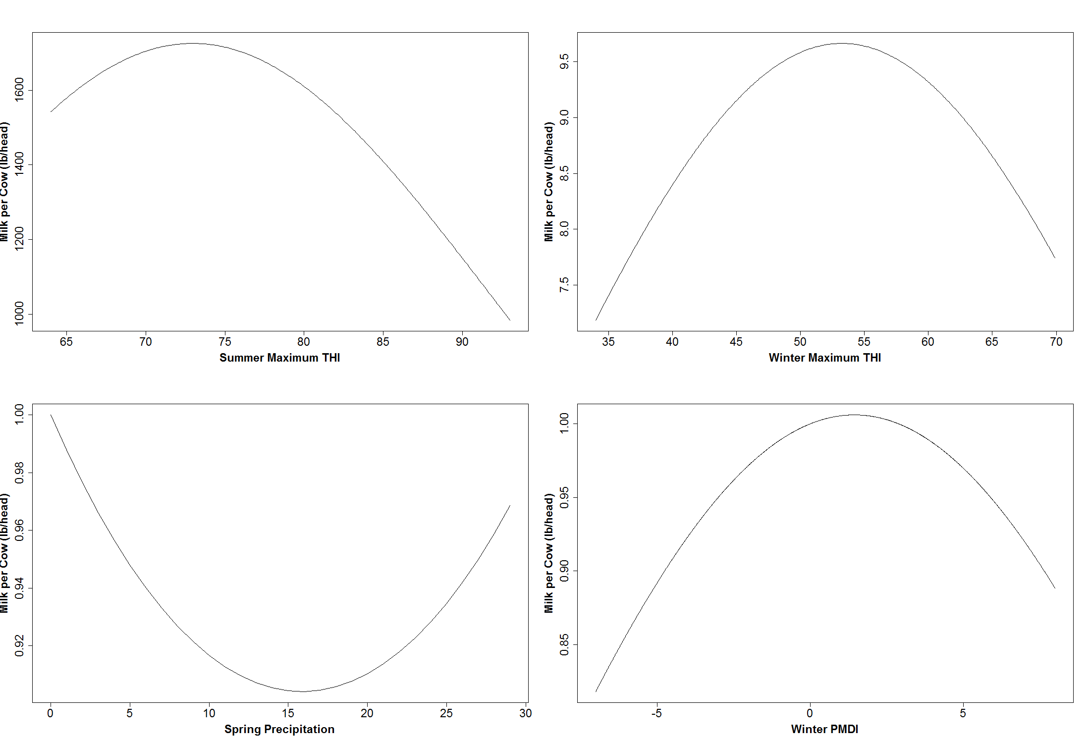
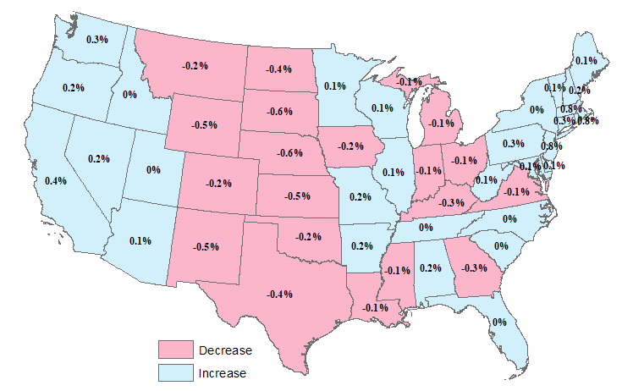
Results
Climate and Milk Production
Based on climate projection in 2030:
Milk production weights of the states would:
increase West and Northeast
decrease Midwest and South
Based on SDM:
Summer maximum THI, winter maximum THI and winter PMDI: inverse U-shaped relationships, respectively with a critical value of 72, 55, 1.5
Spring precipitation: U-shaped relationship with a threshold value of 15

Slide 33
CO2 and crop Production
CO₂ is widely acknowledged as a major growth stimulating factor for some crops and a drought response factor for others
In estimations CO2 is a missing factor since time is almost always a proxy for technological progress
Plus CO₂ and time are highly correlated not allowing identification of their separate effects. (correlation ~ 0.96
Consequently, the estimates of climate change effects from observed data are almost certainly biased.
Here is attempt to resolve this difficulty by merging historical data with FACE experiment data.
Attavanich, W., and B.A. McCarl, "How is CO2 Affecting Yields and Technological Progress? A Statistical Analysis", Climatic Change, Volume 124, Issue 4 (2014), Page 747-762, 2014.
Witsanu Attavanich Essays on the Effect of Climate Change on Agriculture and Agricultural Transportation Ph.D. Dissertation, Texas A&M University, Oct 2011

Slide 34
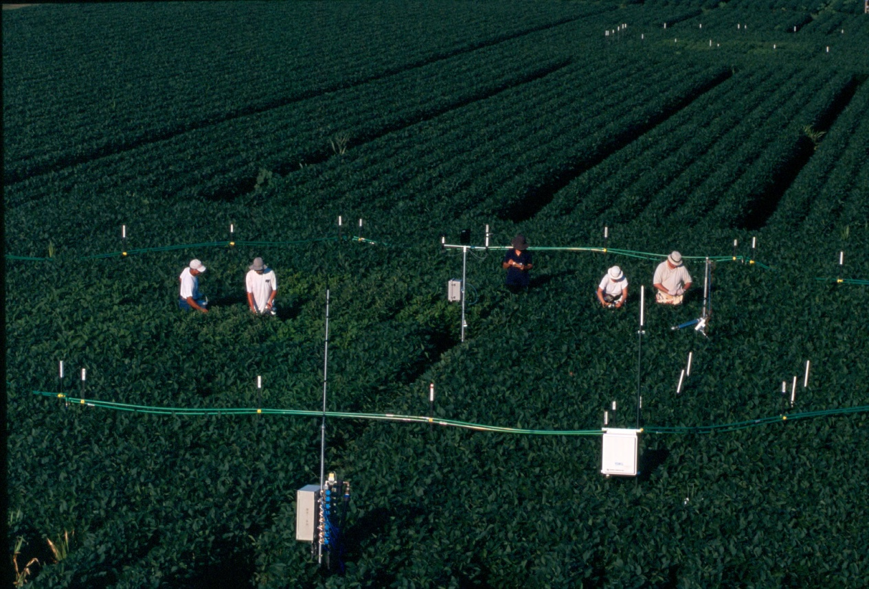
CO2 and crop Production
In the FACE experiments, air enriched with CO₂ is blown into the rings where crops are grown in the real field (not in the chamber). Then, a computer-control system uses the wind speed and CO₂ concentration information to adjust the CO₂ flow rates to maintain the desired CO₂ concentration.
Source: http://soyface.illinois.edu/
Notes:
In the FACE experiments, air enriched with CO₂ is blown into the rings where crops are grown in the real field (not in the chamber). Then, a computer-control system uses the wind speed and CO₂ concentration information to adjust the CO₂ flow rates to maintain the desired CO₂ concentration.

Slide 35
CO2 and crop Production - Modeling
Just-Pope Production Function
  Considering average and variability of crop yields
  y is yield
  X are independent variables
  is the function of average yield with β being estimated parameters
  is the function of yield variance with α being estimated parameters
  X contains time trend, planted acreage, yearly growing season mean temperature, yearly total precipitation, atmospheric CO₂, drought index, yearly precipitation intensity, number of hot days, ENSO events, dummy variable for FACE experiment observations, and state dummies plus interactions

Slide 36
CO2 and crop Production - Data
Observational data
  The state-level dataset of annual crop yields, planted acreage across the US from 1950 – 2009 were drawn from the USDA-NASS
  Atmospheric CO₂ concentration and state-level climate data, total precipitation, growing season temperature, seasonal Palmer Drought Severity Index (PDSI) are obtained from NOAA
  State-yearly precipitation intensity, number of days in each state that maximum temperature > 32°C, and the crop-growing-season ENSO phases by state are constructed using data from NOAA

Slide 37
CO2 and crop Production - Data
FACE experiment data
  Arizona and Illinois FACE experiment datasets.
  In Arizona, cotton (1989, 1990,1991), wheat (1993, 1994, 1996, 1997), and sorghum (1998, 1999)
  In Illinois corn (2004, 2008) and soybeans (2002-2007).
  Each crop is planted under ambient and elevated CO₂. There are generally 4-5 rings for each experiment in each year

Slide 38
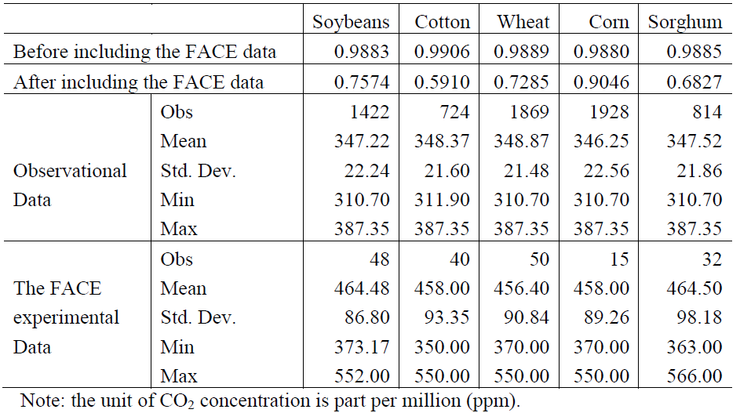
CO2 and crop Production - Data
Table 1. CO₂ concentration statistics and correlation coefficients between time trend and CO₂ concentration before and after combining the FACE data
Notes:
Before merging in the FACE data, time trend and CO₂ are highly correlated,
After including the FACE data correlation coefficient drops substantially except for corn, where we only have a few FACE observations.

Slide 39
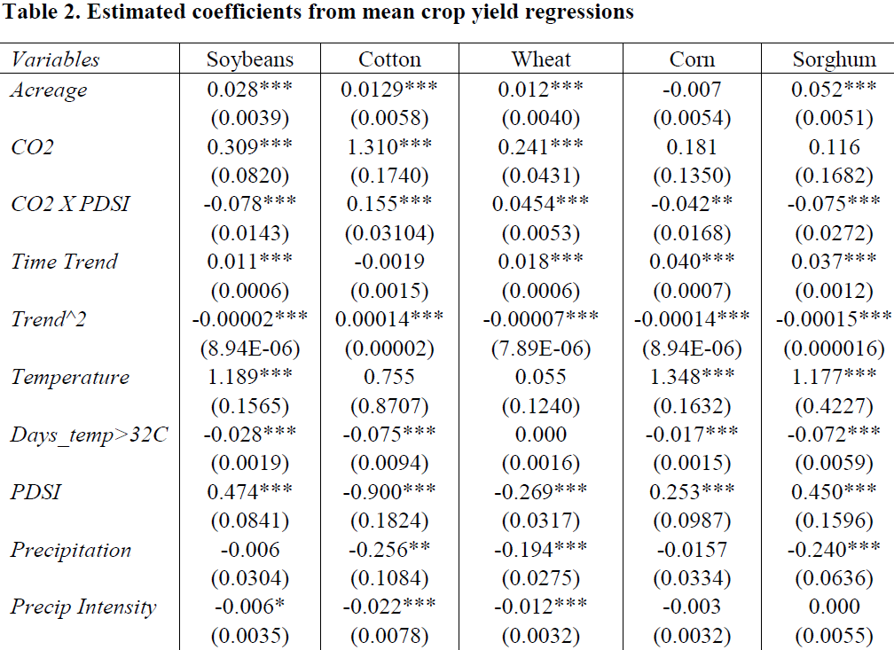
CO2 and crop Production - Results
Notes:
Except for Palmer Drought Severity index (PDSI), all variables are studied in their logarithm form.
Due to time limitation, we present only some interesting results. For CO₂ fertilization effect on mean crop yields, soybeans, cotton, and winter wheat (C3 crops) are positively correlated with the CO₂ at 1 percent level, while yields of corn and sorghum (C4 crops) are not. However, yields of corn and sorghum (C4 crops) are negatively correlated to the interaction between CO₂ and PDSI, which implies that C4 crops indirectly benefit from elevated CO₂ in times and places of drought stress meaning that the higher the level of drought stress, the greater the yields of C4 crops. Above findings are consistent with yield stimulation of CO₂ from the existing FACE experiment literature such as Ottman et al. (2001), Kimball (2006), Long et al. (2006), and Leakey (2009).
For time as a proxy for technical change, time effect on mean yields is non-linear with diminishing effects over time, except for cotton
Using specification with/without CO₂ included, we fund that ignoring CO₂ concentration is likely to overestimate technological progress except for sorghum.
For the effect of climate change, a higher of hot days (> max 32°C) adversely affects yields of soybeans, cotton, corn, and winter wheat
Considering influences of drought stress on crop yields, we find that its net effect on yields of soybeans, corn, and sorghum tends to decrease, and vice versa for yields of cotton and winter wheat as CO₂ increases.
For precipitation intensity, we find it is harmful to soybeans, cotton, and wheat,

Slide 40
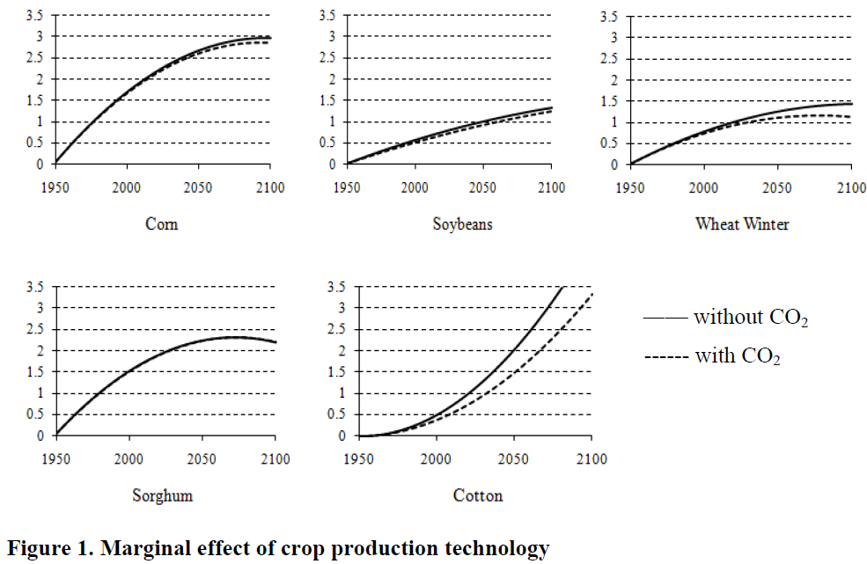
CO2 and crop Production - Results

Slide 41
CO2 and crop Production - Results
To project climate change effect on crop yield, we use GFDL-CM 2.0, GFDL-CM 2.1, MRI-CGCM 2.2, and CNRM-CM3 scenarios with the IPCC SRES scenario A1B
To explore the market outcomes and welfare implications of climate-induced shifts in yields across the US, an Agricultural Sector Model (ASM) developed by McCarl and colleagues is employed
  Briefly, ASM includes all states in the conterminous US, broken into 63 subregions for agricultural production and 11 market regions. The model also links the US to the rest of the world via international trade of major commodities across 37 foreign regions

Slide 42
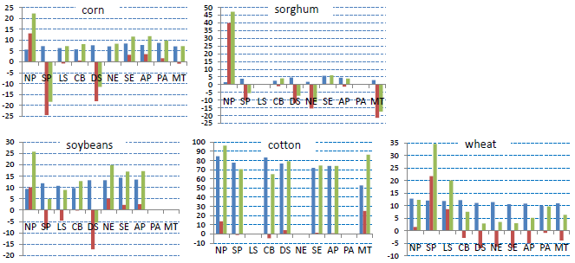

CO2 and crop Production - Results

Slide 43
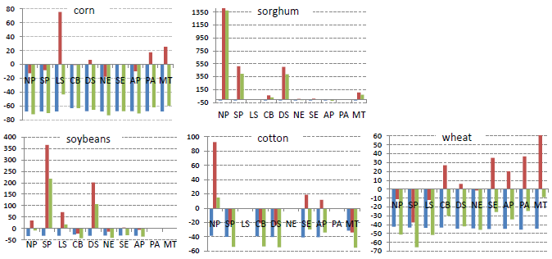
CO2 and crop Production - Results

Slide 44
CO2 and crop Production - Conclusion
C-3 crops positively respond to CO₂, C-4 crops do not.
Ignoring CO₂ in econometric models is likely to overestimate the effect of crop production technology.
Climate conditions and their variability are statistically significant in equations for both average crop yields and their variability.
CS increases, while PS is heterogeneous across US regions, but in total it decreases by about $ 4.72 billion.
Total US welfare is increased about $ 2.27 billion compared to the base scenario.
Yield distributions are non stationary with climate change and CO₂ is a factor.
Returns to agricultural research should be reevaluated by taking into account the effect of the CO₂ fertilization.
Producers are differentially affected across regions.
Notes:
Farm programs and disaster relief registration should be designed to assist producers in regions where their welfare losses are founded.

Slide 45
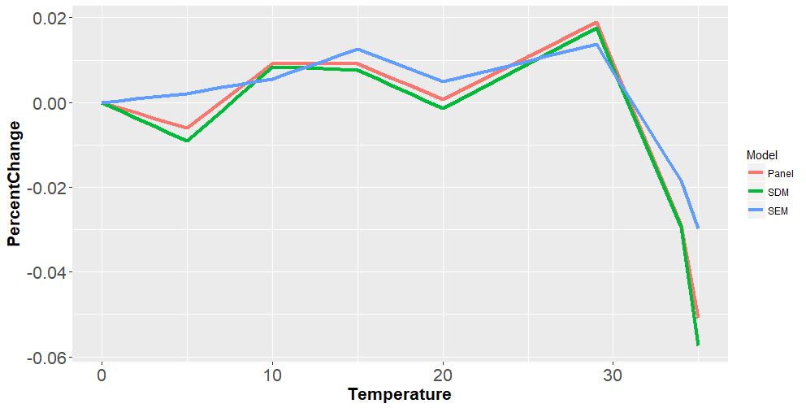
CO2 and crop Production
Projected temperature impact on corn yield
Note: Estimates represent the change in log corn yield due to one additional day of exposure to a given ºC temperature relative to a day spend at 0ºC.
Zidong "Mark" Wang, Three Essays on Climate Change, Renewable Energy and Agriculture in the US, Ph.D. Dissertation, Texas A&M University, Feb, 2018

Slide 46
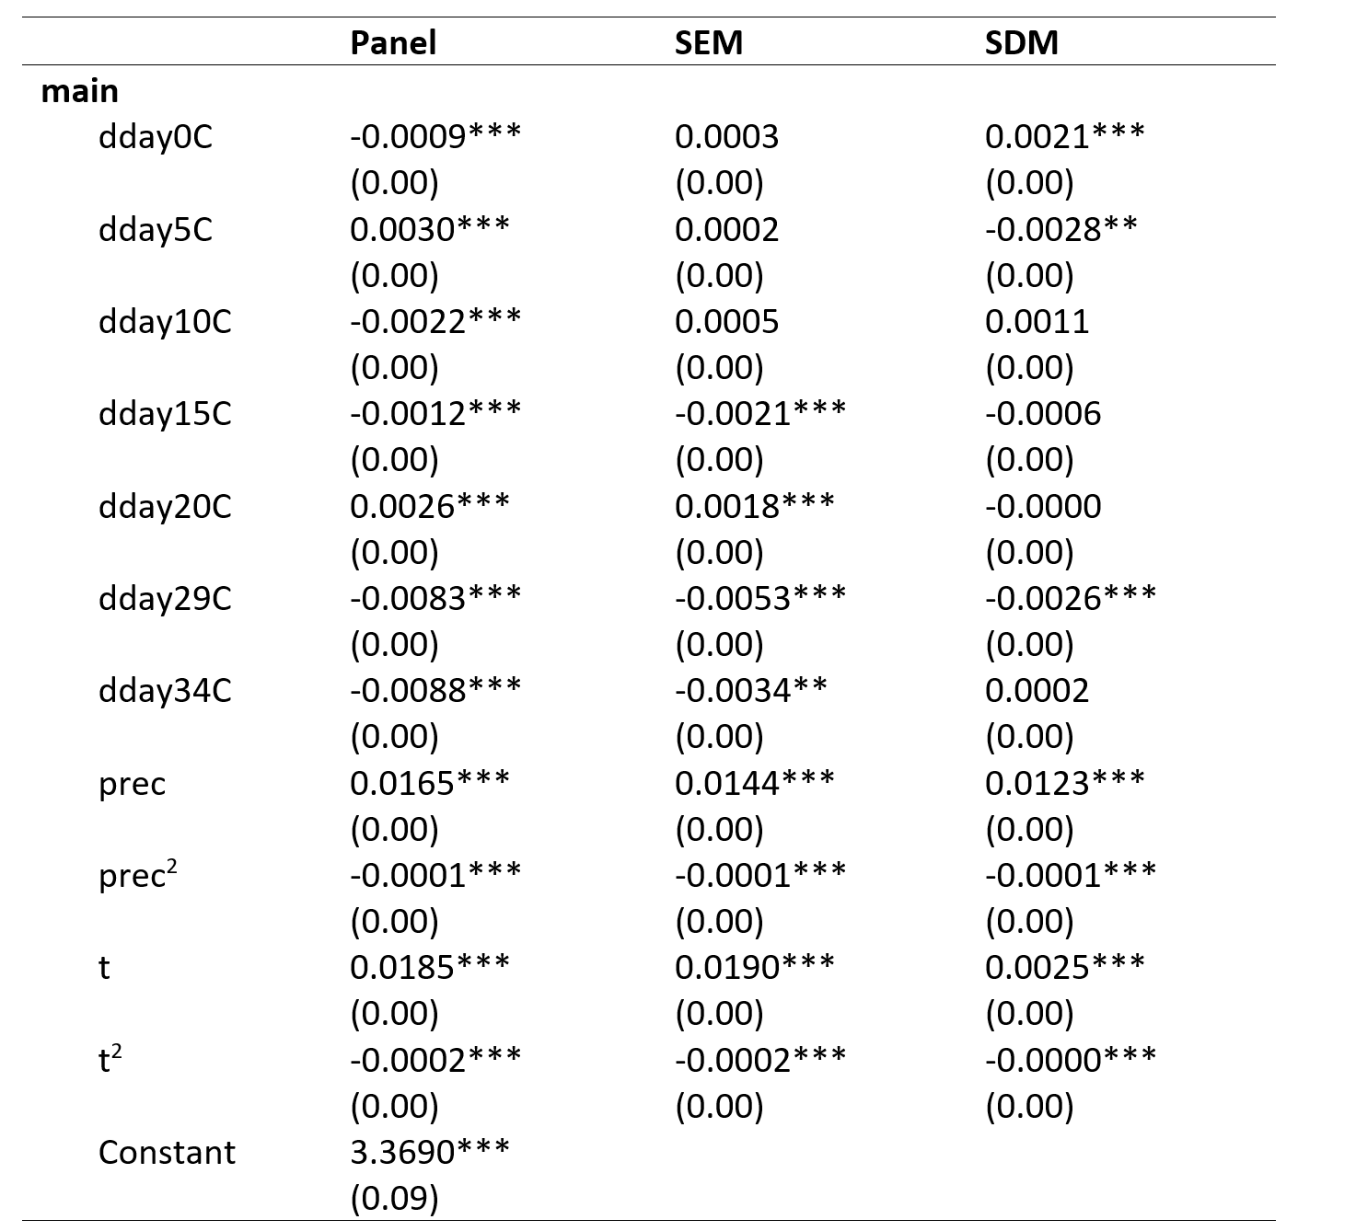
CO2 and crop Production
*P<0.05,**p<0.01,***P<0.001
  Linear splines used for temperature variable: growing season degree days with knots at (0, 5, 10, 15, 20, 29, 34 ºC)
Zidong "Mark" Wang, Three Essays on Climate Change, Renewable Energy and Agriculture in the US, Ph.D. Dissertation, Texas A&M University, Feb, 2018

Slide 47
Climate Impacts on Pests
Impacts of rainfall on total pesticide usage cost for corn, cotton, soybeans and wheat are positive. mixed Impact of temperature.
% Change in Pesticide Cost for a % Change in Climate
Precipitation
Temperature
CORN
-0.0292
0.2284
COTTON
0.3100
0.6607
POTATOES
-0.0777
0.2998
SOYBEANS
-0.0435
-0.1042
WHEAT
-1.1579
1.8678
Chen, C.C. and B.A. McCarl, "Pesticide Usage as Influenced by Climate: A Statistical Investigation", Climatic Change, 50, 475-487, 2001.

Slide 48
CO2 and crop Production – Crop Simulation
National crop sensitivity over all crops giving average yield change in percent to 2030
-- GCM behind Climate Scenario --
Hadley Canadian CSIRO REGCM
Corn Belt 24.02 18.23 6.05 6.58
Great Plains 25.29 17.28 3.67 4.82
Lake States 43.75 53.03 9.34 11.84
Northeast 9.48 -2.07 2.13 4.45
Rocky Mountains 27.74 19.37 18.27 15.04
Pacific Southwest 17.76 21.44 15.58 15.05
Pacific Northwest 65.42 17.01 17.22 18.30
South Central 13.25 -6.06 -0.71 -0.79
Southeast 10.00 -3.16 3.84 2.40
South West 21.66 14.69 3.38 2.60
National 25.14 16.51 6.02 6.46
Red signifies results below mean Source McCarl work for US National Assessment
http://agecon2.tamu.edu/people/faculty/mccarl-bruce/papers/778.pdf

Slide 49
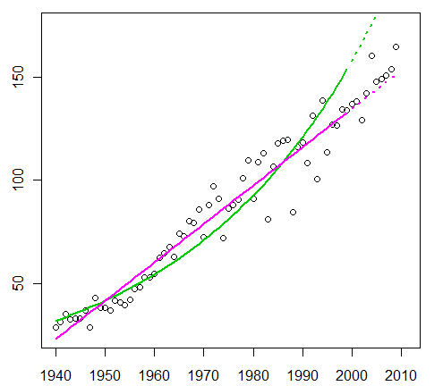
Technology Effects
Technical progress is slowing down work shows part due to climate
US corn yields
Villavicencio, X., B.A. McCarl, X.M. Wu, and W.E. Huffman, "Climate Change Influences on Agricultural Research Productivity", Climatic Change, Volume 119, Issue 3-4, pp 815-824, 2013.
Baker, J.S., B.C. Murray, B.A. McCarl, S.J. Feng, and R. Johansson, "Implications of Alternative Agricultural Productivity Growth Assumptions on Land Management, Greenhouse Gas Emissions, and Mitigation Potential", American Journal of Agricultural Economics, 95: 435-441, 2013.

Slide 50
Live with it – Ecology, Ag, M&I, Water
    Use data for 2030 and 2090
        Canadian Climate Center Model (CCC)
        Hadley Climate Center Model (HAD)
        Average changes for the 10 year periods
Climate Change Scenario Temperature Precipitation
(⁰F) (Inches)
HAD 2030 3.20 -4.10
HAD 2090 9.01 -0.78
CCC 2030 5.41 -14.36
CCC 2090 14.61 -4.56

Slide 51
Live with it – Ecology, Ag, M&I, Water
Results for EA Recharge Prediction
(% change from the BASE )
Hadley
Canadian
Recharge in Drought Years
-20.59
-
29.65
Recharge in Normal Years
-
-19.68
-
-
28.99
Recharge in Wet Years
-23.64
-
34.42
    Municipal Demand
    Forecasted that climate change will increase municipal water demand by 1.5% (HAD) to 3.5% (CCC).

Slide 52
Some Technical Findings - Climate Change Assessment
Using crop simulations climate change has been found to alter dryland and irrigated crop yields as well as irrigation water use.
Crop sensitivity varies by crop, and location as well as the magnitude of warming, the direction and magnitude of precipitation change.
Crops are differentially sensitive. Full range of cropping possibilities needs to be considered when assessing climate change. Early US studies limited to corn, soybeans and wheat, in contrast to later studies which included many more heat tolerant crops. Including cotton, sorghum etc changed sign of total effect.
CO₂ fertilization effect is important factor. Inclusion significantly raises the estimates of climate effected yields of many crops. It is however controversial.
Yield effects vary latitudinally across the world. Yields generally improve in the higher latitudes,. On the other hand there are estimates that there will be net reductions in crop yields in warmer, low latitude areas and semi-arid areas.

Slide 53
Some Technical Findings - Climate Change Assessment
Yield changes can be reduced or enhanced by adaptations made by producers. Farmers may adapt by changing planting dates, substituting cultivars or crops, changing irrigation practices, and changing land allocations to crop production, pasture, and other uses.
Livestock effects can be significant. Adjustments also expected in pasture requirements and range productivity.
Irrigation water availability is an issue. There is also a need to develop estimates on how nonagricultural water use might change in the face of climate change.

Slide 54
Some Economic Findings - Climate Change Assessment
Climate change is not expected to greatly alter global food production or cause a global economic disaster in food production. This occurs because the climatic alteration is less that the range of temperatures now experienced across agriculture.
Impacts on regional food supplies in low latitude regions could amount to large changes in productive capacity and significant economic hardship.
Climate induced productivity changes act in opposite directions for consumers and producers. Either less is produced and consumers' pay higher prices with producers making more money or more is produced with opposite effect.
Climate change influences prices, acreage and market signals. Market-level supply increases or decreases induce behavioral responses that mitigate impacts projected by biophysical changes alone.

Slide 55
Some Economic Findings - Climate Change Assessment
Based on many studies covering a wide range of regions and crops, negative impacts of climate change on crop yields have been more common than positive impacts (high confidence).
Studies showing positive impacts relate mainly to high-latitude regions, though it is not yet clear whether the balance of impacts has been negative or positive
Climate change has negatively affected wheat and maize yields for many regions and in the global aggregate (medium
Effects on rice and soybean yield have been smaller .
Observed impacts relate mainly to production aspects of food security rather than access or other components.
Since AR4, several periods of rapid food and cereal price increases following climate extremes in key producing regions indicate a sensitivity of current markets to climate extremes among other factors (medium confidence).
Source ipcc wg ii 2014, spm

Slide 56
Emerging or Untreated Issues in Assessment
Probability and severity of extreme events
Valuation of non-market impacts (loss of life and bio-diversity)
Distributional issues (weights)
Aggregation and extrapolation from limited geographic studies hides heterogeneity of responses to climate change
How can we alter policy/research innovation investment to achieve a more desirable mix of CC Impacts
Notes:
xx

Slide 57
Climate, the Risk of Avian Influenza Outbreaks and Economic Loss under Climate Change
Jianhong H. Mu, Bruce A. McCarl, Ximing Wu and Li Gan

Slide 58
Research Question
Is AI outbreak risk increased by climatic conditions and other agro-ecological factors?
What are the expected economic losses due to past and projected climate change?

Slide 59
Data
Data from 90 regions in 16 countries from Jan,2004 to Dec, 2008 giving
  Count of AI poultry outbreaks and number of human cases from the World Health Origination (WHO)
  Climate data on temperature and precipitation from National Environmental Satellite, Data and Information Service (NESDIS)
  Environmental and industry characteristic Niche dummies from Hoegerwerf et al. (2010)
  Annual gross domestic product (GDP), the growth rate of GDP, chicken meat production, export values of poultry products, total population, and country sizes from World Bank, FAO, ERS, respectively.

Slide 60
Method
Estimate probability of AI outbreak using Probit model
However, there is a problem of excess zeros in empirical data (months where there is no outbreak, so need model that accommodates this
a Mixture Logit-Poisson Model (Hurdle model) is used estimated via Maximum likelihood

Slide 61
Results(1)
The outbreak risk increases in areas with higher temperature and lower humidity;
On average across countries, the probability of an outbreak increases by 0.4% per Celsius degree temperature increase;
Outbreak risks are lower in regions with higher levels of poultry productivity and regional income, however, are higher in regions with higher density of agricultural population;

Slide 62
Results(2)
Under past climate change, the associated expected economic loss of AI outbreaks may have caused additional $0-$684 million across countries and it is about $16.05 million in Texas;
Under future climate change until 2030, the expected economic loss in China is approximately 1.8 billion dollars and 5 million dollars in the U.S.
Countries with lower GDPs, and heavier investments in poultry production will have higher economic losses under climate change.

Slide 63
Simulator Bundle
FASOMGHG “System”
(and friends/ancestors)
Crop and
Env
Simulators
Livestock
Simulators
Ag Census
NRI
State Annual
Crop Acres
Pest
Regressions
GREET
FASOMGHG
Runoff
Simulators
GIS
Regional
Crop Mix
input use
Env.
loads
FASOM
Regionalizing
Model
County
Crop Mix
& percent
loads
Transport
simulation
Non ag
Resource
demand
GHG
Implications
Model
Water
Quality
Model
GCMs
IPCC
Scenarios

Slide 64
Simulator Bundle
Simulator Component Functions
Crop and
Env
Simulators
Livestock
Simulators
Crop and Environmental simulators
Why – crop yield, input use, env emissions, grass, energy crops
What – yield, fert, water, variability, runoff, erosion
Components – EPIC, CENTURY, CERES, Blaney-Criddle
Example – USNA, Reilly et al
Livestock Simulators
Why – performance, feed use,
disease spread
What – yield – meat, milk, young,
land use, feed need, disease spread
Components – PHYGROW, DADS,
RIFT, AUSPREAD
Example – USNA, High Plains
Pest
Regressions
GREET
Runoff
Simulators
GIS
Transport
simulation
Non ag
Resource
demand
GCMs
IPCC
Scenarios

Slide 65
Simulator Bundle
Simulator Component Functions
Crop and
Env
Simulators
Livestock
Simulators
Pest regressions
Why – pest damages and climate
What – pest cost increases w climate changes
Components – regression from USDA data
Example – USNA, Reilly et al, Chen and McCarl
GREET
Why – GHG LCA data
What – GHGs from input manufacture, fuel
use, processing
Components – GREET, FASOM GHG acct
Example – Adams et al, Murray et al, McCarl, Argonne
Pest
Regressions
GREET
Runoff
Simulators
GIS
Transport
simulation
Non ag
Resource
demand
GCMs
IPCC
Scenarios

Slide 66
Simulator Bundle
Simulator Component Functions
Crop and
Env
Simulators
Livestock
Simulators
Runoff simulators
Why – water availability under climate/ El Nino
What – water changes as climate changes
Components – SWAT, USGS, regressions from water data
Example – USNA, Reilly et al, Chen, Gillig and McCarl
GIS
Why – Producer location, crop suitability
What – Suitable land, herd location
Components – Misc data
Example – Ward et al High plains
Pest
Regressions
GREET
Runoff
Simulators
GIS
Transport
simulation
Non ag
Resource
demand
GCMs
IPCC
Scenarios

Slide 67
Simulator Bundle
Simulator Component Functions
Crop and
Env
Simulators
Livestock
Simulators
Transport simulators
Why – Hauling distance and GHGs
What – Cost and hauling distance
Components – Algebraic model
Example – McCarl, Annals of OR
Non Ag Resource demand
Why – Water competition, land conversion
What – Water demand, Land demand, Water quality demand
Components – Regressions, projections
Example – Chen, Gillig and McCarl, Adams et al
Pest
Regressions
GREET
Runoff
Simulators
GIS
Transport
simulation
Non ag
Resource
demand
GCMs
IPCC
Scenarios

Slide 68
Simulator Bundle
Simulator Component Functions
Crop and
Env
Simulators
Livestock
Simulators
GCMs
Why – Climate conditions under GHGs
What – Temperature, Rainfall, variability
Components – IPCC Suite
Example – IPCC 2007
IPCC Scenarios
Why – Future of society and emissions
What – Population, GHG emissions, Income
Components – IPCC SRES
Example – IPCC 2007
Pest
Regressions
GREET
Runoff
Simulators
GIS
Transport
simulation
Non ag
Resource
demand
GCMs
IPCC
Scenarios

