Slide 1
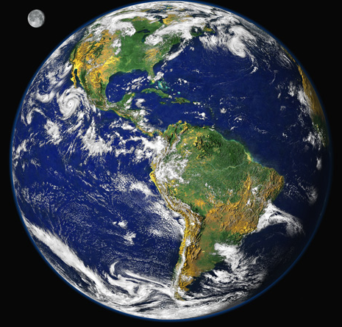
Why is this happening?
Bruce A. McCarl
Distinguished Professor of Agricultural Economics
Texas A&M University mccarl@tamu.edu
http://agecon2.tamu.edu/people/faculty/mccarl-bruce/
Climate Change Adaptation
Energy
Climate Change Impacts
Climate Change Mitigation

Slide 2
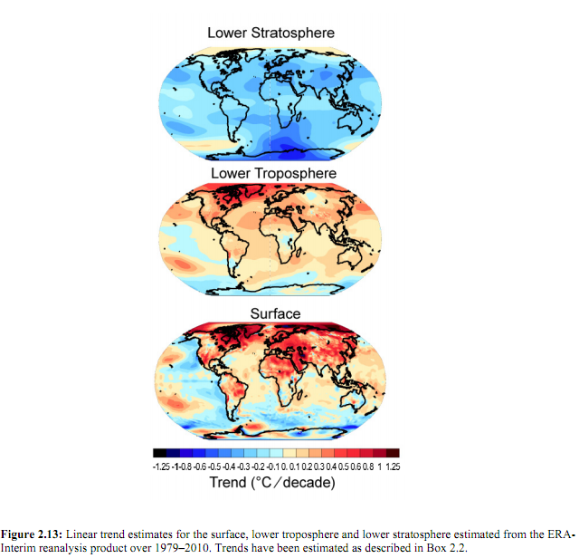
Is it the sun?
If sun is cause should warm
most at higher atmosphere
Can’t be from the sun

Slide 3
Human Influence
IPCC (1995) “The balance of evidence suggests a discernible human influence on global climate.”
IPCC (2001) “Most of the warming of the past 50 years is likely (>66%) to be attributable to human activities.”
IPCC (2007) ”Most of increase in global avg temperatures since mid-20th century is very likely (>90%) due to increase in anthropogenic (human) greenhouse gas concentrations.”
IPCC (2014) “extremely likely that human influence … dominant cause of observed warming since mid-20th century. ”
“extremely likely that more than half observed increase in surface temperature was caused by anthropogenic GHG concentrations. Estimate of human contribution to warming is similar to the observed warming.”

Slide 4
Emissions
Anthropogenic emissions Emissions of greenhouse gases, aerosols, and precursors of a greenhouse gas or aerosol caused by human activities. These activities include the burning of fossil fuels, deforestation, land use changes, livestock production, fertilization, waste management, and industrial processes.

Slide 5
What is a Greenhouse Gas?
Water vapor is the most important GHG, since globally it is the most abundant of these gases, although it varies from 0-3% in a given location.
Six greenhouse gases (GHGs) are produced by human activities: carbon dioxide, methane, nitrous oxide, hydrofluorocarbons, perfluorocarbons and sulfur hexafluoride.
Emissions of these GHGs are usually measured in terms of carbon dioxide equivalents on the basis of global warming potential. An important natural GHG is water vapor.
Gasses have different efficiencies in trapping radiation hereafter called radiative forcing.

Slide 6
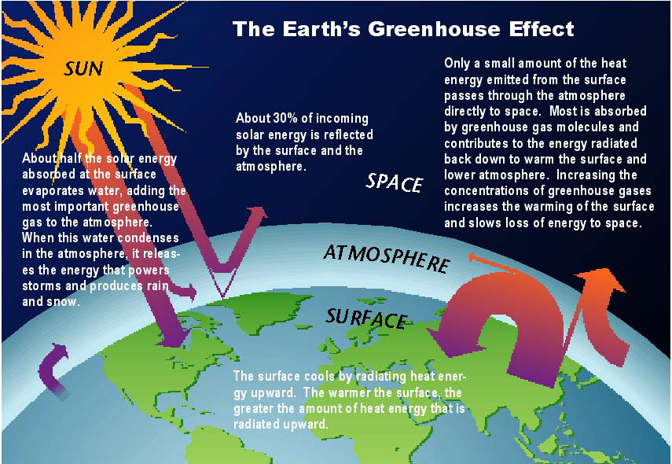
Greenhouse Impact
Some gases, like carbon dioxide (CO), trap heat in the atmosphere by absorbing longwave radiation while letting the Sun's energy pass through. A greenhouse allows in sunlight while keeping in heat. Since the gases act similarly in atmosphere, we name them greenhouse gases.
Source : U.S. National Assessment/ http://www.usgcrp.gov/usgcrp/Library/nationalassessment/images/Greenhouse-s.jpg.

Slide 7
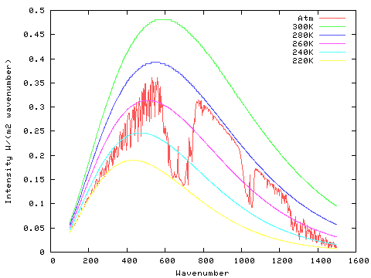
Radiation Escaping
earth emission with today’s atmosphere;
ground temperature adjusted to balance the radiation (no clouds)
microns
50
16.7
10
7.14
http://geosci.uchicago.edu/~archer/cgimodels/radiation.html
emitted high in the atmosphere from carbon dioxide

Slide 8
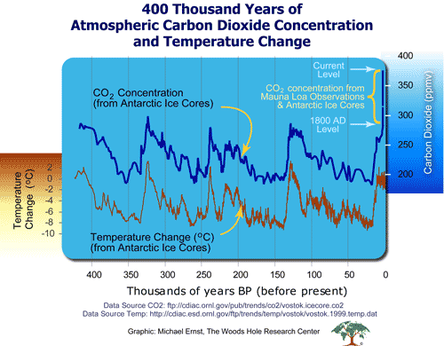
CO2 and Climate over History
http://www.whrc.org/resources/online_publications/warming_earth/scientific_evidence.htm
CO2 and temperature linked but does not lead

Slide 9
GWP
Global Warming Potential (GWP)
An index, based on radiative properties of greenhouse gases, measuring the radiative forcing following a pulse emission of a unit mass of a given greenhouse gas in the present-day atmosphere integrated over a chosen time horizon, relative to that of carbon dioxide.
The GWP represents the combined Impact of the differing times these gases remain in the atmosphere and their relative Effectiveness in causing radiative forcing. The Kyoto Protocol is based on GWPs from pulse emissions over a 100-year time frame. As for the Kyoto Protocol, this report uses GWP values derived from the IPCC Second Assessment Report: 21 for methane (CH4), 310 for nitrous dioxide (N2O), 1,300-11,700 for hydrofluorocarbons (HFCs), 6500-9200 for perfluorocarbons (PFCs), and 23,900 for sulfur
hexafluoride (SF6).

Slide 10
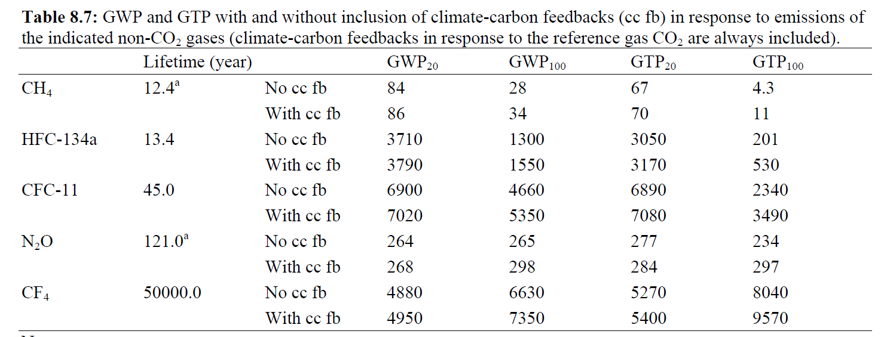
GWP, GTP and Climate Change
GWP is used to make comparisons of relative contributions among GHGs to global warming by comparing the ability of each gas to trap radiation in the atmosphere over a chosen time horizon. Global Temperature change Potential (GTP), which is change in GMST at a chosen point in time relative to CO2
IPCC uses CO₂ as a reference gas with a GWP or GTP of 1
CO2 lifetime is complicated by multiple physical and biogeochemical processes in the ocean and the land. For a pulse of about 1000 PgC, about half is removed within a few decades, but the remaining fraction stays in the atmosphere for much longer. About 15 to 40% of the CO2 pulse is still in the atmosphere after 1000 years.
Source: Climate Change 2014: The Scientific Basis, Table 8.7

Slide 11
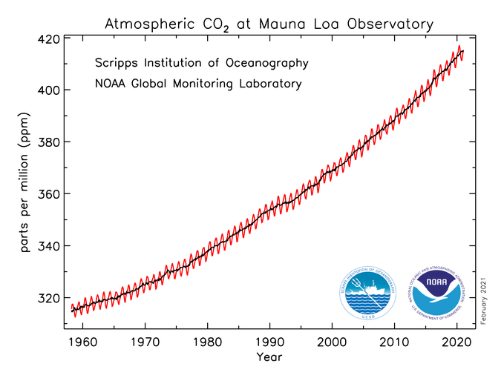
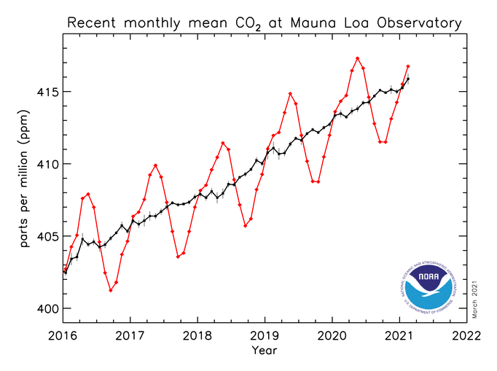
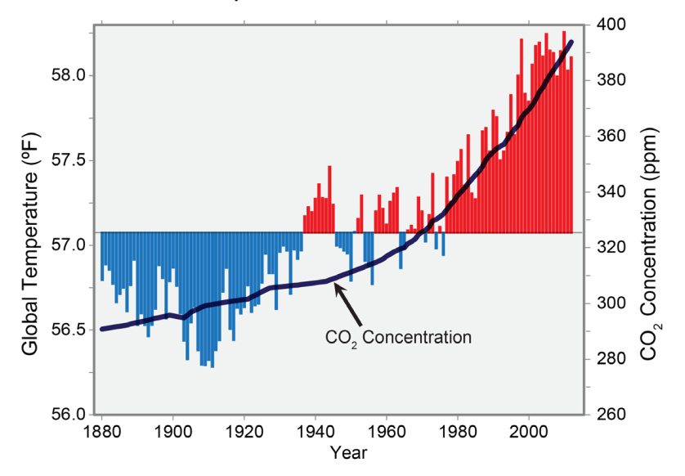
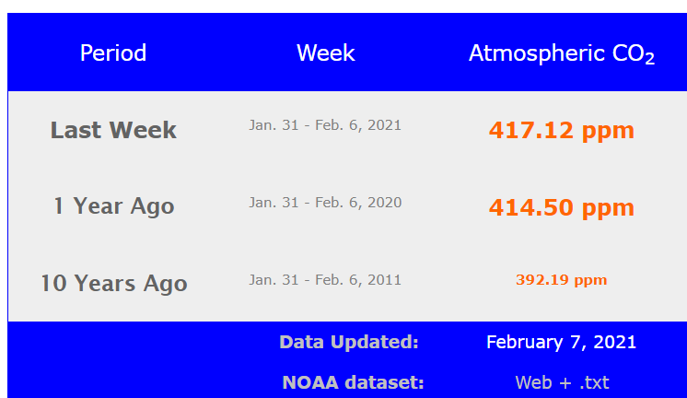
GHG Concentration
http://co2now.org/
Pre industrial - 275
- 345
2021 - 416

Slide 12
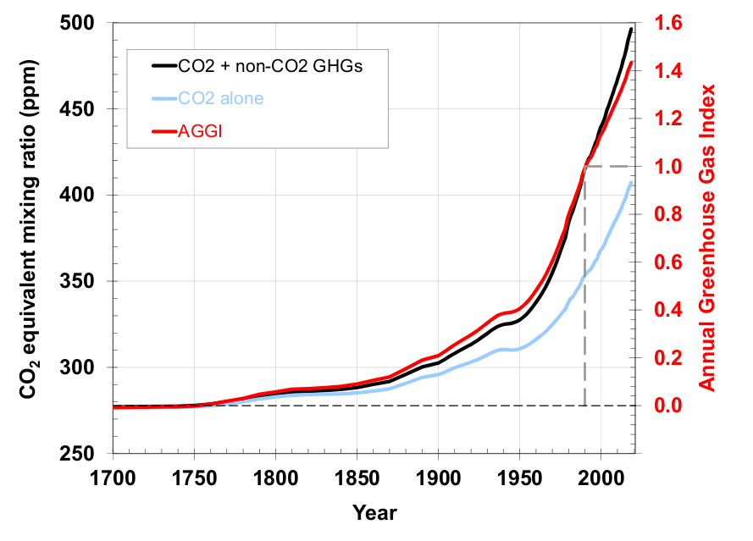
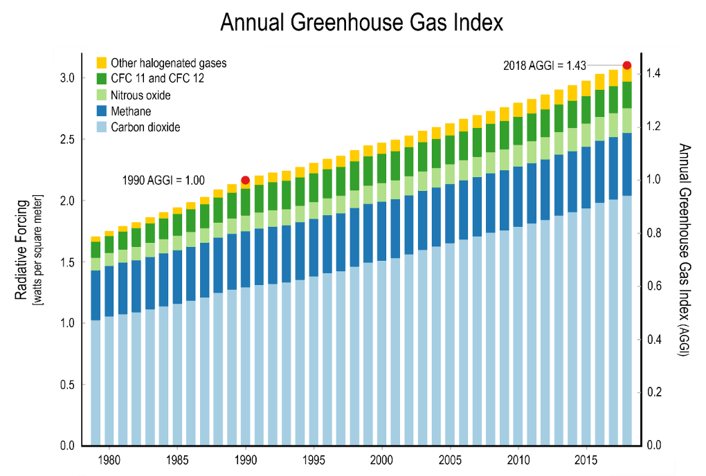
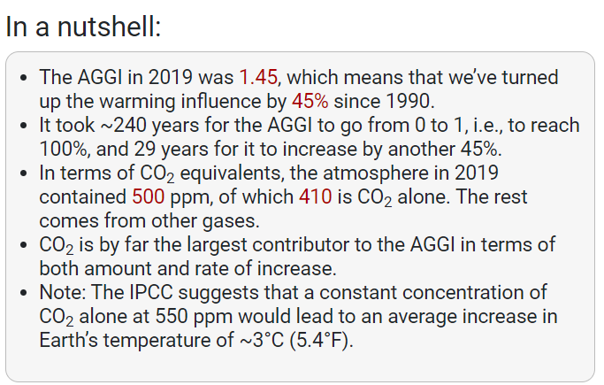
Multi-Gas GHG Total Forcing
Data 1700-2018
Greenhouse gas radiation reflection
Increase in CO2 concentration
Plus CH4 N2O
Energy related emissions
Energy – development relationship
Growth of BRIC economies
https://www.globalchange.gov/browse/indicators/indicator-annual-greenhouse-gas-index
https://www.esrl.noaa.gov/gmd/aggi/

Slide 13
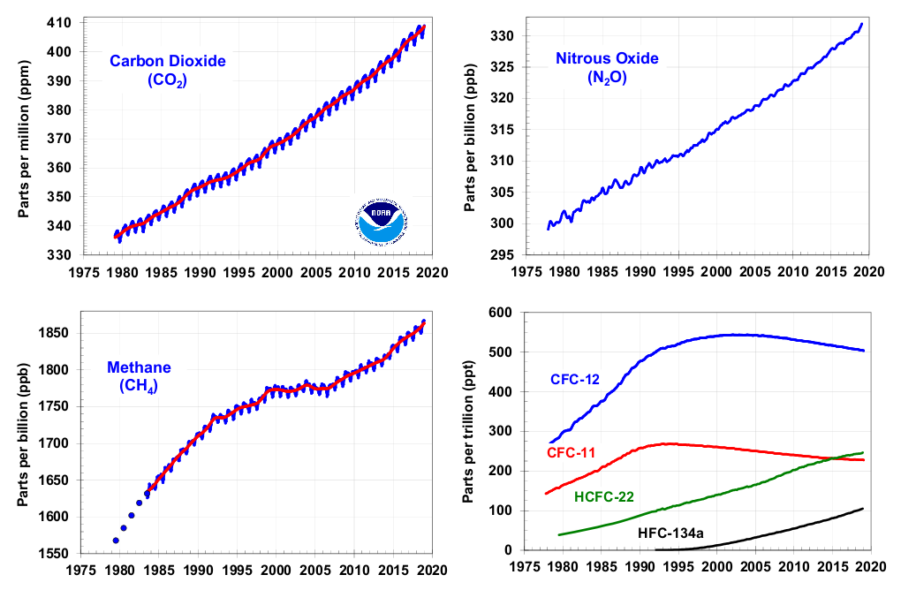
Multi-Gas GHG Total Forcing
https://www.esrl.noaa.gov/gmd/aggi/aggi.html

Slide 14
Sources of Emissions

Slide 15
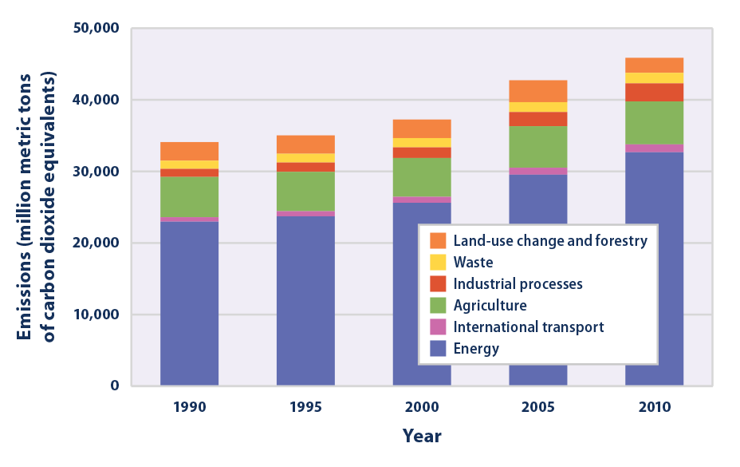
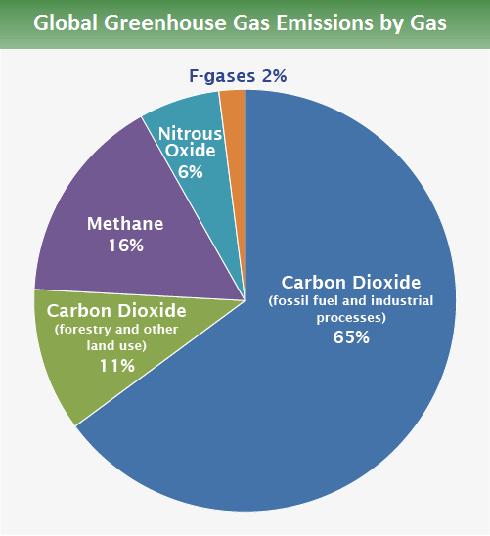
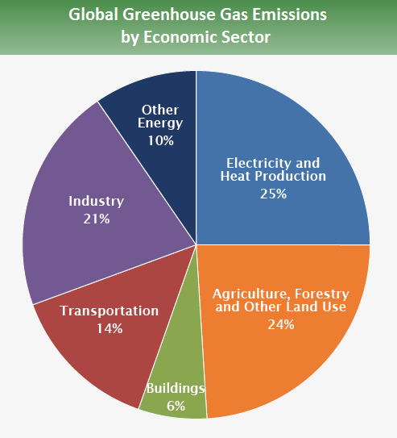
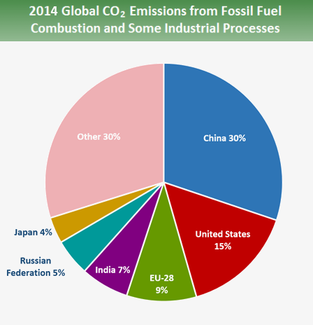
Global GHG Emissions By Source
Shares in 2014
Globally energy is big one – about 75%
https://www.epa.gov/climate-indicators/climate-change-indicators-us-greenhouse-gas-emissions

Slide 16
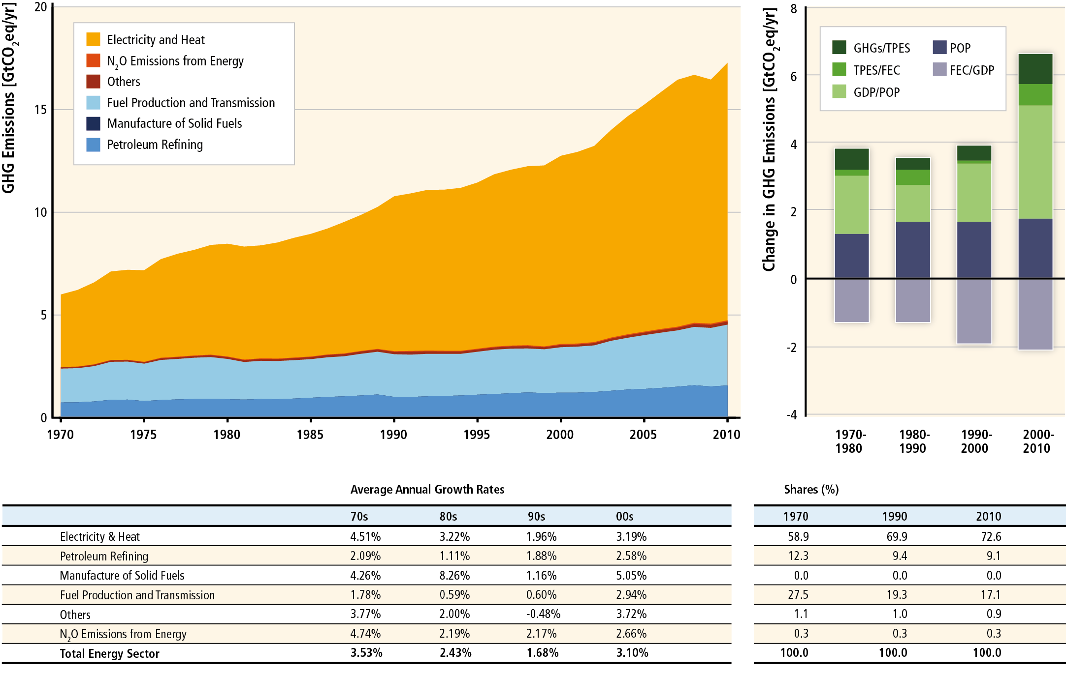
Global Energy Emissions Sources
Emissions/energy supplied
Supply efficiency
Income Impact
Population Impact
Energy consumption efficiency
Electricity growth is big area
Income + population cause increases
Consumption efficiency decreases
IPCC 2014 WGIII Figure 7.3. Energy supply sector GHG emissions by Subsectors.
Table shows average annual growth rates of emissions over decades and the shares
Plus drivers POP = population, GDP = gross domestic product, FEC = final energy consumption, TPES = total primary energy supply

Slide 17
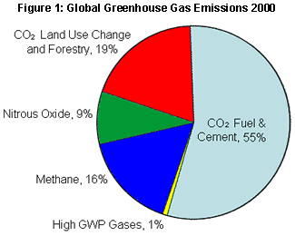
Source of GHGs
http://www.epa.gov/climatechange/emissions/globalghg.html
Emissions share
Fossil fuels big
Deforestation+ag = 30%

Slide 18
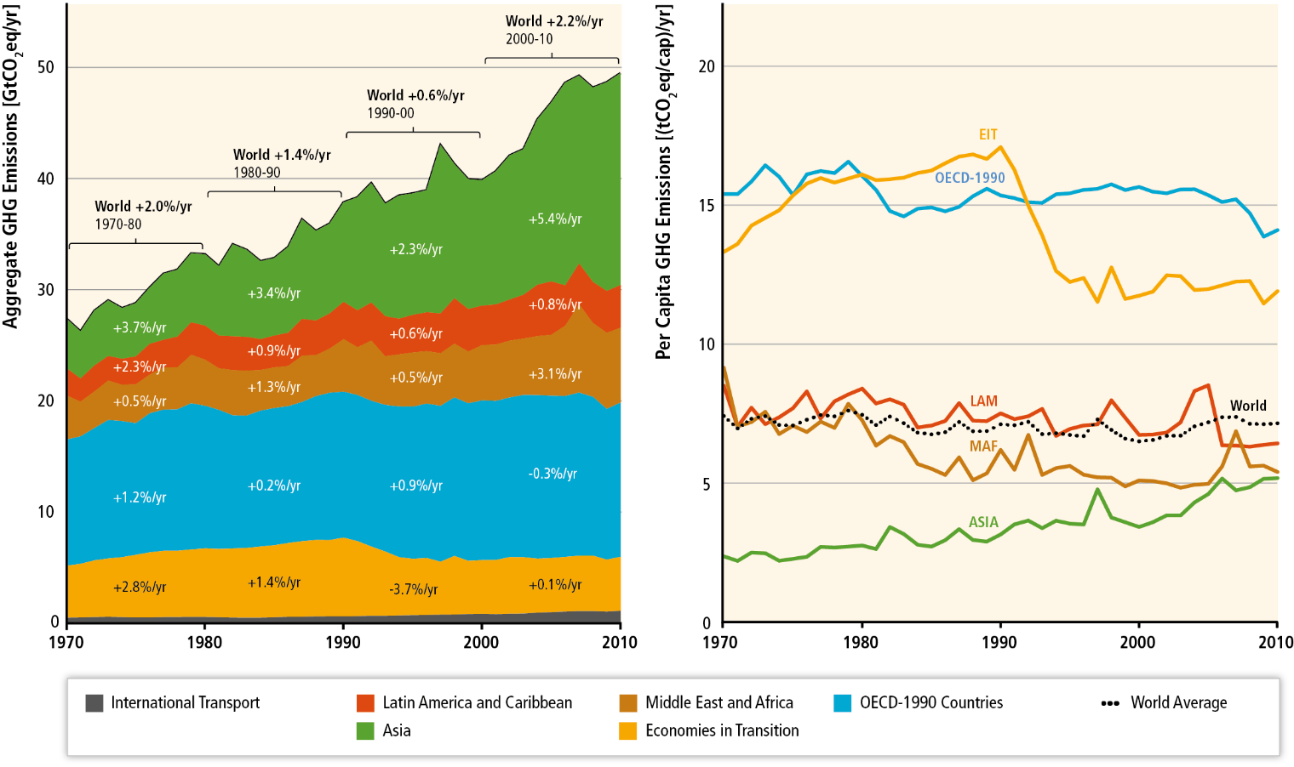
Sources by region
Fastest Growth in developing countries (income growth)
Per capita highest in OECD and Former Soviet Union (EIT)
IPCC WG III AR5 chapter 5

Slide 19
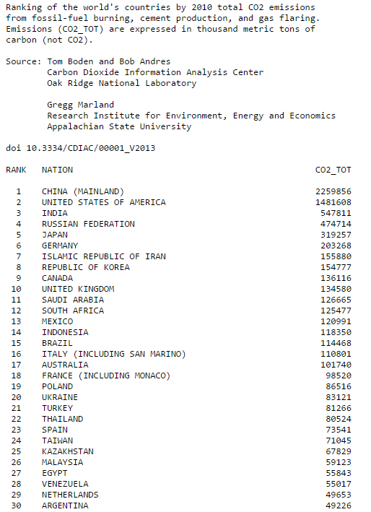
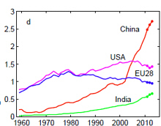
Emissions shares
http://cdiac.ornl.gov/GCP/carbonbudget/2014/

Slide 20
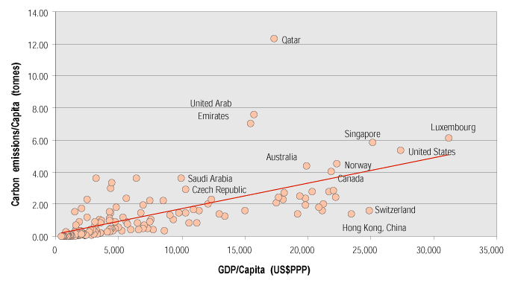
Who Emits

Slide 21

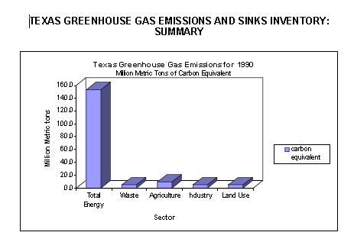
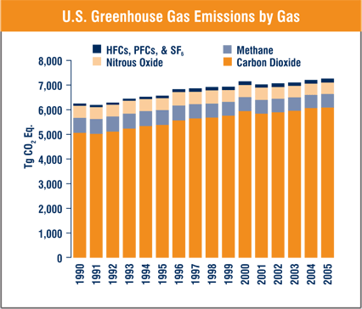
What about Texas GHG Emissions
2003 State by State Energy related CO2 emissions -- Texas wins
Most emissions from energy
Emissions growing
US EIA, http://www.eia.doe.gov/environment.html
US EPA, http://www.eia.doe.gov/environment.html

Slide 22
Emissions per unit Fossil Fuel
Carbon Dioxide (CO2) Factors: | Unit | Emissions per Unit in Pounds CO2 | Emissions per Unit in Kilograms CO2 | Weight in pounds | LBs CO2 per pound
Diesel | Gallon | 22.4 | 10.16 | 7.11 | 3.15
Natural Gas | !000 Cubic Ft | 117.1 | 53.12 | 50 | 2.34
Gasoline | Gallon | 19.6 | 8.89 | 6.3 | 3.11
Jet Fuel | Gallon | 21.1 | 9.57 | 6.8 | 3.10
Aviation Gas | Gallon | 18.4 | 8.35 | 6.01 | 3.06
Anthracite Coal | Short ton | 5685 | 2579 | 2000 | 2.84
Bituminous Coal | Short ton | 4931 | 2237 | 2000 | 2.47
Subbituminous Coal | Short ton | 3716 | 1686 | 2000 | 1.86
Lignite Coal | Short ton | 2792 | 1267 | 2000 | 1.40
Fossils yield CO2 in proportion to carbon content
http://www.engineeringtoolbox.com/gas-density-d_158.html

Slide 23
Size of Potential Emissions
Atmosphere 800 PgC (2004)
Biomass
~500 PgC
N. Gas
~260 PgC
Oil
~270 PgC
Soils
~1,500 PgC
Coal
5,000 to 8,000 PgC
Unconventional Fossil Fuels
15,000 to 40,000 PgC
Source Jae Edmonds, Joint Global Change Research Institute at the University of Maryland

Slide 24
Per-capita fossil-fuel CO2 emissions, 2005
World emissions: 27 billion tons CO₂
AVERAGE TODAY
STABILIZATION
1-
Source: IEA WEO 2007 and Socolow presentation at Americas Climate Choices
Notes:
Source: IEA WEO 2007, pg. 203. Energy related CO2 emissions

Slide 25
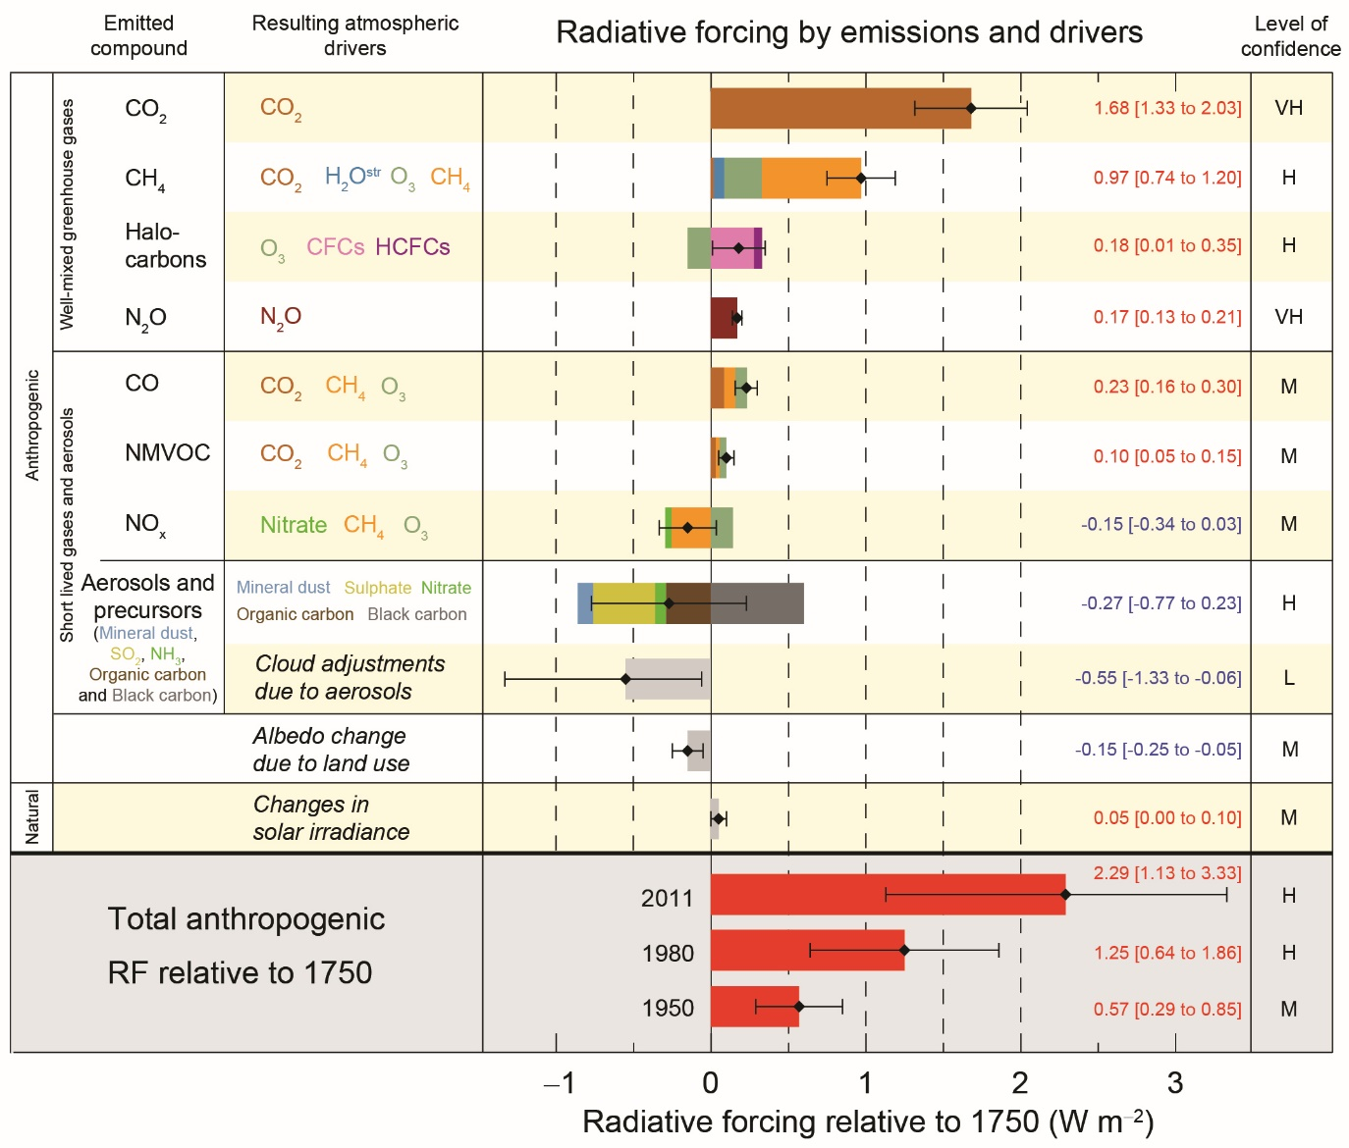
Emissions concentrations and forcing
Source : IPCC 2013 ar5 wg I
Science of Climate Change
Figure SPM.5 | Radiative forcing estimates in 2011 relative to 1750 and aggregated uncertainties for the main drivers of climate change. Values are global average radiative forcing (RF14), partitioned according to the emitted compounds or processes that result in a combination of drivers. The best estimates of the net radiative forcing are shown as black diamonds with corresponding uncertainty intervals; the numerical values are provided on the right of the figure, together with the confidence level in the net forcing (VH – very high, H – high, M – medium, L – low, VL – very low). Albedo forcing due to black carbon on snow and ice is included in the black carbon aerosol bar. Small forcing due to contrails (0.05 W m–2, including contrail induced cirrus), and HFCs, PFCs and SF6 (total 0.03 W m–2) are not shown.

