Slide 1
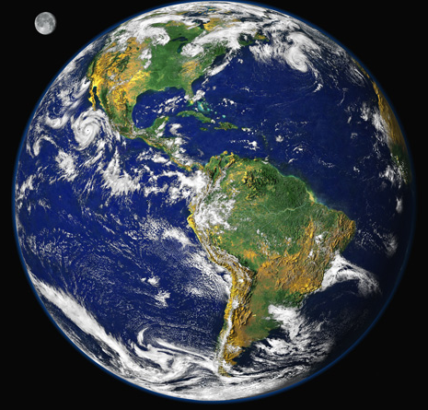
Basics of Climate Change Decision Making
Bruce A. McCarl
Distinguished Professor of Agricultural Economics
Texas A&M University mccarl@tamu.edu
http://agecon2.tamu.edu/people/faculty/mccarl-bruce/
Climate Change Adaptation
Energy
Climate Change Impacts
Climate Change Mitigation

Slide 2
Basic Resources
Intergovernmental Panel on Climate Change. Climate Change 2013 and 2014
Four reports , secience basis, Impacts/adaptation, mitigation and synthesis
All are accessed through http://www.ipcc.ch/report/ar5/
Fourth US National assessment – 2014 https://nca2018.globalchange.gov/downloads/
National Assessment Synthesis Team, US Global Change Research Program , Climate Change Impacts on the United States:The Potential Consequences of Climate Variability and Change Overview: 2000 http://www.usgcrp.gov/usgcrp/Library/nationalassessment/overview.htm
U.S. Climate Change Science Program (CCSP) Assessment reports http://www.climatescience.gov/Library/sap/sap-summary.php
US National Academy of Science reports on Impacts, adaptation, mitigation and communication all at
http://nas-sites.org/americasclimatechoices/sample-page/panel-reports/americas-climate-choices-final-report/
Other IPCC reports
Special reports ( extremes, renewable energy, CCS,….)
https://www.ipcc.ch/publications_and_data/publications_and_data_reports.shtml#2
Technical reports (water, biodiversity …) https://www.ipcc.ch/publications_and_data/publications_and_data_technical_papers.shtml

Slide 3
Basic Terms
Climate change refers to a change in the state of the climate that can be identified (e.g., by using statistical tests) by changes in the mean and/or the variability of its properties, and that persists for an extended period, typically decades or longer.
Climate change may be due to natural internal processes or external forcing such as modulations of the solar cycles, volcanic eruptions and persistent anthropogenic changes in the composition of the atmosphere or in land use.
Note that the Framework Convention on Climate Change (UNFCCC), in its Article 1, defines climate change as: ‘a change of climate which is attributed directly or indirectly to human activity that alters the composition of the global atmosphere and which is in addition to natural climate variability observed over comparable time periods’.
The UNFCCC thus makes a distinction between climate change attributable to human activities altering the atmospheric composition, and climate variability attributable to natural causes.
Source : Intergovernmental Panel on Climate Change. IPCC Third Assessment Report – Synthesis Report, http://www.ipcc.ch/.

Slide 4
Basic Terms
Climate change commitment
Due to the thermal inertia of the ocean and slow processes in the cryosphere and land surfaces, the climate would continue to change even if the atmospheric composition were held fixed at today’s values.
Past change in atmospheric composition leads to a committed climate change, which continues for as long as a radiative imbalance persists and until all components of the climate system have adjusted to a new state.
Climate change commitment includes other future changes, for example, in the hydrological cycle, in extreme weather events, in extreme climate events, and in sea level change.
The constant emission commitment is the committed climate change that would result from keeping anthropogenic emissions constant and the zero emission commitment is the climate change commitment when emissions are set to zero.
Source : Intergovernmental Panel on Climate Change. IPCC Third Assessment Report – Synthesis Report, http://www.ipcc.ch/.

Slide 5
Basic Terms
Impacts (Consequences, Outcomes)
Effects on natural and human systems. Impacts refers to effects on natural and human systems of extreme weather, climate events and climate change. Impacts generally refer to effects on lives, livelihoods, health, ecosystems, economies, societies, cultures, services, and infrastructure due to climate changes or climate events.
Adaptation
Process of adjustment to actual or expected climate and its Impacts. In human systems, adaptation seeks to moderate or avoid harm or exploit beneficial opportunities. In some natural systems, human intervention may facilitate adjustment to climate and its Impacts.
Mitigation (of climate change)
Human intervention to reduce sources or enhance sinks of
greenhouse gases.
Source : Intergovernmental Panel on Climate Change. IPCC Third Assessment Report – Synthesis Report, http://www.ipcc.ch/.

Slide 6
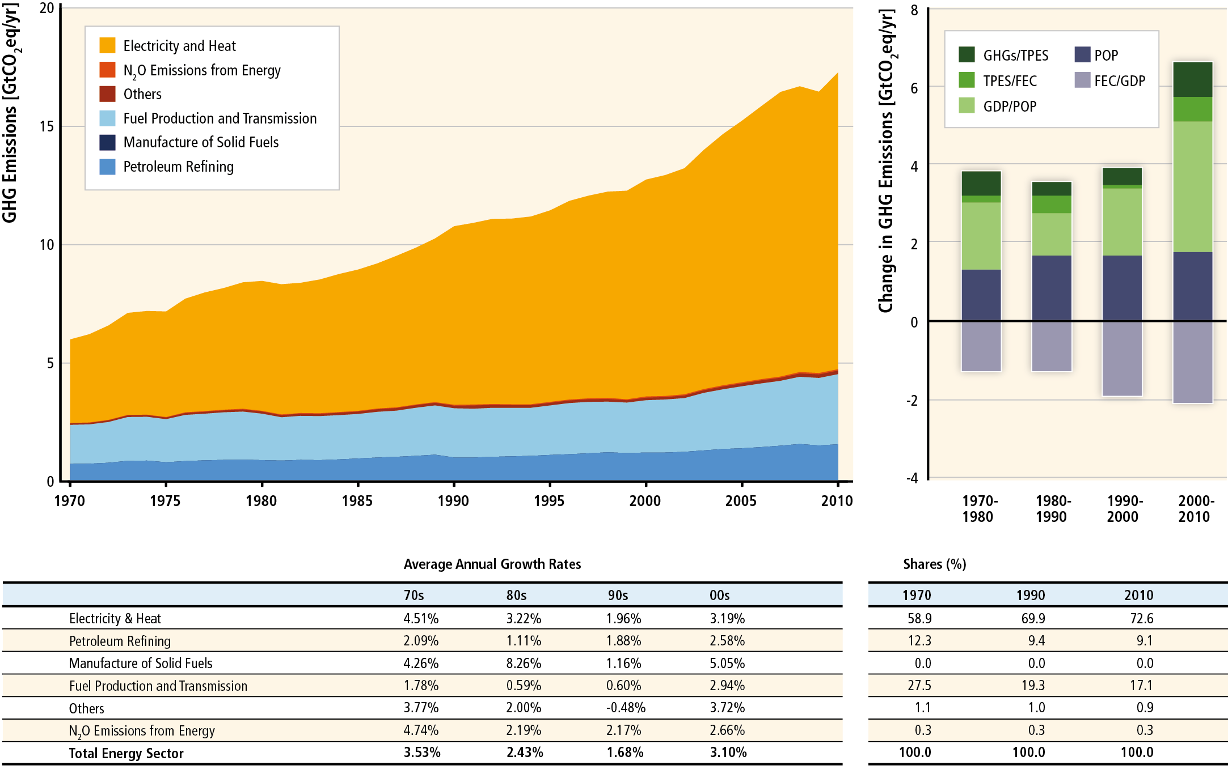
Global Energy Emissions Sources
Emissions/energy supplied
Supply efficiency
Income Impact
Population Impact
Energy consumption efficiency
Electricity growth is big area
Income + population cause increases
Consumption efficiency decreases
IPCC 2014 WGIII Figure 7.3. Energy supply sector GHG emissions by Subsectors. Table shows average annual growth rates of emissions over decades and the shares Plus drivers POP = population, GDP = gross domestic product, FEC = final energy consumption, TPES = total primary energy supply

Slide 7
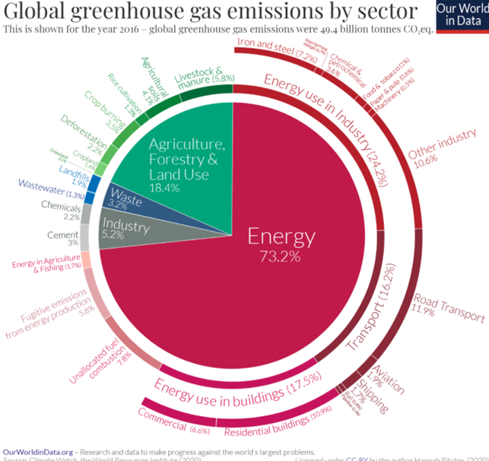
Global Emissions Sources
https://ourworldindata.org/ghg-emissions-by-sector

Slide 8
Basics of Climate Change Action
Impacts and
Information
Reducing Drivers
Adapt
  Climate shift alters growing conditions and productivity - Impacts
  Alter operations to reduce future extent by limiting drivers Mitigation
  Alter management to reduce impact of change - Adaptation
McCarl, B.A., "Some Thoughts on Climate Change as an Agricultural Economic Issue", Journal of Agricultural and Applied Economics, vol 44 no 5, 299-305, 2012.

Slide 9
Policy Challenge
Most Impacts in future but much of Mitigation and adaptation costs now
Exact nature of Impacts and effectiveness of adaptation and mitigation are uncertain + controversial
Unilateral action on mitigation not effective but collective no action means nothing gets done
Resource and investment competition between current production/R&D and needs for mitigation/adaptation
So grand challenge is
How much to invest now in mitigation and adaptation in interest of future parties at likely cost of current?

Slide 10
So Where Does an Economist Come In?
Example issues
  What are Impacts/costs, now and in future?
  What Adaptation actions are possible and what are best (those having best cost benefit results). Plus what has been done
  What Mitigation actions are possible and best. Plus actions have been done
  How can we determine who/what gains, who/what loses and how do we adapt?
  How do we configure measurement and monitoring (best system for finding out what is occurring)
  How can we predict what private and public actions will do plus how that will that affect the ecosystem, economy and social groups
  How do we design incentives and possibly compensation

Slide 11
What might your role be
You will live through this Decisions will be made and Impacts will happen
You will need to decide what to support in terms of action or inaction
You may need to decide if you or your employer are vulnerable and how to react in terms of adaptation
You may also need to look at what the Impacts are of any mitigation policies and what your response will be

Slide 12
The onset and exact Impacts of climate change
are uncertain
Energy
Climate Change Adaptation
Climate Change Mitigation
Climate Change Impacts
We are vulnerable and We will be squeezed

