Slide 1
Building composite models

Slide 2
Motivation
The models we have looked at so far are often used as building blocks in making more complex models
It is not unusual to see a model that has multiple locations and is a composite of say resource allocation models to make goods, transport models to move them and then something like a feed or assembly model where we use the goods as an input to make other products and finally a final good transport.
This basically means we may need to glue together multiple types of model types to adequately represent the entity we are trying to model

Slide 3
Motivation (continued)
Consider an example from the US milk industry.
We might have
a representation of dairy farms that produce raw milk in the form of a resource allocation model
movement of raw milk to several processing locations via a transport model
Processing of milk into fluid and cream plus ice cream, butter, yogurt etc in the form of both disassembly and assembly models
Movement of final products to consumption locations using multiple transportation models
This basically means we need to glue these three model types to represent either the industry as a whole or a vertically integrated firm in that industry

Slide 4
Basics of Model Gluing
When gluing models we typically have to take things that were assumed to be
fixed in availability like available supply
or
reflective of a single possible decision (like an items disposed of in one and only way - no choice)
and
Make them a consequence of choices involving variables
Suppose we consider this in the case of integrating a resource allocation – production model and a transport model

Slide 5
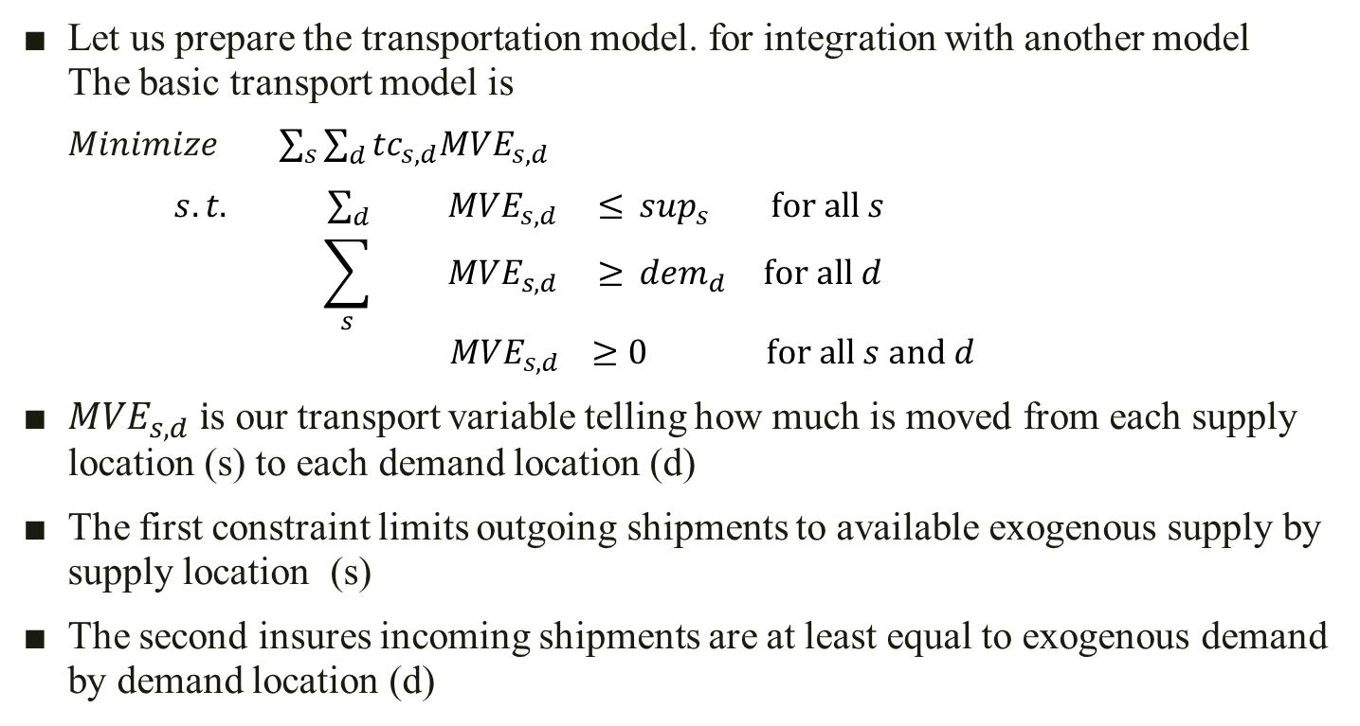
Basics of Model Gluing
Let us prepare the transportation model. for integration with another model The basic transport model is
$Minimize \sum_{s}{\sum_{d}{{tc}_{s,d}{MVE}_{s,d}}}$
$s.t. \sum_{d}{{ MVE}_{s,d} ≤\sup_{s} } for all s$
$$\sum_{s}{{ MVE}_{s,d} ≥{ dem}_{d} }for all d$$
$${ MVE}_{s,d} ≥0 for all s and d$$
${MVE}_{s,d} i$s our transport variable telling how much is moved from each supply location (s) to each demand location (d)
The first constraint limits outgoing shipments to available exogenous supply by supply location (s)
The second insures incoming shipments are at least equal to exogenous demand by demand location (d)

Slide 6
Basics of Model Gluing
First we will change the model to a maximization model with less than or equal to constraints. The resultant model is
$Maximize − \sum_{s}{\sum_{d}{{tc}_{s,d}{ ∗ MVE}_{s,d}}}$
$s.t. \sum_{d}{{ MVE}_{s,d} ≤\sup_{s} } for all s$
$$− \sum_{s}{{ MVE}_{s,d} <{ − dem}_{d} }for all d$$
$${ MVE}_{s,d} ≥0 for all s and d$$
Next instead of supply being exogenous lets make it an endogenous variable. We also move the supply variable to the left hand side. The resultant model is
$Maximize − \sum_{s}{\sum_{d}{{tc}_{s,d}{ ∗ MVE}_{s,d}}}$
$s.t. \sum_{d}{{ MVE}_{s,d}{ − sup}_{s} ≤ 0 } for all s$
$$−\sum_{s}{{ MVE}_{s,d} ≤−{dem}_{d }} for all d$$
$${ MVE}_{s,d} ,\sup_{s} ≥ 0 for all s and d$$

Slide 7
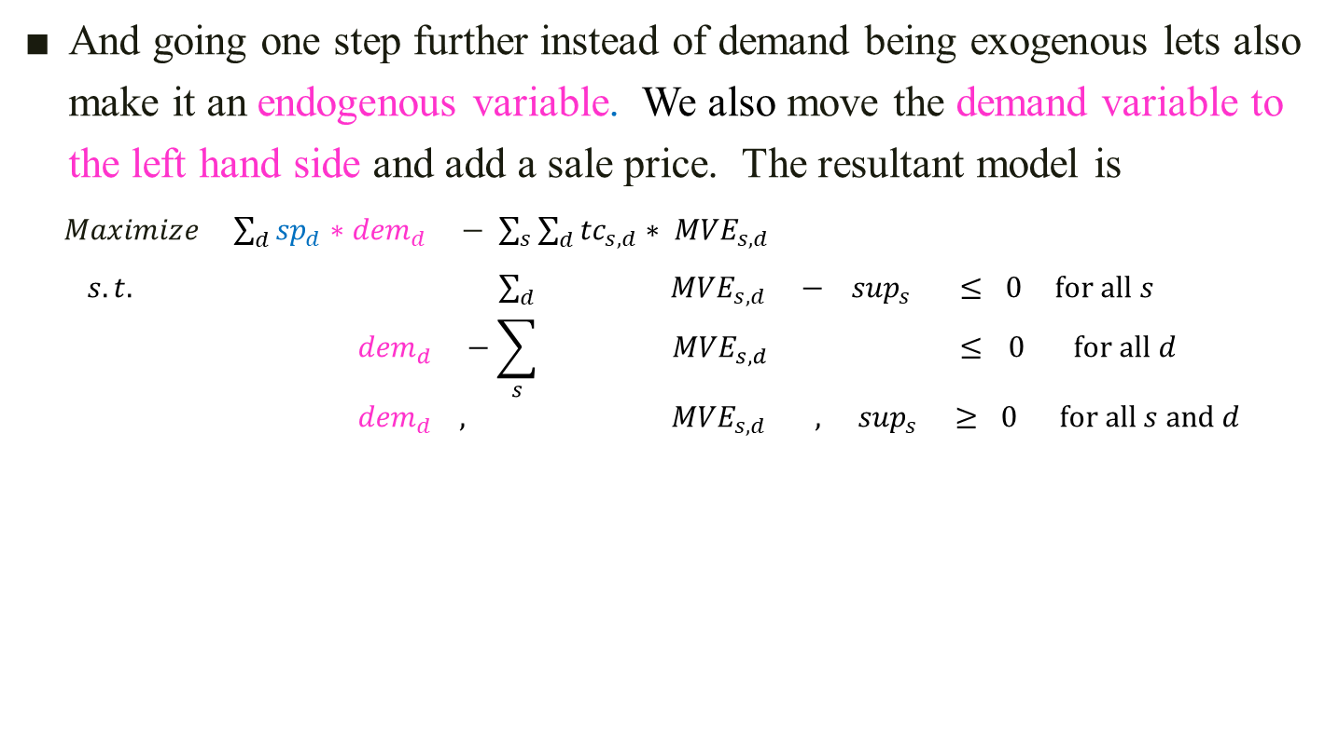
Basics of Model Gluing
And going one step further instead of demand being exogenous lets also make it an endogenous variable. We also move the demand variable to the left hand side and add a sale price. The resultant model is
$Maximize {\sum_{d}{{sp}_{d}{ ∗dem}_{d}}}_{ }− \sum_{s}{\sum_{d}{{tc}_{s,d}{ ∗ MVE}_{s,d}}}$
$s.t. \sum_{d}{{ MVE}_{s,d}{ − sup}_{s} ≤ 0 } for all s$
$${dem}_{d }−\sum_{s}{{ MVE}_{s,d} ≤} 0 for all d$$
$${{ dem}_{d }, MVE}_{s,d} ,\sup_{s} ≥ 0 for all s and d$$
Now we have a model ready for gluing
If this was to be our final model we would likely add some cost for supply and perhaps some constraints on supply and demand. We do not do that as we will gain those terms on the supply side when gluing

Slide 8
Basics of Model Gluing
Now lets set up a joint products model so it is ready for gluing
Suppose we have a model that purchases inputs (inp) from the market and employs a number of processes (prc) to produce a single good and that good sells at a predetermined price.
Our basic model is
$\operatorname{Max}{spr∗SALE −\sum_{prc}{{ cst}_{prc}}}{∗PRD}_{prc} −\sum_{inp}{icst_{inp}∗{BUY}_{inp} }$
$S.t.{ SALE−\sum_{prc}{{ yld}_{prc }} }{∗PRD}_{prc} ≤0$ $\sum_{prc}{{ use}_{res, prc}{∗PRD}_{prc}} ≤{avl}_{res}$ for all res
${ \sum_{prc}{ r_{prc,inp}}∗PRD}_{prc} −{BUY}_{inp} ≤0 \text{for} \text{all} \text{inp}$
${ SALE , PRD}_{prc}, { BUY}_{inp} ≥0$ for all prc,pos, inp
Here we do not have alternatives for selling our good
this we will alter as when we add transport we do not know exactly where to send the good so will thus need alternative variables
We will also need to add a balance between supply and demand

Slide 9
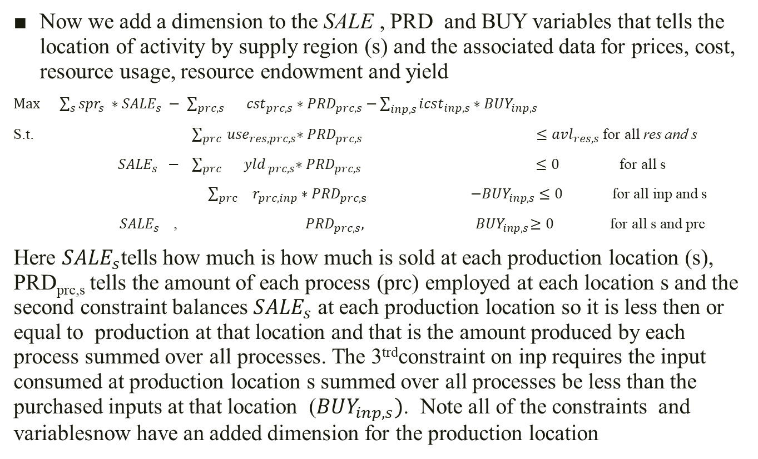
Basics of Model Gluing
Now we add a dimension to the SALE , PRD and BUY variables that tells the location of activity by supply region (s) and the associated data for prices, cost, resource usage, resource endowment and yield
$\operatorname{Max}{\sum_{s}{{spr}_{s}} ∗{SALE}_{s} − \sum_{prc,s}{ {cst}_{prc,s}}}{∗PRD}_{prc,s}−\sum_{inp,s}{icst_{inp,s}∗{BUY}_{inp,s} }$
S.t. $\sum_{prc}{{ use}_{res, prc,s}{∗PRD}_{prc,s}} ≤{avl}_{res,s}$ for all res and s
${ SALE}_{s} − \sum_{prc}{{ yld}_{ prc,s}{∗PRD}_{prc,s}} ≤0$ for all s
${ \sum_{prc}{{ r}_{prc,inp}}∗PRD}_{prc,s} −{BUY}_{inp,s}≤0 \text{f}\text{o}\text{r} \text{all} \text{inp}$ and s
${ SALE}_{s}$ , ${PRD}_{prc,s},{ BUY}_{inp,s}≥0$ for all s and prc
Here ${SALE}_{s}$tells how much is how much is sold at each production location (s), PRD_{prc,s} tells the amount of each process (prc) employed at each location s and the second constraint balances ${SALE}_{s}$ at each production location so it is less then or equal to production at that location and that is the amount produced by each process summed over all processes. The 3^{trd}constraint on inp requires the input consumed at production location s summed over all processes be less than the purchased inputs at that location (${BUY}_{inp,s})$. Note all of the constraints and variablesnow have an added dimension for the production location

Slide 10
Basics of Model Gluing
Now we have the 2 models
$Maximize {\sum_{d}{{sp}_{d}{ ∗dem}_{d}}}_{ }− \sum_{s}{\sum_{d}{{tc}_{s,d}{ ∗ MVE}_{s,d}}}$
$s.t. \sum_{d}{{ MVE}_{s,d}{ − sup}_{s} ≤ 0 } for all s$
$${dem}_{d }−\sum_{s}{{ MVE}_{s,d} ≤} 0 for all d$$
$${{ dem}_{d }, MVE}_{s,d} ,\sup_{s} ≥ 0 for all s and d$$
$\operatorname{Max}{\sum_{s}{{spr}_{s}} ∗{SALE}_{s} − \sum_{prc,s}{ {cst}_{prc,s}}}{∗PRD}_{prc,s}−\sum_{inp,s}{icst_{inp,s}∗{BUY}_{inp,s} }$
S.t. $\sum_{prc}{{ use}_{res, prc,s}{∗PRD}_{prc,s}} ≤{avl}_{res,s}$ for all res and s
${ SALE}_{s} − \sum_{prc}{{ yld}_{ prc,s}{∗PRD}_{prc,s}} ≤0$ for all s
${ \sum_{prc}{{ r}_{prc,inp}}∗PRD}_{prc,s} −{BUY}_{inp,s} ≤0 \text{for} \text{all} \text{inp}$ and s
${ SALE}_{s}$ , ${PRD}_{prc,s},{ BUY}_{inp,s} ≥0$ for all s and prc
Note here that the SALE variable in the transport model will now come from the joint product model and will be equivalent to the SALE variable in the joint products model. So we glue there and remove the price term allowing it to appear against the dem variable in the transport model

Slide 11
Basics of Model Gluing
Now we glue models resulting in the following
$$Max {\sum_{d}{{sp}_{d}{ ∗dem}_{d}−}}_{}\sum_{s}{\sum_{d}{{tc}_{s,d}{ ∗MVE}_{s,d}}}− \sum_{prc,s}{{cst}_{prc,s}}{{∗PRD}_{prc,s}}−\sum_{inp,s}{icst_{inp,s}∗{BUY}_{inp,s} }$$
$$s.t. \sum_{d}{{ MVE}_{s,d}{ − sup}_{s} ≤ 0 }$$
$${ dem}_{d }−\sum_{s}{{ MVE}_{s,d} ≤} 0$$
${ + sup}_{s}$ ${ −SALE}_{s }$ $≤ 0$
${ SALE}_{s} −\sum_{prc}{{ yld}_{ prc,s}{∗PRD}_{prc,s}} ≤ 0$
$\sum_{prc}{{ use}_{res, prc,s}{∗PRD}_{prc,s}} ≤{avl}_{res,s}$ ${\begin{aligned} \\ \sum_{prc}{{ r}_{prc,inp}}∗PRD\end{aligned}}_{prc,s} −{BUY}_{inp,s} ≤0$
${ dem}_{d}{{ MVE}_{sd}\sup_{s} SALE}_{s}$ , ${PRD}_{prc,s},{ BUY}_{inp,s} ≥0$
Note here that the SUP variable is balanced with the SALE variable from the joint product model.

Slide 12
Basics of Model Gluing
Note we can eliminate the sale and sup variables yielding
$$Max {\sum_{d}{{sp}_{d}{ ∗dem}_{d}−}}_{}\sum_{s}{\sum_{d}{{tc}_{s,d}{ ∗MVE}_{s,d}}}− \sum_{prc,s}{{cst}_{prc,s}}{{∗PRD}_{prc,s}}−\sum_{inp,s}{icst_{inp,s}∗{BUY}_{inp,s} }$$
$$s.t. \sum_{d}{{ MVE}_{s,d}−\sum_{prc}{{ yld}_{ prc,s}{∗PRD}_{prc,s}} ≤ 0 }$$
$${ dem}_{d }−\sum_{s}{{ MVE}_{s,d} ≤} 0$$
$\sum_{prc}{{ use}_{res, prc,s}{∗PRD}_{prc,s}} ≤{avl}_{res,s}$ ${\begin{aligned} \\ \sum_{prc}{{ r}_{prc,inp}}∗PRD\end{aligned}}_{prc,s} −{BUY}_{inp,s} ≤0$
${ dem}_{d }$, ${{ MVE}_{s,d} PRD}_{prc,s},{ BUY}_{inp,s} ≥0$
Our glued model

Slide 13
Toward more Gluing
The possibilities for model gluing are large.
In our example we could do things like the following
Treat multiple products – here we would add a product dimension to the basic production and movement variable along with the supply demand balance between outgoing shipments and total production
Possibly add a disassemble component that cut animals into products replacing the dem variable.
Further, the meat product could be reassembled into packs or sausage or bologna. Then we would glue an assembly model in and possible outgoing products via another transport structure

Slide 14
Gluing Tableau Models
Suppose John has two dairy farms (Farm A and B) producing raw milk. Two milk processing companies (M1 and M2) would like to purchase milk from John. The milk processing companies require John to ship the raw milk to their facilities at his cost.
John has two possible feeding options, just feed standard feed mix or feed 90% standard feed mix and 10% soybean meal. If John feeds the cow more soybean meals, it will yield more milk, but also consumes more labor.
Prices of standard feed mix and soybean mills are $100 and $300 per US ton.
The processing companies will purchase milk @ $3.5/gallon. M1 will purchase 1000 gallons and M2 will buy 1200 gallons
More information is given in the tables.

Slide 15
Gluing Tableau Models
Table 1: Cost and yield of feeding procedure for Farm A and Farm B
Table 2: Resource Availability of Farms
 | Farm A | Farm B
Cow (head) | 100 | 200
Labor (Hour) | 35 | 80
 | P1 | P2
Yield (gallon per cow per day) | 6 | 7
Standard Feed Mix (lb) | 100 | 90
Soybean Meal (lb) |  | 10
Labor (hour) | 0.3 | 0.4
Processing cost ($) | 4 | 5
Table 3: Transportation cost ($/gallon)
 | M1 | M2
FarmA | 0.3 | 0.6
FarmB | 0.2 | 0.5

Slide 16
Gluing Tableau Models
We first build the joint model of Farm A, in which we allow purchasing inputs, processing to output and selling outputs.
 | Sales | P1 | P2 | FeedMix | Soybean Meal
level |  |  |  |  |  |  | MAX
obj | 3.5 | -4 | -5 | -0.05 | -0.15
Milk Balance | 1 | -6 | -7 |  |  |  | <= | 0
Feed mix balance |  | 100 | 90 | -1 |  |  | <= | 0
soybean meal balance |  |  | 10 |  | -1 |  | <= | 0
labor |  | 0.3 | 0.4 |  |  |  | <= | 35
cow |  | 1 | 1 |  |  |  | <= | 100
non-negative | 1, | 1, | 1, | 1, | 1, |  | >= | 0

Slide 17
Gluing Tableau Models
Now, we add a dimension to the SALES and PROD variables that tells the location of activity by supply region (s) and the associated data for prices, cost, resource usage, resource endowment and yield
In the tableau we prepare one more tableau for Farm B and then glue them diagonally.
 | Sales | P1 | P2 | FeedMix | Soybean Meal
level
obj | 3.5 | -4 | -5 | -0.05 | -0.15 |  | MAX
Milk Balance | 1 | -6 | -7 |  |  |  | <= | 0
Feed mix balance |  | 100 | 90 | -1 |  |  | <= | 0
soybean meal balance |  |  | 10 |  | -1 |  | <= | 0
labor |  | 0.3 | 0.4 |  |  |  | <= | 80
cow |  | 1 | 1 |  |  |  | <= | 200
non-negative | 1, | 1, | 1, | 1, | 1, |  | >= | 0

Slide 18
 | Sales FarmA | P1 FarmA | P2 FarmA | Feed Mix FarmA | Soybean Meal FarmA | Sales FarmB | P1 FarmB | P2 FarmB | Feed Mix FarmB | Soybean Meal FarmB
level
obj | 3.5 | -4 | -5 | -0.05 | -0.15 | 3.5 | -4 | -5 | -0.05 | -0.15 |  | Max
Milk Balance FarmA | 1 | -6 | -7 |  |  |  |  |  |  |  | <= | 0
Feed mix balance FarmA |  | 100 | 90 | -1 |  |  |  |  |  |  | <= | 0
SoyMeal balance FarmA |  |  | 10 |  | -1 |  |  |  |  |  | <= | 0
labor FarmA |  | 0.3 | 0.4 |  |  |  |  |  |  |  | <= | 35
cow FarmA |  | 1 | 1 |  |  |  |  |  |  |  | <= | 100
Milk Balance FarmB |  |  |  |  |  | 1 | -6 | -7 |  |  | <= | 0
Feed mix balance FarmB |  |  |  |  |  |  | 100 | 90 | -1 |  | <= | 0
soy meal balance FarmB |  |  |  |  |  |  |  | 10 |  | -1 | <= | 0
labor FarmB |  |  |  |  |  |  | 0.3 | 0.4 |  |  | <= | 80
cow FarmB |  |  |  |  |  |  | 1 | 1 |  |  | <= | 200
non-negative | 1, | 1, | 1, | 1, | 1, | 1, | 1, | 1, | 1, | 1, | >= | 0

Slide 19
Gluing Tableau Models
Now we set up the transportation model
As we don’t know the supply availability of Farm A and B, we set the RHS parameter as “a” and “b”
 | A/M1 | A/M2 | B/M1 | B/M2
obj | 0.3 | 0.6 | 0.2 | 0.5 | MIN
Farm A supply balance | 1 | 1 |  |  | <= | a
farm B supply balance |  |  | 1 | 1 | <= | b
M1 demand balance | -1 |  | -1 |  | <= | -1000
M2 Demand balance |  | -1 |  | -1 | <= | -1200

Slide 20
Gluing Tableau Models
Now we will change the model to a maximization model and include a sale price.
 | A/M1 | A/M2 | B/M1 | B/M2
obj | 3.2 | 2.9 | 3.3 | 3 | MAX
Farm A supply balance | 1 | 1 |  |  | <= | a
farm B supply balance |  |  | 1 | 1 | <= | b
M1 demand balance | 1 |  | 1 |  | >= | 1000
M2 Demand balance |  | 1 |  | 1 | >= | 1200

Slide 21
Gluing Tableau Models
Now we will change supply from being exogenously fixed to being an endogenous variable
 | A/M1 | A/M2 | B/M1 | B/M2 | Supply A | Supply B
obj | 3.2 | 2.9 | 3.3 | 3 |  |  | Max
Farm A supply balance | 1 | 1 |  |  | -1 |  | <= | 0
farm B supply balance |  |  | 1 | 1 |  | -1 | <= | 0
M1 demand balance | 1 |  | 1 |  |  |  | >= | 1000
M2 Demand balance |  | 1 |  | 1 |  |  | >= | 1200

Slide 22
Gluing Tableau Models
Note here that the Supply variables in the transport model are equivalent to the SALEs Variables in the Joint products model. So we glue there and remove the price term allowing it to appear against the MVE variable in the transport model
 | Sales FarmA | P1 FarmA | P2 FarmA | FeedMix FarmA | Soybean Meal FarmA | Sales FarmB | P1 FarmB | P2 FarmB | Feed Mix FarmB | Soybean Meal FarmB
level
obj | 3.5 | -4 | -5 | -0.05 | -0.15 | 3.5 | -4 | -5 | -0.05 | -0.15 |  | Max
Milk Balance FarmA | 1 | -6 | -7 |  |  |  |  |  |  |  | <= | 0
Feed mix balance FarmA |  | 100 | 90 | -1 |  |  |  |  |  |  | <= | 0
Soybean Meal balance FarmA |  |  | 10 |  | -1 |  |  |  |  |  | <= | 0
labor FarmA |  | 0.3 | 0.4 |  |  |  |  |  |  |  | <= | 35
cow FarmA |  | 1 | 1 |  |  |  |  |  |  |  | <= | 100
Milk Balance FarmB |  |  |  |  |  | 1 | -6 | -7 |  |  | <= | 0
Feed mix balance FarmB |  |  |  |  |  |  | 100 | 90 | -1 |  | <= | 0
soybean meal balance FarmB |  |  |  |  |  |  |  | 10 |  | -1 | <= | 0
labor FarmB |  |  |  |  |  |  | 0.3 | 0.4 |  |  | <= | 80
cow FarmB |  |  |  |  |  |  | 1 | 1 |  |  | <= | 200
non-negative | 1, | 1, | 1, | 1, | 1, | 1, | 1, | 1, | 1, | 1, | >= | 0
 | A/M1 | A/M2 | B/M1 | B/M2 | Supply A | Supply B
obj | 3.2 | 2.9 | 3.3 | 3 |  |  | Max
Farm A supply balance | 1 | 1 |  |  | -1 |  | <= | 0
farm B supply balance |  |  | 1 | 1 |  | -1 | <= | 0
M1 demand balance | 1 |  | 1 |  |  |  | >= | 1000
M2 Demand balance |  | 1 |  | 1 |  |  | >= | 1200

Slide 23
 | Sales FarmA | mA | P2 FarmA | Feed Mix FarmA | SoybeanMeal FarmA | Sales FarmB | P1 FarmB | P2 FarmB | Feed Mix FarmB | SoybeanMeal FarmB | AM1 | AM2 | BM1 | BM2 | Supply A | Supply B
obj | 3.5 | -4 | -5 | -0.05 | -0.15 | 3.5 | -4 | -5 | -0.05 | -0.15 | 3.2 | 2.9 | 3.3 | 3 |  |  | MAX
Milk Balance FarmA | 1 | -6 | -7 |  |  |  |  |  |  |  |  |  |  |  |  |  | <= | 0
Feed mix balance FarmA |  | 100 | 90 | -1 |  |  |  |  |  |  |  |  |  |  |  |  | <= | 0
soybean meal balance FarmA |  |  | 10 |  | -1 |  |  |  |  |  |  |  |  |  |  |  | <= | 0
labor FarmA |  | 0.3 | 0.4 |  |  |  |  |  |  |  |  |  |  |  |  |  | <= | 35
cow FarmA |  | 1 | 1 |  |  |  |  |  |  |  |  |  |  |  |  |  | <= | 100
Milk Balance FarmB |  |  |  |  |  | 1 | -6 | -7 |  |  |  |  |  |  |  |  | <= | 0
Feed mix balance FarmB |  |  |  |  |  |  | 100 | 90 | -1 |  |  |  |  |  |  |  | <= | 0
soybean meal balance FarmB |  |  |  |  |  |  |  | 10 |  | -1 |  |  |  |  |  |  | <= | 0
labor FarmB |  |  |  |  |  |  | 0.3 | 0.4 |  |  |  |  |  |  |  |  | <= | 80
cow FarmB |  |  |  |  |  |  | 1 | 1 |  |  |  |  |  |  |  |  | <= | 200
Farm A supply balance |  |  |  |  |  |  |  |  |  |  | 1 | 1 |  |  | -1 |  | <= | 0
farm B supply balance |  |  |  |  |  |  |  |  |  |  |  |  | 1 | 1 |  | -1 | <= | 0
M1 demand balance |  |  |  |  |  |  |  |  |  |  | -1 |  | -1 |  |  |  | <= | -1000
M2 Demand balance |  |  |  |  |  |  |  |  |  |  |  | -1 |  | -1 |  |  | <= | -1200
Farm A Supply demand balance | -1 |  |  |  |  |  |  |  |  |  |  |  |  |  | 1 |  | <= | 0
Farm B supply demand balance |  |  |  |  |  | -1 |  |  |  |  |  |  |  |  |  | 1 | <= | 0
non-negative | 1, | 1, | 1, | 1, | 1, | 1, | 1, | 1, | 1, | 1, | 1, | 1, | 1, | 1, | 1, | 1, | >= | 0
Note we have linked milk transport to milk production

Slide 24
We can simplify the model to be this format
 | Sales FarmA | P1 FarmA | P2 FarmA | Feed Mix FarmA | Soybean Meal FarmA | Sales FarmB | P1 FarmB | P2 FarmB | Feed Mix FarmB | Soybean Meal FarmB | AM1 | AM2 | BM1 | BM2
obj |  | -4 | -5 | -0.05 | -0.15 |  | -4 | -5 | -0.05 | -0.15 | 3.2 | 2.9 | 3.3 | 3
Milk Balance FarmA | 1 | -6 | -7 |  |  |  |  |  |  |  |  |  |  |  | <= | 0
Feed mix balance FarmA |  | 100 | 90 | -1 |  |  |  |  |  |  |  |  |  |  | <= | 0
soybean meal balance FarmA |  |  | 10 |  | -1 |  |  |  |  |  |  |  |  |  | <= | 0
labor FarmA |  | 0.3 | 0.4 |  |  |  |  |  |  |  |  |  |  |  | <= | 35
cow FarmA |  | 1 | 1 |  |  |  |  |  |  |  |  |  |  |  | <= | 100
Milk Balance FarmB |  |  |  |  |  | 1 | -6 | -7 |  |  |  |  |  |  | <= | 0
Feed mix balance FarmB |  |  |  |  |  |  | 100 | 90 | -1 |  |  |  |  |  | <= | 0
soybean meal balance FarmB |  |  |  |  |  |  |  | 10 |  | -1 |  |  |  |  | <= | 0
labor FarmB |  |  |  |  |  |  | 0.3 | 0.4 |  |  |  |  |  |  | <= | 80
cow FarmB |  |  |  |  |  |  | 1 | 1 |  |  |  |  |  |  | <= | 200
Farm A supply balance | -1 |  |  |  |  |  |  |  |  |  | 1 | 1 |  |  | <= | 0
farm B supply balance |  |  |  |  |  | -1 |  |  |  |  |  |  | 1 | 1 | <= | 0
M1 demand balance |  |  |  |  |  |  |  |  |  |  | 1 |  | 1 |  | >= | 1000
M2 Demand balance |  |  |  |  |  |  |  |  |  |  |  | 1 |  | 1 | >= | 1200
non-negative | 1, | 1, | 1, | 1, | 1, | 1, | 1, | 1, | 1, | 1, | 1, | 1, | 1, | 1, | >= | 0

Slide 25
Toward more Gluing—Tableau
As the example in the mathematical notation part
If the farms have multiple products
We built the joint model tableau with multiple output
We then built multiple transportation models to ship products
Gluing the joint models with transportation models by adding supply demand balance between the SALES variable in joint models and SUPPLY variables in transportation models

Slide 26
Toward more Gluing– tableau
Possibly disassemble an input like milk into component parts like skim milk and cream, then ship to customers
Setup disassembly model Tableau to disassemble milk to skim milk and cream
Multiple disassembly models are need if you have more than one disassembling facilities
Build more transportation model, not only for different locations, but also for different products
Gluing joint model with disassembly model(s). The SALES variables in joint models are equivalent to INPUT variables in disassembly models.
Gluing the big model with transportation models. The OUTPUT variables in disassembly model are equivalent to Supply variable in Transportation model

Slide 27
Toward more Gluing– tableau
Further, the skim milk, cream and butter disassembled from the raw milk can be processed to diary products, e.g ice cream, yogurt, sour cream, and different types of cheeses.
Build assembly model tableau
Then we can glue one assembly model after gluing disassembly model and change the transportation model to ship the final products. The output variables in disassembly model will be the input variables in assembly model and the output variables in assembly model will replace the supply availability parameters in transportation model

