Slide 1
Augmenting a model

Slide 2
Motivation
The models we have looked at so far are often extended to represent other possible cases
It is not unusual to see a model
that covers a single product extended to cover multiple products or
one with a single sale possibility changed to one having more than one sale possibility.
This basically means we may need to add additional variables and constraints to adequately represent the entity we are trying to model

Slide 3
Motivation (continued)
Consider an example from the US lumber milling industry.
We might have
a representation of a mill that creates a fixed mix of products
But now we need to add possibilities for processing of a log into one of several combinations like
2x4’s plus 4x4’s plus sawdust
or and alternatively into
Plywood and sawdust
or and alternatively into
More 2x4’s without 4x4’s plus sawdust
Also we need to add two sale possibilities for sawdust one to a maker of pressed board and one to someone who uses it to make pellets for combustion
We need to allow input (logs) to be purchased from market

Slide 4
Basics of Model Extension
When extending the model above we need to include production of multiple goods and represent sale of the goods so we can include sale possibilities.
We first add multiple goods by adding up in objective function
Suppose we consider this in the case of a resource allocation – production model
Suppose we have a model that employs a number of processes to produce revenue from several goods (prd) that yields a mix of goods (yld _{prc,prd} ) that sell at a predetermined price ( $sp_{prd}$) . We add up revenue in a term $(\sum_{prd}{{sp}_{prd}∗{yld}_{prc,prd}})$
Then our basic multiproduct model is
$\operatorname{Max}{\sum_{prc}{((\sum_{prd}{{sp}_{prd}∗{yld}_{prc,prd}})}}−{cst}_{prc}){∗PRD}_{prc}$
S.t. $\sum_{prc}{{ use}_{reso, prc}{∗PRD}_{prc}}≤{avail}_{res}$ for all res
${ PRD}_{prc} ≥0$ for all prc

Slide 5
Basics of Model Extension
Now lets extend the model so it has sales variables. To do this we add a new variable that tells how much we sell of each product (SALE_{prd}) and supply demand balances by product
Our resultant model is
$\operatorname{Max}{\sum_{prd}{{sp}_{prd}∗{SALE}_{prd}} − \sum_{prc}{{ cst}_{prc}}}{∗PRD}_{prc}$
$S.t.{{ SALE}_{prd} −\sum_{prc}{{yld}_{prc,prd}} }{∗PRD}_{prc}≤0 \text{for} \text{all} \text{prd}$
$\sum_{prc}{{ use}_{res, prc}{∗PRD}_{prc}}≤{avail}_{res}$ for all res
${{ SALE}_{prd} PRD}_{prc} ≥0$ for prc, prd
Here we added a supply demand balance where for each product the use of the good or its demand- ( in this case SALE_{prd}) is less than or equal to total supply added across all processes ${\sum_{prc}{{yld}_{prc,prd}} }{∗PRD}_{prc}$
Here we have joint products when we use a process since each process can produce more than one good as a joint product ( ${yld}_{prc,prd}$)
But we have just one way of selling our good - this we will alter as when we add another dimension to the SALE variable

Slide 6
Basics of Model Extension
Now lets extend the model so it has multiple sale possibilities. For each product To do this we add multiple sales possibilities by subscripting our SALE variable with a term for the individual sales possibilities (pos) ${SALE}_{prd,pos}$ that tells how much of each good is sold via each sales possibility . We also add this into the supply demand balances by product
Our resultant model is
$\operatorname{Max}{\sum_{prd,pos}{{sp}_{prd,pos}∗{SALE}_{prd,pos}} − \sum_{prc}{{ cst}_{prc}}}{∗PRD}_{prc}$
$S.t.{ \sum_{pos}{{SALE}_{prd,pos}}−\sum_{prc}{{yld}_{prc,prd}} }{∗PRD}_{prc}≤0 \text{for} \text{all} \text{prd}$
$\sum_{prc}{{ use}_{reso, prc}{∗PRD}_{prc}}≤{avail}_{res}$ for all res
${{ SALE}_{prd,pos} PRD}_{prc} ≥0$ or prc,prd,pos
Here there are no multiple sale spossibilities (pos) for selling a good (${SALE}_{prd,pos}$) each with different prices and in the supply demand balance where for each product we balance the use summed over multiple possibilities ($\sum_{pos}{{SALE}_{prd,pos}}$) and hold that less than or equal to total supply added across all processes

Slide 7
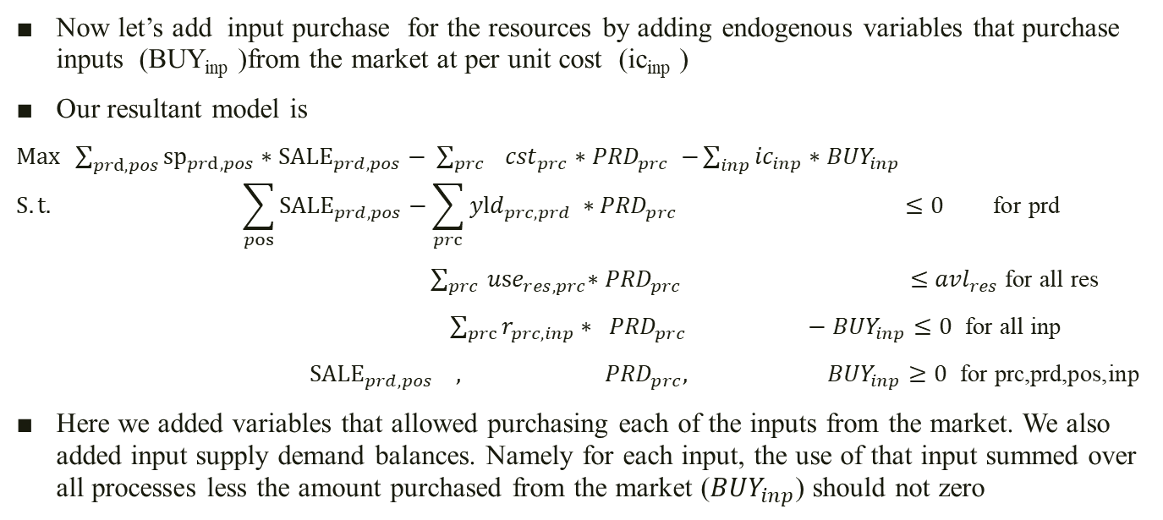
Basics of Model Extension
Now let’s add input purchase for the resources by adding endogenous variables that purchase inputs (BUY_{inp} )from the market at per unit cost (ic_{inp} )
Our resultant model is
$\operatorname{Max}{\sum_{prd,pos}{{sp}_{prd,pos}∗{SALE}_{prd,pos}}− \sum_{prc}{{ cst}_{prc}}}{∗PRD}_{prc} −\sum_{inp}{{ic}_{inp}∗{BUY}_{inp} }$
$$S.t.{ \sum_{pos}{{SALE}_{prd,pos}}−\sum_{prc}{{yld}_{prc,prd}} }∗{PRD}_{prc} ≤0 \text{for} \text{prd}$$
$\sum_{prc}{{ use}_{res, prc}{∗PRD}_{prc}} ≤{avl}_{res}$ for all res
${\sum_{prc}{r_{prc,inp}}∗ PRD}_{prc} −{BUY}_{inp}≤0 \text{for} \text{all} \text{inp}$
${{ SALE}_{prd,pos} , PRD}_{prc}, {BUY}_{inp}≥0$ for prc,prd,pos,inp
Here we added variables that allowed purchasing each of the inputs from the market. We also added input supply demand balances. Namely for each input, the use of that input summed over all processes less the amount purchased from the market (${BUY}_{inp}$) should not zero

Slide 8
Extending the Tableau Model
We might have
a representation of a mill that creates a fixed mix of products
Process 1: 2x4’s plus 4x4’s plus sawdust
Process 2: Plywood and sawdust
Process 3: More 2x4’s without 4x4’s plus sawdust
The mill has 100 logs as inventory and 35 units labor
The yield and cost are listed in the table
 | Proc 1 | Proc 2 | Proc 3 | Price
2x4’s balance | 3 |  | 6 | 3.5
4x4’s balance | 2 |  | 1 | 7.5
plywood balance |  | 5 |  | 6
sawdust balance | 0.7 | 0.6 | 0.9 | 2
labor | 0.3 | 0.4 | 0.045
Logs | 1 | 1 | 1 | 20
Cost | 4 | 5 | 6

Slide 9
Extending Tableau Models
We first build the multiproduct resource allocation model, in which we have three processing possibilities and two resources.
We calculate the net profit from each process and set up the labor and log availability constraints
 | Proc 1 | Proc 2 | Proc 3
obj | 22.9 | 26.2 | 24.3 | MAX
labor | 0.3 | 0.4 | 0.045 | <= | 35
log | 1 | 1 | 1 | <= | 100
non-negative | 1, | 1, | 1, | >= | 0

Slide 10
Extending the Tableau Model
Now we extend the model to cover 2x4’s, 4x4’s, plywood and sawdust and their sales possibilities. This adds 4 new variables and 4 supply demand balances
 | Sell 2x4 | Sell 4x4 | Sell plywood | Sell sawdust | Proc 1 | Proc 2 | Proc 3
level |  |  |  |  |  |  |  | MAX
obj | 3.5 | 7.5 | 6 | 2 | -4 | -5 | -6
2x4’s balance | 1 |  |  |  | -3 |  | -6 | <= | 0
4x4’s balance |  | 1 |  |  | -2 |  | -1 | <= | 0
plywood balance |  |  | 1 |  |  | -5 |  | <= | 0
sawdust balance |  |  |  | 1 | -0.7 | -0.6 | -0.9 | <= | 0
labor |  |  |  |  | 0.3 | 0.4 | 0.045 | <= | 35
logs |  |  |  |  | 1 | 1 | 1 | <= | 100
non-negative | 1, | 1, | 1, | 1, | 1, | 1, | 1, | >= | 0

Slide 11
Gluing Tableau Models
Now we extend the model to two different Sawdust sales possibilities with different prices
 | Sell 2x4 | Sell 4x4 | Sell plywood | Sell sawdust To fabricate | Sell sawdust To burn | Proc 1 | Proc 2 | Proc 3
level |  |  |  |  |  |  |  |  | MAX
obj | 3.5 | 7.5 | 6 | 2 | 1.8 | -4 | -5 | -6
2x4’s balance | 1 |  |  |  |  | -3 |  | -6 | <= | 0
4x4’s balance |  | 1 |  |  |  | -2 |  | -1 | <= | 0
plywd balance |  |  | 1 |  |  |  | -5 |  | <= | 0
sawdust balance |  |  |  | 1 | 1 | -0.7 | -0.6 | -0.9 | <= | 0
labor |  |  |  |  |  | 0.3 | 0.4 | 0.045 | <= | 35
logs |  |  |  |  |  | 1 | 1 | 1 | <= | 100
non-negative | 1, | 1, | 1, | 1, | 1, | 1, | 1, | 1, | >= | 0

Slide 12
Gluing Tableau Models
Now we extend the model to allow purchasing logs from the market @ $20 /log
 | Sell 2x4 | Sell 4x4 | Sell plywood | Sell sawdust To fabricate | Sell sawdust To burn | Proc 1 | Proc 2 | Proc 3 | Log Input
level |  |  |  |  |  |  |  |  |  | MAX
obj | 3.5 | 7.5 | 6 | 2 | 1.8 | -4 | -5 | -6 | -20
2x4’s balance | 1 |  |  |  |  | -3 |  | -6 |  | <= | 0
4x4’s balance |  | 1 |  |  |  | -2 |  | -1 |  | <= | 0
plywood balance |  |  | 1 |  |  |  | -5 |  |  | <= | 0
sawdust balance |  |  |  | 1 | 1 | -0.7 | -0.6 | -0.9 |  | <= | 0
labor |  |  |  |  |  | 0.3 | 0.4 | 0.045 |  | <= | 35
logs |  |  |  |  |  | 1 | 1 | 1 | -1 | <= | 0
non-negative | 1, | 1, | 1, | 1, | 1, | 1, | 1, | 1, |  | >= | 0

