Slide 1
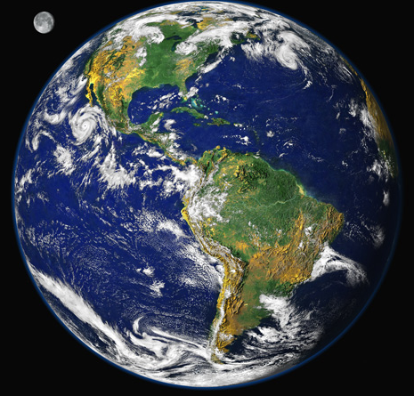
Climate Change Mitigation
Bruce A. McCarl
Distinguished Professor of Agricultural Economics
Texas A&M University mccarl@tamu.edu
http://agecon2.tamu.edu/people/faculty/mccarl-bruce/
Climate Change Adaptation
Energy
Climate Change Mitigation
Climate Change Effects

Slide 2
An assignment to be done before Next Tuesday March 5, 2019
Assignment
Look at IPCC 2013/2014 or new US national assessment
Pick one climate change development other than ones featured in class that you feel to be important
For that put together a powerpoint slide or two illustrating the issue
Put one slide together on why this is economically important
Layout a very brief outline of an approach that could be used to estimate what the inherent damages from this would be
Send all your slides to the designated assembler by next Tuesday noon
For auditors in a group of no more than 3 make a slide on the issue
When you have selected the issue email your classmates telling what you have chosen to avoid duplication – the early bird gets the worm
Notes:
The graphics team in the TSU has been working on a revised visualization which is depicted here.
This is the graphic that we are hoping all regional chapters will use to summarize how climate change is shifting risks and the potential for risk reduction through adaptation and mitigation
This graphic has a few key features

Slide 3
Readings and an assignment to be done before Thursday class
March 21, 2019
Assignment
Pick spatial analogue paper on climate effects
Mendelsohn, Shaw and Nordhaus
Schlenker and Roberts
McCarl , Villavicencio, Wu
Attavanich and McCarl
Come to class ready to discuss WITH SEVERAL OVERHEADS
1. What was done
2. Econometric approach
3. Why are new ones done with panel )see paper by Schlenker)
4. What were basic findings
5. what is wrong
6. What extensions could be done
Notes:
The graphics team in the TSU has been working on a revised visualization which is depicted here.
This is the graphic that we are hoping all regional chapters will use to summarize how climate change is shifting risks and the potential for risk reduction through adaptation and mitigation
This graphic has a few key features

Slide 4
Readings and an assignment to be done before Tuesday class
March 26, 2019
Assignment
Pick simulation paper on climate effects
Adams et al 1990
Reilly et al 2003
Elizabeth Marshall, Marcel Aillery, Scott Malcolm, Ryan Williams. Climate Change, Water Scarcity, and Adaptation in the U.S. Fieldcrop Sector, ERR-201,U.S. Department of Agriculture, Economic Research Service, November 2015.
Come to class ready to discuss WITH SEVERAL OVERHEADS
1. What was done
2. analytic approach
3. What was done on adaptation
4. What were basic findings
5. what is wrong
6. What extensions could be done
Notes:
The graphics team in the TSU has been working on a revised visualization which is depicted here.
This is the graphic that we are hoping all regional chapters will use to summarize how climate change is shifting risks and the potential for risk reduction through adaptation and mitigation
This graphic has a few key features

Slide 5
Settings for assignment
Pick one of the following setting
You go to work for an oil company
Your family owns 5 cars
You drive and heat/cool your housing
You work for a coal fired energy generator
You have farm land in a place with a lot of trees
You have rice land
You work at a beef feedlot
You are going to work for a city
You work for a natural gas generator
You work for a large industrial concern
Your business generates a lot of food waste and cans that you haul to a landfill
You beg McCarl for permission to do something else before 10 am Monday (mccarl@tamu.edu)
Notes:
The graphics team in the TSU has been working on a revised visualization which is depicted here.
This is the graphic that we are hoping all regional chapters will use to summarize how climate change is shifting risks and the potential for risk reduction through adaptation and mitigation
This graphic has a few key features

Slide 6
Old Readings and an assignment to be done before Monday at 3pm
Readings
McCarl and Schneider Curbing Greenhouse Gases: Agriculture's Role
(don’t worry about ag details but look at ways mitigation impacts and can be done plus cap and trade)
http://agecon2.tamu.edu/people/faculty/mccarl-bruce/papers/0728CurbingGreenhouseGases.pdf
IPCC Technical Summary AR5 WGIII pages 42-49 and 93-99 http://www.ipcc.ch/pdf/assessment-report/ar5/wg3/ipcc_wg3_ar5_technical-summary.pdf
Assignment
Pick one of the settings on the next page and come to class ready to address
1. How might they mitigate
2. What effects would widespread mitigation do to their costs of operation
3. How might they participate in a cap and trade
Notes:
The graphics team in the TSU has been working on a revised visualization which is depicted here.
This is the graphic that we are hoping all regional chapters will use to summarize how climate change is shifting risks and the potential for risk reduction through adaptation and mitigation
This graphic has a few key features

Slide 7
Settings for assignment
Pick one of the following setting
You go to work for an oil company
Your family owns 5 cars
You drive and heat/cool your housing
You work for a coal fired energy generator
You have farm land in a place with a lot of trees
You have rice land
You work at a beef feedlot
You are going to work for a city
You work for a natural gas generator
You work for a large industrial concern
Your business generates a lot of food waste and cans that you haul to a landfill
You beg McCarl for permission to do something else before 10 am Monday (mccarl@tamu.edu)
Notes:
The graphics team in the TSU has been working on a revised visualization which is depicted here.
This is the graphic that we are hoping all regional chapters will use to summarize how climate change is shifting risks and the potential for risk reduction through adaptation and mitigation
This graphic has a few key features

