Slide 1
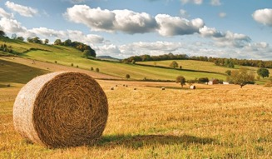
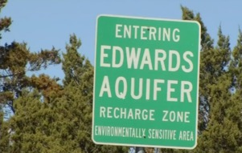
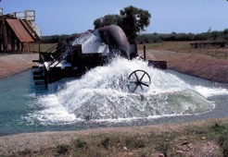
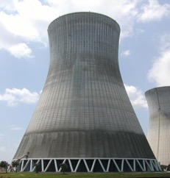
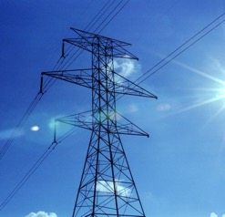
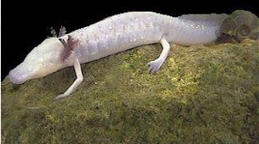
Economics of possible welfare increasing energy sector decisions in water stressed regions
Chengcheng Fei, Yingqian Yang, B.A. McCarl
Department of Agricultural Economics
Texas A&M University
Presented at TAMU Conference on Energy
Sep 25, 2018

Slide 2
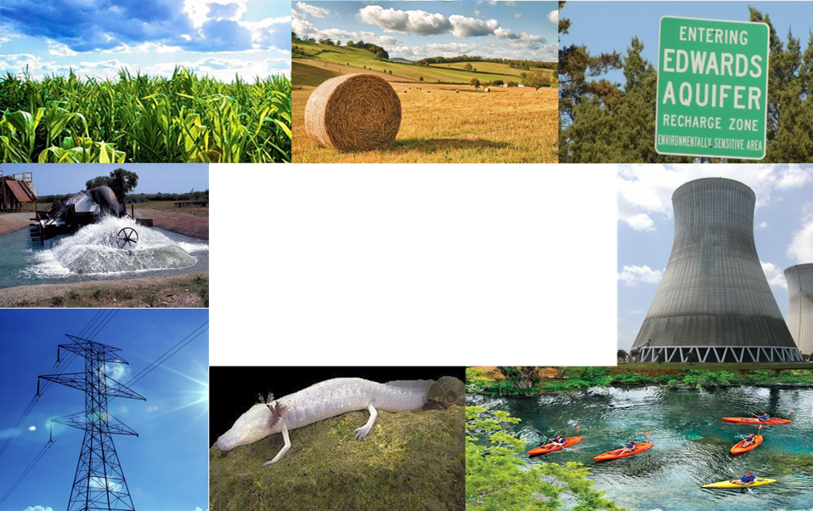
FEW Nexus
Food-Energy-Water Nexus Analysis considers way sectors interact in the food, energy and water space and in cases ways in which actions by some parties in the FEW sectors can benefit total regional welfare.
We are involved in Nexus Analysis in 2 settings
Nexus analysis under Water scarcity: Limited supply and increasing demand for water are driving Nexus forces
Nexus Analysis under major bioenergy decisions – US renewable fuel standard and whether we will expand cellulosic ethanol production plus use marginal land
Today we will focus on the first project and the impact of Nexus on energy sector, as that is the one we started at

Slide 3
FEW Nexus – Water Scarcity
Water Scarcity FEW Nexus Analysis is stressed by evolving climate and population
Climate
Increases water demand per acre, per household, for electrical cooling , other industries
In study area lowers water supplies and increases variability
In area lowers yields per unit land, lessening food supply
Population growth
Increases household and supporting industry water demand.
Increases household and supporting industry electricity demand.
Also the increases demand of food
Collectively makes Water scarcity worse
Lowering water supply and increasing demand plus adding energy and food demands while lowering food supply

Slide 4
FEW Nexus – Water Scarcity
In our study we examine FEW Nexus actions in the form of new water related sectoral investments and altered operating strategies- we collectively call these projects
We are working on defining projects:
Agricultural related projects
Water related projects
Energy related projects
We also examine who gains and who loses as we feel compensation and mechanisms to achieve it will be a big issue

Slide 5
Background on Regional Issues

Slide 6
Study Region - Geographic & Hydrologic Scope

Slide 7
Study Region - Geographic & Hydrologic Scope
Water Sources
4 River Basins
5 Aquifers
2 Springs
5 Lakes/Reservoirs
Users
Agriculture
Municipality
Industry
Energy - power plants and fracking)
Recreational
Environmental

Slide 8
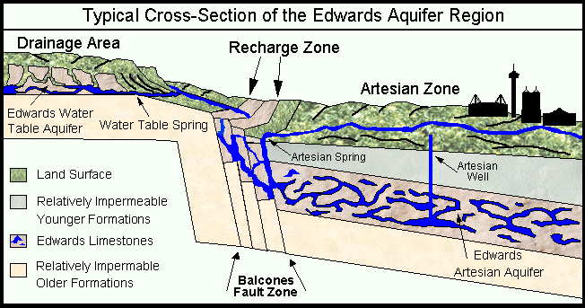
Limited water supply : Aquifers
Edwards Aquifer
Source: Edwards Aquifer Website http://www.edwardsaquifer.net/intro.html

Slide 9
Limited water supply : Rivers
Average precipitation in the region varies from 20 -30 inches (50-75 cm) per year in the ag areas in west to about 40 inches (100 cm) per year in the east
Sufficient flows needed for downstream water use and flows to Estuary to protect fishery and species.
Interaction with ground water
Springs from Edwards Aquifer provide 30-80% of base flow in eastern river under drought
Overpumping of groundwater will lower river flows

Slide 10
Limited water supply : Edwards Aquifer
Problems
Limited water supply (recharge)
Heavy discharge (pumping and
springs)
Environment concerns and
endangered species finding
EAA solution
Edwards Aquifer Authority (EAA) issued permits to limit pumping and regulated withdraw amount based on water level
Permit trading is allowed in EAA (water market)

Slide 11
Stochastic water supply Edwards Aquifer
Unit is thousands of acft which is 1,233 cubic meters)

Slide 12
Stochastic water supply : Aquifers
Edwards Aquifer does not retain water

Slide 13
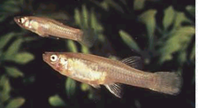
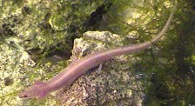
Environmental Issue - Edwards
Aquifer supports Endangered species
Texas Blind Salamander
Fountain Darter
San Marcos Gambusia
San Marcos Salamander

Slide 14
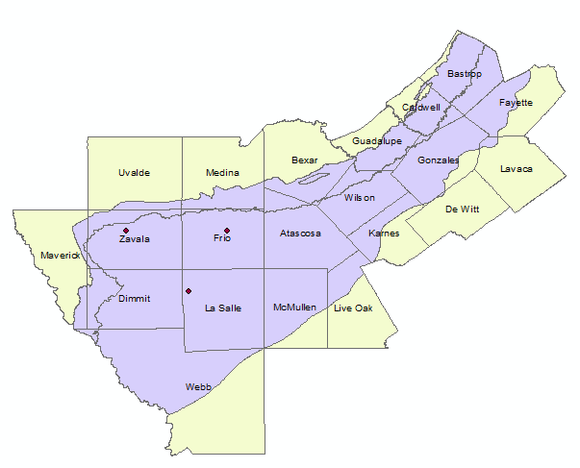
Carrizo-Wilcox Aquifer Water Level falling
In Groundwater Management area 13 covering southern segment of Carrizo-Wilcox Aquifer, desired 2070 condition is no more than 48 feet average drawdown relative to 2012

Slide 15
Background on Demand and Population

Slide 16
Regional Water Usage by Sector - 2015
Heavy water usage by municipal sector
Irrigation uses mainly groundwater

Slide 17
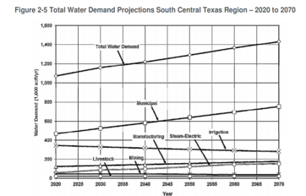
Rapid Population Growth
Population growth leads to
Rapid municipal industrial and electricity cooling demand
Growing deficit

Slide 18
Challenges from Fracking
Between 2000 and 2014, water used to drill a horizontal natural gas well increased from 177,000 to 5.1 million gallons per well
Fracking (mining) is largest water use in some counties.
Heavy fracking in winter garden increased Carrizo-Wilcox drawdown.

Slide 19
Existing Power Plants
51 Power plants in the research region
10 solar power plants
7 wind farms
7 hydroelectric power plants
4 biomass power plants
4 coal power plants
18 natural gas power plants
20 out of 22 fossil fuel power plants
in the research region used surface water for cooling
Plus there are 7 hydroelectric power plants
on Guadalupe River, but they don’t consume
the water

Slide 20
Cooling Water Usage under different cooling methods
 | Water withdrawn and consumption (Gallons per MWh) |  |  |  |  |  | Construction cost per KW | Generation Cost per MWh | Fuel cost per MWh
 | Once-through |  | Recirculating |  | Dry-cooling
 | Withdrawal | Consumption | Withdrawal | Consumption | Withdrawal | Consumption
Coal (conventional) | 20,000 - 50,000 | 100 - 317 | 500 - 1,200 | 480 - 1,100 | N/A | N/A | $2934-6600 | $8-17 | ~$30
Natural gas (combined cycle) | 7,500 - 20,000 | 20 - 100 | 150 - 283 | 130 - 300 | 0 - 4 | 0 - 4 | $676-7108 | $5-43 | ~$41
Nuclear | 25,000 - 60,000 | 100 - 400 | 800 - 2,600 | 600 - 800 | N/A | N/A | $5530 | $12.79
Source: Macknick, Jordan, Robin Newmark, Garvin Heath, and Kathleen C. Hallett. "Operational water consumption and withdrawal factors for electricity generating technologies: a review of existing literature." Environmental Research Letters7, no. 4 (2012): 045802. Summarized by Union of Concerned Scientists |  |  |  |  |  |  | EIA, https://www.eia.gov/outlooks/capitalcost/

Slide 21
Power Plant Retrofit
Boiler retrofit (coal to natural gas)
Cooling retrofit
(Once-through to Recirculating to Dry-cooling)
Switch to renewable source: Wind and solar.
Add new capacity in or outside region
Could export water use
Wind and solar reliability are issue
Retrofit and new capacity cost will be in first stage of the model

Slide 22
Cooling Retrofit Cost
 | Capital cost (once-through to recirculating) ($/kW) | Capital cost (once-through or recirculating to dry) ($/kW) | Capital cost (once-through to recirculating) ($/kW) | Capital cost (once-through or recirculating to dry) ($/kW) | O&M cost (once-through to recirculating) ($/kW/yr.) | O&M cost (once-through to dry) ($/kW/yr.) | O&M cost (recirculating to dry) ($/kW/yr.)
 | Average difficulty retrofits |  | Difficult retrofits |  | All retrofits
Coal | 90 | 220 | 140 | 330 | 2 | 5 | 3
Natural gas combined cycle | 40 | 170 | 65 | 270 | 2 | 10 | 8
Nuclear | 90 | 220 | 140 | 330 | 2 | 5 | 3
Biopower/biogas | 90 | 220 | 140 | 330 | 2 | 5 | 3
Oil/gas simple cycle | 90 | 220 | 140 | 330 | 2 | 5 | 3
Geothermal | N/A | 170 | N/A | 270 | N/A | N/A | 2
Concentrating Solar power | N/A | 170 | N/A | 270 | N/A | N/A | 2

Slide 23
Projects

Slide 24
WEF Alternatives – a starting point
Irrigation methods and practices Alternative crops
Ag Land to dryland or grazing Removing minimum limits
Degraded water use Crop mix
Dry year option
Water Use of more distant aquifers Injection &recovery
Reservoirs Saline sources
Enhanced recharge Conservation
Reuse Broader markets / leasing
Interbasin transfer
Energy Alternative cooling Coal to Natural Gas
Renewable sources wind solar Import more
Fracking water reuse Fracking technology

Slide 25
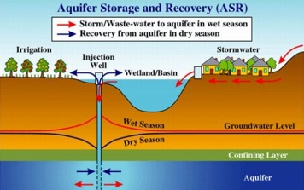
Water Projects Examples
Out-of-Region Water Project: Vista Ridge
143 miles pipelines
Yield: 50,000 acft/yr
Water cost full operation $1,976 /acft
Total cost of facility: $493 million
Pumping Energy: 156,691 MWh/year
ASR Project: Luiling ASR
Total cost of facility: $23 million
Annual cost of water: $1,086 / acft
Energy Consumption for pumping: 1,617 MWh/year

Slide 26
Public Goods Concern
Some Nexus actions will not be adopted by private individuals as they benefit the public not just the individual. In such cases the public will need to get directly involved in adoption.
Water Projects in our projects are public goods some ag possibilities are not

Slide 27
Compensation Reallocation
When do we possibly need it?
Suppose an entity like a Power plant could retrofit its cooling system to save water but don’t do it because its benefits are less than its cost
In such a case those benefitting possibly need to provide compensation to the power plants to increase their incentive to do the water saving retrofit.

Slide 28
Modeling

Slide 29
EDSIMR – the concept
Unify
Detailed aquifer hydrologic model
Regionalized economic Model
Surface water flow model
Hydrology embedded in regional economic model via regression (Keith Keplinger dissertation)
Keith O. Keplinger. "An investigation of Dry Year Options for the Edwards Aquifer. " Ph.D. Thesis, TAMU, 1996.
File Number 598 - Keplinger, K.O., and B.A. McCarl, "Regression Based Investigation of Pumping Limits and Springflow Within the Edwards Aquifer", Texas A and M University, 1995.
File Number 829 - Gillig, D., B.A. McCarl, and F.O. Boadu, "An Economic, Hydrologic, and Environmental Assessment of Water Management Alternative Plans for the South-Central Texas Region", Journal of Agricultural and Applied Economics, 33, 1 (April ), 59-78, 2001.

Slide 30
EDSIMR “System” (and friends/ancestors)
Simulator Bundle
Crop and
Env
Simulators
(EPIC/SWAT)
Livestock
Data
Pest
Regressions
Non Ag
Resource
Demand
Regional
Crop Mix
input use
Env.
loads
EDSIMR
SWAT
Runoff
Simulators
(SWAT)
GIS
Water
Quality
GCMs
Groundwater
Simulator
(GAM)

Slide 31
EDSIMR – Components Edwards Aquifer Groundwater and River System Simulation Model
What is contained in EDSIMR ?
Simulation Model (GAM)
Springflow, beginning/ending aquifer elevations, pumping
Econometric Model
Springflow/ending = f (beginning, recharge, pumping)
Mathematical Linear Programming
Components : objective function
: ag, M&I, power and fracking decision variable
: constraints
: Surface water Network flow
: ground water characteristics
Linkage : Ground Water + Surface Water

Slide 32
Water Rights, & Markets
Reuse
Aquifers
(Edwards, Carrizo-Wilcox, Gulf Coast, Trinity)
Water Project Use (Exist and New)
Treatment Plants
Investments
State of Nature
New Water Projects (Y/N)
Modeled Water Demand
Rivers (Nueces, Guadalupe, San Antonio)
Aquifer Diverters
River Diverters
Hydrological Processes
Energy Retrofits
(Y/N)
Reservoirs (Canyon , Choke Canyon, Coleto Creek, Lake Corpus Christi, Medina Lake, Lake Texana)
Aquifer recharge, Depletion, Elevation
River Flows
Return Flows
Evaporation

Slide 33
Modeled Water Demand
Municipal Water
Water Projects (Exist & New)
Brackish Water
Reuse
Industrial Water Use
Electrical Cooling Water
Treatment Plants
Treatment Plants
Cropland
Crop Production
Aquifer Diversion
Agricultural Water Use
River Diversion
Fresh water
Pasture&
Range
Livestock Production
Fracking Water Use
Return Flows
Water Recreation
Red means we are
Working on adding it
Hydro-Electric
Environmental

Slide 34
Preliminary Results

Slide 35
Power Plant Retrofit
Power Plant | Location | Retrofit
Coleto Creek | Goliad | Coal → NGCC
J. T. Deely | Bexar | Coal → NGCC
JK Spruce | Bexar | Coal → NGCC
San Miguel | Atascosa | Coal → NGCC
O.W. Sommers | Bexar | Recirculating → Dry
V.H. Braunig | Bexar | Recirculating → Dry
Barney | Nueces | Once Thru → Recirculating
Nueces Bay | Nueces | Once Thru → Dry
Penalties on once through
Other retrofits are on upstream of the river to save water

Slide 36
Effects on Water Projects
Comparing with the model not forcing the inelastic demand of power plants cooling water, one water project is built and operated to support the increase demand of water.

Slide 37
Effects on Water Costs
Water Source | Sector | Before ($/Acft) | After ($/Acft)
Surface | Agriculture | 10.6 | 10.6
Surface | Industrial | 1316.095 | 1439.283
Surface | Municipal | 1665.995 | 1826.492
Surface | Mining | 1898.065 | 1901.735
Ground | Agriculture | 12.39949 | 16.46617
Ground | Industrial | 1644.199 | 1584.059
Ground | Municipal | 1733.719 | 1713.315
Ground | Mining | 1950.404 | 1933.99

Slide 38
Water Allocation
 |  | Before (Acft) | After (Acft)
Other Minor Aquifers | Industrial | 1677.248 | 2172.012
Other Minor Aquifers | Municipal | 44697.23 | 44720.9
Other Minor Aquifers | Mining | 3606.895 | 2517.664
Water Project | Municipal |  | 1174
Surface | Agriculture | 50238.41 | 64063.83
Surface | Industrial | 51772.6 | 14876.29
Surface | Municipal | 81857.28 | 27506.22
Surface | Mining | 4452.683 | 4674
Ground | Agriculture | 200742 | 203657.3
Ground | Industrial | 20976.1 | 25605.17
Ground | Municipal | 389464.2 | 444226.6
Ground | Mining | 44353.94 | 45221.85

Slide 39
Conclusion
Power plant retrofit is a possible but expensive option to release water stress in the research region under FEW Nexus analysis.
The water projects will increase demand for electricity and generating more electricity will raise water demand.
The power plant surface water usage is not very responsive to price and it is likely more adjustment will be made in agricultural, industrial and municipal water plus switched to groundwater
Push up the price of water

Slide 40
Future Research
Enhance the preliminary electricity part improving data and modeling on cooling alternatives and the use of electricity when developing the water projects
Considering the benefits of improved storage for wind and solar power plants
Consider water usage and reliability of power plants under climate change.
Add alternative strategies via which fracking can reduce its usage of fresh water.
Further consider means of compensation to incentivize power plant retrofit and the water projects

Slide 41
Acknowledgement
This material is based upon work partially supported by the National Science Foundation under Grant Addressing Decision Support for Water Stressed FEW Nexus Decisions Numbered 1739977

Slide 42
Thank you!

