Slide 1
FEW Nexus Water Scarcity
Chengcheng Fei
Bruce McCarl
Yingqain Yang
Department of Agricultural Economics
Presentation at Department Seminar
April, 20, 2018

Slide 2
FEW Nexus in Our Study
Food-Energy-Water Nexus Analysis considers way actions by some parties in the FEW sectors can benefit total regional welfare.
Water scarcity: Limited supply and increasing demand for water are driving Nexus forces in our study
Economic Concerns: Transaction cost, Public goods, compensation
FEW Nexus actions : new water related sectoral investments and altered operating strategies which we collectively call projects
We are working on defining projects:
Agriculture related projects
Water related projects
Energy related projects

Slide 3
Study Region Geographic & Hydrologic Scope
Water Sources
4 River Basins
5 Aquifers
2 Springs
5 Lakes/Reservoirs
Users
Agriculture
Municipality
Industries (including power plants and fracking)
Recreationalists
Environmentalists

Slide 4
Limited water supply : Rivers
The precipitation in the research region varies from 8-20 inches per year in the west to 30-50 inches per year in the east
Sufficient flows needed for downstream water use and flows to Estuary to protect fishery and species.
Interaction with ground water
Springs
Overpumping of groundwater will lower river flows (not involved in the model now)
River Authority: Division Permits
Annual precipitation map (1981-2010)
Source: twdb

Slide 5
Limited water supply : Aquifers
Problems
Limited water supply (recharge)
Heavy discharge (pumping and springs)
Environment concerns and endangered species finding
EAA solution
Edwards Aquifer Authority (EAA) issued permits to limit pumping and regulated withdraw amount based on water level
Permit trading is allowed in EAA (water market)

Slide 6
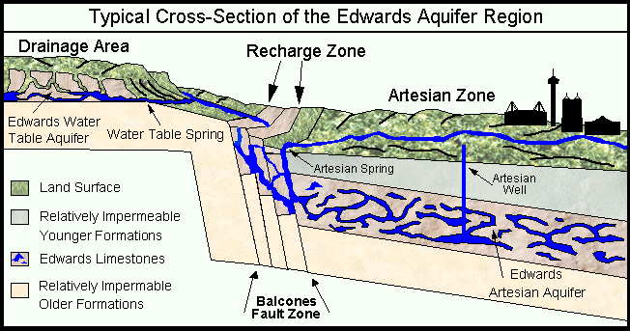
Limited water supply : Aquifers
Edwards Aquifer
Source: Edwards Aquifer Website http://www.edwardsaquifer.net/intro.html

Slide 7
Stochastic water supply : Aquifers
Edwards Aquifer does not retain water

Slide 8
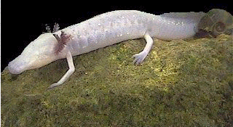
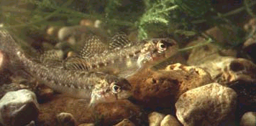
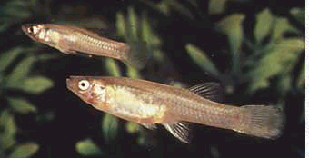
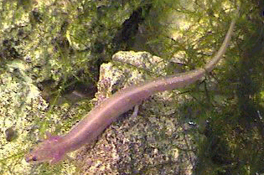
Environmental Awareness
Increase Environmental Awareness (Edwards Aquifer)
⇨ Endangered species
Texas Blind Salamander
Fountain Darter
San Marcos Gambusia
San Marcos Salamander

Slide 9
Edwards Aquifer Regulation

Slide 10
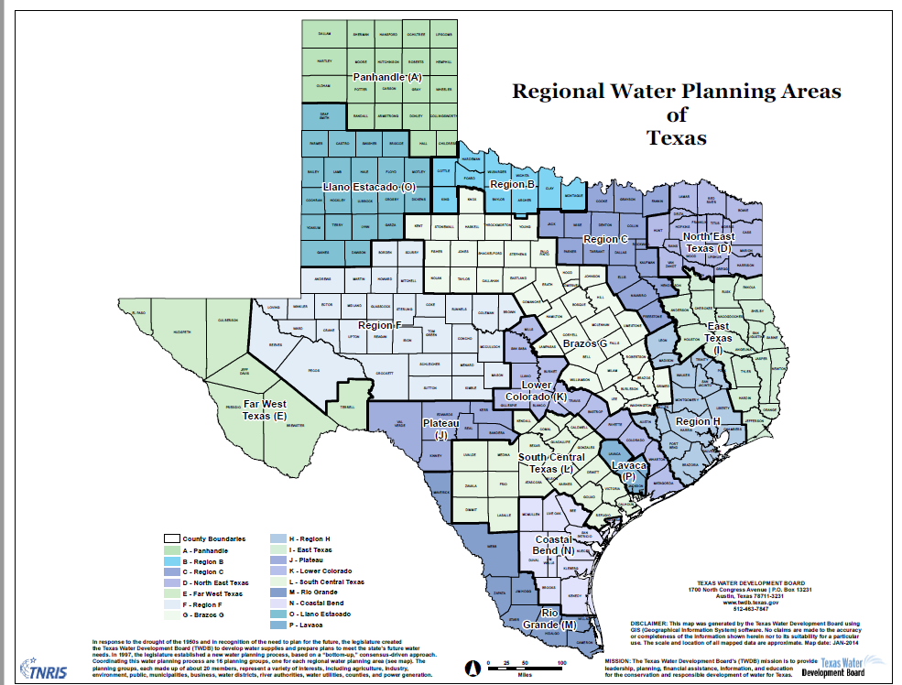
Water Usage by Sector in 2015
Heavy water usage by municipal sector in both region
Region L has heavy irrigation demand
Region L relies more on groundwater
L
N

Slide 11
Municipal Sector
Municipal water use per capita is relatively stable over time
Municipal total water use will increase with population booming in this region
It is hard to reduce demand (Conservation and Education might help to reduce water demand)

Slide 12
Fracking
Between 2000 and 2014, water used to drill a horizontal natural gas well increased from 177,000 to 5.1 million gallons per well
Fracking (mining) is largest water use in some counties.
Heavy fracking in winter garden increased Carrizo-Wilcox drawdown.

Slide 13
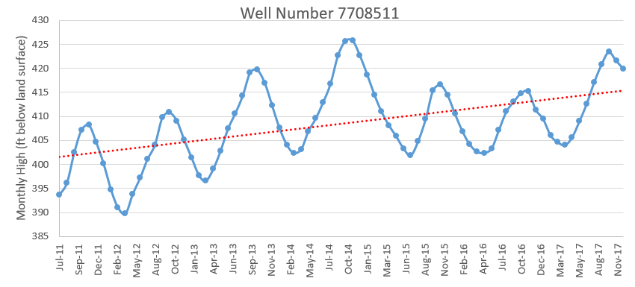
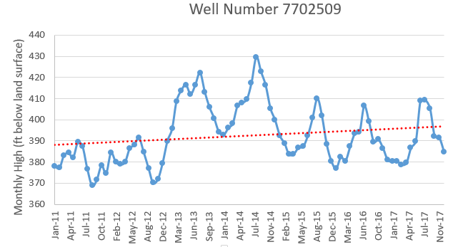
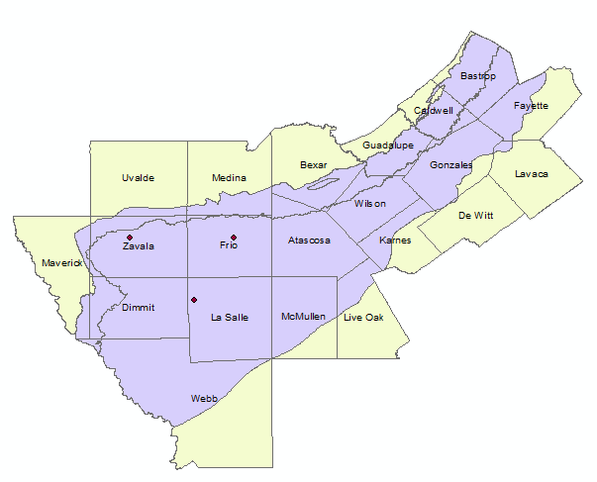
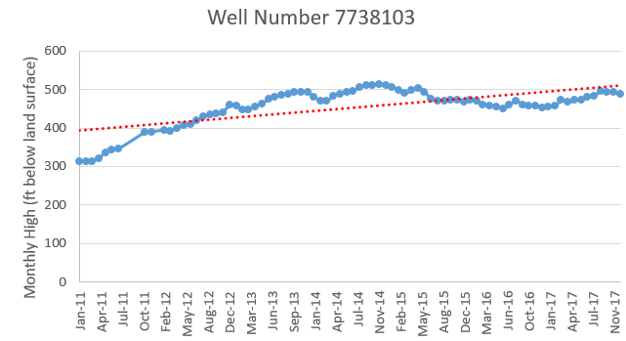
Carrizo-Wilcox Aquifer Lift Increase (water level falling)
In Groundwater Management area 13 covering southern segment of Carrizo-Wilcox Aquifer, desired 2070 condition is no more than 48 feet average drawdown relative to 2012

Slide 14
Economic Concerns

Slide 15
Major Obstacle and solutions
No enough information or benefit for water conversation
Transaction cost is too high
Public goods concern/ no public activities
Regulation constraint
Build water market and increase conversation
Increase public activities
Relax legislative requirement

Slide 16
Increase Social Benefit
Much Nexus work arises from a basic assumption that we can increase social benefits by better managing the resources involved. Economics can be used to evaluate whether decisions achieve benefit increases.
We define projects (Agriculture/water/energy related) to achieve the overall increase of social benefit.
This will be discussed later

Slide 17
Water Value in Diff Market
Water has different value in different uses and this needs both quantification and consideration when making decisions.
Concerns:
Water movement costs
Water allocation patterns between users
Regulation
We will build water market to achieve this goal

Slide 18
Public Goods Concern
Some Nexus actions will not be adopted by private individuals as they benefit the public not just the individual. In such cases the public may need to get directly involved in adoption.
Water Projects in our projects is public goods

Slide 19
Externalities
Nexus actions can cause negative impacts or externalities on other parties that need to be taken into account. Social justice is a concern when Nexus actions negatively affects disadvantaged populations.
Example: Pollution caused by fertilizer and fossil power plant

Slide 20
Compensation Reallocation
Power plant Retrofit to save water
We need provide subsidy to the power plants to increase their incentive of cooling and heating retrofit.
Details will be discussed later

Slide 21
Projects

Slide 22
Nexus Projects/Strategies Agriculture Sector
Halt irrigation moving land to dryland or pasture
Sell water in market
Deficit irrigation
Alter crop mix
Irrigation using brackish or saline water (not included in the model now)
Relax legislative requirement for retained water

Slide 23
Nexus Projects/Strategies Regional Water Projects (mainly M&I)
Regional water planning group identified possible projects in regional water plan. The major classes of these water projects include:
Build new reservoirs
Transmit surface and groundwater via pipelines from other regions (mainly ground)
Desalinate brackish groundwater
Store mainly flood waters in aquifers for later recovery (ASR)
Desalinate seawater
Augment reuse
Electricity consumption by some of these water projects is large
SAWS Seawater desal would use over 0.1 million MWh per year for pumping only.
Desal consumption: 3-4.3 MWh/acft (AMTA, 2016) and SAWS seawater desal project is 84,012 acft
Net electricity generation in Region L was 46 million MWh in 2015
Total net electricity generation in Texas is 450 million MWh in 2015

Slide 24
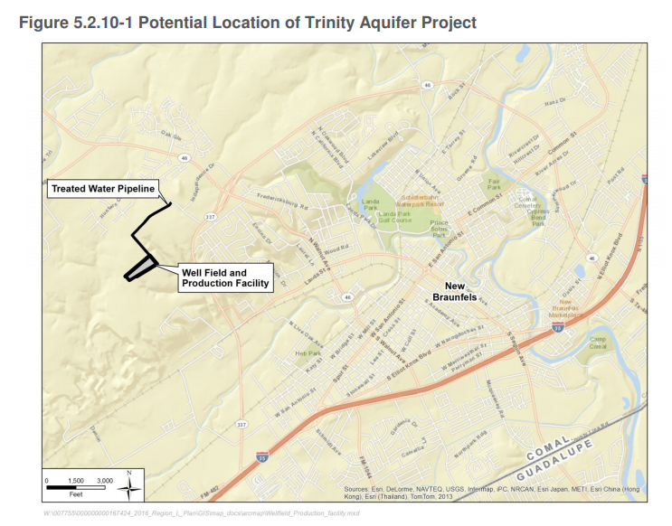
Water project - Groundwater Transmission
Transfer groundwater via pipeline
Vista Ridge Project
From Burleson County to SAWS
143 miles pipelines
Yield: 50,000 acft/yr
Water cost full operation $1,976 /acft
Total cost of facility: $493 million
Pumping Energy: 156,691 MWh/year
Trinity Groundwater for New Braunfels
Yield : 1,090 acft/yr
Annual water cost : $634 / Acft
Total cost of facility: $4 million
Pumping Energy: 810 MWh/year

Slide 25
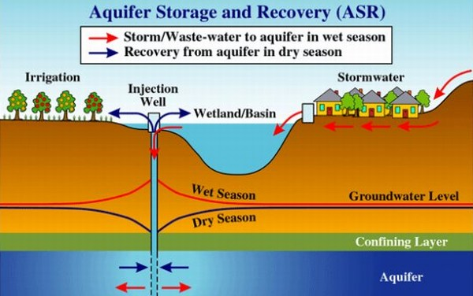
Water Project - Aquifer Storage and Recovery
Luling ASR
When surface water exceeds customer demands, and there is unused aquifer storage then surplus water diverted to injection wells for storage.
When surface water supplies are scarce a blend of treated surface water and recovered water from aquifer wells would be delivered
Total cost of facility: $23 million
Annual cost of water: $1,086 / acft
Energy Consumption for pumping: 1,617 MWh/year

Slide 26
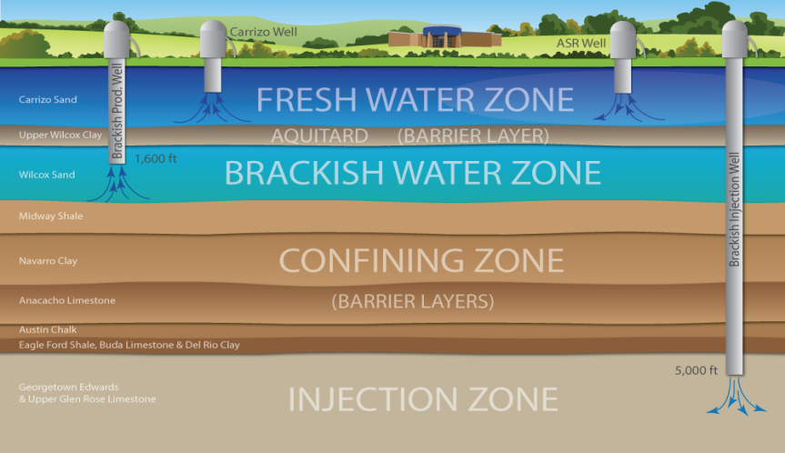
Water Project - Aquifer Storage and Recovery
Broad Advantages:
Store excess flows for later use
Provide supply during drought,
Meet seasonal demands when use restrictions are imposed,
Meet demands at the ends of the distribution system
Provide an emergency supply
Minimize construction of new facilities and their environmental impacts
Disadvantages:
Leakage (Edwards: high leakage and brackish; Trinity: high leakage)
Cannot prevent usage from other users, if the water is stored in the aquifer

Slide 27
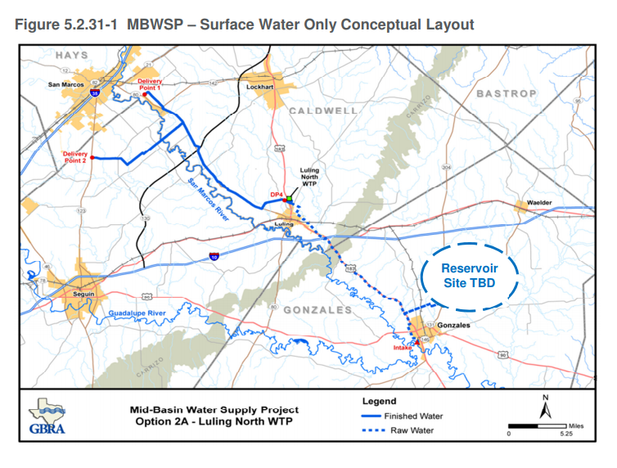
Water Project Build new reservoirs
The Guadalupe-Blanco River Authority (GBRA) Mid-Basin Water Supply Project (MBWSP)
Off-channel reservoir to store flood water.
Capacity: 40,000 acft.
Water cost: $2,561/acft
Pipelines: 31.4 miles
Total cost of facility: $405,562,000
Energy consumption by pumping: 31,158 MWh

Slide 28
Water Project Desalinate brackish groundwater
Brackish Wilcox Aquifer Groundwater for Sutherland Springs Water Supply Corporation (SSWSC)
Annual Water Cost: $2,554/acft
Yield: 1120 acft/year
Total cost of facility: $12 million
Pumping energy: 392 MWh/year

Slide 29
Water Project Seawater Desalination
Seawater Desalination for SAWS
The strategy will be a large-scale desalination plant with capacity of 84,012 acft/yr drawing saline water from San Antonio Bay then treated and pumped for delivery to San Antonio Water System
Annual cost: $1,766 / acft
Total cost of facilities: $1.07 billion
Pipeline: 162 miles
Pumping Energy:148,260 MWh/year

Slide 30
Nexus Projects/Strategies Power Plant Retrofits
Boiler retrofit (coal to natural gas) – need to get water consequences
Cooling retrofit (Once-through to Recirculating to Dry-cooling)
Switch to reusable source: Wind, solar and Nuclear.
Add new capacity in or outside region
Could export water use
Wind and solar reliability are issue
Retrofit and new capacity cost will be in first stage of the model

Slide 31
Power Plant water consumption and costs
 | Water withdrawn and consumption (Gallons per MWh) |  |  |  |  |  | Construction cost per KW | Generation Cost per MWh | Fuel cost per MWh
 | Once-through |  | Recirculating |  | Dry-cooling
 | Withdrawal | Consumption | Withdrawal | Consumption | Withdrawal | Consumption
Coal (conventional) | 20,000 - 50,000 | 100 - 317 | 500 - 1,200 | 480 - 1,100 | N/A | N/A | $2934-6600 | $8-17 | ~$30
Natural gas (combined cycle) | 7,500 - 20,000 | 20 - 100 | 150 - 283 | 130 - 300 | 0 - 4 | 0 - 4 | $676-7108 | $5-43 | ~$41
Nuclear | 25,000 - 60,000 | 100 - 400 | 800 - 2,600 | 600 - 800 | N/A | N/A | $5530 | $12.79
Solar thermal (trough) | N/A | N/A | 725 - 1,109 | 725 - 1,109 | 43 - 79 | 43 – 79 | $3873-5067 | $2.82-7.68
Source: Macknick, Jordan, Robin Newmark, Garvin Heath, and Kathleen C. Hallett. "Operational water consumption and withdrawal factors for electricity generating technologies: a review of existing literature." Environmental Research Letters7, no. 4 (2012): 045802. Summarized by Union of Concerned Scientists |  |  |  |  |  |  | EIA, https://www.eia.gov/outlooks/capitalcost/

Slide 32
Cooling Retrofit Cost
 | Capital cost (once-through to recirculating) ($/kW) | Capital cost (once-through or recirculating to dry) ($/kW) | Capital cost (once-through to recirculating) ($/kW) | Capital cost (once-through or recirculating to dry) ($/kW) | O&M cost (once-through to recirculating) ($/kW/yr.) | O&M cost (once-through to dry) ($/kW/yr.) | O&M cost (recirculating to dry) ($/kW/yr.)
 | Average difficulty retrofits |  | Difficult retrofits |  | All retrofits
Coal | 90 | 220 | 140 | 330 | 2 | 5 | 3
Natural gas combined cycle | 40 | 170 | 65 | 270 | 2 | 10 | 8
Nuclear | 90 | 220 | 140 | 330 | 2 | 5 | 3
Biopower/biogas | 90 | 220 | 140 | 330 | 2 | 5 | 3
Oil/gas simple cycle | 90 | 220 | 140 | 330 | 2 | 5 | 3
Geothermal | N/A | 170 | N/A | 270 | N/A | N/A | 2
Concentrating Solar power | N/A | 170 | N/A | 270 | N/A | N/A | 2

Slide 33
Other considerations
Water cost is just a small proportion of power plant cost. We may have to consider cost sharing from other parties to get power plants to retrofit.
Water projects increase the electricity demand significantly, if they are applied. Will increase need for more power production / capacity as well as population growth
Build new power plant? High cost, maybe more water usage, increased cost to consumers.

Slide 34
EDSIMR “System” (and friends/ancestors)
Simulator Bundle
Crop and
Env
Simulators
(EPIC/SWAT)
Livestock
Data
Pest
Regressions
Non Ag
Resource
Demand
Regional
Crop Mix
input use
Env.
loads
SWAT
EDSIMR
Regionalizing
Model
Runoff
Simulators
(SWAT)
GIS
Water
Quality
GCMs
Groundwater
Simulator
(GAM)

Slide 35
EDSIMR – the scope
Water Rights, & Markets
Reuse
Aquifers
(Edwards, Carrizo-Wilcox, Gulf Coast, Trinity)
Water Project Use (Exist and New)
Treatment Plants
Investments
State of Nature
New Water Projects (Y/N)
Modeled Water Demand
Rivers (Nueces, Guadalupe, San Antonio)
Aquifer Diverters
River Diverters
Hydrological Processes
Energy Retrofits
(Y/N)
Reservoirs (Canyon , ChokeCanyon, ColetoCreek, Lake Corpus Christi, Medina Lake, Lake Texana)
Aquifer recharge, Depletion, Elevation
River Flows
Return Flows
Evaporation

Slide 36
EDSIMR – demand scope
Modeled Water Demand
Municipal Water
Brackish Water
Reuse
Water Projects (Exist & New)
Industrial Water Use
Electrical Cooling Water
Treatment Plants
Treatment Plants
Cropland
Crop Production
Aquifer Diversion
Agricultural Water Use
River Diversion
Fresh water
Pasture&
Range
Livestock Production
Fracking Water Use
Return Flows
Water Recreation
Red means we are
Working on adding it
Hydro-Electric
Environmental

Slide 37
Acknowledgement
This material is based upon work partially supported by the National Science Foundation under Grant Addressing Decision Support for Water Stressed FEW Nexus Decisions Numbered 1739977

