Slide 1
Lecture 11 Solving Non-linear Programming Problems
Chengcheng Fei
2017 Fall
Based on material written by Gillig and McCarl; Improved upon by many previous lab instructors; Special thanks to Zidong Mark Wang.

Slide 2
Introduction
We often encounter problems that cannot be solved by LP algorithms, in which the objective function or constraints are in non-linear forms.
Solving non-linear programming models are generally much complicated than linear programming models based on the types of non-linear models. For example:
The objective is linear but constraints are non-linear
Non-linear objectives and linear constraints
Non-linear objectives and constraints

Slide 3
Approximation of NLP problem
One important intuition in solving NLP problems is approximation.
A continuous function (x) can be approximated by a polynomial to any accuracy desired.
Linear approximation of a NLP problem. GAMS handles linear problems faster and more efficient.
Besides, GAMS has some nice NLP solvers which can be applied to NLP models directly.

Slide 4
Using NLP solvers in GAMS
As before
Define sets
Data assignment
Define variables
Define equations (now non-linear)
Model statement
Except now the last step is: Solve modelname using NLP maximizing/minimizing objective

Slide 5
Price Endogenous Problem Example
Demand : $P_{d}=a_{d}−b_{d}Q_{d}$
Supply :$P_{s}=a_{s}−b_{s}Q_{s}$
The mathematical formation for this problem is:
The problem maximizes welfare (consumer surplus + producer surplus).

Slide 6
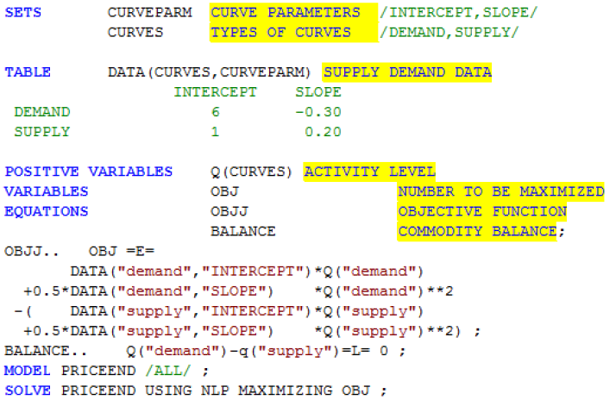
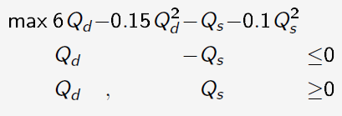
GAMS code

Slide 7
NLP Solvers
Gradient based search
With a starting point and a direction, the algorithm repeatedly search for optimal.
Potential problems
Solver may only find a local solution.

Slide 8
Starting Points
Initial values for variables
Default starting point is zero or the variable lower bound.
Starting point in right neighborhood is likely to return a desirable solution.
Initial values close to optimal one reduces work required to find the optimal solution.
Poor initial values can lead to numerical problems. Starting points can help avoid such.

Slide 9
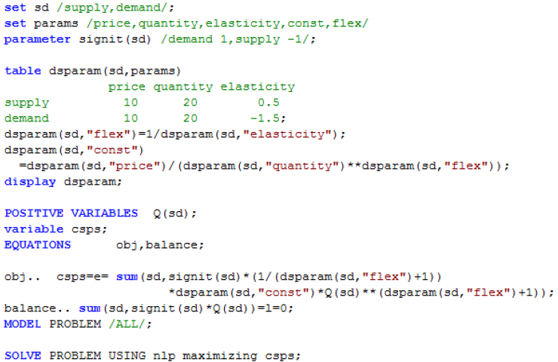
Starting points - example
Suppose we solve a simple CS-PS maximization problem without specifying starting points

Slide 10
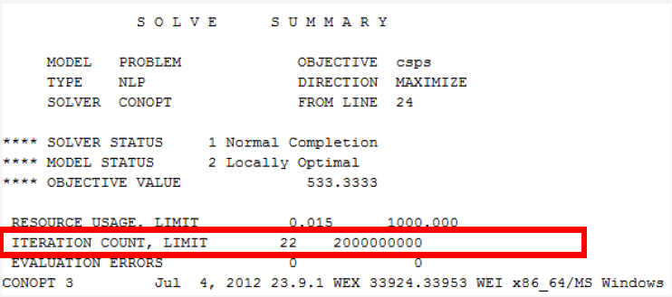
The NLP solver takes 22 iterations to get the solution.

Slide 11
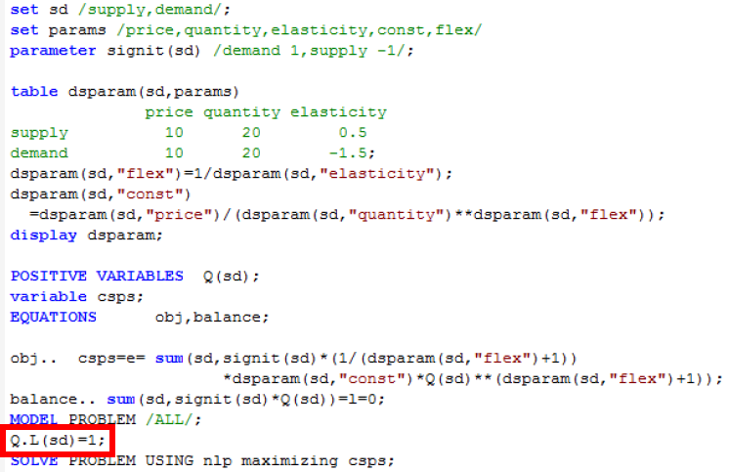
If we specify a proper starting points before solving the model

Slide 12
The NLP solver only takes 8 iterations to get the solution.

Slide 13
Upper and lower bounds
Set upper bound and lower bound for specific variables
More realistic
Keep algorithm in a range
Improve solution feasibility and pre-solve performance

Slide 14
Linear Approximation
Generally, GAMS takes much more time to solve a NLP problem than a LP problem.
We sometimes can linearly approximate the NLP problem, and then solve it as a LP problem.
A typical example in our class is the MOTAD

Slide 15
MOTAD: Linear Approximation
Linear Approximation to the expected value variance (E-V) problem, which is generally quadratic
LP not appropriate without some adjustments
MOTAD depicts tradeoffs in expected income and absolute deviations of income
Minimization of Total Absolute Deviations

Slide 16
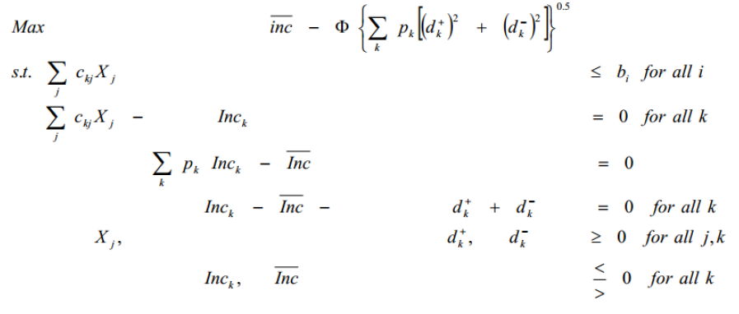
The algebraic form of MOTAD

Slide 17
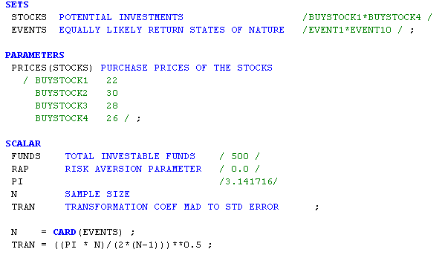

Slide 18
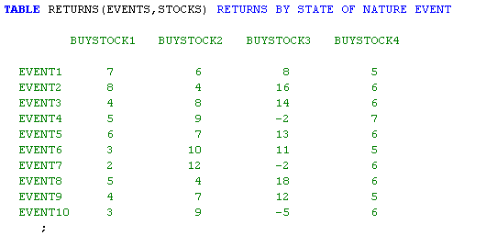

Slide 19
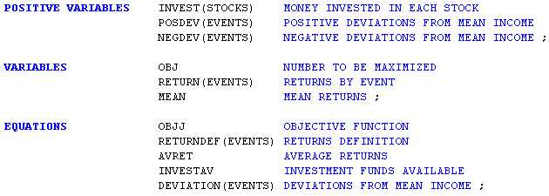

Slide 20
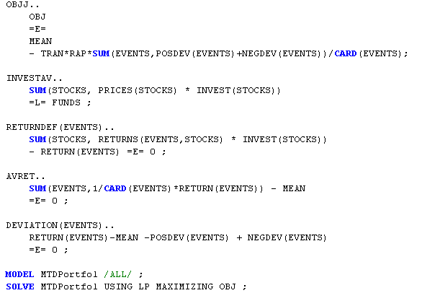

Slide 21
Questions?

