Slide 1
Lecture 9 Report writing
Chengcheng Fei
2017 Fall
Based on material written by Gillig and McCarl; Improved upon by many previous lab instructors; Special thanks to Zidong Mark Wang.

Slide 2
Review - display statement
General format
Display itemname;
Display variablename.L(setdependency);
Display equationname.M(setdependency);
. L refers to optimal solution and .M refers to shadow price values.
Variable
.L optimal solution levels
.M optimal reduced costs / variable marginals
Equation
.L optimal equation levels (RHS – SLACK)
.M equation marginals /shadow prices

Slide 3
Solution Reports: Slack Option

Slide 4
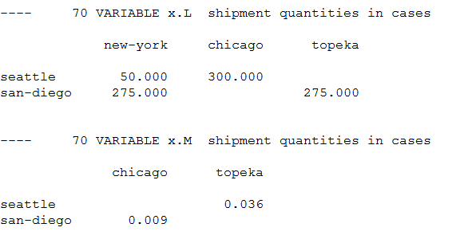
The transportation example

Slide 5
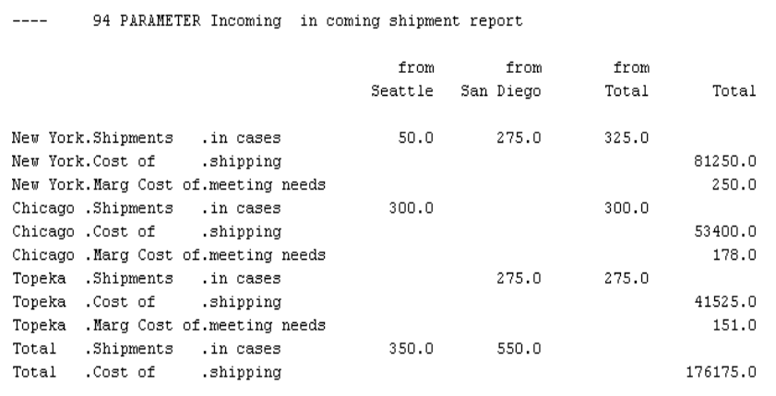
Why report writing
GAMS model solution is not adequate for conveying solution information. One should do calculations using solution information to improve information content. We might want the output to be more informative and condense as follows:

Slide 6
Review - universal set *
Set references may be indefinite allowing any entries at all by referring to the universal set.

Slide 7
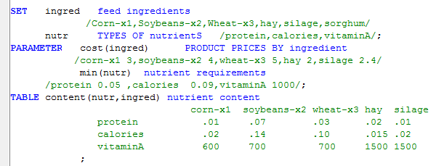
Report Writing – another example
Suppose we wish to work up a report in a least cost feed model of diet composition and cost

Slide 8
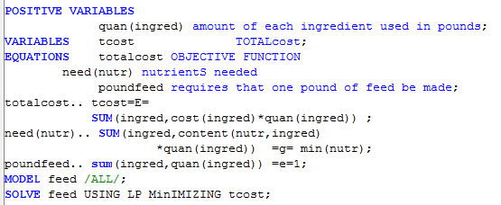
And we want to generate a 2-dimension report table:
Ingredient | Cost/pound | Pound used | Mix cost
Corn
Soybeans
Etc
Total

Slide 9
First define a 2-dimensional report
Then fill in the report

Slide 10
c
Ingredient | Cost/pound | Pound used | Mix cost
Corn
Soybeans
Etc
Total

Slide 11
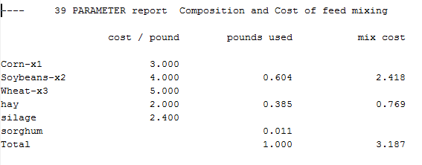
Obtaining

Slide 12
The transportation example
How many dimensions are needed in such a report table?

Slide 13
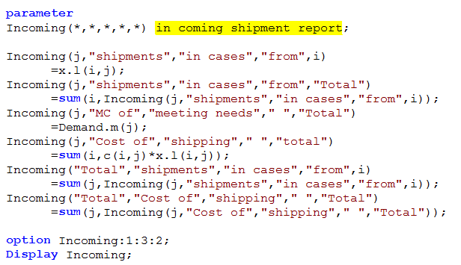

Slide 14
Review: Decimals and Format
General form:
OPTION Item:Decimals:RowItems:ColumnItems
Example:
Option TotalValue:1:0:1;
Decimals: number of decimal places to be included
RowItems: number of indices displayed within rows
ColumnItems: number of indices displayed within columns

Slide 15
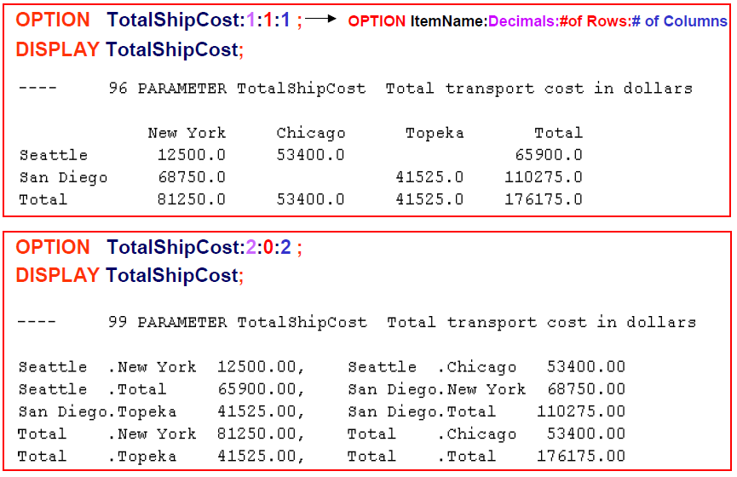
Example

Slide 16
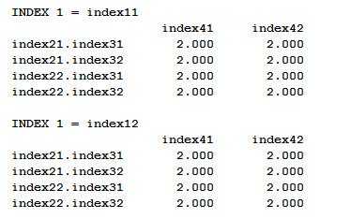
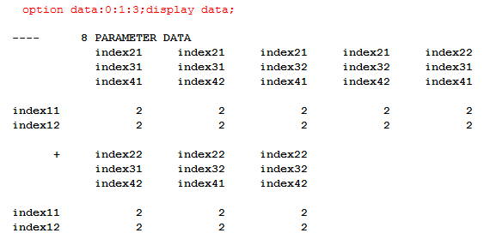

Slide 17
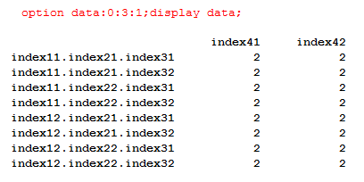

Slide 18
Questions?

