Slide 1
Lecture 7 GAMS Check
Chengcheng Fei
2018 Fall
Based on material written by Gillig and McCarl; Improved upon by many previous lab instructors; Special thanks to Zidong Mark Wang.

Slide 2
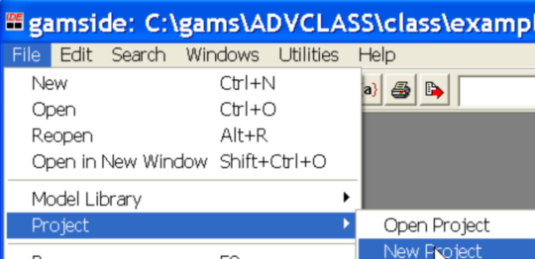
An side note: project file
*.gpr file: the GAMS project file.
The project location determines where all saved files are placed (to place files elsewhere use the save as dialogue) and where GAMS looks for files when executing.
The project saves file names and program options associated with the effort in a file called projectname.gpr.
It is a good idea to define a new project every time you wish to change the file storage directory.

Slide 3
GAMSCHK
GAMSCHK is a system for verifying model structure and solutions to see if all is correct. It is designed to aid in PRE and POST solution model analysis and help fix improperly working models.
PRE solution: To verify the model structure before worrying too much about the answer.
POST solution: To enlist the solvers help in an exercise to find the causes of unrealistic solutions, unbounded or infeasible problems.

Slide 4
PRE Solution
PRE- solution procedures can be used to
List selected equations and/or variables (DISPLAYCR)
Generate schematics on equations/variables blocks (BLOCKPIC)
List characteristics of equations/variables blocks (BLOCKLIST)
Find obvious specification errors (ANALYSIS)
Generate schematics on location of coefficients by sign and magnitude on individual equation/variable basis (PICTURE)
List characteristics of equations/variables (MATCHIT)

Slide 5
Post Solution
Reconstructing reduced cost and equation activity (POSTOPT)
Helping resolve problems with unbounded or infeasible models (NONOPT)
On a post solution basis, POSTOPT is used to check for nonsensical solutions by observing a faulty attribute of the solution in terms of
Allocation (variable and equation levels, e.g. Variable.L, Equation.L)
Valuation (variable and equation marginals e.g. Variable.M, Equation.M)

Slide 6
Steps to run GAMSCHK
Step 1: Insert a command line
OPTION LP = GAMSCHK
OPTION NLP = GAMSCHK
OPTION MIP = GAMSCHK
Right before the solve

Slide 7
Step 2: Create a new file with extension *.gck that has the same corresponding name as the program file.
exgamschk.gms → exgamschk.gck

Slide 8
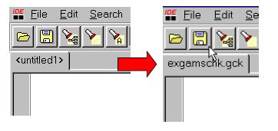
To create a new file, go to the FILE menu and use the NEW option. You will then get a file called untitled with an empty screen then save as exgamschk.gck
Make sure *gms and * gck files are saved within the same folder

Slide 9
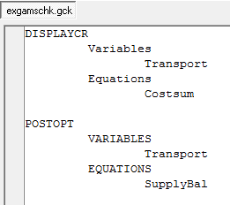
STEP 3: select procedures and provide inputs in the *.gck file.
If the *.GCK file cannot be found, then it is assumed that the BLOCKPIC procedure is selected.
Procedure Name
Item Selection
input

Slide 10
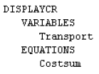
Input rules
If a particular equation is not specified, then display all equations
If a variable or equation name is entered without any following parentheses, then all cases for that variable or equation are selected.
If all elements from sets are selected, wild cards can be used
If a wild card is used to select items (e.g. Tr*), GAMS will select anything starting Tr

Slide 11
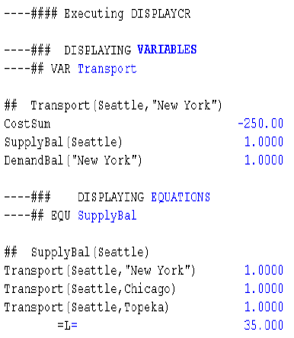
DISPLAYCR
DISPLAYCR produces output much like the results under Equation Listing and Column Listing (controlled by LIMROW and LIMCOL options), but DISPLAYCR allows one to select specific items.
Display variable names and associated coefficients in equations
Display equations and associated coefficients with variables

Slide 12
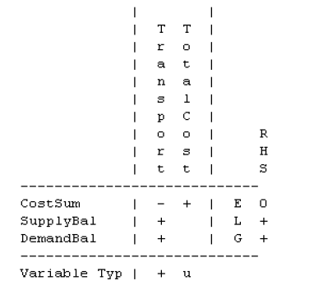
BLOCKPIC
BLOCKPIC is used to find GAMS coding errors in a model structure by looking at a whole summary of the model.
Scaling can also be investigated.

Slide 13
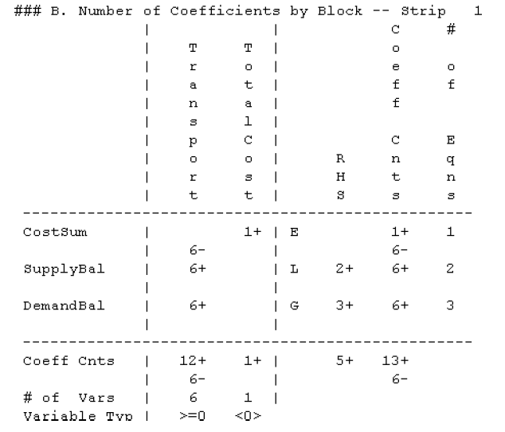
BLOCKPIC

Slide 14
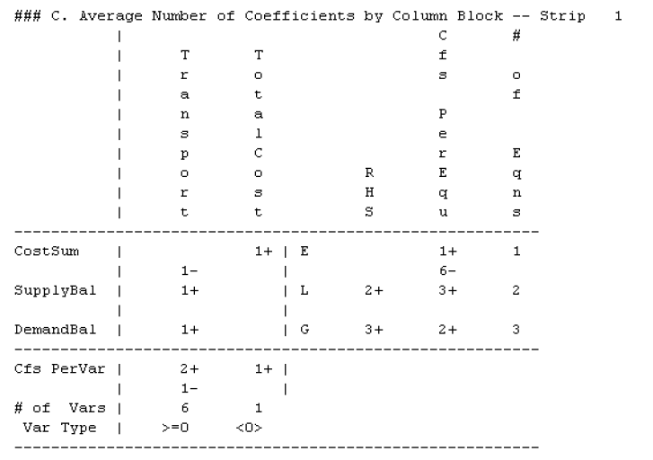
BLOCKPIC

Slide 15
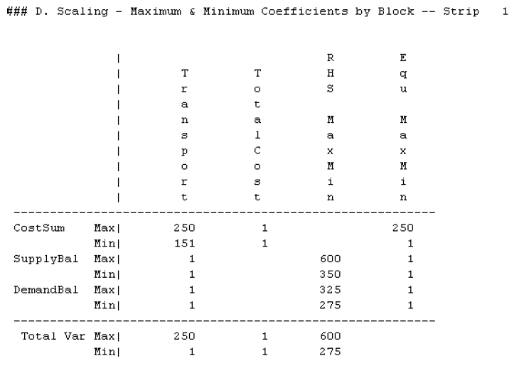
BLOCKPIC

Slide 16
PICTURE
PICTURE permits investigation and verification of the structure of equations and variables.
Look at interrelationships between items
how coefficients for a variable appear across equations?
What variables appear in an equation?
How some variables balance against other variables in equations?
How signs are distributed?
Look at magnitude, sign and location of coefficients
Avoid immense output from using LIMROW/LIMCOL or DISPLAYCR

Slide 17
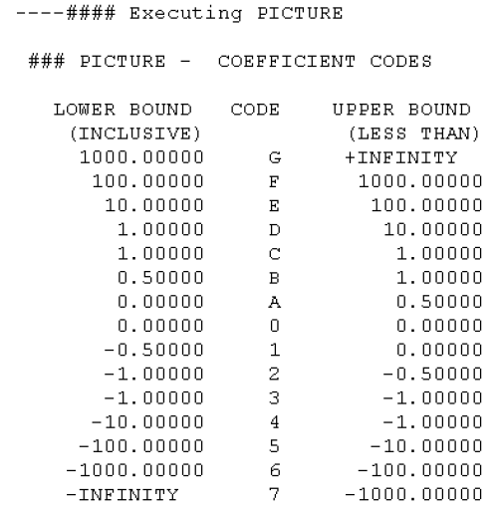
PICTURE coefficient code

Slide 18
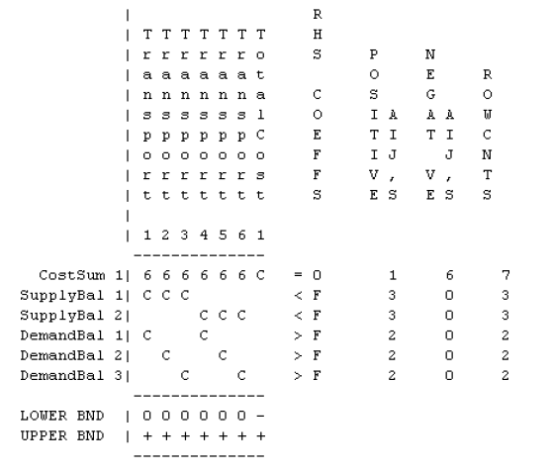
PICTURE magnitude, sign & location

Slide 19
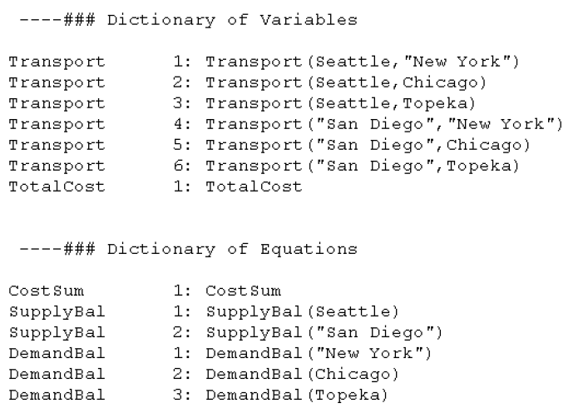
PICTURE dictionary

Slide 20
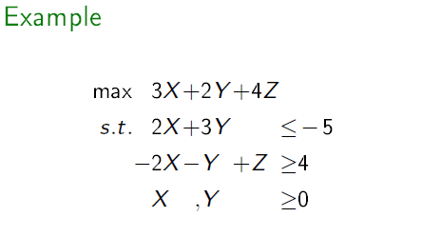
ANALYSIS
ANALYSIS is used to analyze the structure of all variables and equations. Information from ANALYSIS is used to dene if individual variables or equations in the model have specification errors which lead to redundancy, zero variable values, infeasibility, unboundedness, or obvious constraint redundancy in linear programs.
Z is unbounded.
Eq. (1) is infeasible.
Notes:
Example2.gms Example2.gck

Slide 21
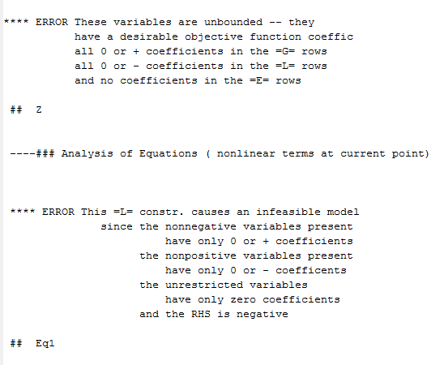
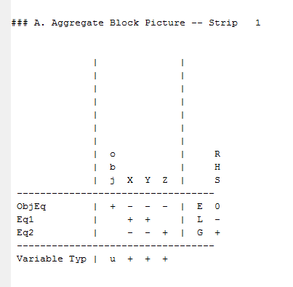
Z is unbounded.
Eq. (1) is infeasible.

Slide 22
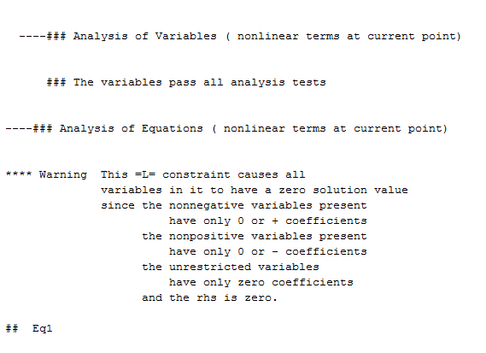
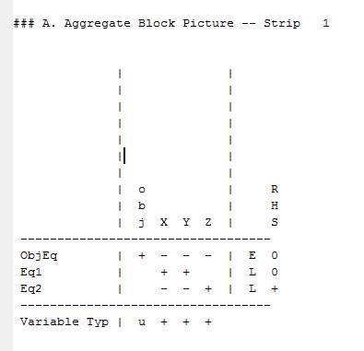
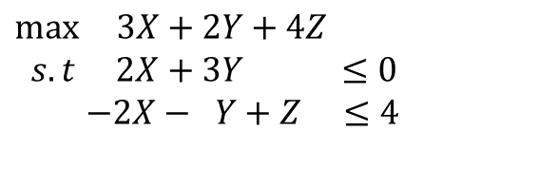
$$\max{ 3X+2Y+4Z}$$
$$s.t 2X+3Y ≤0$$
$$−2X− Y+Z ≤4$$

Slide 23
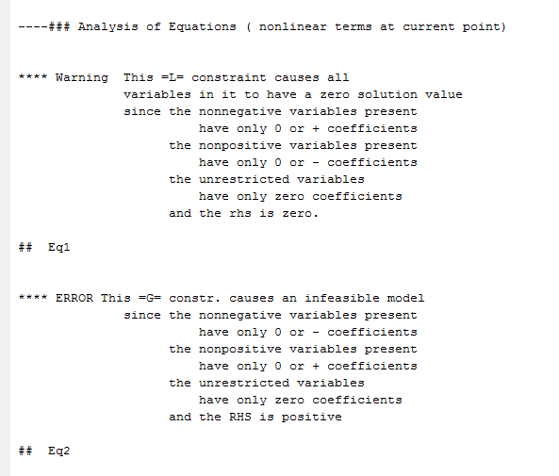
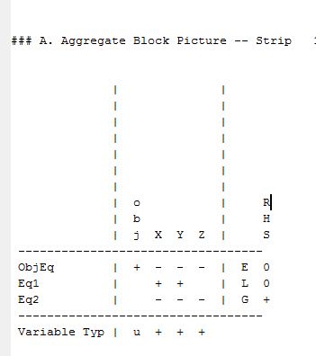
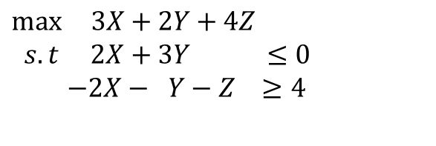
$$\max{ 3X+2Y+4Z}$$
$$s.t 2X+3Y ≤0$$
$$−2X− Y−Z ≥4$$

Slide 24
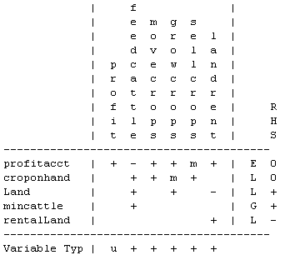
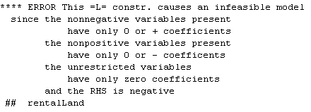

Slide 25
POSTOPT and NONOPT
POSTOPT reconstructs the reduced cost and equation activity. It is used to investigate a misbehaving model yielding an unrealistic, infeasible, or unbounded solution.
NONOPT is used to help find the potential set associated with infeasibility problems.
Since both are used to exam model flaws, they will be introduced in detail in the next section: examine model flaws.

Slide 26
Questions?

