Slide 1
Lecture 5 Good modeling
Chengcheng Fei
2018 Fall
Based on material written by Gillig and McCarl; Improved upon by many previous lab instructors; Special thanks to Zidong Mark Wang.

Slide 2
Why bother ?
How easy is it to reuse or modify a model at a later time for you?
How easy can a colleague work with your code?
A user-friendly model should include the following features
Using longer names or descriptions
Including comments on nature and source of data
Including as much raw data as possible as opposed to externally calculated data
Less * as a set speciation for input data
Using sets to aid in readability
A readable format

Slide 3
Review: Subset and Upper set
One can define subsets containing part of the elements of another set using a set statement. The general format is
SET subsetname(setname) optional explanatory text
/ Elementname1 optional explanatory text
Elementname2 optional explanatory text/;
where subsetname is the name of the subset and setname is the name of the “upper” set.

Slide 4
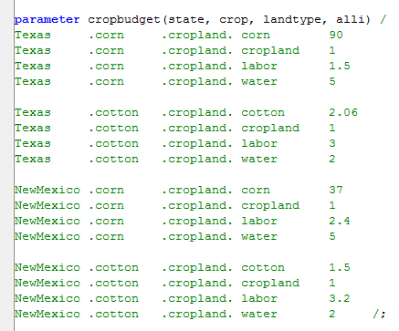
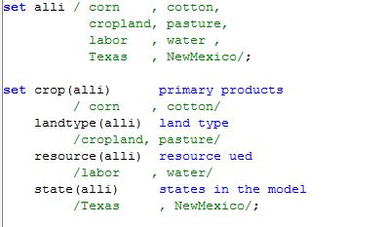
Subset
Allow items to be treated simultaneously in some places, but separately elsewhere.

Slide 5
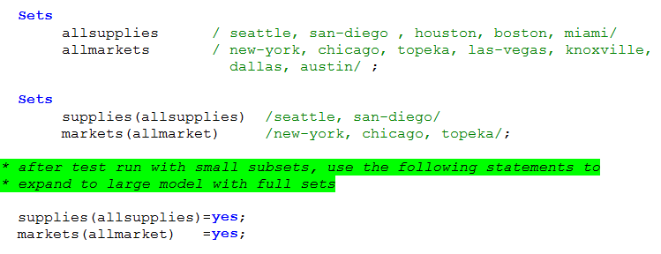
Subset
Allow small to large modeling
Conditional statements (discuss in Lab 6)

Slide 6
Naming Conventions
GAMS allows 63 character long names and 254 characters of explanatory text to define Sets , parameters, tables, scalars, variables, equations, models. The explanatory text must be contained on the same line as the identifier or label it describes.
Names longer than 10 characters do not work well in multi-column displays (Example Here)
It is wise to make GAMS code to be self documenting by using descriptive character names and make sure that there is no item that goes undefined (e.g. unit, data source)
Enter units, sources, and descriptions. Check for completeness with $ONSYMLIST (list the names of all symbols that have been defined and their explanatory text in alphabetical order grouped by symbol type).
Check for unused items that are already defined with rf=list.ref in the dialogue box (Example).
Notes:
For the item names longer than 10 characters, go to check how it shows in gams list file
Take a picture

Slide 7
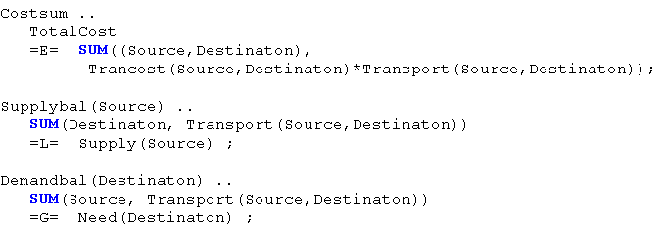
Using longer names
Same algebras but different names
Notes:
LongNameExample.gms

Slide 8
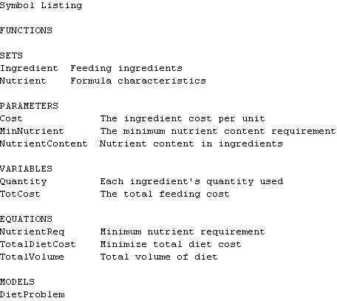
Gms file
Lst file
The Symbol Listing in the lst file after compliation.
Default in GAMS is
$OFFSYMLIST
Notes:
Lab04_data.gms, lab04_model.gms in folder 5
Introduce $include here

Slide 9
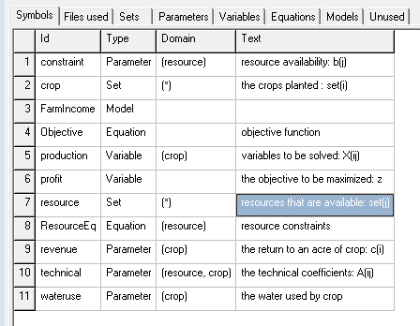
The reference list

Slide 10
Including Comments
Questions often asked when looking at a set of data are:
Where did the data come from?
What characteristics such as units, and year of applicability do those data possess?
It is nice to go beyond the GAMS 254 character description by putting several lines of description comments identifying what document a data set is from including sources, page numbers, table number, years, units, etc.

Slide 11
Raw vs. Calculated Data
Modelers often face two choices with respect to data.
Enter raw data into GAMS and transform it to the extent needed inside GAMS
Externally process data entering the final results in GAMS (e.g. from a spreadsheet where the data are previously manipulated)
Recommendation: Put data in as close to the form as it was collected into GAMS and then manipulate the data in GAMS code
Justification: (1) Over time spreadsheets change or get lost.
(2) Keep a record of what you did.

Slide 12
Calculated Data Example
Instead of directly entering the transportation cost that was previously calculated in the spreadsheet in GAMS using TABLE statement, one should enter a raw data in GAMS and then let GAMS do a calculation.

Slide 13
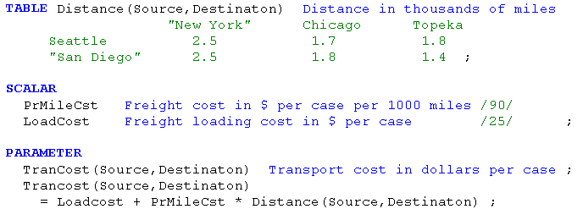

Slide 14
Cautions about Calculation
Dynamic: calculations repeated every time the model is generated. Only calculations in the model .. statements are dynamic
Static : calculations executed once only at the place the GAMS instruction appears in the code.
Notes:
Example: calculation_new.gms

Slide 15
Repeated Static: calculations within a GAMS flow control structure (e.g. loop) which are executed repeatedly but are static within the control structure.

Slide 16
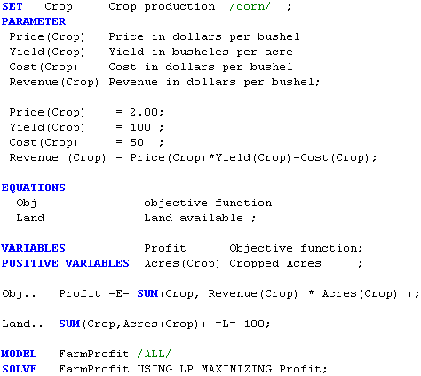
Dynamic vs. Static Calculation
The data on revenue is previously calculated using PARAMETER statement.
Then this revenue is used in the OBJ.. equation

Slide 17
Universal set *
Set references may be indefinite allowing any entries at all by referring to the universal set.
One application of the universal set is quick report writing to make summary tables. (Report writing will be discussed in Lab 9).
No * In input data Set Specification

Slide 18
No * In input data Set Specification
* in the first index position of MiscData. GAMS allows anything in that position suppressing “domain” checking. Suppose we mistyped endinv-value as endinv-valu, then GAMS code would compile and execute w/o a GAMS error but the result would be wrong.

Slide 19
No * In input data Set Specification
Here if we replace * set with InputItem set,
then GAMS would have given the error messages.

Slide 20
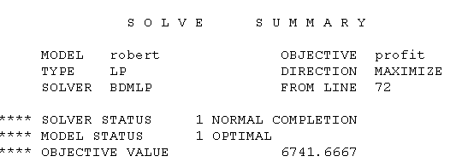
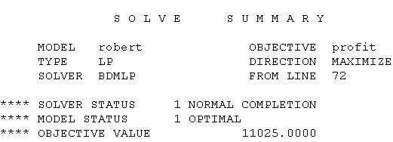
No * In input data Set Specification
The solution from solving the model with mistyping on “endinv-value” as “endinv-valu”
The solution from solving the model with correction on “endinv-value”

Slide 21
Improve Readability
Format the code for readability using spacing and indents.
Align item names, descriptions, and definitions
Indent in sums, loops, and ifs to delineate terms
Use blank lines to set things off
Do not split variables between lines in equations, but rather keep them together with all their index positions

Slide 22
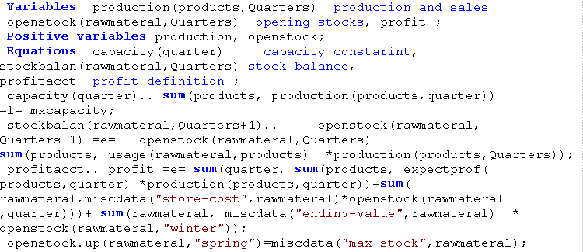
Do you prefer this?

Slide 23
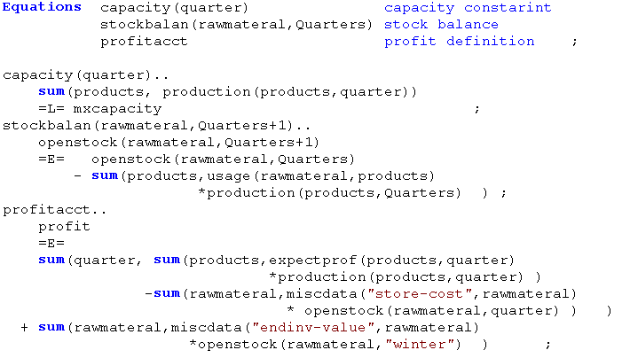
… or this?

Slide 24
Questions?

