Slide 1
Lecture 4 Power of GAMS
Chengcheng Fei
2018 Fall
Based on material written by Gillig and McCarl; Improved upon by many previous lab instructors; Special thanks to Zidong Mark Wang.

Slide 2
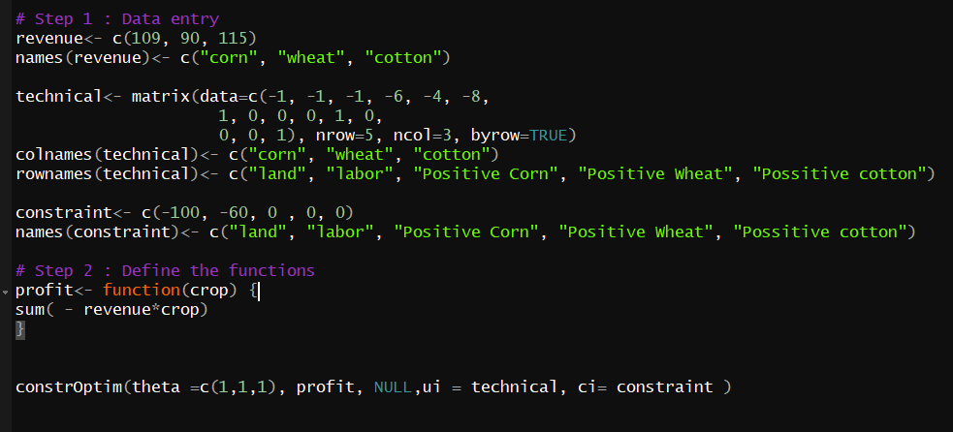
R Example

Slide 3
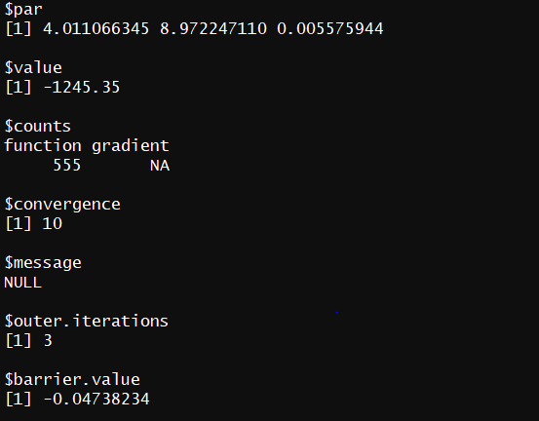
R Result

Slide 4
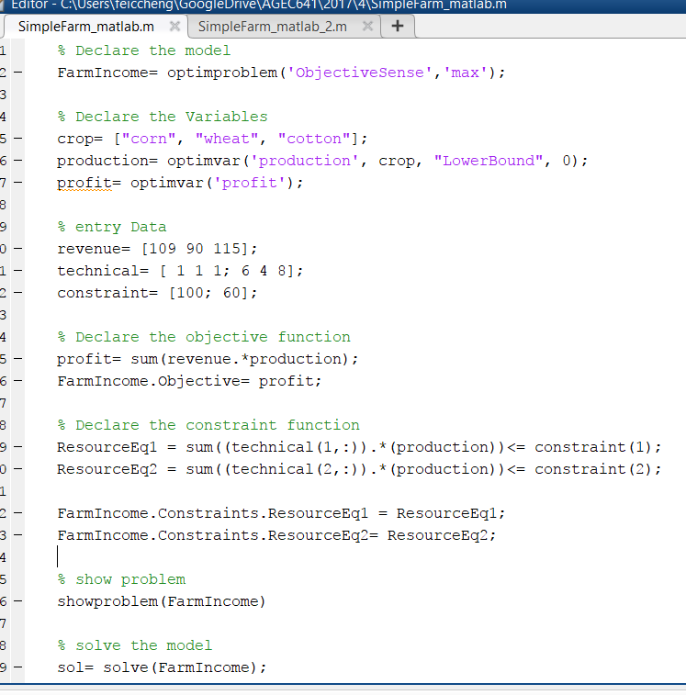
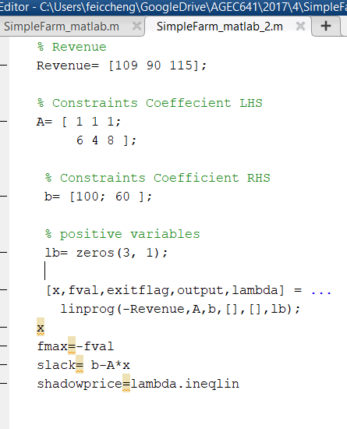
Matlab Example

Slide 5
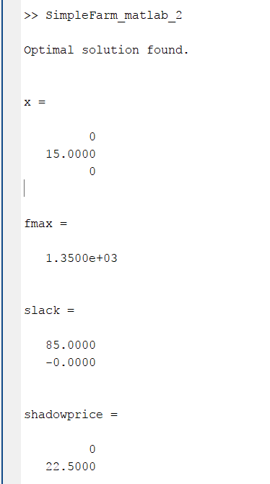
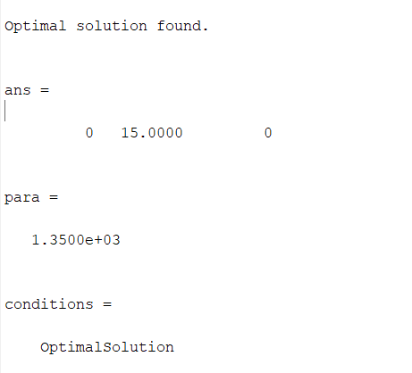
Matlab Result
Result of “linprog” Function
Result of “solve” Function

Slide 6
Why Do We Use GAMS?
Algebraic Modeling
Context Changes
Expandability of Models
Adding Conditionals
Display Formatting
Self Documenting Nature
Small to Large Model Development
Model Library
Use by others
Nonlinear and other problem forms

Slide 7
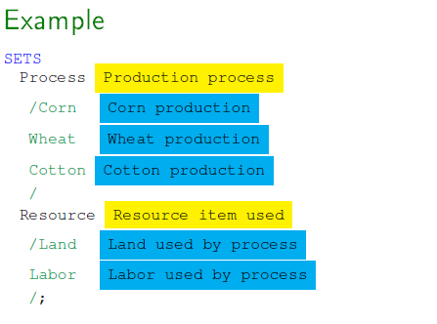
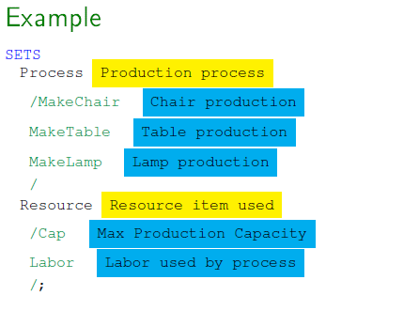
1.a Context Changes
The same algebraic model can be used in multiple contexts often with the same or very similar structure.
For example, we have two problems:
A crop production problem where a farmer wants to maximize the net farm income from growing crops.
a manufacturing production problem where a manufacturer wants to maximize the net income from making goods.

Slide 8
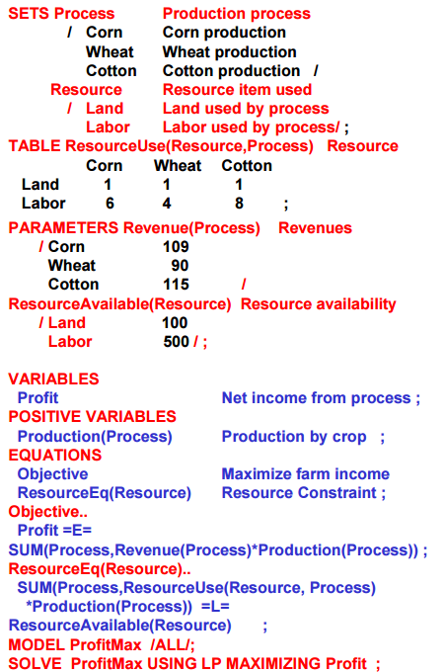
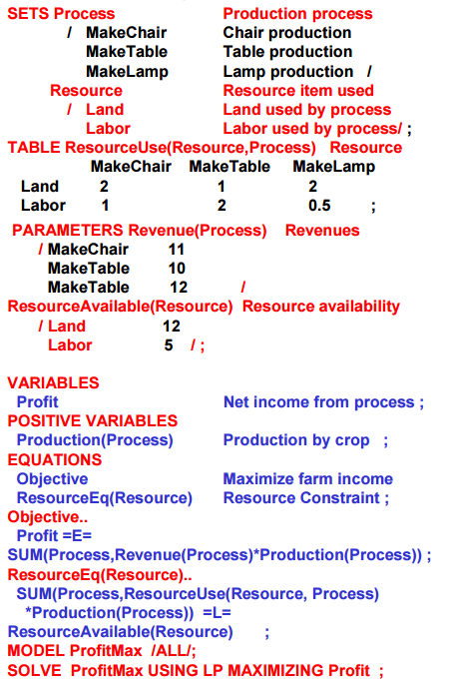
1.a Context Changes

Slide 9
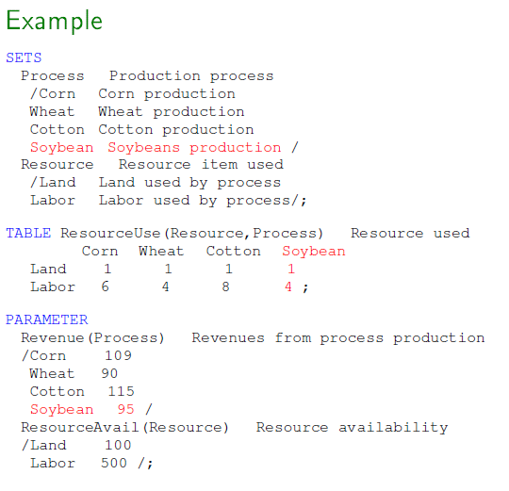
1.b Expandability - Scope
Instead of growing 3 crops, now a farmer also wants to grow soybeans. One needs only to add an element in
set PROCESS
table ResourceUse
parameter revenues
Other data and the model structure remains the SAME!

Slide 10
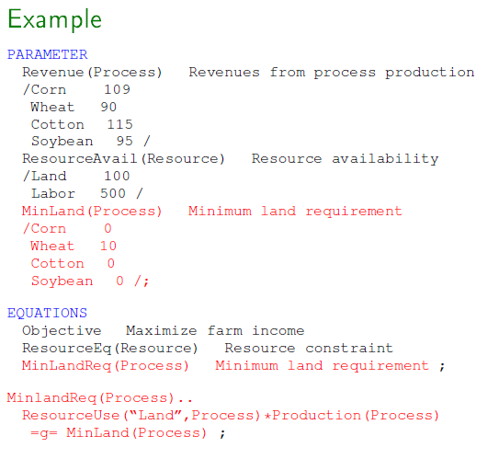
1.b Expandability -Augmenting Existing Models
In the previous example of crop production, a new constraint is added such as at least 10 units of wheat to be produced for self-consumption.
Modification includes:
adding data on minimum land use,
and equation specification on minimum land use.

Slide 11
1.c Adding Conditionals
Modelers need to be able to write expressions that operate over less than full sets or incorporate various model features conditionally depending on data.
Land types (dry land or irrigated land ) for crop production
Seasonal labor availability
Such tasks can be accomplished in GAMS using conditionals.
Several alternatives are available for conditional statements. We will talk about this in details later in Lab Lecture 6.

Slide 12
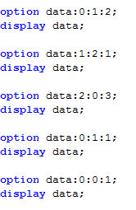
2. Control display format
General Format
option Itemname:Decimal:RowItems:ColumnItems
Explanation
Decimal: number of decimal places to be included
RowItems: Number of indices displayed within rows
ColumnItems: Number of indices displayed within columns
Example
ColumnItems cannot be 0!

Slide 13
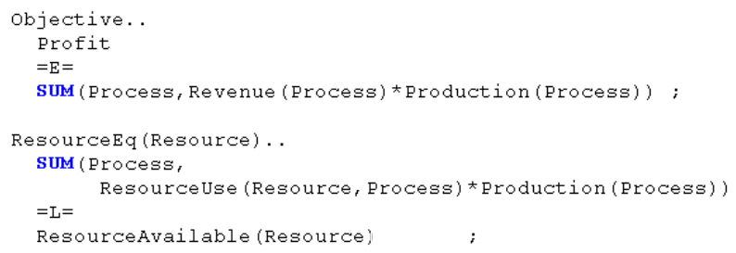
3. Self-documenting Nature
GAMS allows one to add explanatory text when naming SETS, PARAMETERS, TABLES, VARIABLES, EQUATIONS, but it is a good habit to name them with easy-understanding words instead of simple letters.
(A)
(B)

Slide 14
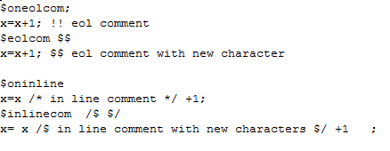
3. Self-documenting Nature
Always remember commenting your code. Comments can not only help others read your code, but also help yourself read for future references.
Comment a line: asterisk *
Comment multiple lines: put comments between $ONTEXT and $OFFTEXT
End of line comment: Use commands$oneolcom and $eolcom “two character specification”
Default specification is !!
In line comment: $oninline /* */ and $inlinecom beginningcharacter endingcharacter
Notes:
Exclamation mask

Slide 15
4. Small to large model
GAMS expandability allows the same model structure, calculations, and report writing to be used with SETS with few elements vs. SETS with many items.
Using a small data set allows up to examine the model structure and function easier and better. Then later one can use same algebra and full problem.
To expand, one uses SmallStocks(Stocks) = YES;

Slide 16
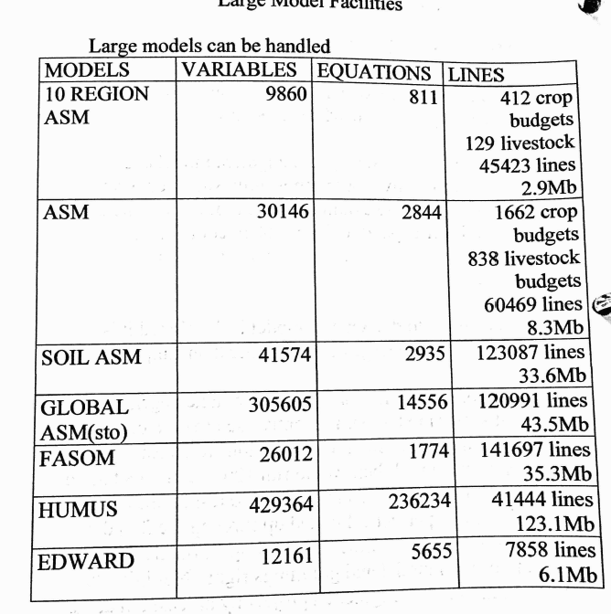
Large Model Facilities

Slide 17
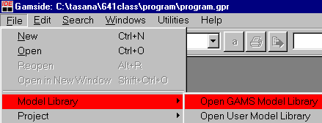
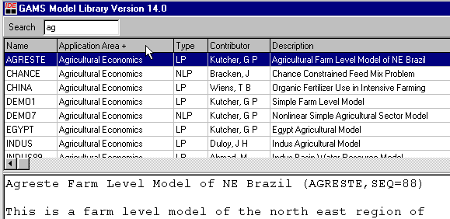
5. GAMS model library
GAMS has been used as a standard in optimization models in many fields
Models exist from experienced users that address similar problems
Textbook (McCarl and Spreen)
Fixing Models Book (McCarl)
GAMS Library
GAMS Newsletter

Slide 18
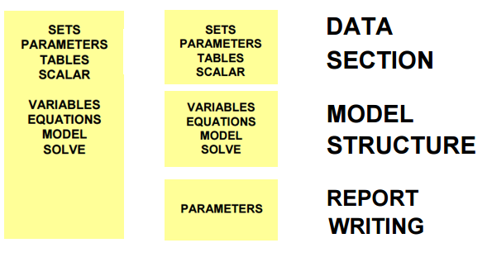
6. Save and Restart
GAMS permits one to separate data from the algebraic model, particularly through the use of SAVE , RESTART, and $INCLUDE.
This feature allows data files to be worked on by other people and also increases run efficiency. One also can use this to separate code functions (e.g. data section, model structure, and report writing).

Slide 19
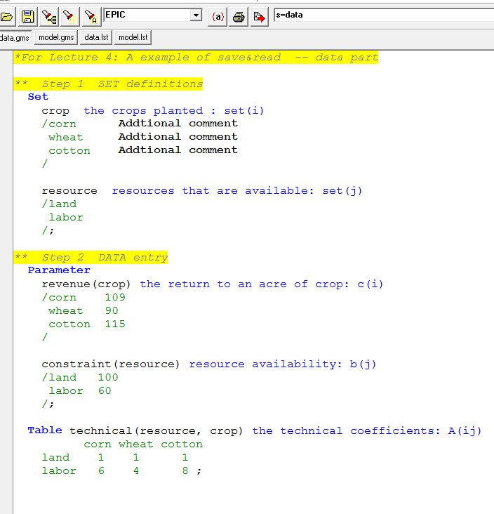
6. Save and Restart
Two files: data.gms and model.gms.
Run data.gms
Type the content “s=data” in the red box before you click “Run GAMS”
When finished running data.gms which includes all of data, GAMS will save all the information as data.g00 where it is ready to be used.

Slide 20
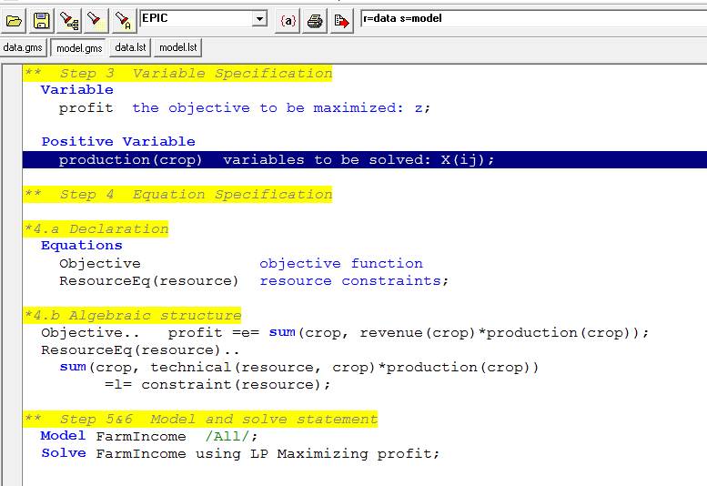
6. Save and Restart
Run model.gms
Type the content “r=data s=model” in the red box before running the model
When finished solving model.gms, GAMS will save all information including solutions in model.g00 where it is ready to be used later, say, report writing.
You can also specify the path
r=c:\foldername\data
default path of GAMS is with the project file

Slide 21
7. Non-linear and Other Problem Forms
Set declarations
Parameter declarations
Variable declarations
Equation declarations
Specifying algebraic structure
Model specifications
Solve specifications
Data
Model
SOLVE Ex USING LP MAXIMIZING Z;
SOLVE Ex USING MIP MAXIMIZING Z;
SOLVE Ex USING NLP MAXIMIZING Z;

Slide 22
Questions?

