Slide 1
Lecture 3 Inspection and Error Messages
Chengcheng Fei
2018 Fall
Based on material written by Gillig and McCarl; Improved upon by many previous lab instructors; Special thanks to Zidong Mark Wang

Slide 2
Transportation Problem Illustration

Slide 3
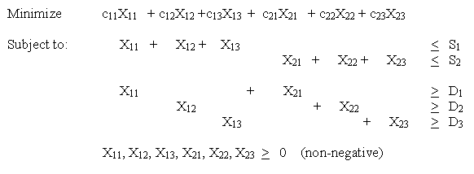
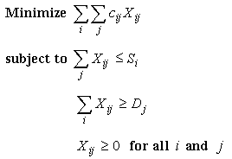
Min Cost of shipping goods from S to D
minimization of total cost across all possible shipment routes
Limited outgoing shipments from each supply point i
Minimum demand constraint at each demand point j
Nonnegative shipments

Slide 4
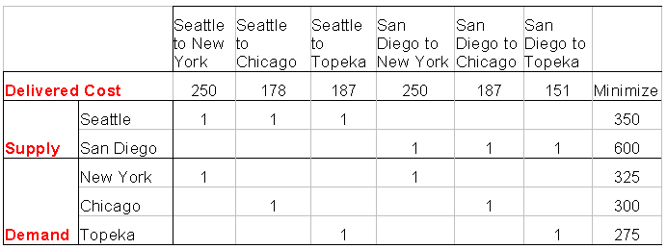

Slide 5
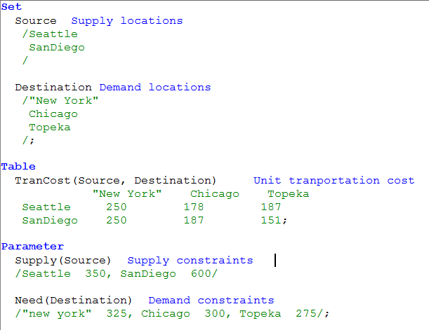
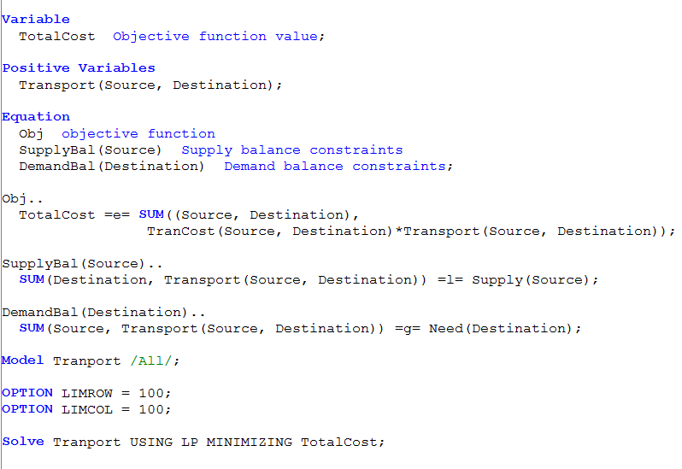

Slide 6
Display Equation and Variable in List File (.lst)
LIMROW : controls the number of rows in the equation listing
LIMCOL : controls the number of variables in the column listing
Default value is 3.
To eliminate: OPTION LIMROW = 0;
OPTION LIMCOL = 0;
To expand: OPTION LIMROW = 100; (or another number)
OPTION LIMCOL = 100 ;
Example

Slide 7
Transportation Problem Illustration: Equations

Slide 8
Transportation Problem Illustration: Equations

Slide 9
Transportation Problem Illustration: Equations

Slide 10
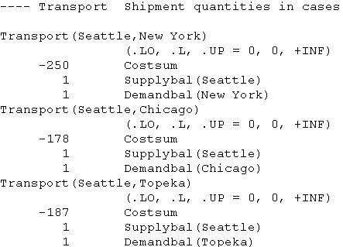
Transportation Problem Illustration: Variables

Slide 11
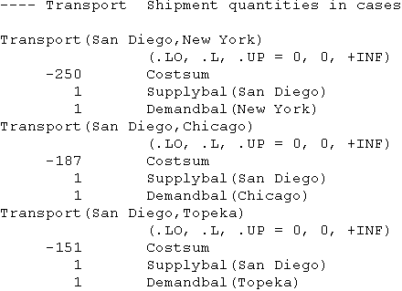
Transportation Problem Illustration: Variables

Slide 12
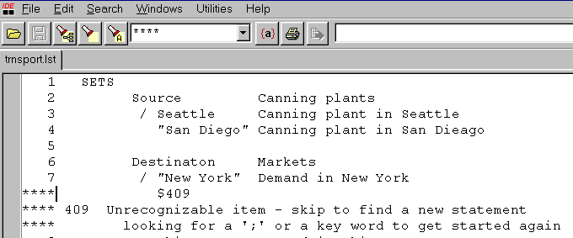
Locate the errors
When GAMS detects errors, it inserts coded error messages inside the echo print in the *.LST file. All errors are marked with four asterisks **** at the beginning of a line. One can use to find where errors occur and fix them

Slide 13
Locate the errors
Double click on Red Color Lines in the process window, causes the cursor to jump to location in *.gms file where error occurs.

Slide 14
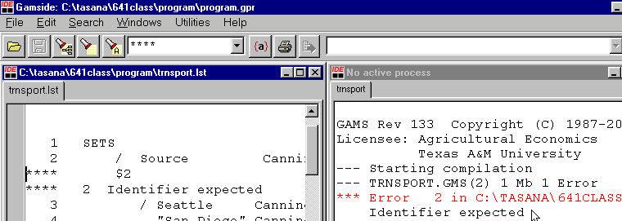
Locate the errors
Double click on Black Color Lines in the process window, then a cursor will jump to a *.lst file where the error is listed.

Slide 15
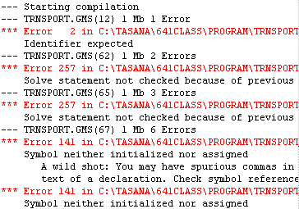
First show, First fix
Concentrate on fixing the first or first few errors and ignore the others since many subsequent errors may result from previous

Slide 16
Common Error – Handling Sets
In every equation all subscripts (SETS) must be handled in every term. They either must be summed over, or must appear in the equation definition

Slide 17
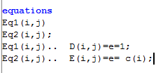
Rules for summation
Rule 1: Family defining subscript indicates the sets on the equation LHS and gives the conditions over which the equations exist– a “for all” condition.
Example
For parameter Ci =2 for all i
c(i)=2;
Similarly for equations
$$D_{ij}=2$$
$E_{ij}=c_{i}$

Slide 18
Rules for summation
Rule 2: When writing an equation defined over sets( with a for all statement), all subscripts which are not in the equation “for all” definition must be dealt with (summed over) in the terms of the equation.
It is proper to write
It is improper to write
Error message $149 : “Uncontrolled set entered as constant”

Slide 19
Rules for summation
Rule 3: In any term, the result after mathematical operations must be of a dimension less than or equal to family definition in the for all statement
It is proper to write
EQA(I,M).. SUM((J,K),R(I,J,K,M)+SUM(J,S(I,J))=E=N(I,M);
EQB(I,M).. 2+SUM((J,K),R(I,J,K,M))+SUM(J,Q(I,J,M))=E=O(I,M);
It is improper to write
EQC(I).. P(I,J,K)=E=L
Error message $149 : “Uncontrolled set entered as constant”

Slide 20
Rules for summation
Rule 4: In an equation you can never sum over the parameter that determines the family of equations or the for all condition.
Example with errors
EQW(I).. SUM(I,W(I))=E=N(I);
W(I)=SUM(I,N(I));
Error Message $125 “Set is under control already”

Slide 21
Common Error – Handling Sets
Source is not operated over in a sum or the .. specification.

Slide 22
Common Error – Handling Sets
The set Source is handled both in equation declaration SupplyBal(Source).. and summation SUM.

Slide 23
Common Error – Floating entry
We have not aligned the data under a column set name so GAMS does not know which data column a number goes with

Slide 24
Common Error – Dimension inconsistency

Slide 25
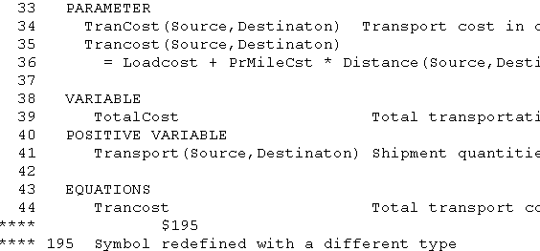
Common Error – Redefine

Slide 26
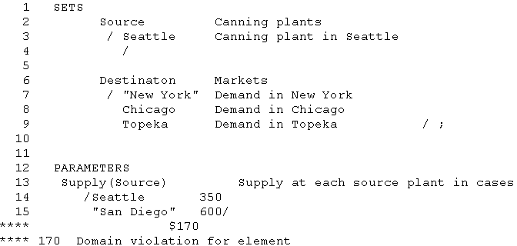
Common Errors – Domain violation
We forgot to include “San Diego” element in Source set, but this “San Diego” is used later in the PARAMETERS

Slide 27
Common Errors – Domain violation
We misspelled “New Yor” element of Destination set.

Slide 28
Common Errors – Mismatched parentheses
(A)
(B)

Slide 29
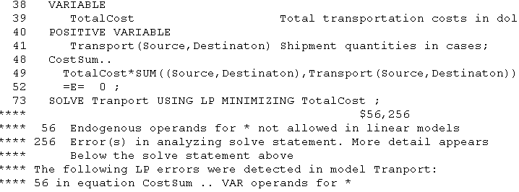
Common Errors - Entering improper nonlinear expressions
CostSum equation contains nonlinear terms beyond the capacity of the solver being used. In SOLVE statement, we define to solve this problem as a LP problem.

Slide 30
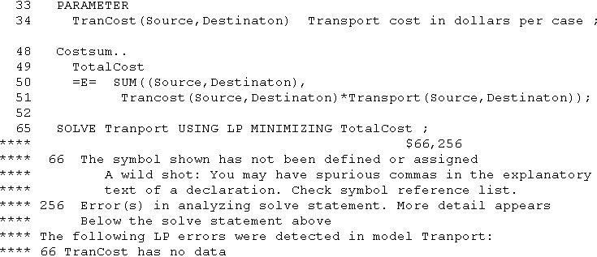
Common Errors - Using undefined data
We declared a TransCost as a parameter but we did not declare numerical values to the TransCost and it is used in the CostSum equation.

Slide 31
Common Errors – Unknown Symbol
A CostSum equation is used but it has not been declared.

Slide 32
Common Errors – Insufficient semi colon
;
We forgot to terminate the EQUATIONS statement with the semi colon

Slide 33
Common Errors – Missing ‘=’ or ‘..’ operator
The algebraic structure of equations must be specified by using .. notation.
Here we omitted the “..” in CostSum equation.

Slide 34
Common Errors – Unknown symbol
We named a model “Tranpor”, but then later we solve the model called “Transport”. Obviously, misspelled in the MODEL statement.

Slide 35
Questions?

