Slide 1
Lab Section for AGEC 641
Chengcheng Fei
2018 Fall
Based on material written by Gillig and McCarl; Improved upon by many previous lab instructors;
Special thanks to Zidong Mark Wang.

Slide 2
Info
Office: AGLS 375
Email: feiccheng@tamu.edu OR chengcheng.fei@gmail.com
Office hour: “walk in” or email in advance
Class time: TBA (We may have more sessions in a week whenever Dr. McCarl is traveling. I will email you when there is a change)

Slide 3
Info
Connecting lecture materials with mathematical programming (MP) practices
10-12 sessions covering basic aspects for applied MP with GAMS
6-8 assignments
Equally weighted
Usually due one week after assigned

Slide 4
Outlines
First Look at GAMS and GAMSIDE
Formulation of A General Problem
Model Inspection & Error Messages
Power of GAMS
Good Modeling Practices
Conditionals
GAMS Check: Pre/Post Solution Analysis
Examining A Model for Flaws
Report Writing
Comparative Analysis: Multiple Submissions and Loops
Non-linear Programming Problems

Slide 5
Lecture 1 Introduction
Introduce GAMS/GAMSIDE & Formulate a Simple Problem

Slide 6
What is GAMS
Generalized Algebraic Modeling System
Programming language for setting up and solving optimization models
All-In-One Package that allows to
Specify the structure of an optimization model
Specify and calculate data that go into the model
Solve that model
Conduct report writing on a model
Perform a comparative static analysis

Slide 7
What is GAMSIDE
Integrated Development Environment
Traditional way to use GAMS: use a text editor set up the model then use DOS (or UNIX) command line instructions to find errors in and run the model
With GAMSIDE: a graphical interface to create, debug, edit and run GAMS files

Slide 8
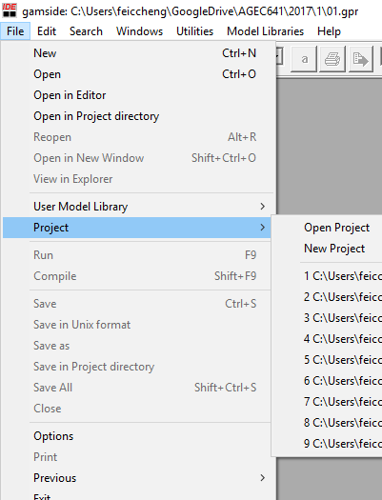
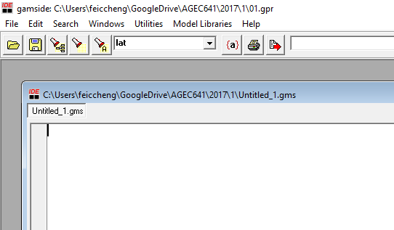
Build a New Project and a New File

Slide 9
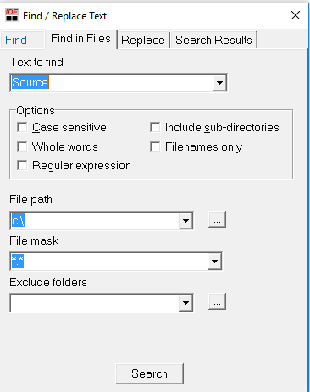
Basic IDE Use---- Finding and Replacing Text
The IDE provides four ways to find and/or replace text strings.
Fundamental Methods involve the flashlight and search window.
Type the text string into the window.
finds what you want in current file
finds it again in current file (as does F3)
finds what you want at all files in the directory specified
Advance way
Access Find and Replace through the search menu (Ctrl+F/R).
The dialogue gives more options.

Slide 10
A Simple Optimization Problem
A farmer wants to maximize the revenue by selecting the proper crop mix: corn, wheat and cotton. The net profits per acre and labor requirement from corn, wheat and cotton are as following:
Corn wheat cotton
Profit 109 90 115
Labor 6 4 8
The farmer has 100 acres of land and 60 units labor availability

Slide 11
A Simple Optimization Problem
A farmer wants to maximize the revenue by selecting the proper crop mix: corn, wheat and cotton
Variables: $X_{corn}, X_{wheat},X_{cotton}$
Equations: Objective, Land constraint, Labor constraint, Non-negativity

Slide 12
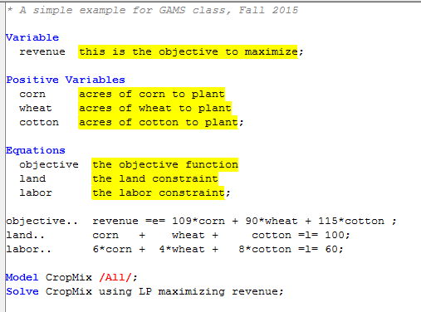
Steps in GAMS
1. Variable specifications
2. Equation specification
Declaration
Algebraic structure specification
3. Model statement
4. Solve statement

Slide 13
1. Variable specifications
GAMS requires variables in each problem to be identified
Objective variable (revenue) needs to be defined as well
Variable name can be up to 64 characters and can have explanatory text
Type of variables in GAMS
Variable
Positive variables
Binary variable
Integer variable

Slide 14
2. Equation specification
Name each equation in the model.
Specify the algebraic structure.
Two dots following each equation name
The specific forms of constraints
Syntax | Explanation
=E= | equality
=L= | less than or equal to
=G= | greater than or equal to

Slide 15
3. Model statement
Name the model
Specify equations that will be included in the model between two slashes / /
Two alternatives:
Or

Slide 16
4. Solve statement
SOLVE causes GAMS to apply a solver to the model named in the Model statement (CropMix) using the data defined just before the solve statement.
Solve ModelName using LP maximizing objective; -- linear max
Solve ModelName using LP minimizing objective; -- linear min
Solve ModelName using NLP maximizing objective; -- non-linear
Solve ModelName using MIP maximizing objective; -- mix integer

Slide 17
Semi-Colons ;
Each declaration must terminate with a ;.
Statements may be several lines long or may contain several elements.
Omission would lead to (many) Syntax Errors!

Slide 18
Solve and read the output
When GAMS is run the output is automatically place in the so called LST file
Example_lec01.gms → Example_lec01.lst
LST file contains a number of components
The echo print
Display of equations/variables
Model statistics and execution time
Model solution report
List of user generated display output

Slide 19
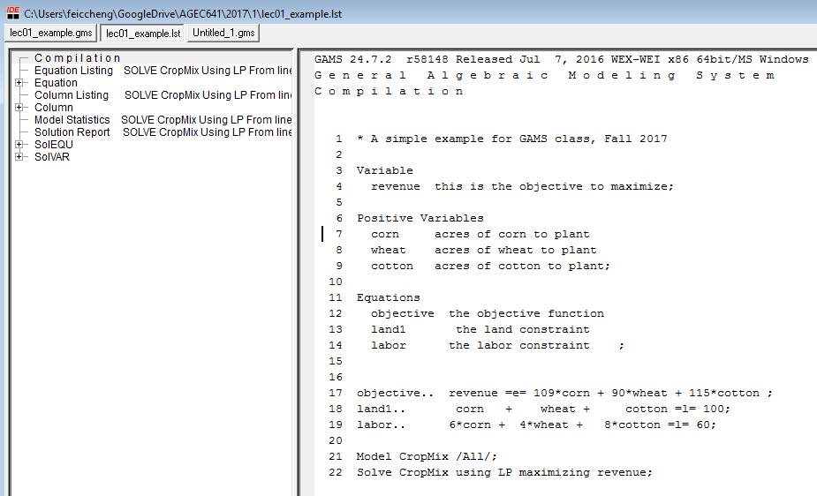
1. echo print
Echo Prints or a copy of an input file (*.gms)

Slide 20
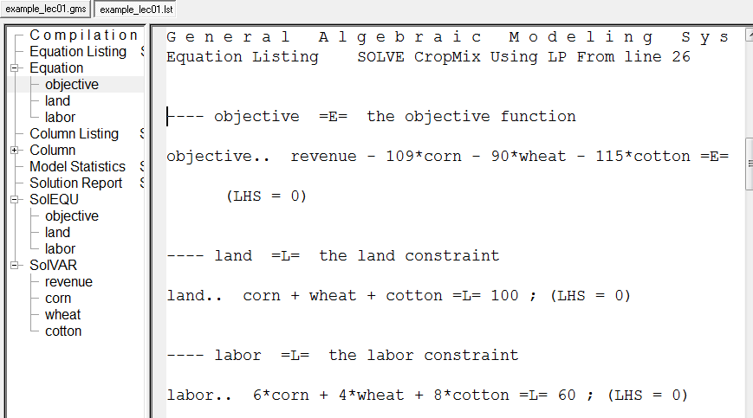
2. Display of equations

Slide 21
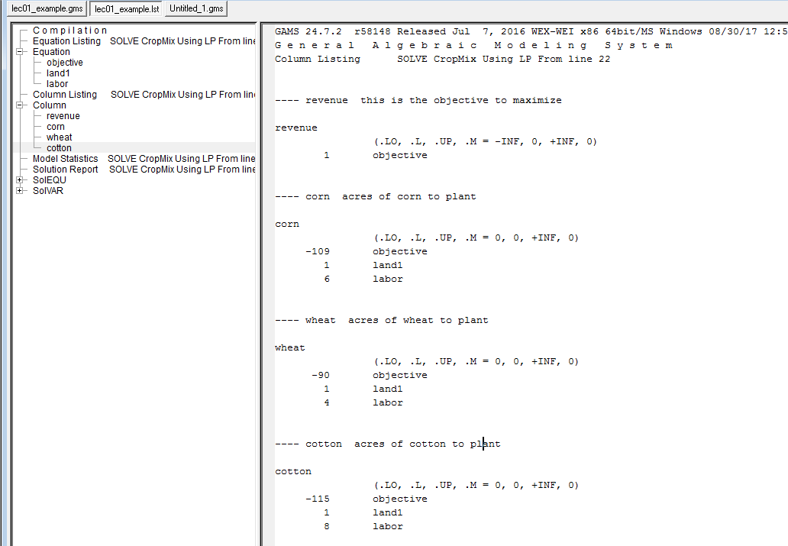
2. Display of Variables (Column)

Slide 22
3. Model statistics and execution time
Model Statistics give information on model size.
The BLOCK counts refer to the number of named GAMS equations and variables.
The SINGLE counts refers to individual rows and columns.
The NON ZERO refers to the number of non-zero coefficients.

Slide 23
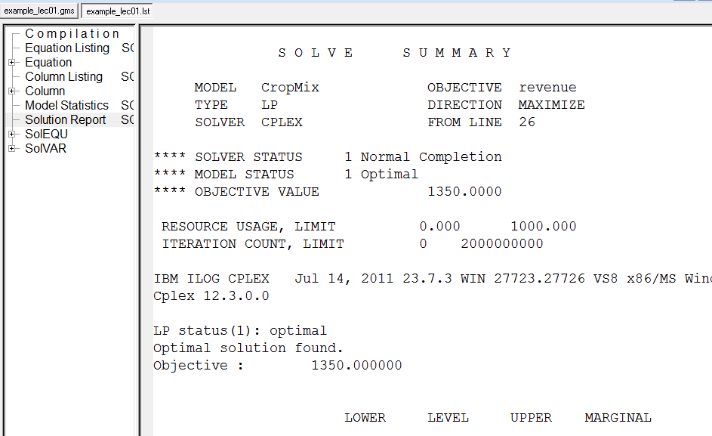
4. Model solution report
SOLVE STATUS (a state of the program) => normal completion, iteration interrupted, resource interrupted, terminated by solver, evaluation error limit, unknown.
MODEL STATUS (what solution looks like) => optimal, infeasible, unbounded, etc.

Slide 24
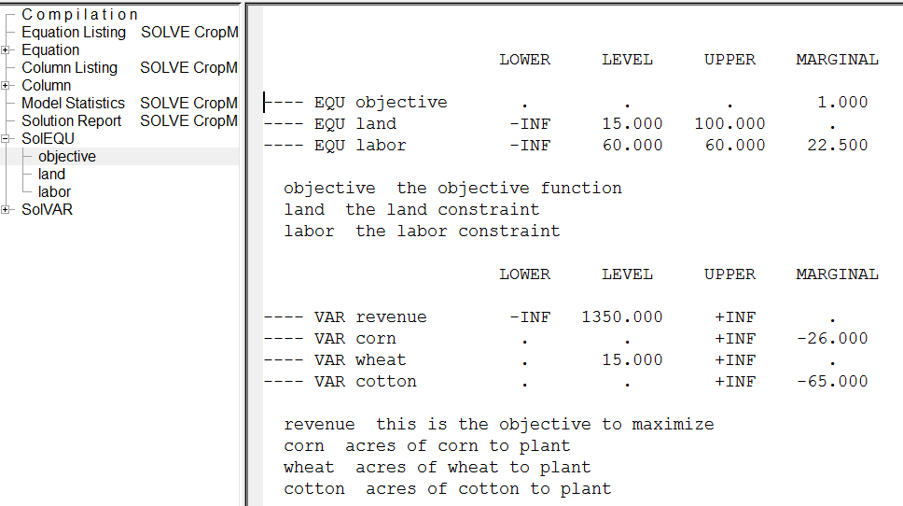
4. Model solution report
The single dot “.” represents a zero;
INF represents infinity
Type | .LO | .UP | .L
=E= | RHS | RHS | RHS
=L= | -INF | RHS | AX
=G= | RHS | INF | AX
Low and upper bounds for a equation

Slide 25
GAMSIDE Project
*.gpr: GAMS project file.
*.gms: GAMS file where to write program codes.
*.lst: GAMS output file generated AFTER the model runs.
*.log: GAMS log file generated WHILE the model runs.

Slide 26
Tools and helpful websites
GAMS homepage: http://www.gams.com/
McCarl GAMS User Guide: GAMS->Help->Expanded GAMS Guide (McCarl)
Stackoverflow: http://stackoverflow.com/
GAMS google group: https://groups.google.com/forum/#!forum/gamsworld
LEI GAMS tools: http://www3.lei.wur.nl/gamstools/
YouTube channels: https://www.youtube.com/channel/UCfTAizXPo4vN54CC-Zs9TTg

Slide 27
Questions?

