Slide 1
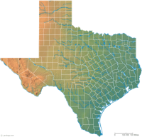
Texas in the Climate Change Squeeze:
The Most Vulnerable State?
Bruce A. McCarl
Regents Professor of Agricultural Economics, Texas A&M University
mccarl@tamu.edu, http//ageco.tamu.edu/faculty/mccarl
Let's Avoid
Climate Change
Climate Change
is Happening
Mitigation
Effects/Adaptation
2007 Sigma Xi Distinguished Scientist Lecture
Texas A&M University, College Station

Slide 2
Why an Economist on climate change?
Poses some large economic issues
Why is climate change happening?
Partially due to unpriced externality
Emitters do not consider emission damages
What will it do to society welfare?
Altered production particularly in ag and forest
Altered ecology
Altered energy costs
What can we do to mitigate or adapt and at what cost?
US Government said Kyoto compliance too costly
Adaptation can be disruptive

Slide 3
Plan of Presentation
Degree of climate change
What is happening up to now, What is projected
Why is this happening
Effects of climate change
Sample findings on agriculture and forest plus Ecology
How might we mitigate
Ag and forestry roles and Renewable energy
How about adaptations
Why and what can it accomplish
All too short but a flavor beyond the news, Al Gore
and Rush Limbaugh

Slide 4
Observed Changes in Temperature

Slide 5
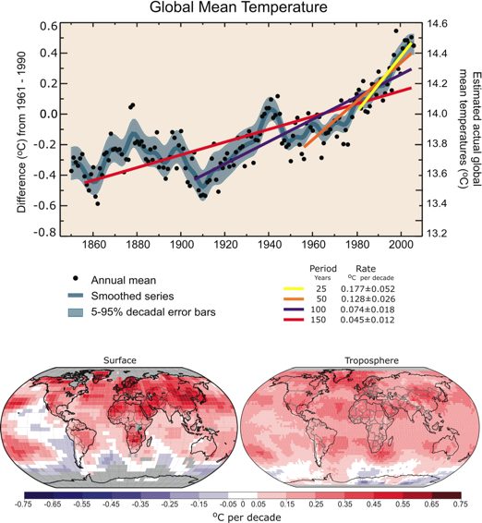
Degree of climate change
What is happening up to now – Temperature since 1979
Rates of change accelerating as time progresses (colored lines)
Texas in a relatively rapidly warming area within continental US
http://ipcc-wg1.ucar.edu/wg1/Figures/AR4WG1_Ch03-Figs_2007-10-23.ppt#299,43,FAQ 3.1, Figure 1

Slide 6
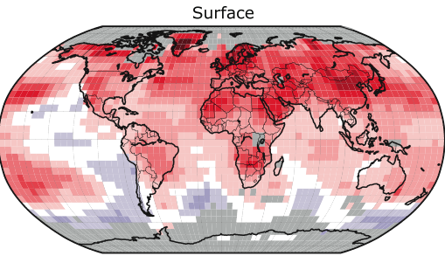

Degree of climate change
What is happening up to now – Temperature since 1979
Texas in a relatively rapidly warming area within continental US
http://ipcc-wg1.ucar.edu/wg1/Figures/AR4WG1_Ch03-Figs_2007-10-23.ppt#299,43,FAQ 3.1, Figure 1

Slide 7
Degree of climate change
What is happening up to now – Ocean Temperature
Ocean also shows temperature increase
Source : Intergovernmental Panel on Climate Change. IPCC Fourth Assessment Report WGI http://ipcc-wg1.ucar.edu/

Slide 8
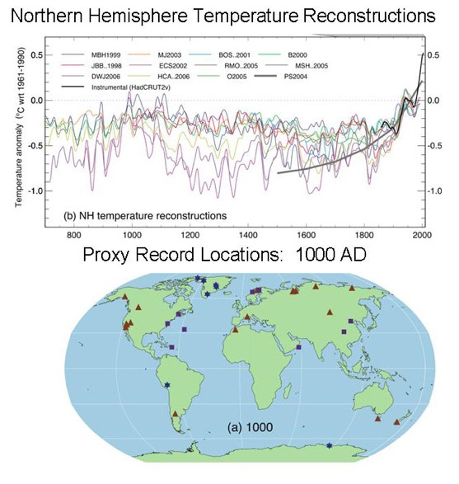
Degree of climate change
What is happening up to now – Land
Figure TS.20. (Top) Records of Northern Hemisphere temperature variation during the last 1300 years with 12 reconstructions using multiple climate proxy records shown in colour and instrumental records shown in black. (Middle and Bottom) Locations of temperature-sensitive proxy records with data back to AD 1000 and AD 1500 (tree rings: brown triangles; boreholes: black circles; ice core/ice boreholes: blue stars; other records including low-resolution records: purple squares). Data sources are given in Table 6.1, Figure 6.10 and are discussed in Chapter 6. {Figures 6.10 and 6.11}
Figure TS.20
Source : Intergovernmental Panel on Climate Change. IPCC Fourth Assessment Report WGI http://ipcc-wg1.ucar.edu/

Slide 9
Observed Changes in Precipitation

Slide 10
Degree of climate change
What is happening up to now – Potential Precipitation
Rainfall is increasing

Slide 11
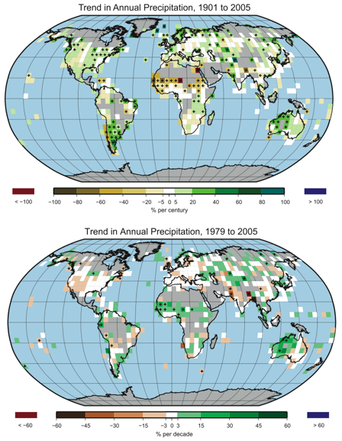
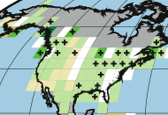
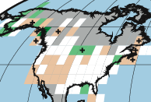
Degree of climate change
What is happening up to now -- Precipitation
Texas has areas that had largest decrease in continental US
http://ipcc-wg1.ucar.edu/wg1/Figures/AR4WG1_Ch03-Figs_2007-10-23.ppt#269,14,Figure 3.13

Slide 12
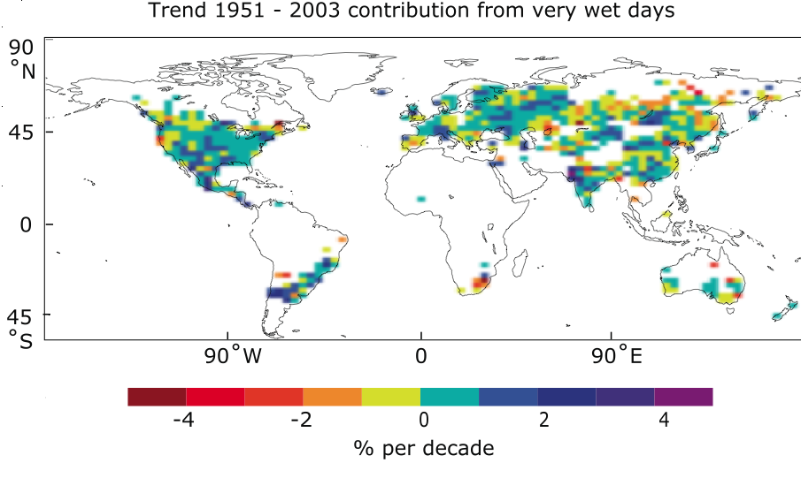
Degree of climate change
What is happening up to now -- Precipitation
  Rainfall became more concentrated and Texas again has such areas
http://ipcc-wg1.ucar.edu/wg1/Figures/AR4WG1_Ch03-Figs_2007-10-23.ppt#296,40,Figure 3.39

Slide 13
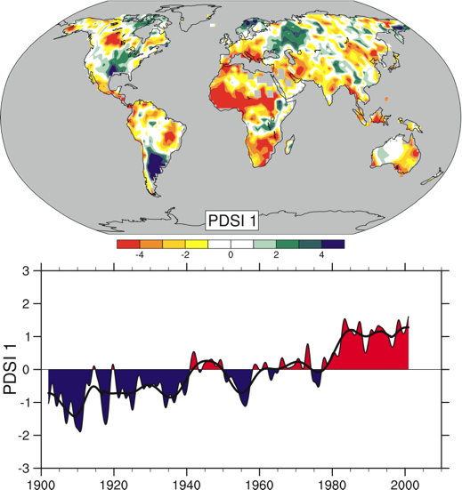
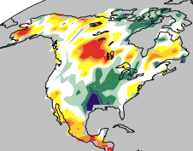
Degree of climate change
What is happening up to now -- Drought
Palmer drought index
change 1900-2002, Regional map and graph of global average
Texas shows lesser index
Did not graph last 20 years
http://ipcc-wg1.ucar.edu/wg1/Figures/AR4WG1_Ch03-Figs_2007-10-23.ppt#300,44,FAQ 3.2, Figure 1

Slide 14
Observed Changes in Oceans, Snow
and other items

Slide 15
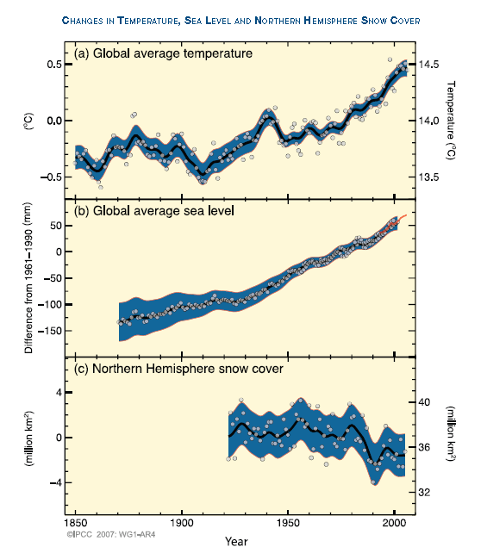
Degree of climate change
What is happening up to now -- Other
Source : Intergovernmental Panel on Climate Change. IPCC Fourth Assessment Report WGI http://ipcc-wg1.ucar.edu/

Slide 16
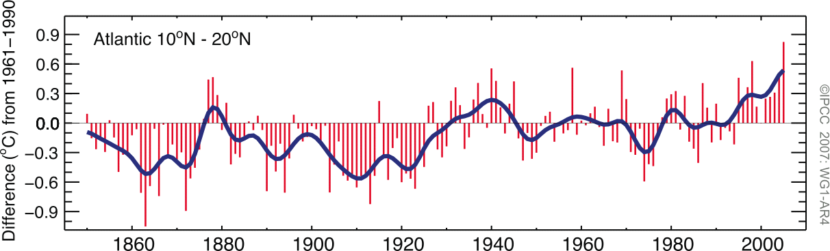
Degree of climate change
What is happening up to now – Hurricanes
Figure TS.11. Tropical Atlantic (10°N–20°N) sea surface temperature annual anomalies (°C) in the region of Atlantic hurricane formation, relative to the 1961 to 1990 mean. {Figure 3.33}
Source : Intergovernmental Panel on Climate Change. IPCC Fourth Assessment Report WGI http://ipcc-wg1.ucar.edu/

Slide 17
Degree of climate change
What is happening up to now -- Other
Available observational evidence indicates that regional changes in climate, particularly increases in temperature, have already affected a diverse set of physical and biological systems in many parts of the world.
Observed changes include
Shrinkage of glaciers and sea ice
Snow cover has decreased
Thawing of permafrost,
Later freezing and earlier break-up of ice on lakes/rivers
Lengthening of mid- to high-latitude growing seasons
Poleward and altitudinal shifts of plant and animal ranges,
Declines of some plant and animal populations,
Earlier flowering of trees, emergence of insects, and egg-laying in birds
Global average sea level has risen and ocean heat content has increased

Slide 18
Why is this happening?

Slide 19
Degree of climate change
Why is this happening
IPCC (1995) “The balance of evidence suggests a discernible human influence on global climate.”
IPCC (2001) “Most of the warming of the past 50 years is likely (>66%) to be attributable to human activities.”
IPCC (2007) ”Most of the observed increase in global average temperatures since the mid-20th century is very likely (>90%) due to the observed increase in anthropogenic (human emission caused) greenhouse gas concentrations.”

Slide 20
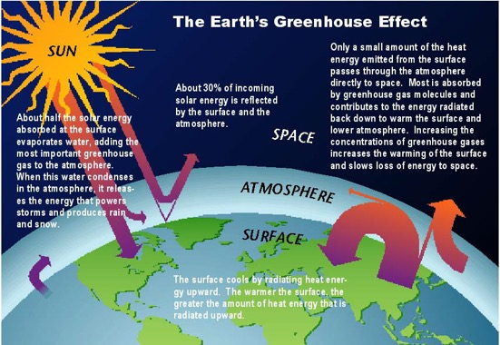
Degree of climate change
Why is this happening
Some gases, like carbon dioxide (CO), trap heat in the atmosphere by absorbing longwave radiation while letting the Sun's energy pass through. The transparent roof and walls of a greenhouse allow in the sunlight while keeping in the heat. Since these gases act similarly in the atmosphere, we call them greenhouse gases.
Source : U.S. National Assessment/ http://www.usgcrp.gov/usgcrp/Library/nationalassessment/images/Greenhouse-s.jpg.

Slide 21
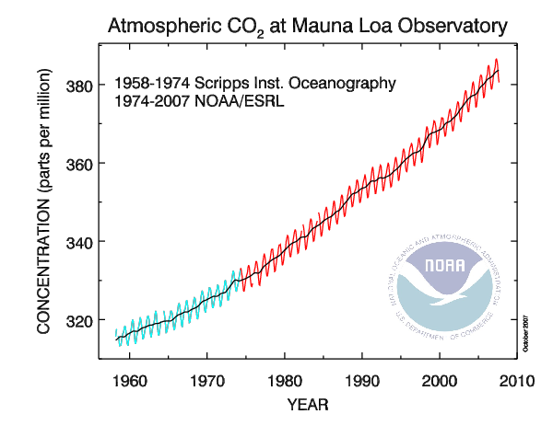
Degree of climate change
Why is this happening
Pre industrial - 275 Counting Non CO₂
- 345 this is increase almost doubles
2007 - 380+
http://www.esrl.noaa.gov/gmd/ccgg/trends/co2_data_mlo.html

Slide 22
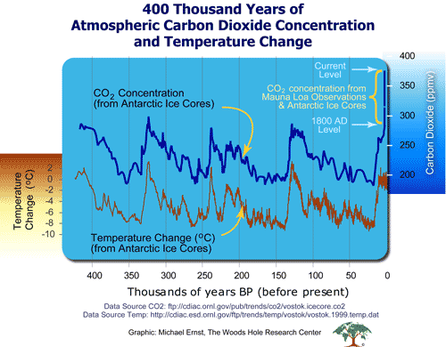
Degree of climate change - Why is this happening
CO2 and temperature linked but does not lead
http://www.whrc.org/resources/online_publications/warming_earth/scientific_evidence.htm

Slide 23
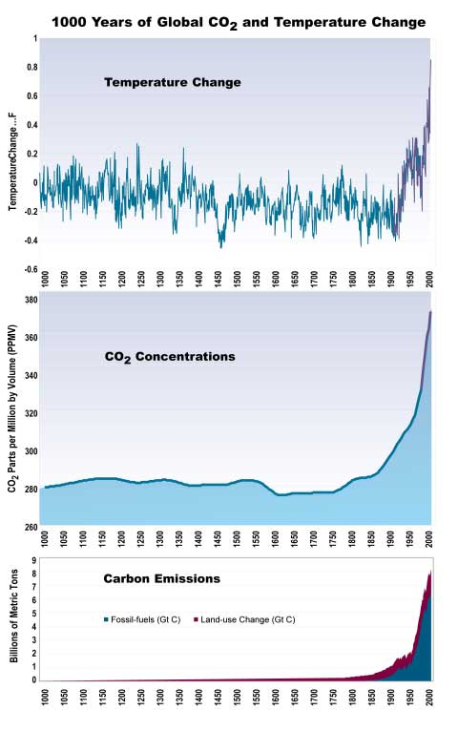
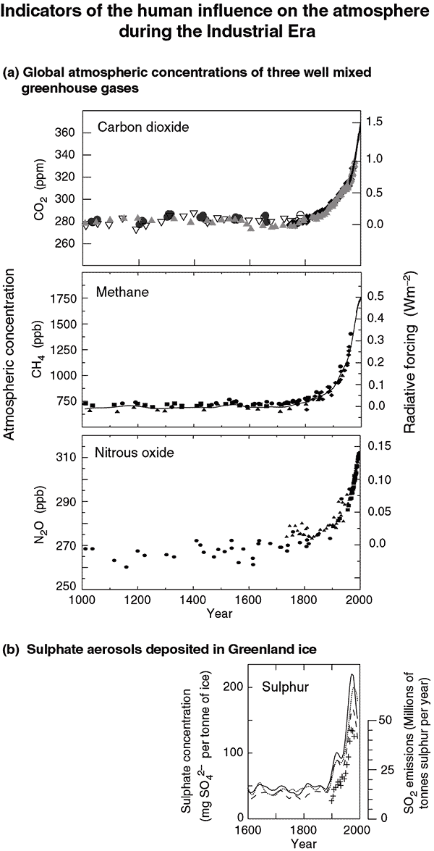
Degree of climate change - Why is this happening

Slide 24

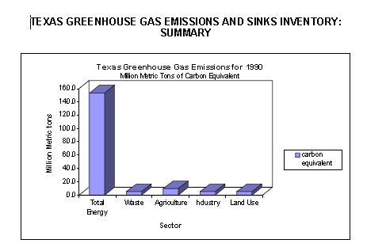
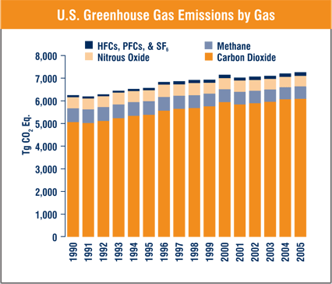
Degree of climate change – Texas and GHGs
2003 State by State Energy related CO2 emissions -- Texas wins
Most emissions from energy
Emissions growing
US EIA, http://www.eia.doe.gov/environment.html
US EPA, http://www.eia.doe.gov/environment.html

Slide 25
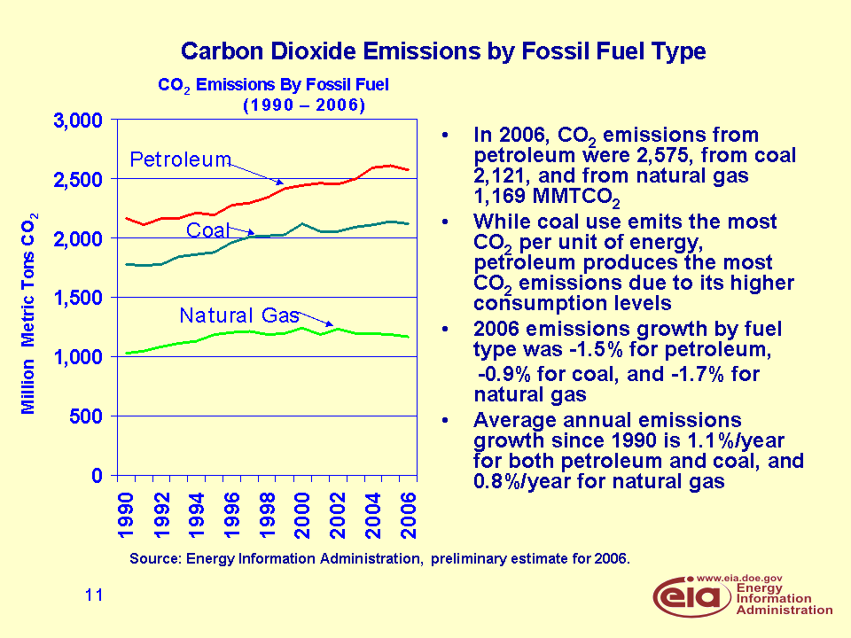
Degree of climate change – Source of GHGs
Energy emissions largely petroleum and coal

Slide 26
What is projected?

Slide 27
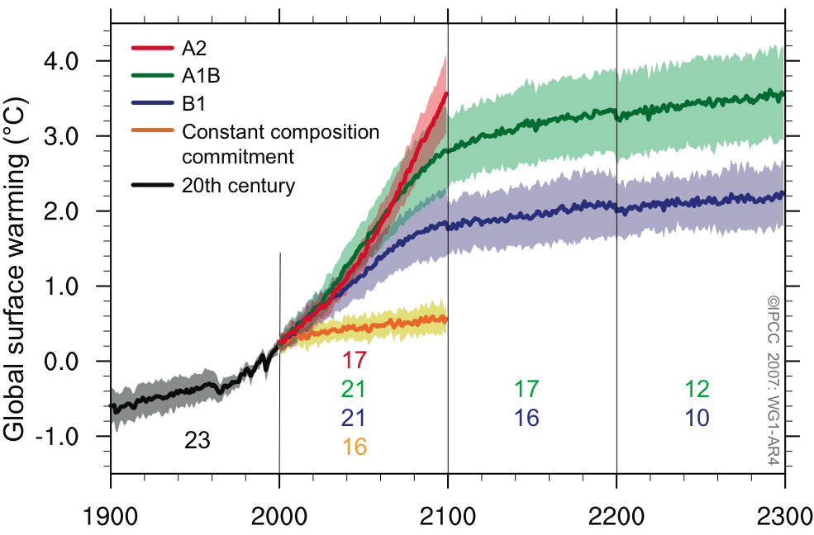
Degree of climate change - What is projected
Climate
models predict increasing
emissions will cause a temp increase
Source : IPCC AR4t

Slide 28
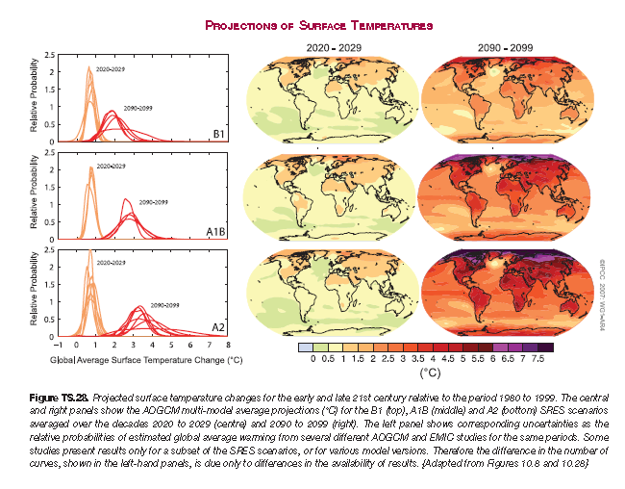
Degree of climate change - What is projected
  Hotter

Slide 29
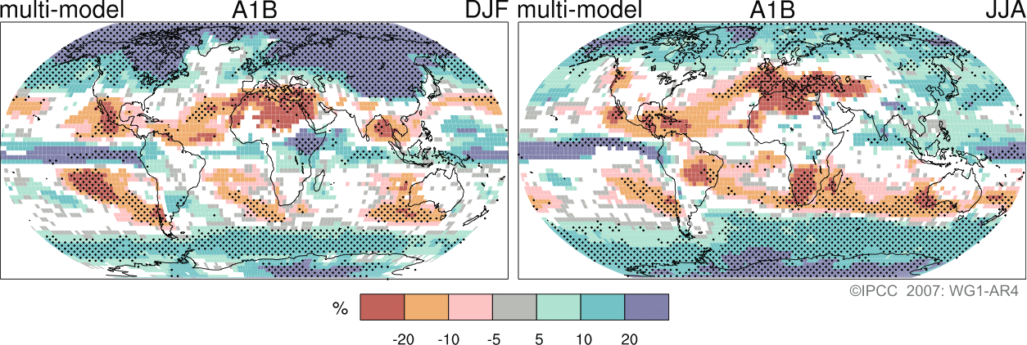
Degree of climate change - What is projected
  Less water
Texas in relatively severely affected area

Slide 30
Degree of climate change - What is projected
  Very likely that heat waves will be more intense, more frequent and longer lasting
  Precipitation generally increases but with general decreases in the subtropics
  Precipitation intensity is projected to increase but there would be longer periods between rainfall events.
  Tendency for drying of mid-continent during summer, indicating a greater risk of droughts in those regions.
  Sea level projected to rise 1999 and 2099 by 0.18 to 0.59 m.
  Likely increase in hurricane peak wind intensities - an increase in the numbers of the most intense.
  Fewer mid-latitude storms- poleward shift of storm tracks
  Atlantic Ocean Meridional Overturning Circulation (MOC) – Gulf Stream will slow down

Slide 31
Texas Is Vulnerable

Slide 32
Texas is quite vulnerable
Current developments are disruptive of some activities
Projections on water, temperature, severe weather and hurricanes are worrisome for agriculture and other sectors. Sea level also
Possibility of Mitigating emissions will influence electricity generation and petroleum industries that are large in state

Slide 33
What can be done?

Slide 34
What can be done
Wait for more information –do little and live with it
Plan to adapt
Try to reduce future change
Mitigate emissions

Slide 35
Implications of living
With a changed climate

Slide 36
Live with it - Agriculture
Table 2 National crop sensitivity over all crops giving average yield change in percent to 2030
-- GCM behind Climate Scenario --
Hadley Canadian CSIRO REGCM
Corn Belt 24.02 18.23 6.05 6.58
Great Plains 25.29 17.28 3.67 4.82
Lake States 43.75 53.03 9.34 11.84
Northeast 9.48 -2.07 2.13 4.45
Rocky Mountains 27.74 19.37 18.27 15.04
Pacific Southwest 17.76 21.44 15.58 15.05
Pacific Northwest 65.42 17.01 17.22 18.30
South Central 13.25 -6.06 -0.71 -0.79
Southeast 10.00 -3.16 3.84 2.40
South West 21.66 14.69 3.38 2.60
National 25.14 16.51 6.02 6.46
Red signifies results below mean
Source McCarl work for US National Assessment
http://agecon2.tamu.edu/people/faculty/mccarl-bruce/papers/778.pdf

Slide 37
Live with it - Agriculture
Table 8 Annual consumer and producer welfare changes
for 2030 climate, with adaption (million of dollars)
GCM scenario name
Canadian Hadley REGCM CSIRO
United States
Consumers Change 3005 9894 1347 1043
Producers Change 1494 -4262 -1002 -866
Percent 4.68% -13.34% -3.14% -2.71%
Total Change 4499 5632 345 177
Rest of the World
Consumers Change 2527 4761 398 143
Producers Change -763 -2264 -251 -15
Total Change 1764 2498 147 127
Overall Gain largely goes to Consumers
Source McCarl work for US National Assessment
http://agecon2.tamu.edu/people/faculty/mccarl-bruce/papers/778.pdf

Slide 38
Live with it - Agriculture
  Consistent losses in the Corn Belt, South Central and Southeast
  Mixed but largely negative results in the Southwest. There up to 40% less cropped land
McCarl, B.A., W.D. Rosenthal, C.C. Chang, and R.M. Adams, "Climate Change and Texas Agriculture," in Implications of Climate Change on Texas, Edited by G.R. North, J. Schmandt and J. Clarkson, Chapter 8 University of Texas Press, 1994.
  McCarl, B.A., "Agricultural Sensitivity to Climatic Change," in The Changing Climate of Texas: Predictability and Implications for the Future, Chapter 15, 179-198, 1995.
  Positive results in the Pacific Northwest
  Mixed but mostly positive results in the Great Plains, Northeast, Pacific Southwest
  Mixed results in the Lake States, and the Rocky Mountains.

Slide 39
Live with it – Ecology, Ag, M&I, Water
A Study of the Effects of Climatic Change on the Texas Edwards Aquifer Region
Chen, C.C., D. Gillig, and B.A. McCarl, "Effects of Climatic Change on a Water Dependent Regional Economy: A Study of the Texas Edwards Aquifer," Climatic Change, 49, 397-409, 2001.

Slide 40
Live with it – Ecology, Ag, M&I, Water
    Use data for 2030 and 2090
        Canadian Climate Center Model (CCC)
        Hadley Climate Center Model (HAD)
        Average changes for the 10 year periods
Climate Change Scenario Temperature Precipitation
(⁰F) (Inches)
HAD 2030 3.20 -4.10
HAD 2090 9.01 -0.78
CCC 2030 5.41 -14.36
CCC 2090 14.61 -4.56

Slide 41
Live with it – Ecology, Ag, M&I, Water
Results for EA Recharge Prediction
(% change from the BASE )
Hadley
Canadian
Recharge in Drought Years
-20.59
-
-
29.65
Recharge in Normal Years
-
19.68
-
-
28.99
-
Recharge in Wet Years
-
23.64
-
-
34.42
-
    Municipal Demand
    Forecasted that climate change will increase municipal water demand by 1.5% (HAD) to 3.5% (CCC).

Slide 42
Live with it – Ecology, Ag, M&I, Water
Strongest effects fall on springflow and the Ag sector
Shifts in the sectoral water use share from Ag to M&I
Decrease in M&I welfare
Farm income falls 16-30% under the 2030 scenario and 30-45% under the 2090 scenario.
Decrease in Comal springflows by 10-16% under the 2030 scenarios and by 20-24% under 2090 scenarios
To maintain Springflow
    Pumping level
    ⇨ decreases 35,000 to 50,000 af ala 2030 scenarios
    ⇨ decreases 55,000 to 80,000 af ala 2090 scenarios
    Substantial economic costs: an additional cost of $0.5 to $2 million per year

Slide 43
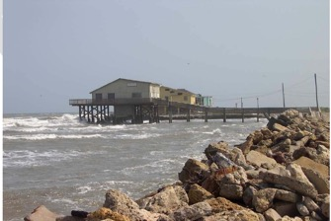
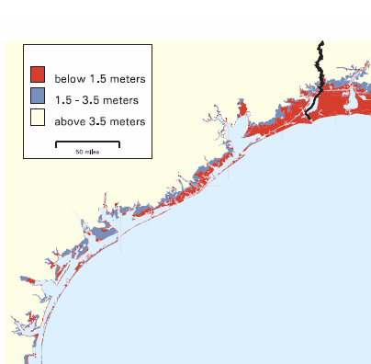
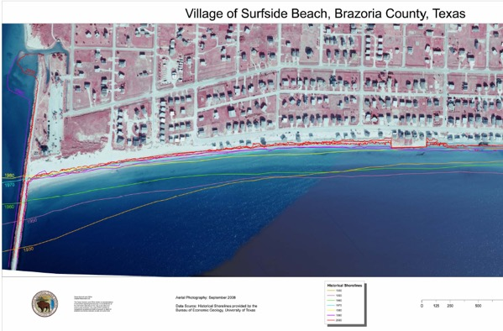
Live with it – Coastal
Example 1 Sea Level and hurricanes
Adapt
Structural protection
Abandonment
http://yosemite.epa.gov/oar/globalwarming.nsf/content/ResourceCenterPublicationsSLRMapsIndex.html
http://www.glo.state.tx.us/coastal/erosion/reimbursement/pdf/Surfside_Beach_historic_shorelines.pdf

Slide 44
Mitigation

Slide 45
Avoid it – GHG Emission Mitigation
What are the strategies
  Reduce where the emissions are
    Fuel standards
    Fuel switching
    Emissions capture and storage
    Conservation – lightbulbs
    Lifestyle
  Offset from elsewhere
    Agriculture
    Forestry
    Biofuels

Slide 46
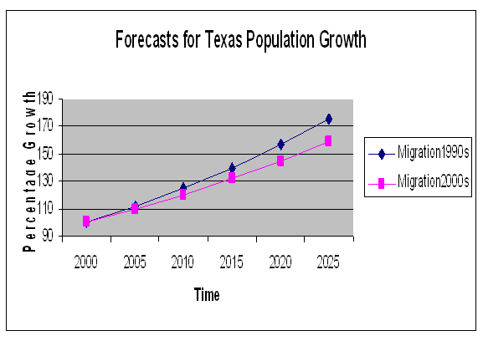
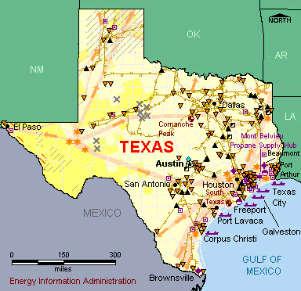
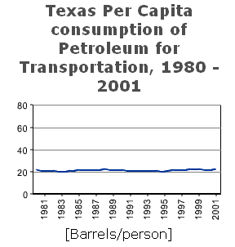
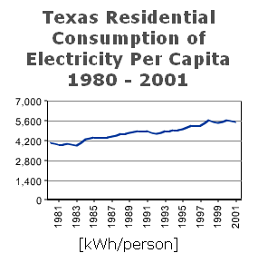
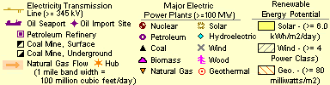
Avoid it – Energy
A tall order
http://txsdc.utsa.edu/tpepp/2006projections/summary/
http://tonto.eia.doe.gov/state/state_energy_profiles.cfm?sid=TX
Source: USDOE Texas Energy Consumption
http://www.eere.energy.gov/states/state_specific_statistics.cfm/state=TX#consumption

Slide 47
Avoid it – Energy
Big Needs
  Renewables
  Fuel Standards
  Improved miles per gallon
  Fuel switching
  CCS – Future Gen
  Offsets from elsewhere

Slide 48
Avoid it – Ag and Forest
Agricultural/Forestry/Biofuel Mitigation Possibilities
Strategy Basic Nature CO2 CH4 N2O
Crop Mix Alteration Emis, Seq X X
Crop Fertilization Alteration Emis, Seq X X
Crop Input Alteration Emission X X
Crop Tillage Alteration Emission X X
Grassland Conversion Sequestration X
Irrigated /Dry land Mix Emission X X
Biofuel Production Offset X X X
Stocker/Feedlot mix Emission X
Enteric fermentation Emission X
Livestock Herd Size Emission X X
Livestock System Change Emission X X
Manure Management Emission X X
Rice Acreage Emission X X X
Afforestation (not today) Sequestration X
Existing timberland Management Sequestration X
Deforestation Emission X
Murray, B.C., A.J. Sommer, B. Depro, B.L. Sohngen, B.A. McCarl, D. Gillig, B. de Angelo, and K. Andrasko, Greenhouse Gas Mitigation Potential in US Forestry and Agriculture, EPA Report 430-R-05-006, November, 2005. http://www.epa.gov/sequestration/pdf/greenhousegas2005.pdf
McCarl, B.A., and U.A. Schneider, "The Cost of Greenhouse Gas Mitigation in US Agriculture and Forestry," Science, Volume 294 (21 Dec), 2481-2482, 2001.

Slide 49
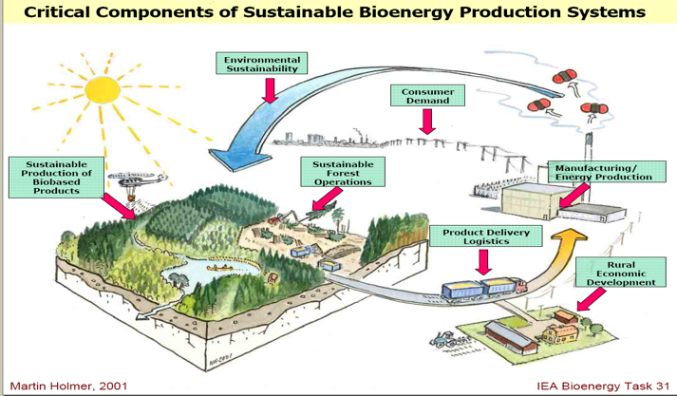
Avoid it – Biofuel
Absorb CO2
Emit CO2
Please Pretend the growing stuff includes crops
Feedstocks take up CO2 when they grow
CO2 emitted when feedstocks burned or when energy product derivatives burned
But Starred areas also emit
Source of underlying graphic: Smith, C.T. , L. Biles, D. Cassidy, C.D. Foster, J. Gan, W.G. Hubbard, B.D. Jackson, C. Mayfield and H.M. Rauscher, “Knowledge Products to Inform Rural Communities about Sustainable Forestry for Bioenergy and Biobased Products”, IUFRO Conference on Transfer of Forest Science Knowledge and Technology, Troutdale, Oregon, 10-13 May 2005

Slide 50
Avoid it – Biofuel
GHG Offsets by Biofuels
 | Ethanol | BioDiesel | Electricity
Corn | 25% | 50%
Soybeans |  | 71%
Sugarcane | 65%
Switchgrass | 50% |  | 80-90%
Bagasse | 85% |  | 95%
Corn Residue | 70% |  | 85-90%
Manure |  |  | 95-99%
Lignin |  |  | 85-95%
Authors calculations, discussed in McCarl, B.A., and J.M. Reilly, "Agriculture in the climate change and energy price squeeze: Part 2: Mitigation Opportunities," Dept of Ag Econ, 2006 but updated since then.

Slide 51
Adaptation and its inevitability

Slide 52
Why Adapt - Inevitability
Characteristics of stabilization scenarios
Stabilization level (ppm CO₂-eq) | Global mean temp. increase at equilibrium (ºC) | Year CO2 needs to peak | Year CO2 emissions back at 2000 level | Reduction in 2050 CO2 emissions compared to 2000
445 – 490 | 2.0 – 2.4 | 2000 - 2015 | 2000- 2030 | -85 to -50
490 – 535 | 2.4 – 2.8 | 2000 - 2020 | 2000- 2040 | -60 to -30
535 – 590 | 2.8 – 3.2 | 2010 - 2030 | 2020- 2060 | -30 to +5
590 – 710 | 3.2 – 4.0 | 2020 - 2060 | 2050- 2100 | +10 to +60
710 – 855 | 4.0 – 4.9 | 2050 - 2080 |  | +25 to +85
855 – 1130 | 4.9 – 6.1 | 2060 - 2090 |  | +90 to +140
Mitigation efforts over the next two to three decades
will have a large impact on opportunities to achieve lower stabilization levels
IPCC WGIII Table SPM.5: Characteristics of post-TAR stabilization scenarios WG3 [Table TS 2, 3.10], SPM p.23
[1] The best estimate of climate sensitivity is 3ºC [WG 1 SPM].
[2] Note that global mean temperature at equilibrium is different from expected global mean temperature at the time of stabilization of GHG concentrations due to the inertia of the climate system. For the majority of scenarios assessed, stabilisation of GHG concentrations occurs between 2100 and 2150.
[3] Ranges correspond to the 15th to 85th percentile of the post-TAR scenario distribution. CO₂ emissions are shown so multi-gas scenarios can be compared with CO₂-only scenarios.
Notes:
Table SPM.5: Characteristics of post-TAR stabilization scenarios WG3 [Table TS 2, 3.10], SPM p.23
In order to stabilize the concentration of GHGs in the atmosphere, emissions would
need to peak and decline thereafter. The lower the stabilization level, the more
quickly this peak and decline would would need to occur. Mitigation efforts over the next
two to three decades will have a large impact on opportunities to achieve lower
stabilization levels WG3 (3.3), SPM p.22.

Slide 53
Why Adapt - Inevitability
Stabilization level (ppm CO₂-eq) | Global mean temp. increase at equilibrium (ºC) | Year CO2 needs to peak | Year CO2 emissions back at 2000 level | Reduction in 2050 CO2 emissions compared to 2000
445 – 490 | 2.0 – 2.4 | 2000 - 2015 | 2000- 2030 | -85 to -50
490 – 535 | 2.4 – 2.8 | 2000 - 2020 | 2000- 2040 | -60 to -30
535 – 590 | 2.8 – 3.2 | 2010 - 2030 | 2020- 2060 | -30 to +5
590 – 710 | 3.2 – 4.0 | 2020 - 2060 | 2050- 2100 | +10 to +60
710 – 855 | 4.0 – 4.9 | 2050 - 2080 |  | +25 to +85
855 – 1130 | 4.9 – 6.1 | 2060 - 2090 |  | +90 to +140
800
700
600
500
[1] The best estimate of climate sensitivity is 3ºC [WG 1 SPM].
[2] Note that global mean temperature at equilibrium is different from expected global mean temperature at the time of stabilization of GHG concentrations due to the inertia of the climate system. For the majority of scenarios assessed, stabilisation of GHG concentrations occurs between 2100 and 2150.
[3] Ranges correspond to the 15th to 85th percentile of the post-TAR scenario distribution. CO₂ emissions are shown so multi-gas scenarios can be compared with CO₂-only scenarios.
Notes:
Table SPM.5: Characteristics of post-TAR stabilization scenarios WG3 [Table TS 2, 3.10], SPM p.23
In order to stabilize the concentration of GHGs in the atmosphere, emissions would
need to peak and decline thereafter. The lower the stabilization level, the more
quickly this peak and decline would would need to occur. Mitigation efforts over the next
two to three decades will have a large impact on opportunities to achieve lower
stabilization levels WG3 (3.3), SPM p.22.

Slide 54
Plan to Adapt
Investment to facilitate adaptation
  Research
  Extension
  Capital investment
Ag Adaptation
  Irrigation
  Drought resistant varieties
  Tolerant breeds and varieties
  Crop and livestock mix
  Abandonment
McCarl, B.A., Adaptation Options for Agriculture, Forestry and Fisheries, A Report to the UNFCCC Secretariat Financial and Technical Support Division, 2007. http://unfccc.int/files/cooperation_and_support/financial_mechanism/application/pdf/mccarl.pdf

Slide 55
Plan to Adapt
 |  |  | Primary Only |  | Plus processing
 | Today | BAU Gain | CC Add | Mitig CC ADD | CC Add | Mitig CC ADD
AFF Research | $35,959 | $30,075 | $3,007 | $2,632 | $3,007 | $2,632
AFF Extension | $6,426 | $547 | $55 | $48 | $55 | $48
AFF Capital Formation | $124,658 | $118,995 | $2,380 | $2,082 | $9,795 | $8,570
Total | $167,043 | $149,617 | $5,442 | $4,762 | $12,857 | $11,250
So with climate change investment level $5 to 13 billion
per year to adjust
McCarl, B.A., Adaptation Options for Agriculture, Forestry and Fisheries, A Report to the UNFCCC Secretariat Financial and Technical Support Division, 2007. http://unfccc.int/files/cooperation_and_support/financial_mechanism/application/pdf/mccarl.pdf

Slide 56
Some possible actions

Slide 57
So now what - actions
Plan to adapt
Inevitability of future -20 Kyoto Accords
Long time to stabilize
Precautionary action
Develop crop and livestock varieties
Pass a price signal
GHG trading
Induced innovation
Harnessing ingenuity
Reduce carbon footprint
Moral suasion
Planning with GHGs in mind
Action on mitigation and eligibility
Mobilize energy industry

Slide 58

The onset and exact effects of climate change
are uncertain
Mitigation
Effects
Texas is very Vulnerable
We will be squeezed

Slide 59
Basic Resources
Intergovernmental Panel on Climate Change. IPCC Fourth Assessment Report - Climate Change 2007: Impacts, Adaptation and Vulnerability, http://www.ipcc.ch/.
Intergovernmental Panel on Climate Change. IPCC Fourth Assessment Report - Climate Change 2007: Mitigation , http://www.ipcc.ch/.
Intergovernmental Panel on Climate Change. IPCC Fourth Assessment Report - The Scientific Basis, http://www.ipcc.ch/.
Intergovernmental Panel on Climate Change. IPCC Fourth Assessment Report – Synthesis Report, http://www.ipcc.ch/.
National Assessment Synthesis Team, US Global Change Research Program , Climate Change Impacts on the United States:The Potential Consequences of Climate Variability and Change Overview: 2000 http://www.usgcrp.gov/usgcrp/Library/nationalassessment/overview.htm
National Assessment Synthesis Team, US Global Change Research Program , Climate Change Impacts on the United States:The Potential Consequences of Climate Variability and Change Foundation: 2000 http://www.usgcrp.gov/usgcrp/Library/nationalassessment/foundation.htm
http://agecon.tamu.edu/faculty/mccarl/papers.htm

